Slide 1
Project 2: human factors
IND2313: Industrial Design I
Ezra Stabler

Slide 2
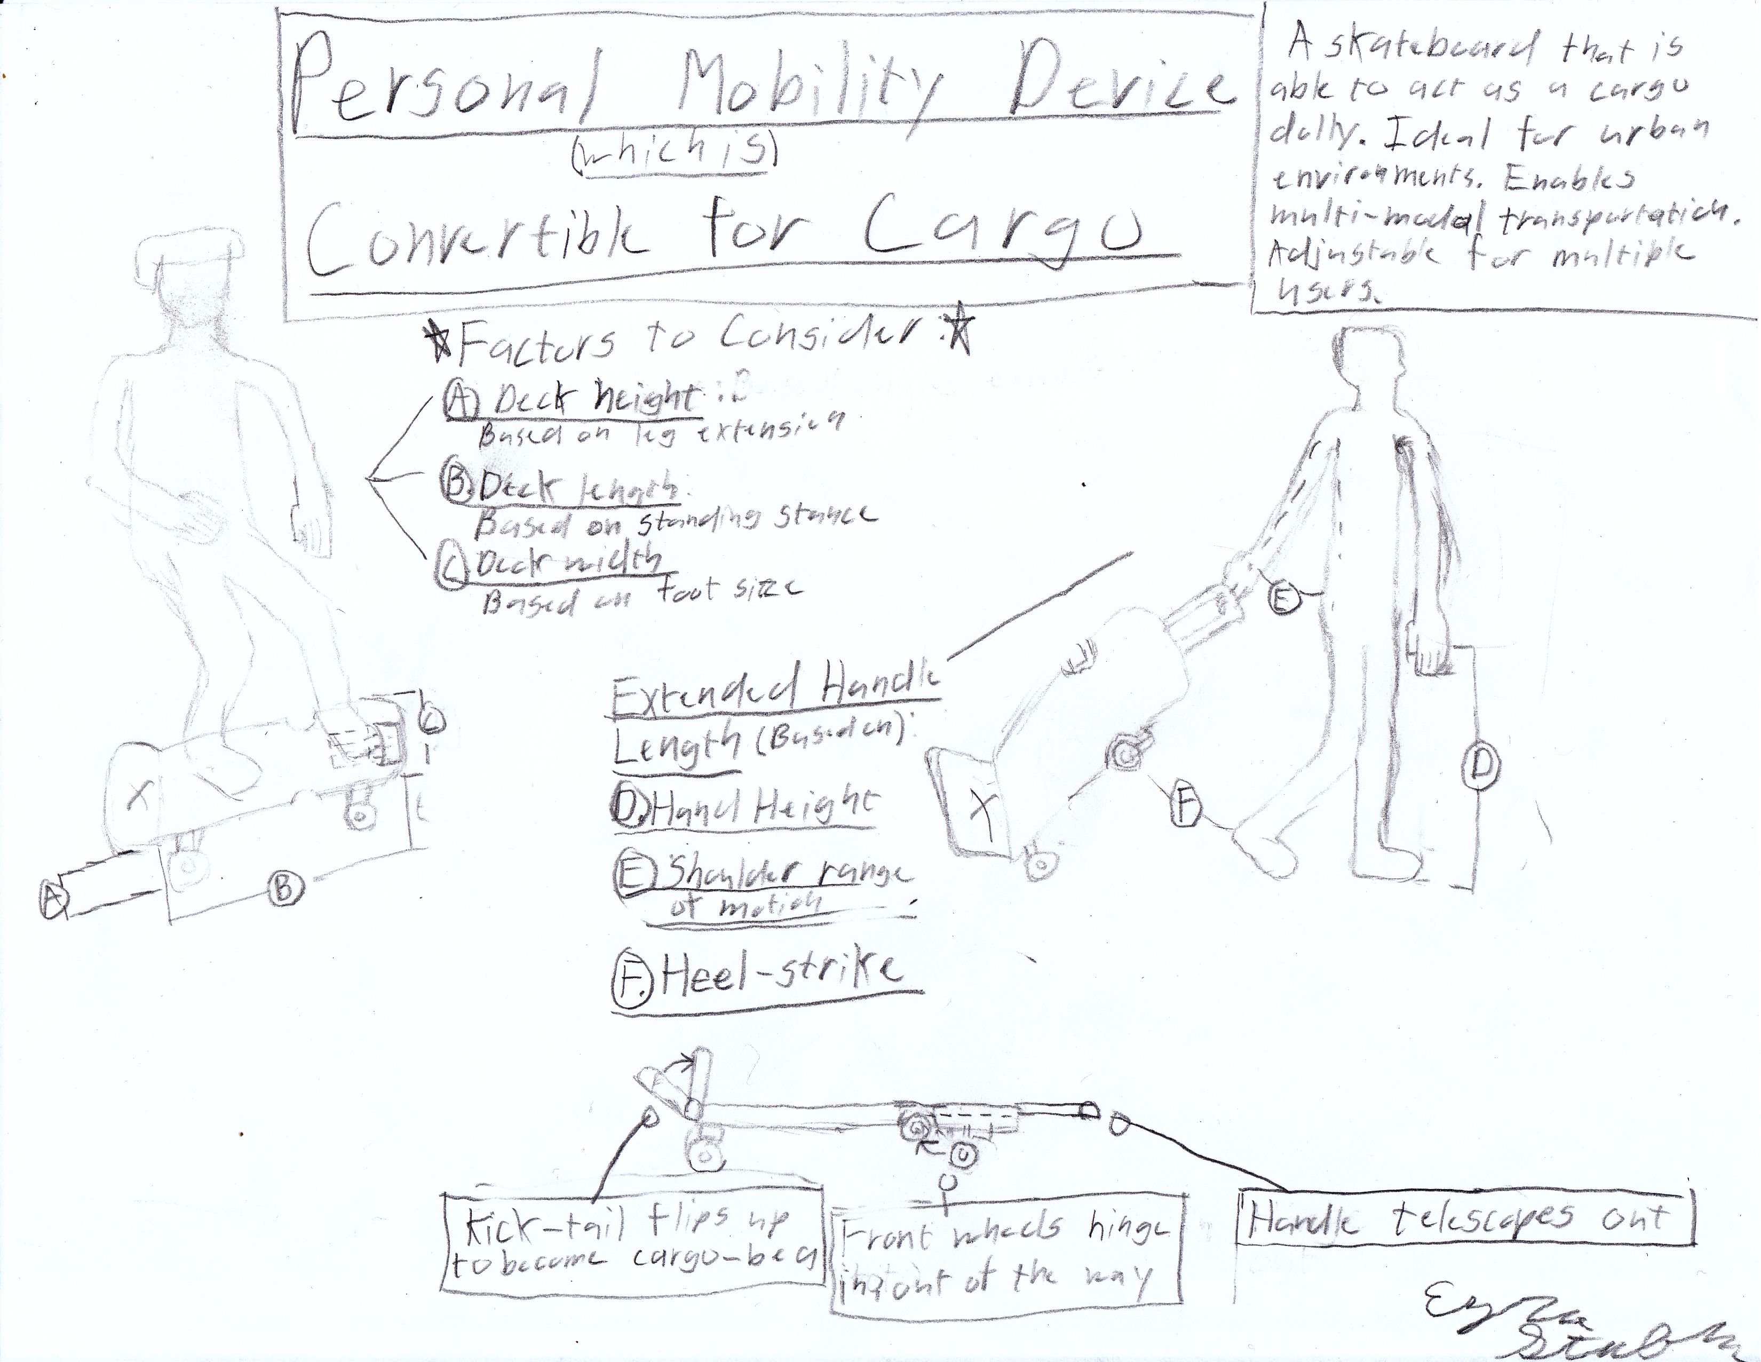
Concept sketch:

Slide 3
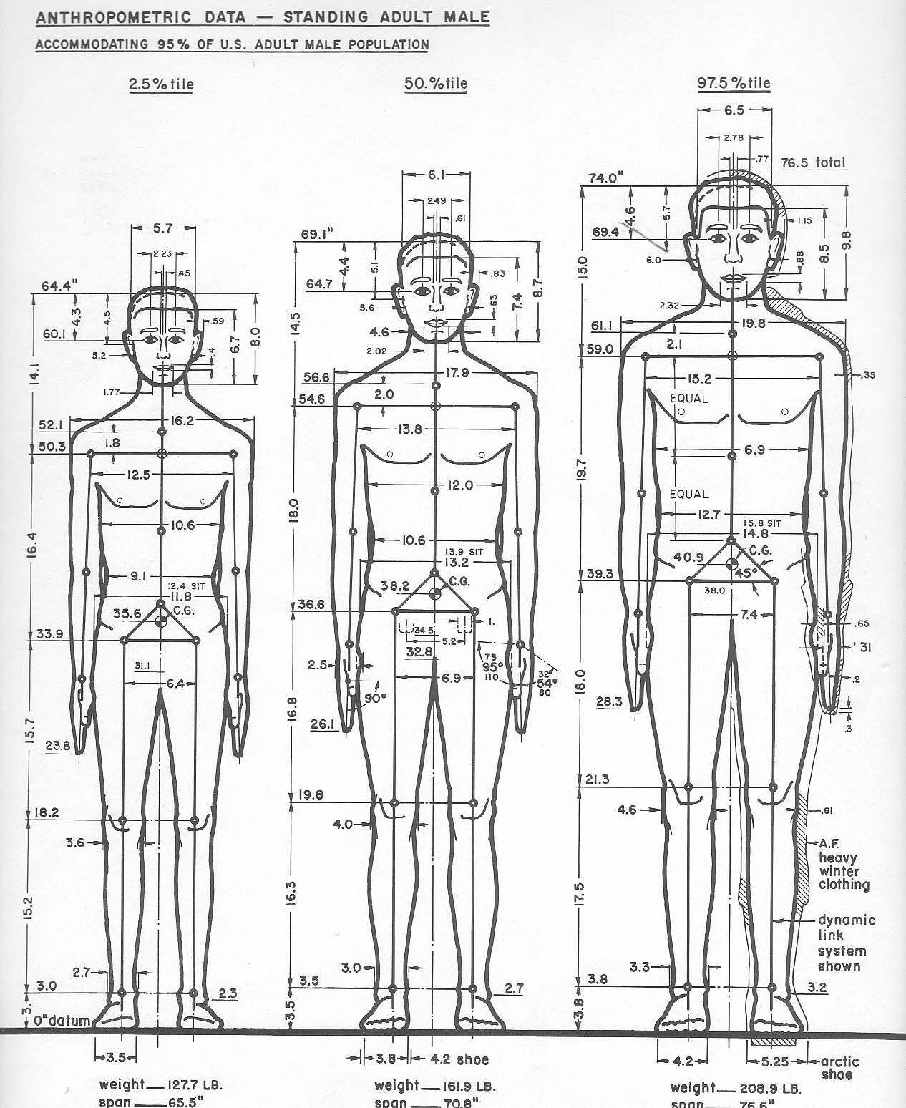
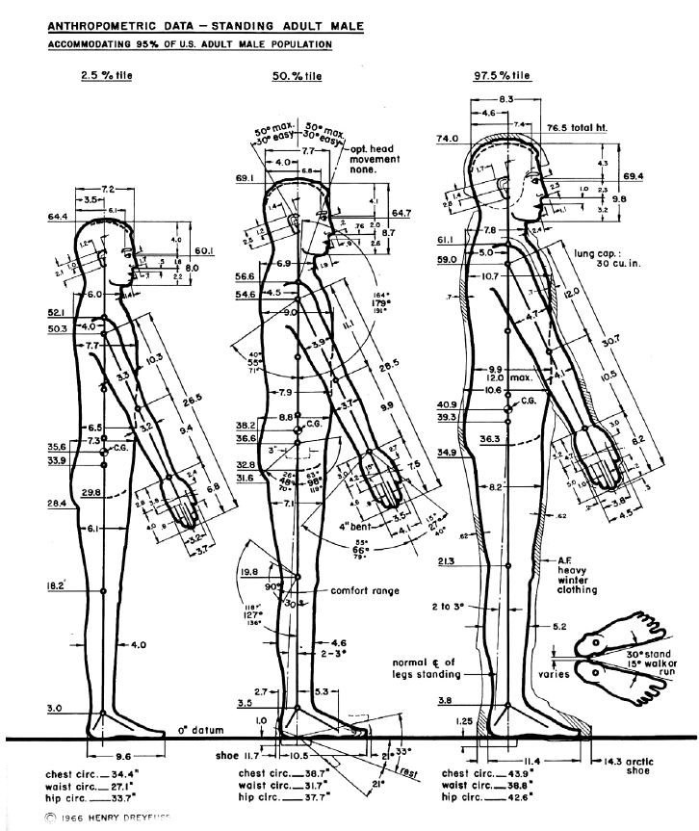
Utilize anthroprometic data

Slide 4
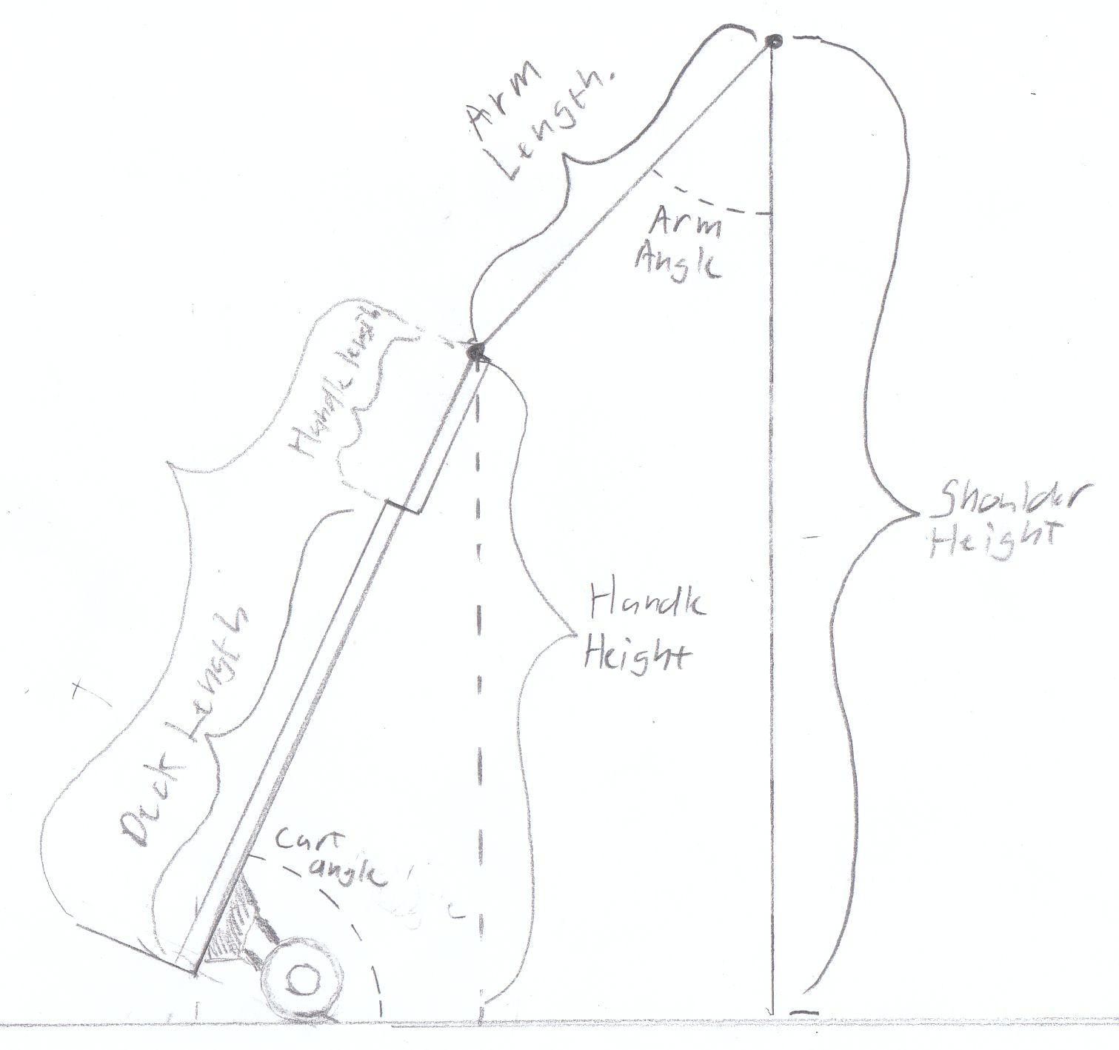
Calculating the dimensions

Slide 5
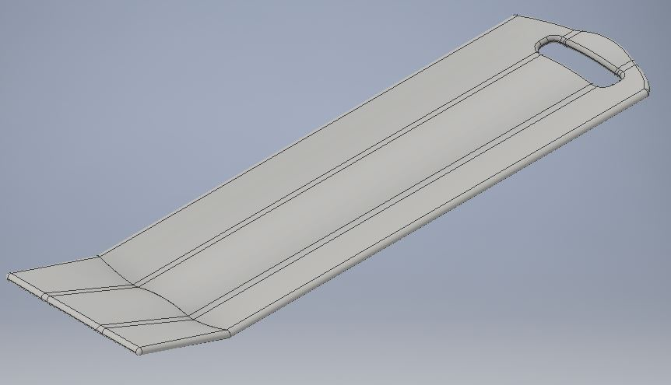
Base deck 3d rendering

Slide 6
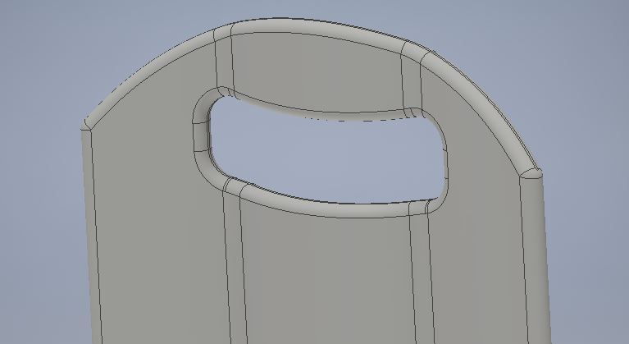
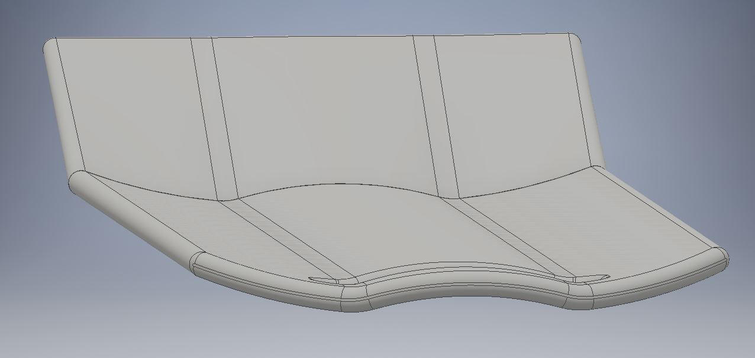
Design strategy utilized:
Affordances
Grasping affordance for handle:
matches profile of hand
Gripping affordance for deck:
matches profile of foot

Slide 7
Additional Considerations
Grasping afforance for handle:
Weight reduction
Vibration reduction
One design to fit all vs. customized to each customer

Slide 8
Thank you for your time
Feel free to ask any questions

