Slide 1
HoBeC
Hospital Bed Chair.
by Arturo Axel Murillo

Slide 2
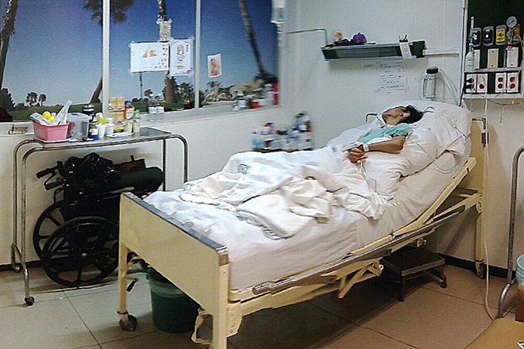
Problem
Hospitals in developing countries do not count with beds that promote the betterment of the patient.

Slide 3
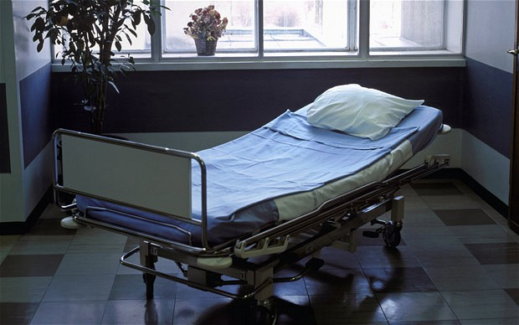
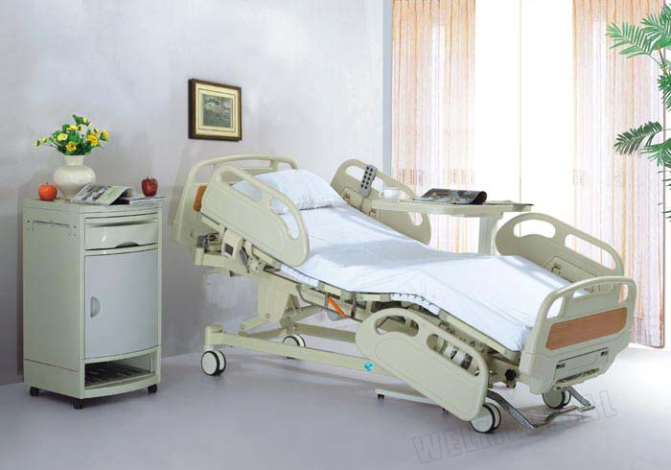
COST
Prices for Beds that provide a better care (being manual or electric) have a steep range.

Slide 4
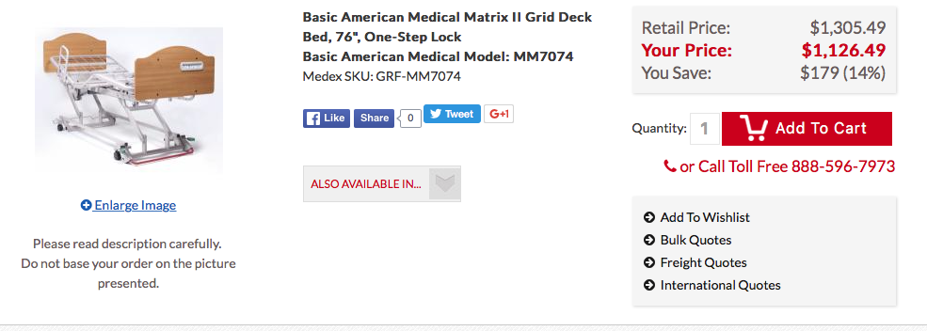
Low mid-range

Slide 5
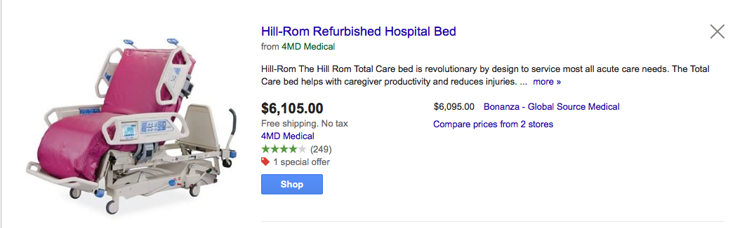
High range

Slide 6
Solution
Low range /High mobility

Slide 7
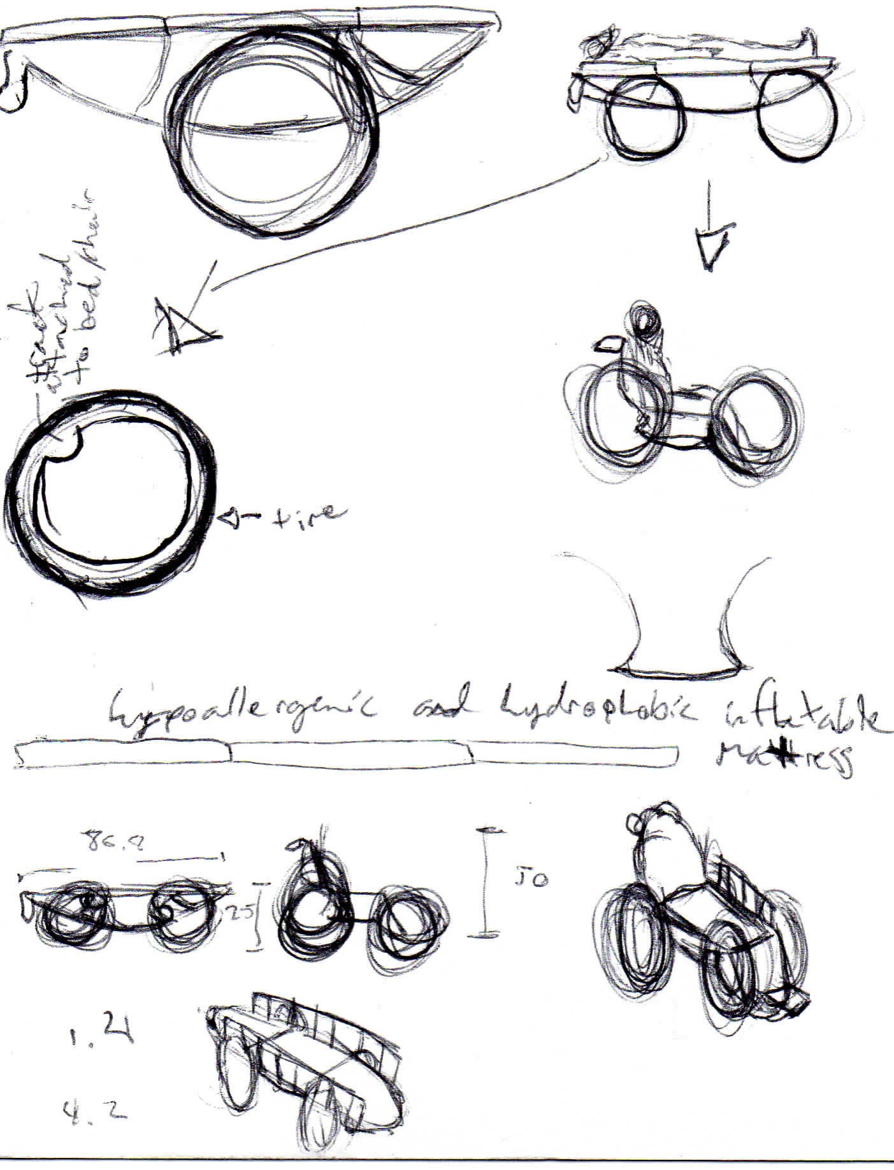
First Draft

Slide 8
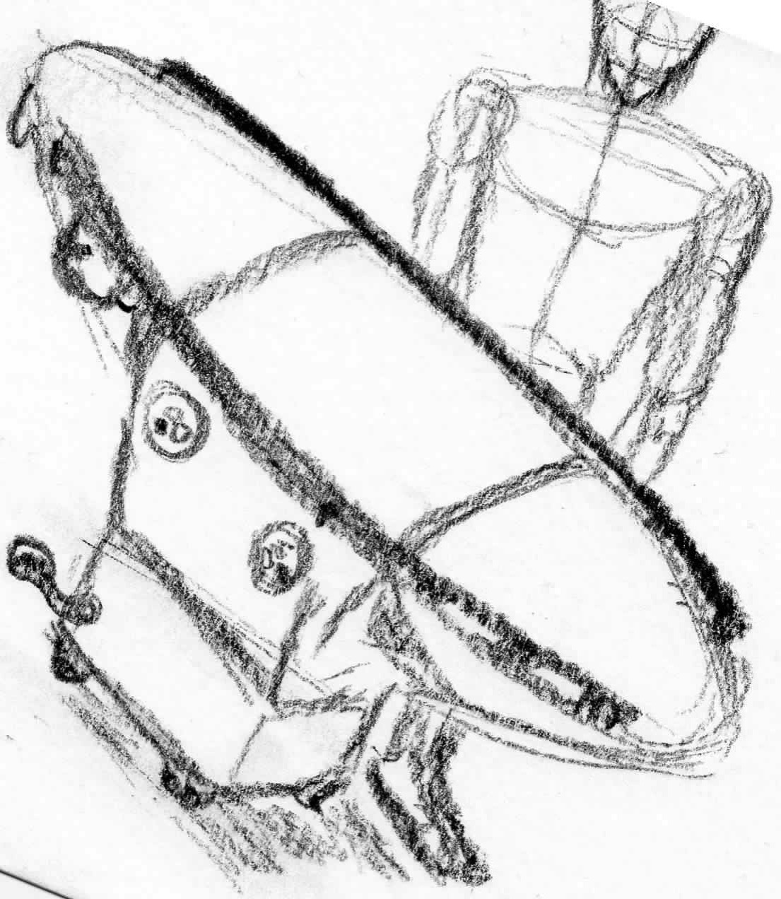
HoBeC

Slide 9
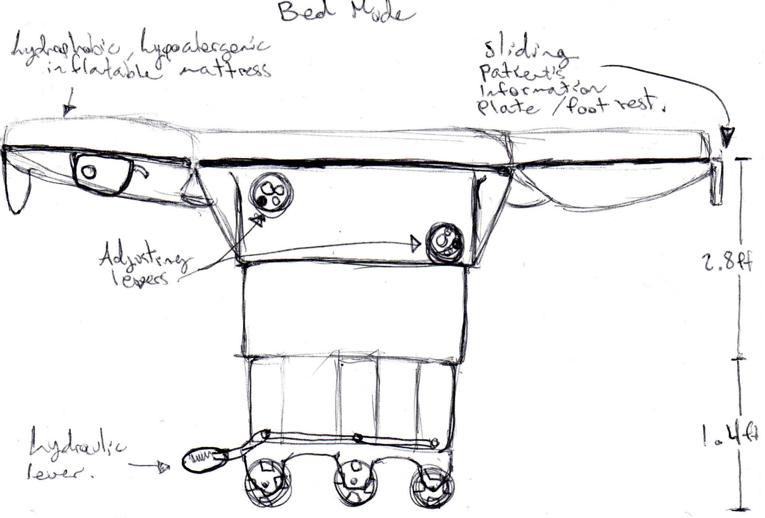
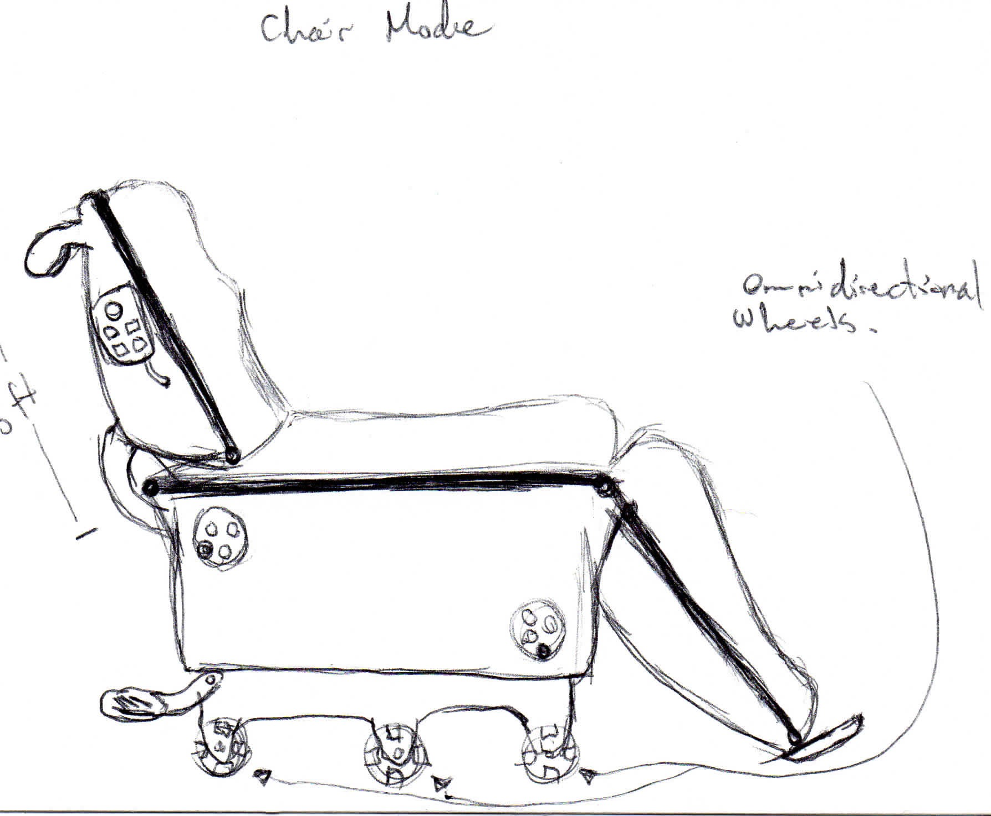

Slide 10
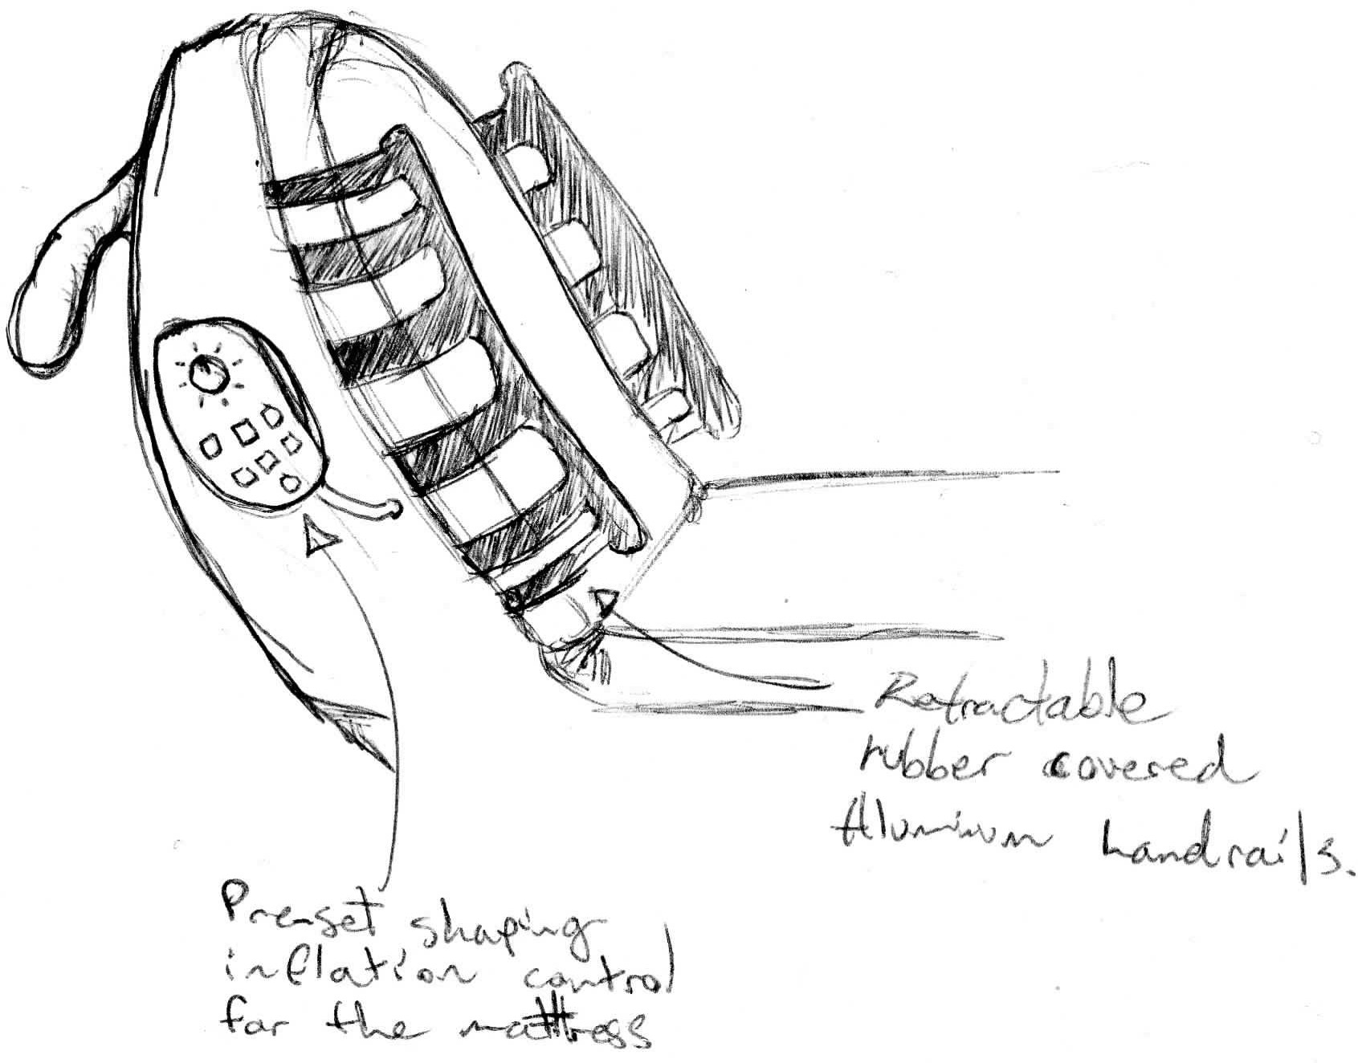

Slide 11
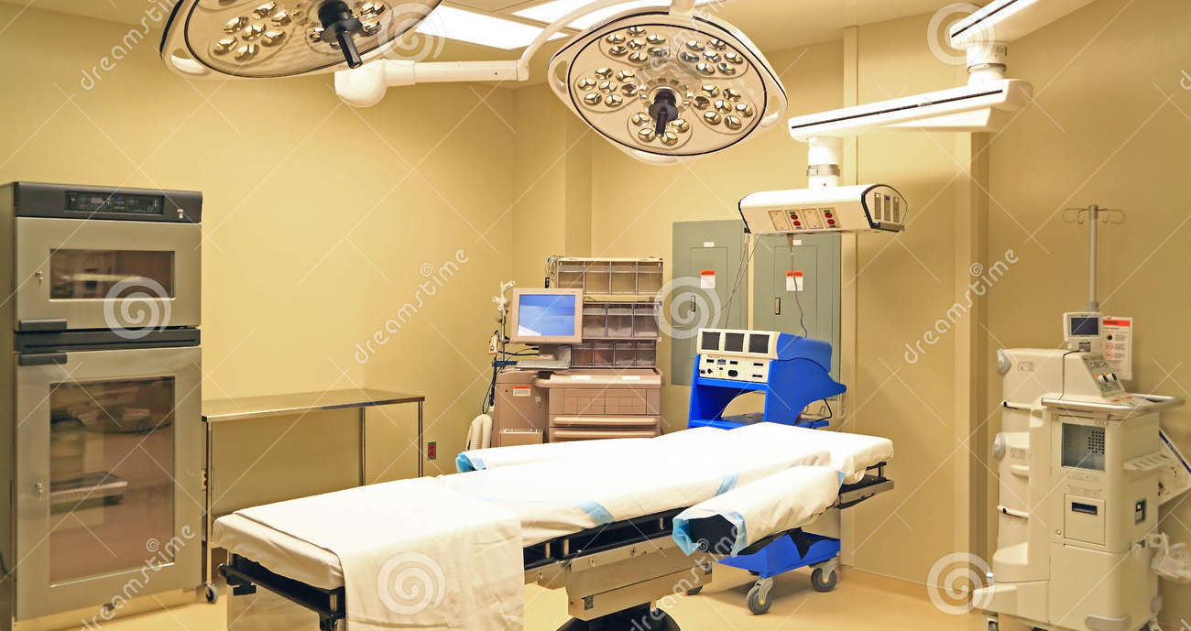
Surgical Table
Mobility, flexibility, specificity.

Slide 12
Breakdown
Approximated price $1512.99 or mass production ≈ $800
Flexibility: from bed to wheelchair. Naturally Hypoallergenic fabric cover(silk). Hydrophobic treatment. Inflatable mattress that adjust patients needs.
Target: High risk patients in developing countries.

Slide 13
Thank you!

