Slide 1
Clamp Watch
No tools required

Slide 2
Abstract
The clamp watch is a design that seeks to allow it’s audience to modify and fix the watch without the use of tools. Used a series of magnetic clamps to hold the watch and removable joints that can be physically unscrewed. The clasp is also a magnetic clasp that must be pulled open. Forces like gravity can’t pull the watch apart

Slide 3
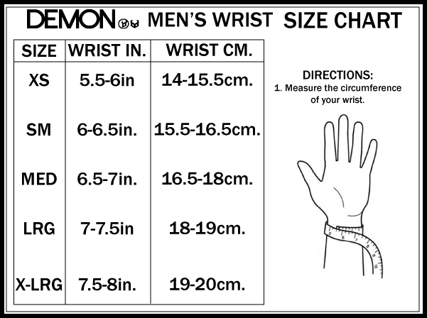
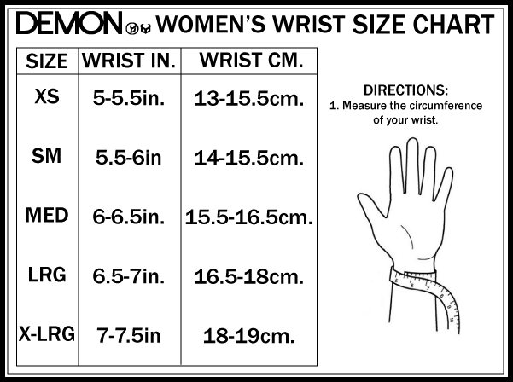
Standard Deviation Chart

Slide 4
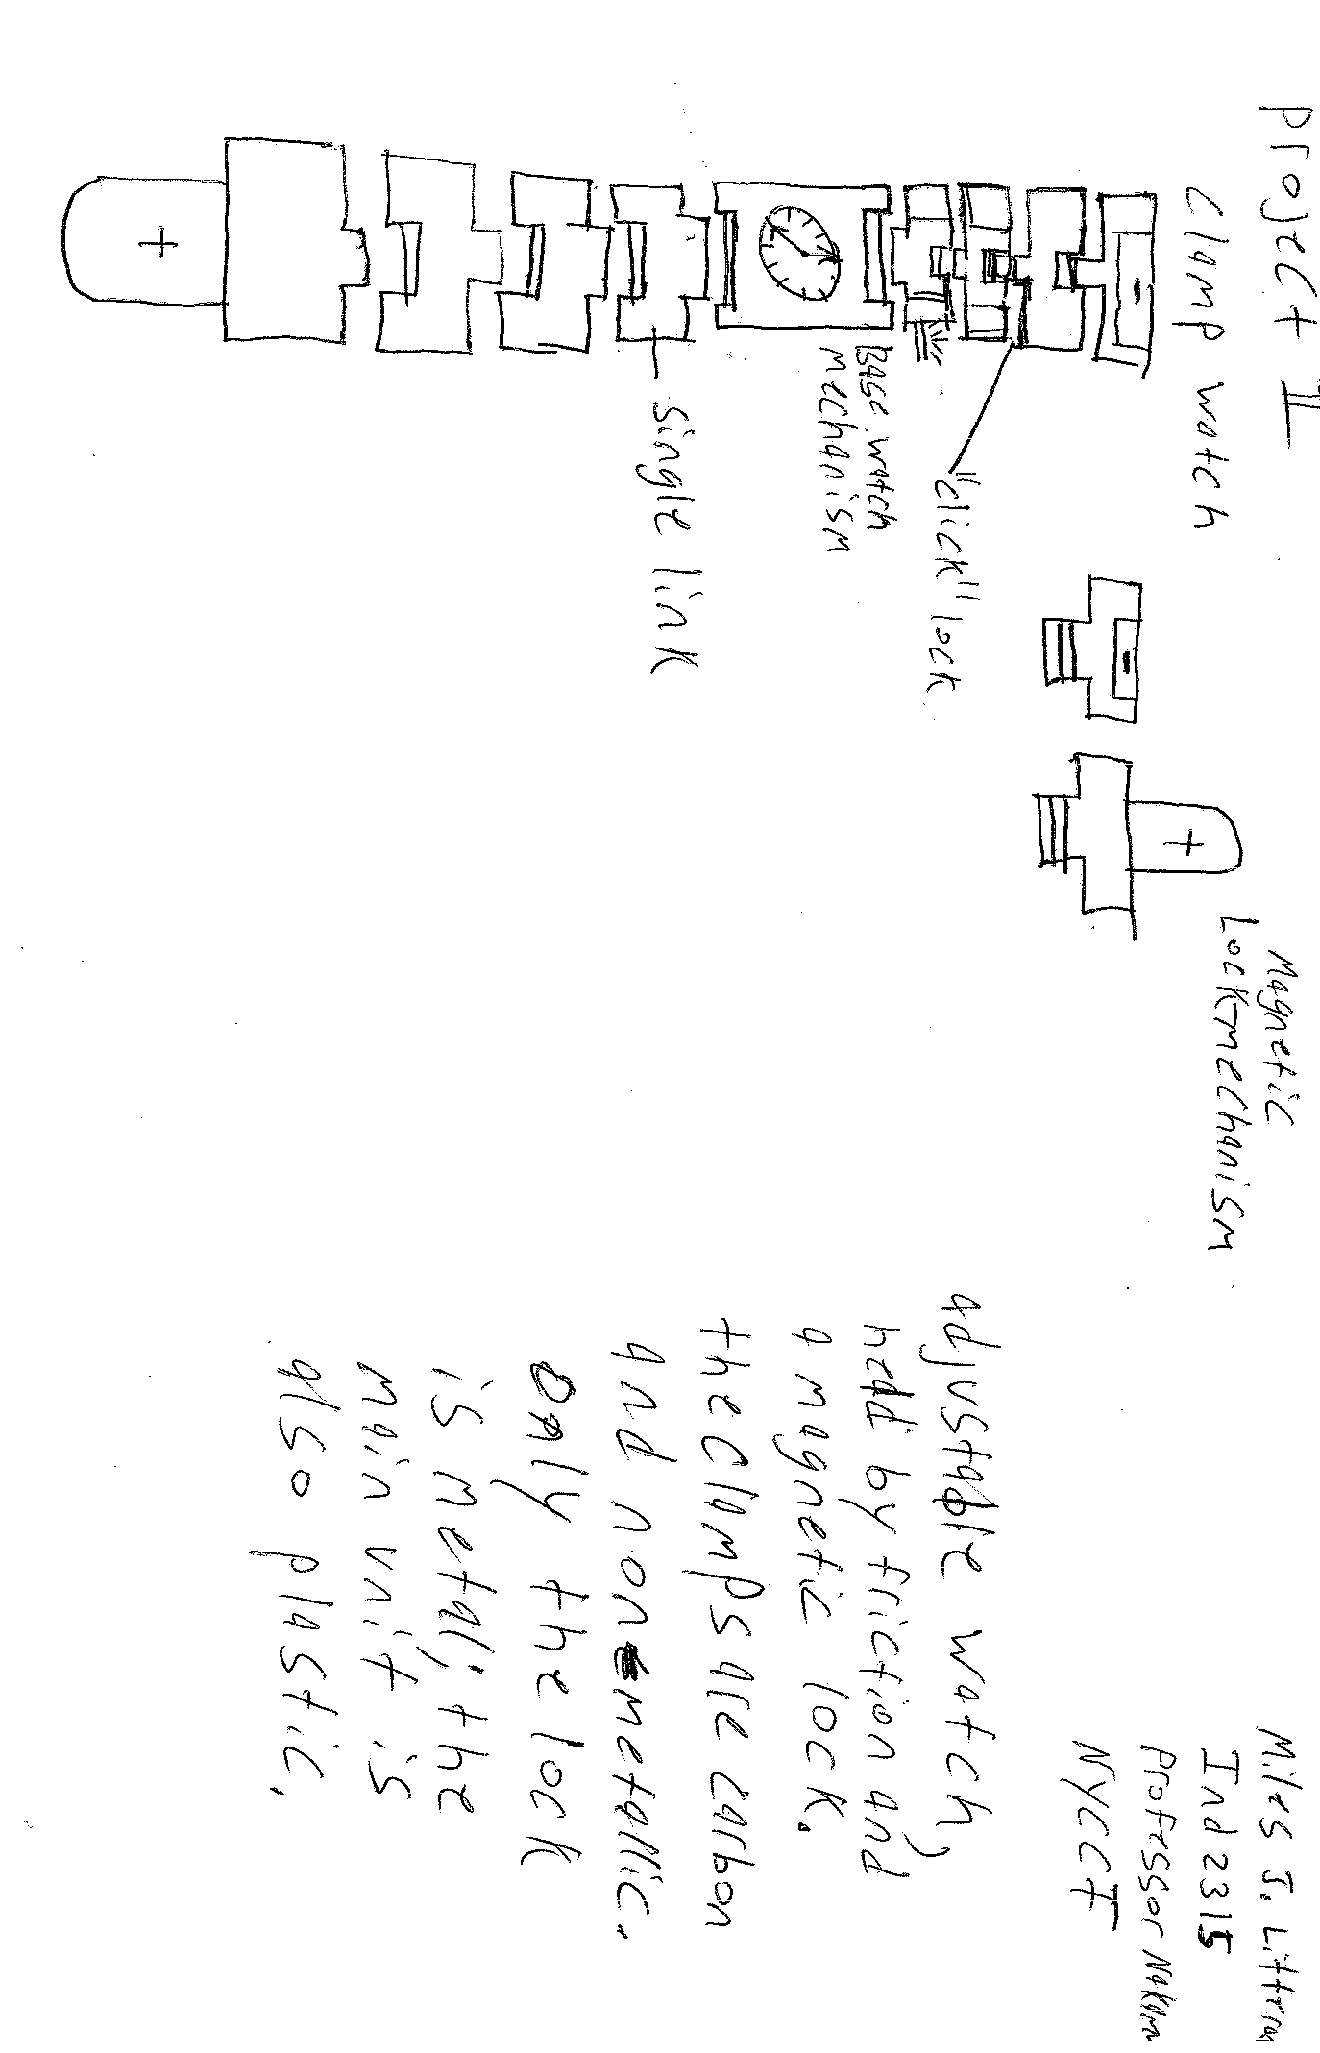
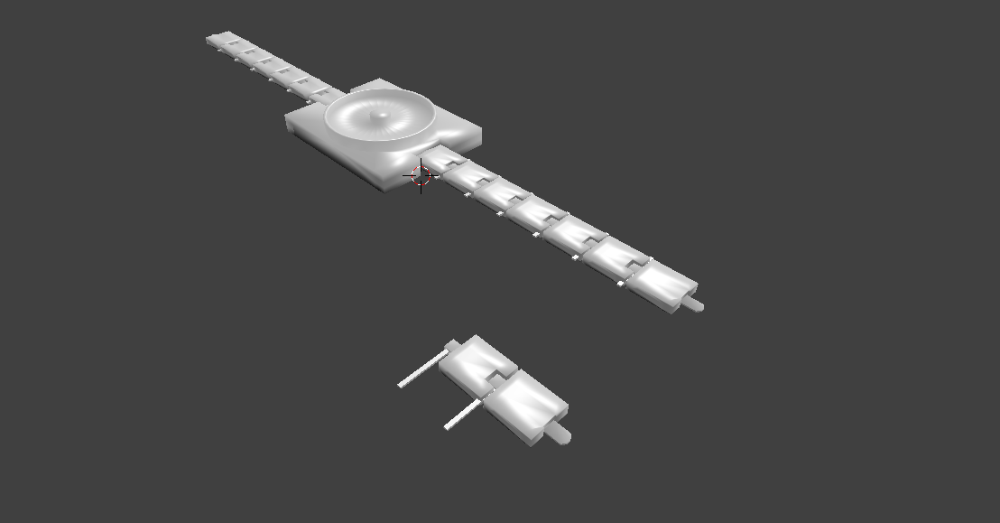
Sketches

Slide 5
References
http://www.allsportprotection.com/v/vspfiles/WmnWrstSizeChart.gif
http://www-spof.gsfc.nasa.gov/Education/Imagnet.html

