Slide 1
MC12.18 Wireless Mouse
(Optical-Mechanical Mouse)
By: Marko Cibic

Slide 2
Ergonomics
A little short history on Ergonomics –
  Ergonomics was studied and practiced way back when humans started designing and making things for their use, for example, the chair. Before the chair came along, people either laid down, squatted or sat cross legged. Mostly likely they didn't experience back pain and neck pain like we do now. However, the term “Ergonomics" was coined much later on, approximately five to six decades ago. With new industrial and office workplaces modernizing accordingly with technology, new ergonomic branches or schools of thoughts had sprung up. Therefore the five principles of ergonomics can be loosely organized into these areas. Physical, Cognitive, & Organizational Ergonomics
The study of people's efficiency in their working environment.
It is intended to provide optimum comfort and to avoid stress or injury.

Slide 3
The 5 Main Principles of Ergonomics
Safety
Comfort
Ease of use
Productivity and performance
Aesthetics

Slide 4
Optical-Mechanical Mouse Description
The optical-mechanical or optomechanical mouse consists of a ball that rolls one of two wheels inside the mouse. Each wheel contains a circle of holes or notches, allowing an LED light to shine through and be detected by a sensor.

Slide 5
Plan/Focus
At first I couldn’t come up with an idea to be honest with you all, the idea for my project popped into my head when I was in class finishing up some work yesterday. The way I uncovered my idea was when I began observing the computer mouse I was using while completing work on Inventor, which is a computer-aided design/manufacturing system. I had plenty of work to complete and the mouse that I was using looked to be that of an older generation and it seemed very bulky and uncomfortable for me to use so that is where I my idea/inspiration for the MC12.18 Wireless Mouse came into play. I wanted my design to implement the purpose of ergonomics which is providing optimum comfort and to avoid stress/injury for the given user. I believe that with my design I have successfully achieved the requirement for this assignment.

Slide 6
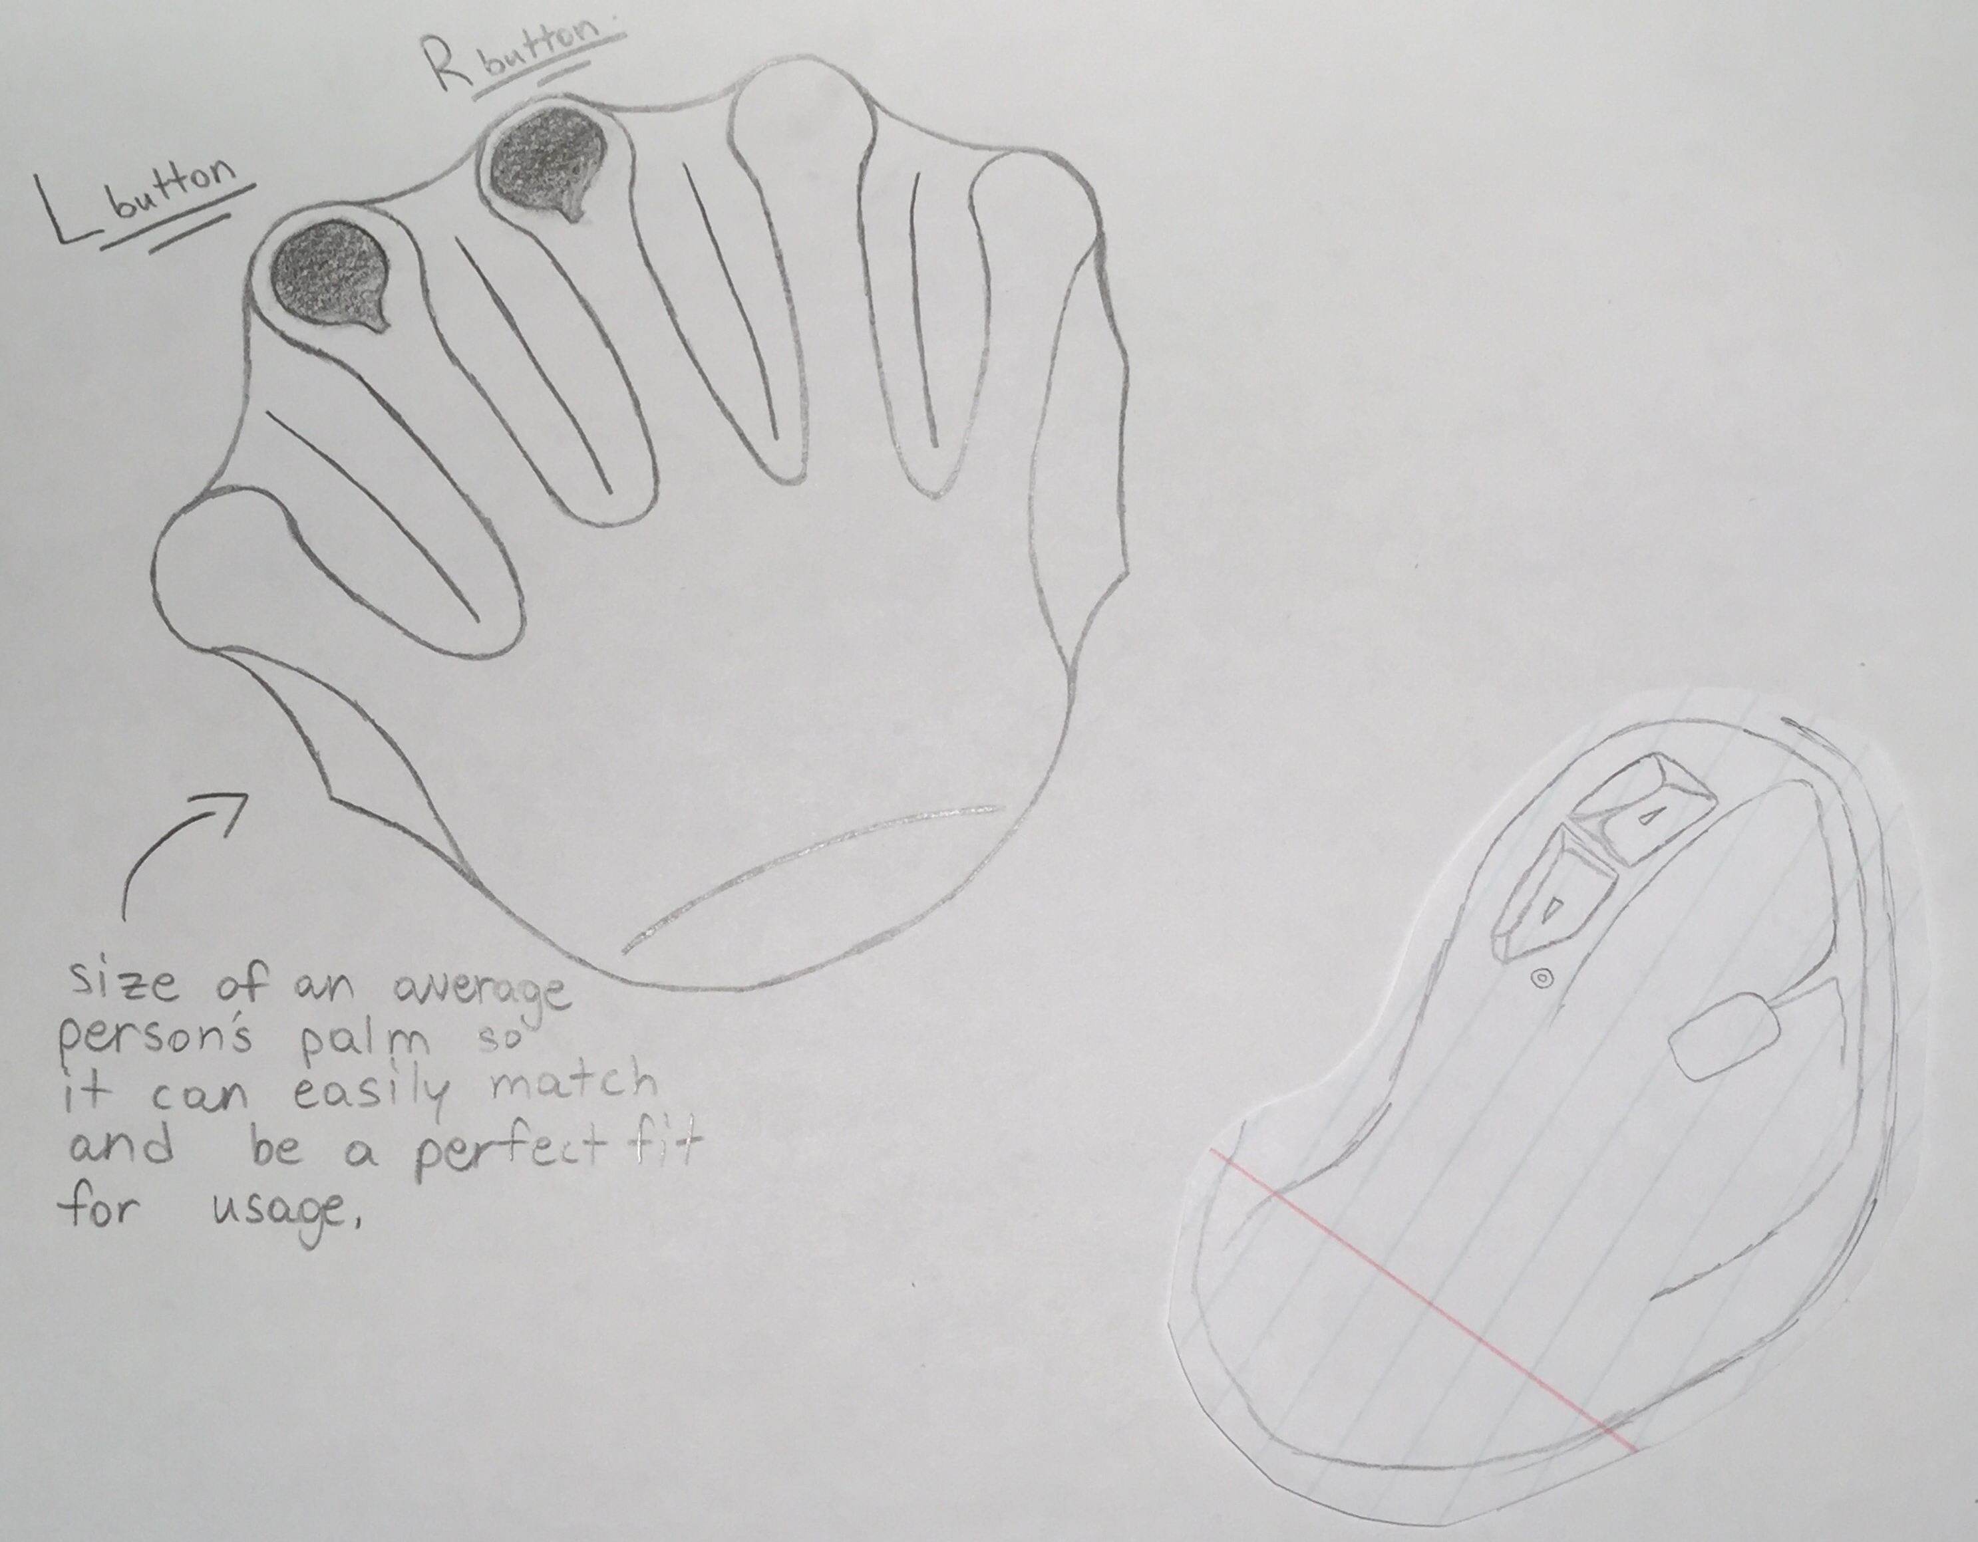
Brain Storming Ideas/Sketches

Slide 7
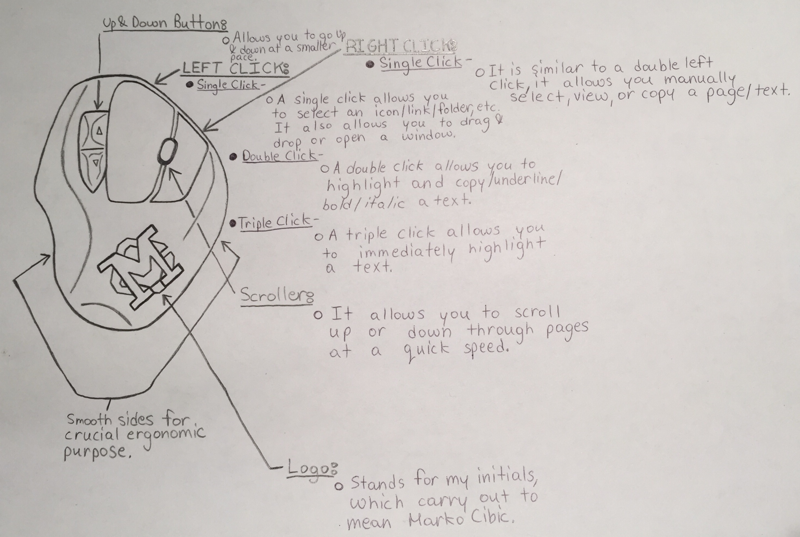
Visual Features of the MC 12.18

Slide 8
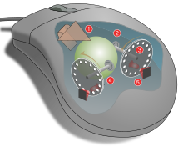
Internal Parts of the MC 12.18
Operating an opto-mechanical mouse. moving the mouse turns the ball.
  X and Y rollers grip the ball and transfer movement
  Optical encoding disks include light holes.
  Infrared LEDs shine through the disks.
  Sensors gather light pulses to convert to X and Y vectors.

Slide 9
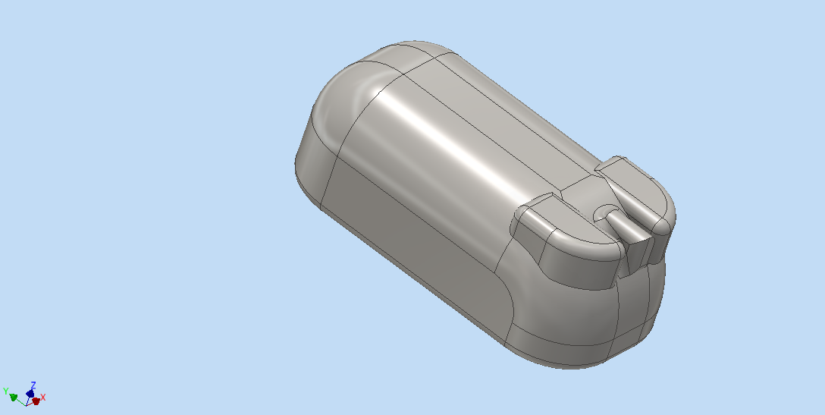
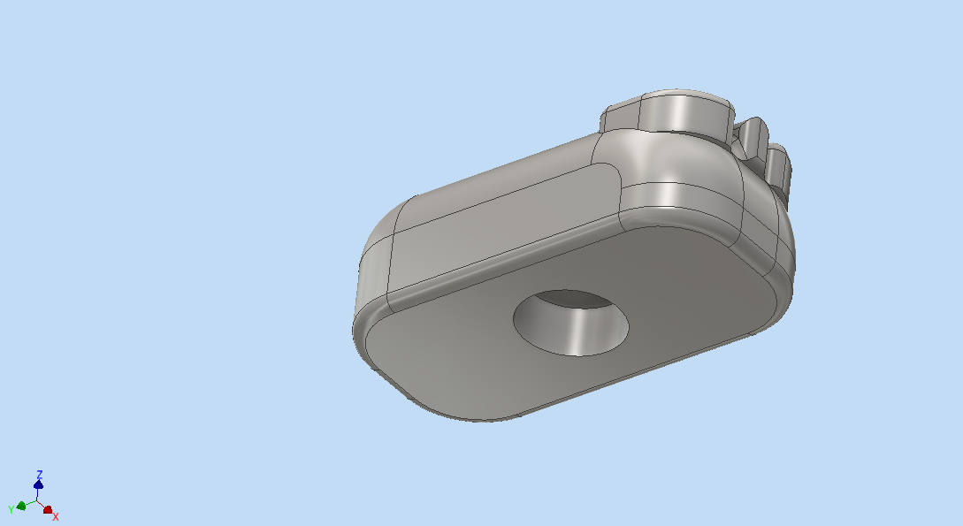
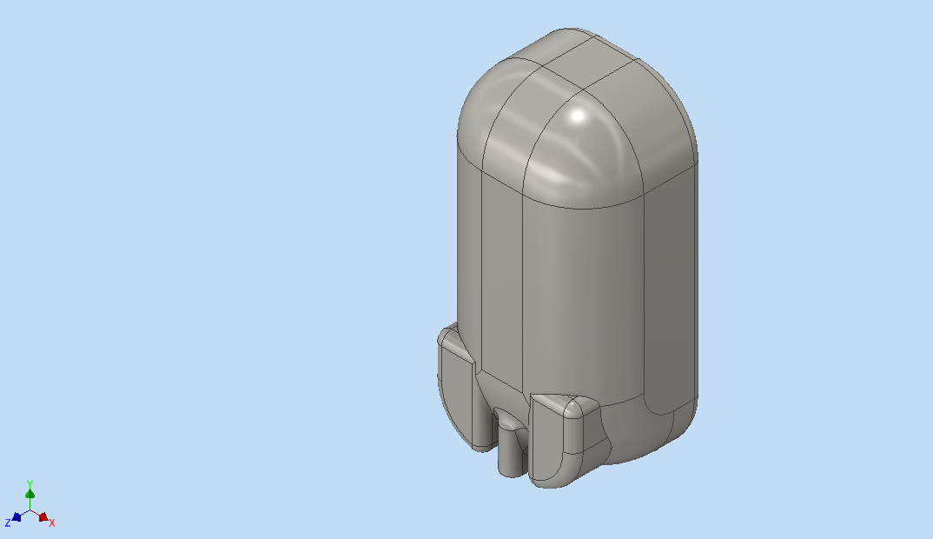
CAD / CAM Layout of MC 12.18

Slide 10
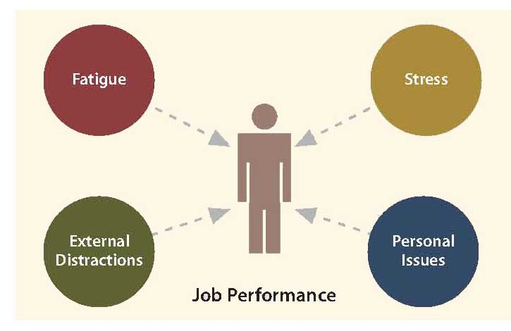
Human Factor
This design allows the user to feel comfortable and stress free once they begin using the mouse during long hours of work.
I think we can all admit that if we had a sleek and cutting edge design of a computer mouse all our troubles and stresses would be over when it came down to working long vigorous hours on certain assignments that need to be completed.

Slide 11
Conclusion
Even though I came up with my idea for the project just yesterday it doesn’t mean that I wasn’t thinking of any ideas previous to this presentation. I had so many ideas run through my head that I couldn’t really focus on one. I think it must have been due to the pressure I was feeling of finals week and all the exams that are in session, I am glad I was able to finish this project on time!

