Slide 1
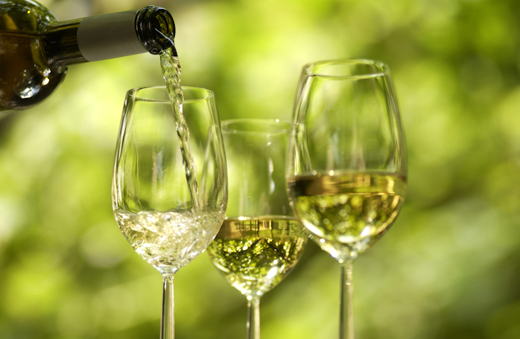
Wines of Germany
Prof. Karen Goodlad
HMGT 2402
Spring 2015

Slide 2
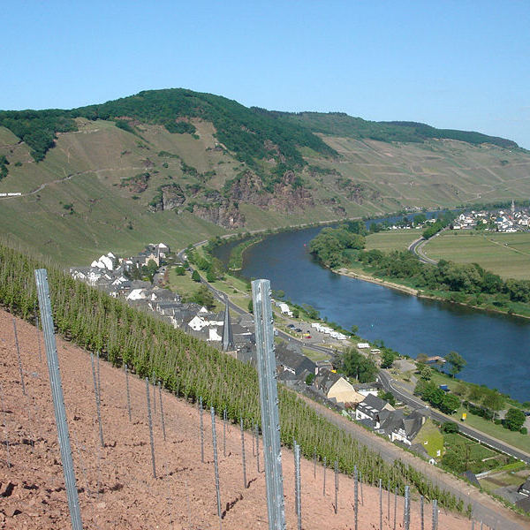
Learning Objectives
Discuss wine making methods using wine industry terminology.
Explain the factors that affect the taste of German wine:
``Identify the grape varieties of Germany
``Differentiate between the various styles of German wine
``Review the unique characteristics of Germany’s climate
``Review the wine laws of Germany
Identify geographical regions where German wines are produced:
`` Examine German Wine Growing Regions
Explore Austrian Wine

Slide 3
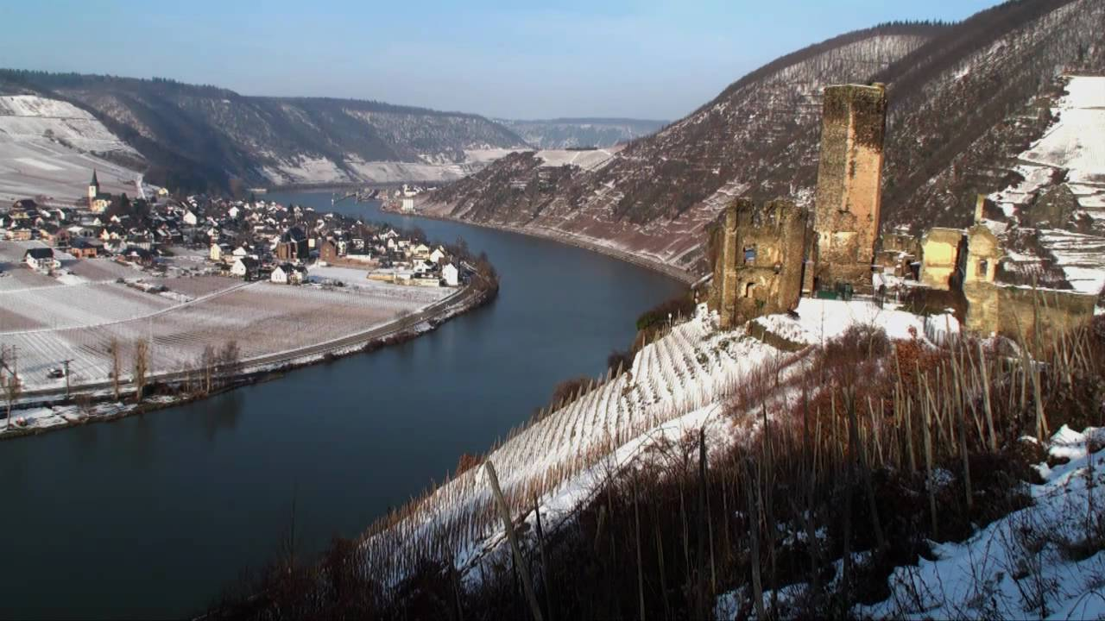
How does the climate affect the way grapes are grown in Germany?
How does this affect the taste of the wine?
Photo of Mosel
Notes:
Long growing season, sometimes until November for dry wines = high acidity
One of the coolest wine producing regions in the world
High latitudes
long daylight hours in summer

Slide 4
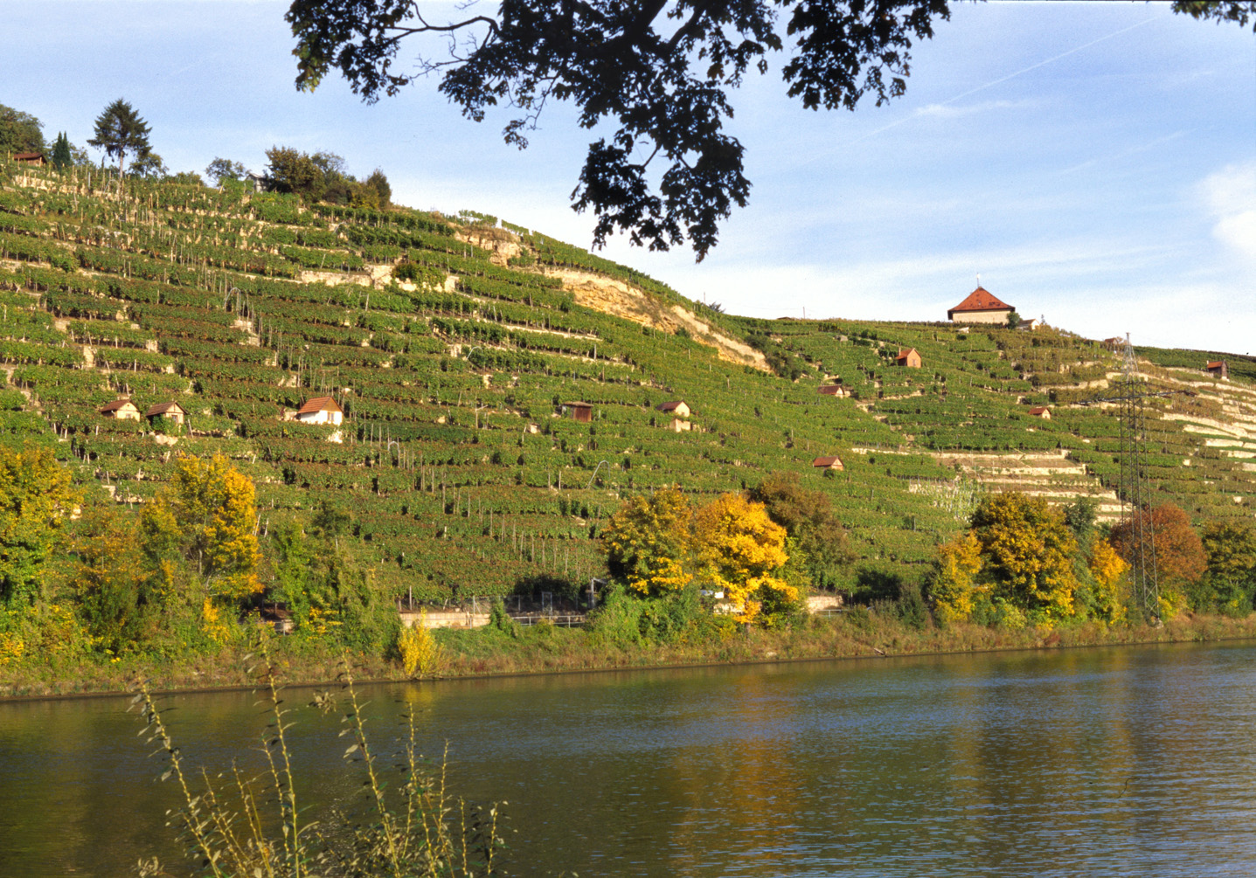
Selective Vineyard Sites
Near Rivers and Steep Banks
Württemberg Anbaugebeit (wine region)
Notes:
Near rivers
reflect sun, moderate temperatures
Steep riverbanks
elevated growing areas to capture more sun light

Slide 5
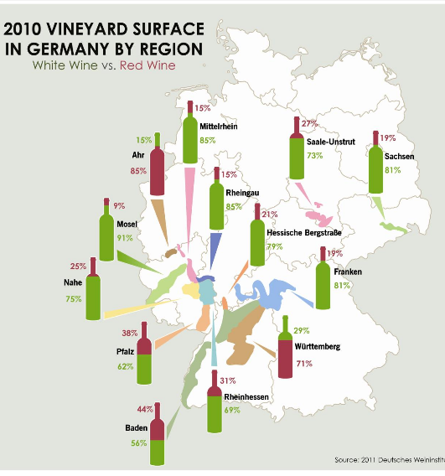
Germany is
Riesling Country
Of all White Grapes
Riesling (22%)
Müller-Thurgau (13.3%)
Of all Red Grapes
Spätburgunder (11%)
Explore More: http://www.germanwineusa.com/download/pdf/white-vs-red-production.pdf

Slide 6
Wine Styles
Dry Still, Sweet Still and Sparkling (Sekt)
75% of German wines are white
  Riesling
  Müller-Thurgau
  Silvaner
  Grauburgunder (Pinot Gris)
  Weissburgunder (Pinot Blanc)
Red wine
  predominately Spätburgunder (Pinot Noir)
Notes:
Sweet wines are made due to botrytis helped by cool misty conditions at the end of the growing season
Sekt = Charmat Method
Fresh lively wines with low alc.
Riesling: Noble grape, 22% of total acreage, wonderfully fresh when young but very expressive when aged
Muller-Thurgau: 20% of acreage, cross between riesling and gutedel developed in 1893 designed to shorten the growing season, floral character, fresh fruit make is and every day drinking wine,
Pinot Noir: 8%, called Spatburgunder, high yields, light wine
Silvaner: 7% of production, late budding and early ripening,
Stainless steel fermentation, some very large oak casks
Technology allows wine makers to stop fermentation to achieve desired level of sugar

Slide 7
Wine Laws
Laws are governed solely by sugar (oechsle) contend at harvest
  NOT vineyard site
  NOT historical preferences
  NOT classifications
  NOT sugar levels after fermentation
Labels identify origin, style and taste characteristics
Notes:
Laws changed significantly in 1971 and have been altered only slightly since.
Grape sugar or must is measured and recorded then categorized

Slide 8
EU Wine Laws: Categories
Pradikatswein, gU
(Protected Designation of Origin)
Landwein, gga
Protected Geographical Indication
Wein (PGI Category)
Qualitatswein
Geschutzte Ursprungs-bezeichnung, gU
(PDO)
Notes:
Unlike other regions in Europe most of the wine in German is of high quality. This is partly due to the understanding that the leading alc. Beverage produced and consumed in Germany is beer.
Deautscher Tafelwein: only general region name on label Rhein and Mosel, Bayern
Nechar, OberrheinLaws are not strict, vitification and vinification has a lot of freedoms, Likr Frances vin d’pay ~4% of production
Geschutzle Geographische Angabe(gga
Landwein: higher yields of sugar, 20 designated wine regions.
QbA: largest amount of German wine grown in specified regions called Anbaugebiete (13)
QmP: any vineyard (Anbaugebiete) with the right growing conditions can qualify, grapes from the same vineyard will be hand picked at various times
Lists region where grapes were grown and grape variety.

Slide 9
Wine Laws: Qualitätswein
Approved Grape Varieties
Reflect natural flavor characteristics of grape and region
Can be Chaptilized
Can use Süssreserve
Grown in one of 13 Anbaugebiete

Slide 10
Wine Laws:Prädiskatswein or QmP Categories
Kabinett: fine light wines, high acidity
Spatlese: “late picked”, fuller flavors than kabinett, higher sugar levels
Auslese: “selected” harvested in clusters with signs of botrytis
Beerenauslese: “berries out picked” wines are rich and luscious, $$$
Trockenbeerenauslese: selected raisins, very rare $$$$$
Eiswein: “icewine” rare, pressed frozen to concentrate grape characteristics $$$$
For more information about German wine categories visit: http://www.winepage.de/
Notes:
Measured by Must Wieght, Oechsle amount of sugar over 1
KABINETT
Usually lighter wines, made from ripe grapes, relatively low alcohol
SPÄTLESE (Late Harvest)
Fuller-bodied wines, made from fully ripened grapes. Because complete ripeness usually requires additional time on the vine, these grapes are normally harvested later in the harvest.
AUSLESE
Made from fully ripened bunches; selectively harvested (unripe or diseased berries are discarded)
BEERENAUSLESE
Full-bodied, fruity wines made from overripe grapes that usually are affected by Botrytis cinerea (noble rot); selectively harvested (berry selection)
TROCKENBEERENAUSLESE (TBA)
Highly concentrated wine made from botrytized grapes dried up almost to raisins; selectively harvested (berry selection)
EISWEIN (ice wine)
Made from grapes harvested and pressed while frozen (-7°C or 19.4°F); only the naturally concentrated juice is pressed out
Kabinett: ripe, not over ripe
Spatlese: fuller bodied
Auslese: very sweet
Beerenauslese: wine has finesse and elegance
Eiswein: pressed frozen, ice floats and is skimmed off top

Slide 11
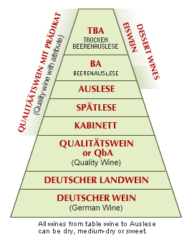
German Wine Laws: Another view
Which is PDO?
Which is PGI
Source: http://www.germanwineusa.com/press-trade/ripeness.html

Slide 12
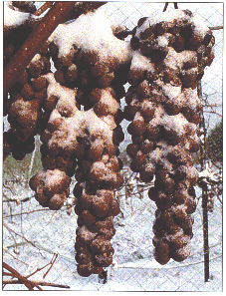
Eiswein

Slide 13
Sweetness After Fermentation
Trocken Dry
Halbtrocken Half-Dry

Slide 14
Wine Laws: Geographic Indication
Anbaugebiete (13): Wine Region
Bereiche (41): District
Grosslagen (176):
  collective vineyard sites
  village
Einzellagen (+2000):
  Vineyard
Weingut: winery
Anbaugebiet
Mosel
Bereich
Saar
Einzenllagen Kupp
Grosslagen
Ayl
How to read a German Wine label:
http://www.germanwineusa.com/press-trade/read-wine-label.html
Notes:
Labels can be a poor marketing tool for German wines
Anbaugebiet: Wine Region, required on all labels
Bereich: District
Grosslage: “collective site” bulk blended wine
Einzellage: Single Vineyard, smallest geographical area allowed by law

Slide 15
Wine Laws: Quality Control Process
A.P.No.
Stipulate grape varieties in an area
Define growing regions
Define minimum sugar levels for all grapes at harvest
Pass a taste panel
  Reduce category if the wine does not pass or winemaker can blend it into other wines

Slide 16
German Wine Labels
Here is an interactive site to explore: http://www.germanwineusa.com/press-trade/read-wine-label.html

Slide 17
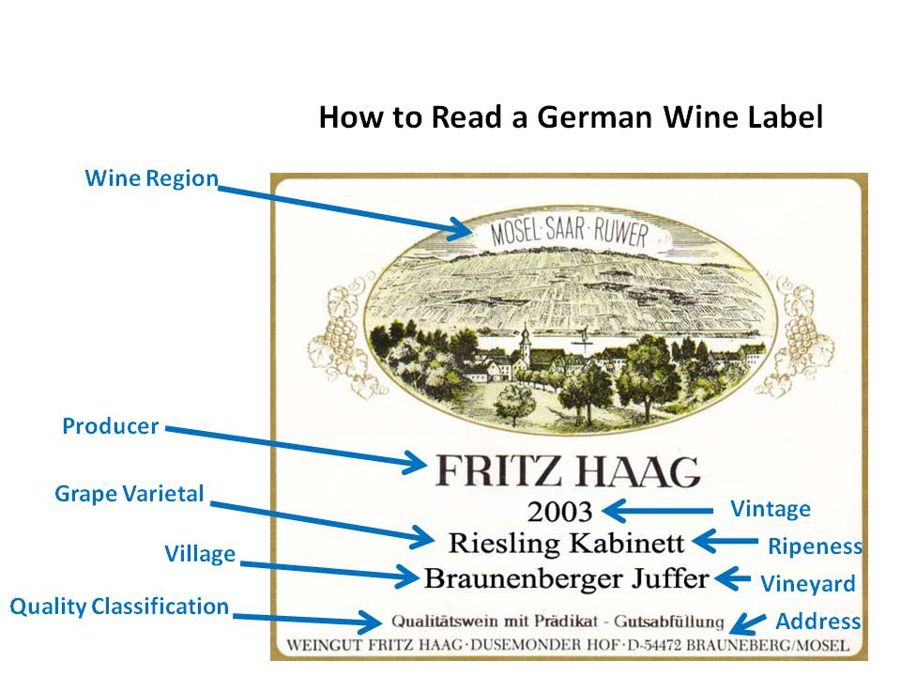
German Wine Labels
Notes:
a Grosslage’s name will always be preceded by the name of a village within the Grosslage,
The term Erzeugerabfüllung means “producer bottled” and may be used by wine cooperative or a single producer.
The term Gutsabfüllung is closer to the meaning of “estate bottled,” hence connoting that it was produced in a single Einzellage.

Slide 18
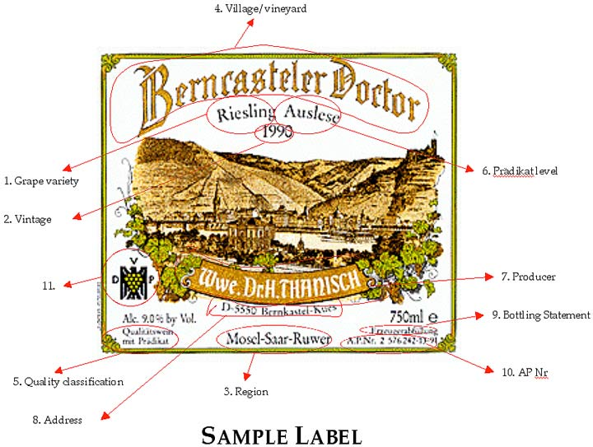
German Wine Labels

Slide 19
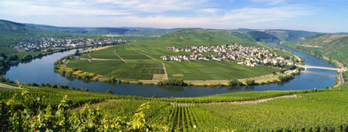
Mosel
Six Bereiche
Elegant Wines
  92% White Wine
  56% Riesling
Mosel River flows from south to north to meet the Rhine River
  Slate Soil ~~ Steep Slopes ~~ Nothing else grows ~~ Riesling 55% ~~ Muller-Thurgau
Notes:
Consistently produces the highest quality of all German wines.
Elegant fruit delicate, minerality

Slide 20
Rheingau
World Class White Wines
  Fuller in body than Mosel
  Slopes create lovely acidity
  Flat areas more full bodied
Johannisberg, Famous and only Bereich
80% Riesling
Rhine River runs through it

Slide 21
Pfalz
2nd largest region
62% white wine
  20% Riesling and Müller-Thurgau and others make up the reminder
“sturdy wines”, higher in alcohol than other German Wines
Soil: sandstone, gravel and granite
  Forest protects it from cold and rain

Slide 22
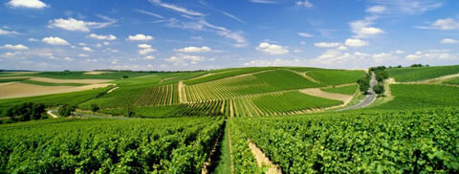
Rheinhessen
Largest Region and largest producer of wine
Mostly fertile, flat plains, some clay, with the Rhine River flowing through
  Muller-Thurgau, 21.5%
  Silvaner 12%
  Riesling10%
Popular Villages: Nierstein & Nackenheim
  Eastern facing slopes

Slide 23
Ahr
On the fringe of the protective Eifel Hills.
Climate:
  Mild and favorable,
  Warner in steeper sites
Soil types:
  slate, volcanic stone and rocky soils in the middle
District ·
Grape varieties, mostly red
Spätburgunder, Portugieser, Riesling
Source: Wines of Germany USA
Notes:
Grape varieties
Spätburgunder (61.7%), Portugieser (11.2%), Riesling (7%)

Slide 24
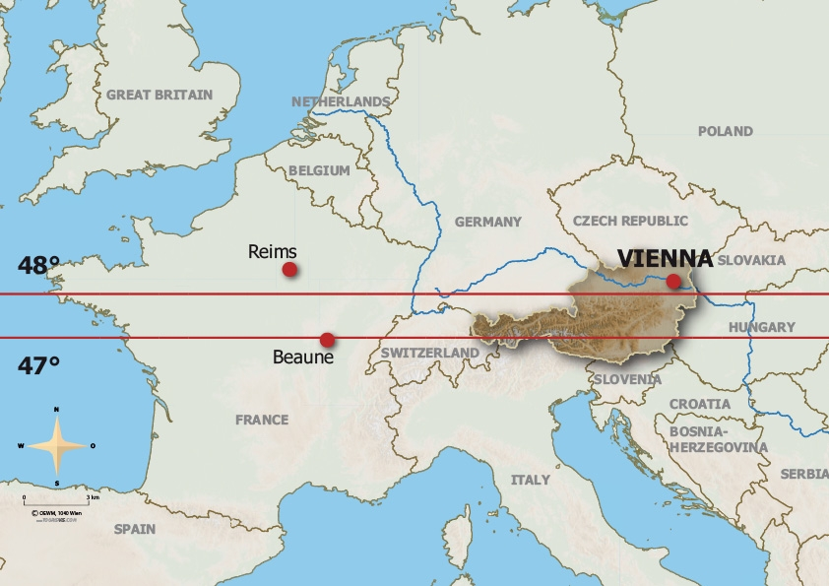
Austria
White Grape Variety: Grüner Veltliner one-third of Austria’s vines. Indigenous to Austria, this grape produces spicy white wines with firm acidity.
Red Grape Variety: Zweigelt Mature, full-bodied and long-living wines deliver tones of black cherry. High-quality wines are matured in barrels
Climate: continental, with cold winters and mild summers, 200 day season
Explore More: http://www.austrianwine.com/

Slide 25
Terms To Know
Bereich
Einzellage
Eiswein
Grosslage
Halbtrocken
Trocken
Landwein
Auslese
Beerenauslese
Trockenbeerenauslese
Kabinett
Spatlese
Tafelwein
QbA
QmP

