Slide 1
Wines of Italy
HMGT 2402, Wine & Beverage Management
Prof. Karen Goodlad
March 2014

Slide 2
What to expect today
Return Exams
Review Retail and Winery Assignments
Introduction to the Laws of Italy
Group work: Regions of Italy

Slide 3
Italian Wine Laws
“As market demands increased, so did the need to guarantee and protect the origin of Italian wines.”
Italian Trade Commission
The Italian Trade Commission is a Great Resource: http://italianmade.com/education/aboutitaly-italianmade.html

Slide 4
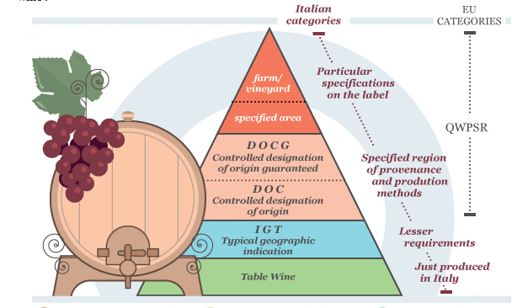
Source: Made in Italy http://www.made-in-italy.com/italian-wine/learn/wine-classification-and-appellation

Slide 5
vino da tavola
Table wine
Industrial alcohol → bulk wines
Label to read only:
  rosso/blanco
  producers name
Notes:
Most Italian wine is consumed in Italy
Comes from any where in Italy
And from any combination of grapes
Producers to know Riinite, Casarsa, Bolla, Cavit and Ecco Domani

Slide 6
Indicazione Geographica Tipica (IGT)
Classified in 1992
  First Application 1996
  ~118 Classified IGTs as of 2007
Produced in DOC/DOCG zone but can not list the zone or village on the label
  Lists Region such as Tuscany, Piedmont, Apulia…
Heavily located in Tuscany
Result: More R&D, Some Recognizable High Quality Wines, Investment in Non-traditional Grapes and Vinification Methods, No impact on DOC and DOCG Quality
Notes:
Introduced in order to bring up level of quality and reputation of Italian Wine
Example: Sassicaia, 1st IGT to become DOC
Cab. Sauv. vine planted in 1968, grown from cuttings of Chateau Lafite-Rothschild vines

Slide 7
Denominazione de Origine Controllata (DOC)
Established for 5 Years
Approved grape varieties/ percentage of production
Grown in approved vineyards
Yield per hectare/pruning methods
Total number of gallons of wine produced
Vinification method for some wines
Aging methods/time
Piedmont 1990
  Color/aroma/flavor controlled by tasting commission
Notes:
About 20% of Italy’s wine production (60% of which are red)
Different from France because of aging requirements

Slide 8
Denominazione de Origine Controllata e Grarantita (DOCG)
DOC plus:
  Bottles smaller that 1.25 Gallons/5 liters
  Official numbered tag across the cork’s capsule
To be a DOCG Zone
  5 years as DOC
  “reputation and commercial impact both at home and at an international level”
  Wines of historical importance
  Wines are internationally recognized
  Wines have attracted attention
  Wines contribute to Italy’s financial wealth
Notes:
Started in 1980
Bottles can also be numbered by producer
Wines that fail tasting panel are re named Vino da Tavola

