Slide 1
Understanding Beer
Prof. K. Goodlad
Spring 2013

Slide 2
Ingredients
Water
Barley
Hops
Yeast

Slide 3
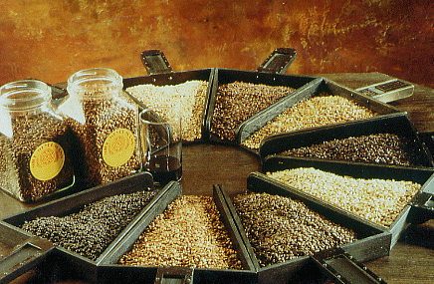
Ingredients: Barley
Barley gives beer color, flavor & is a source of sugar.
Most of the sugar will ultimately be converted into alcohol.
Garrett Oliver on Barley (Video)

Slide 4
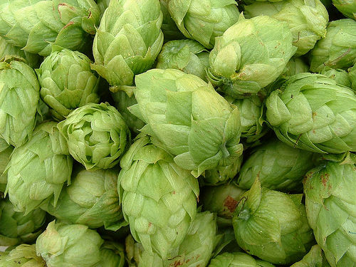
Ingredients: Hops
Hops are a flower that lends natural preservatives to beer along with bitterness & a range of flavors & aromas.

Slide 5
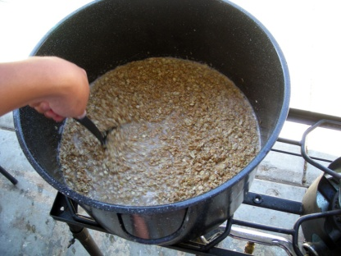
Making Beer
Making Beer with Garret Oliver of the Brooklyn Brewery (Video)
Wort
Hot, Sweet Liquid & Hops Combination Prior to Fermentation
Seperated in a Lauder Tun
Malting Barley
Barley that is allowed to germinate (starch turns to sugars)
Dried and roasted in a kiln in temps ranging from 122˚f-220˚f
Mash
Water + malted barley
Use a Lauter tun to separate grains (draft) and liquid (wort)
Boiled in a kettle
Notes:
Malting Barley: http://www.rpi.edu/dept/chem-eng/Biotech-Environ/beer/malt/barley1.htm This is accomplished industrially by increasing the water content of the seed to 40-45% by soaking it for a period close to 40 hours. The seed is then drained and held at a constant temperature (60 F) for close to 5 days until it starts to sprout. The barley is slowly dried in a kiln at temperatures gradually rising to 122 F for lighter malts and 220 F for darker malts. This kiln drying takes about 30 hours.
The next step to prepare the malted barley for brewing is termed "mashing." It is a process of grinding the malted barley into granular sized pieces. This ground malt is mixed with water in order to dissolve the starch, sugar and enzymes within the malted barley. The temperature of the "mash" is then raised to 150-160 F,

Slide 6
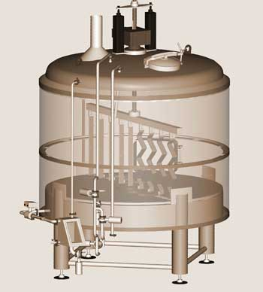
Lauter Tun
To convert mash into wort

Slide 7
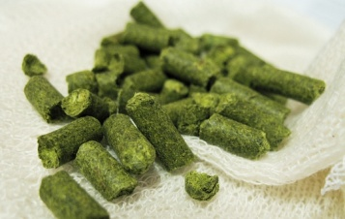
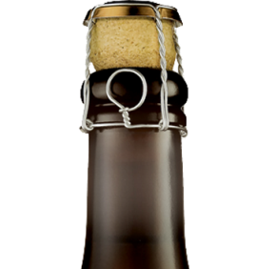
Making Beer (Cont.)
Fermentation
Bottling
Fine and filter (most beers)
Carbonation added
Alternate Style: Bottle Conditioning
Yeast removed, can be aged
Moved from kettle to fermentation tank
Hops
Added for Bitterness + Aroma
Takes 7-10 days
Bottled after boiling, fermentation takes place in the bottle
Garrett Oliver on Fermentation (video)
Garrett Oliver on Local 1 (video)

Slide 8
Mondern Marvels clips 1-5
http://www.youtube.com/watch?v=_DbPUtXtudE&feature=BFa&list=PL7FAA63C233DD4A12
http://www.youtube.com/watch?v=NWk6cBHDEcI&feature=BFa&list=PL7FAA63C233DD4A12
http://www.youtube.com/watch?v=7Nhw6OctrNY&feature=BFa&list=PL7FAA63C233DD4A12
http://www.youtube.com/watch?v=vk6SxA8eDyg&feature=BFa&list=PL7FAA63C233DD4A12
http://www.youtube.com/watch?v=v_N_c6G5Aww&feature=BFa&list=PL7FAA63C233DD4A12

Slide 9
Types of Beer
Ale | Lager
Top Fermenting | Bottom Fermenting
Porters | Pilsner (dominate in US)
Stouts | Bock
Wheat Beers | Double Bock

Slide 10
Serving Temperatures
Notes:
Wikipedia:
Beer writer Michael Jackson proposed a five-level scale for serving temperatures: well chilled (7 °C/45 °F) for "light" beers (pale lagers); chilled (8 °C/46 °F) for Berliner Weisse and other wheat beers; lightly chilled (9 °C/48 °F) for all dark lagers, altbier and German wheat beers; cellar temperature (13 °C/55 °F) for regular British ale, stout and most Belgian specialities; and room temperature (15.5 °C/59.9 °F) for strong dark ales (especially trappist beer) and barley wine.[

Slide 11
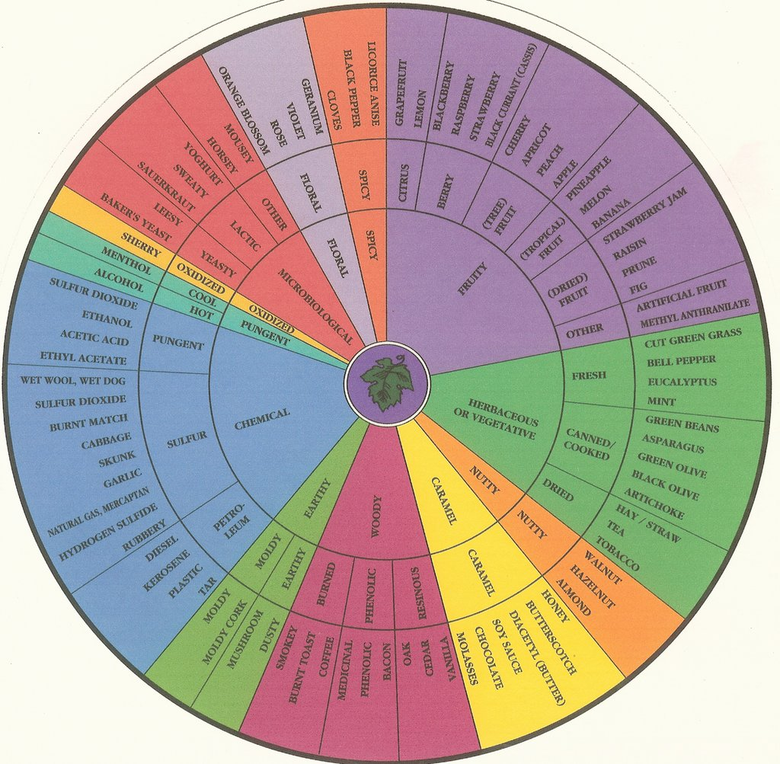
Tasting

Slide 12
Tasting
Brooklyn Lager
Brooklyn Brown Ale
East India Pale Ale
Brooklyn Pennant Ale
Brooklyn Pilsner
Black Chocolate Stout
Brooklyn Local One, Belgium Style Beer

Slide 13
Recommended Reading
“Beer School” By Steve Hindy & Tom Potter
“The Best of American Beer and Food” By Lucy Saunders

