Slide 1

VINSEN ELLIS
PROFESSOR OSTROM
ENG 1101

Slide 2
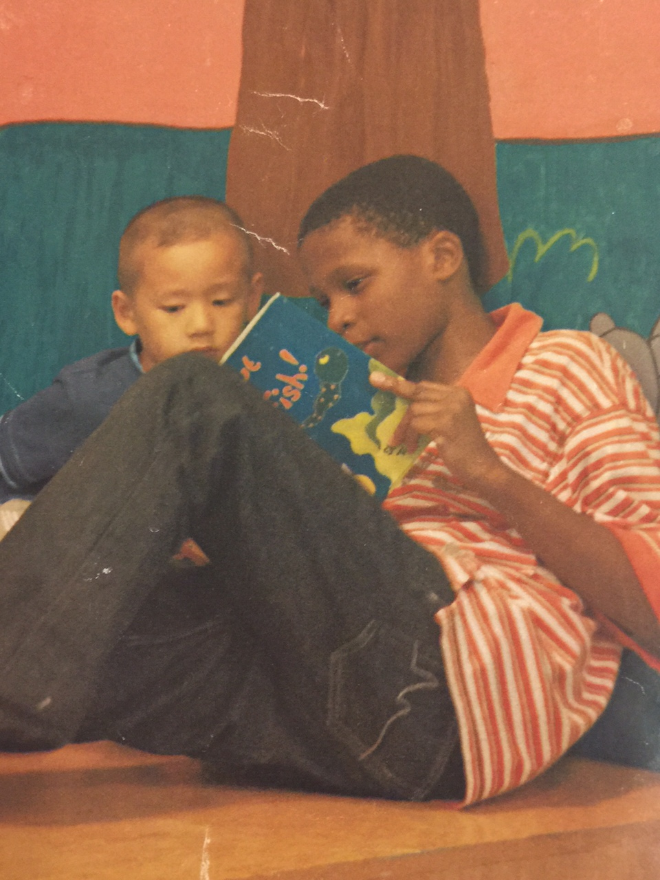
How I became interested in human services
Before I even became a young adult I was always helping someone in any way possible.
❖ I always knew how to read people’s emotions and I felt good when they walk away with a smile.

Slide 3
Volunteering
Since my sophomore year in high school until my freshman year in college, I volunteered at a YMCA in my neighborhood, Jamaica Queens.
Going in and teaching young kids how to swim, play basketball and other things is a great way to make yourself feel useful.
Most of the kids in that area come from low-income neighborhood and it’s also a task to lead them from the path of destruction where the hood leads you.
It feels great knowing kids look up to me even though I don’t see myself as much of a role model.

Slide 4
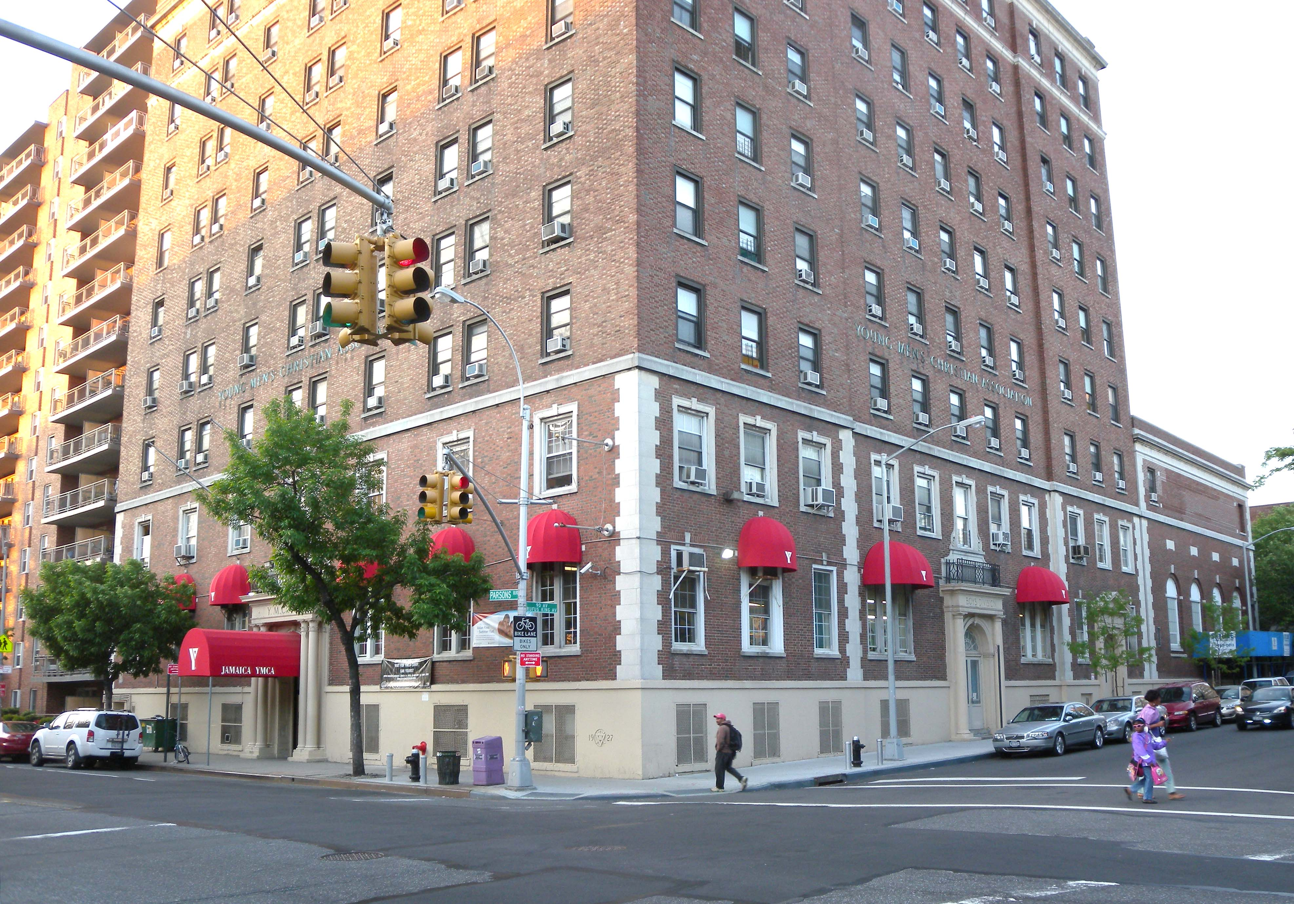
`

Slide 5
Most nba players inspire me
Besides their work as a professional basketball player, they do now and then give back to the community, including kids.
This is also my plan, to have another profession and still have time to do things like this.

Slide 6
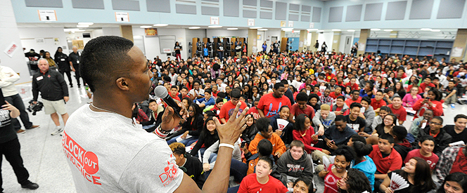
Dwight Howard of the Houston Rockets

Slide 7
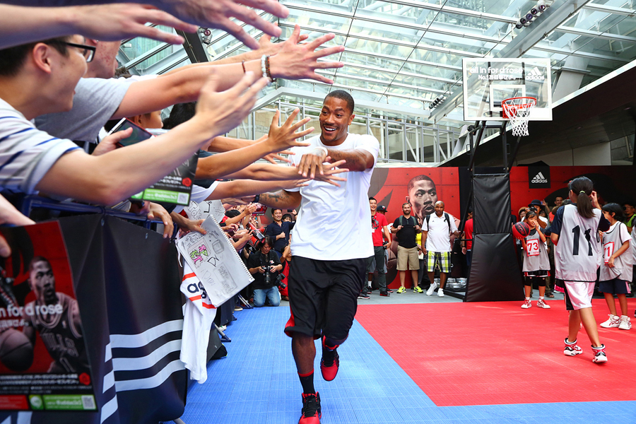
Derrick Rose of the Chicago Bullls playing 1on1’s with kids

Slide 8
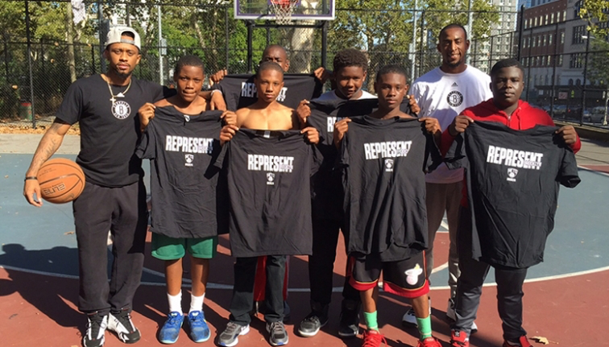
Ryan Boatright and Markel Brown in Tillary Park

Slide 9
Why I want to be a youth coordinator
The passion I have to give anything I could to those less fortunate is real.
When I was a youngin I wish I had a young role model who knew what I was going thorugh and how to handle it.
If a kid I assisted while he grew up became bigger and better than me, it would make me feel accomplished to know I had success in me but never used it, but the kid did.

Slide 10
Obstacles that could prevent me from success
There is really no obstacle that I don’t get over, except for how people view me and think who I am which most defintly will make it harder to make it into their profession.
One flaw of my personality is greed. I want everything to be mine and mine now. Once I begin to start being more giving this career will be easier to go after.

Slide 11
The end
Why I joined Human Services and Why

