Slide 1
Randy Antigua
Professor ostrom
Eng 1101
11/10/15

Slide 2
Why Do I Want To Be A Counselor?
I want to work in human services because I feel like I have a good outlook on life and I feel like I can guide those who feel a little lost in their lives or those are in need of help. I hope to shed some light into kids and young adults so they can be on the right path in their lives.
I used to watch shows like Couple’s Therapy and Dr.Phil so I wanted to provide assistance to people.
I’m a good listener. I used to listen to my friends in high school vent about their problems in/out of school. I would offer advice to them.
I grew up being a helper. I have two nieces and two nephews who I grew up with and I would always help them with their homework and projects.
I like hearing people’s personal stories and see where they come from and why they do the things they do.

Slide 3
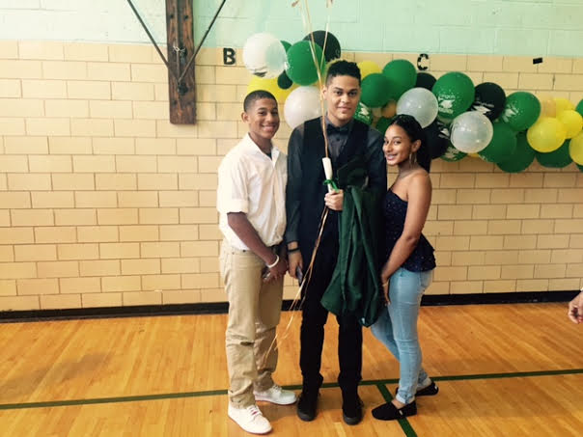

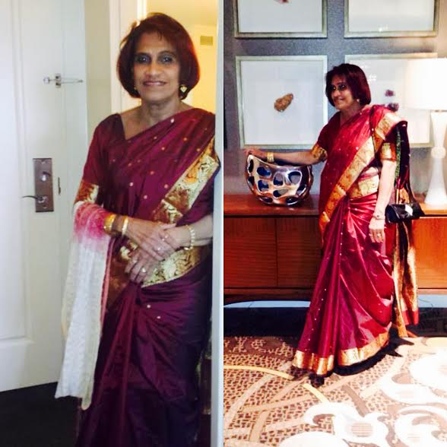
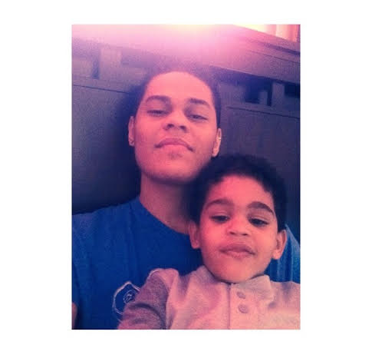
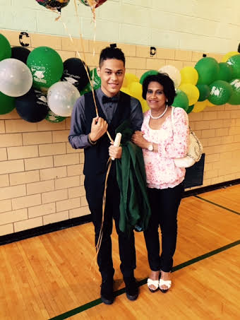
Who/what inspires you?
My Mom.
My nieces and nephews.
Seeing people succeed and making it in their lives.
Making new friends along the way.

Slide 4
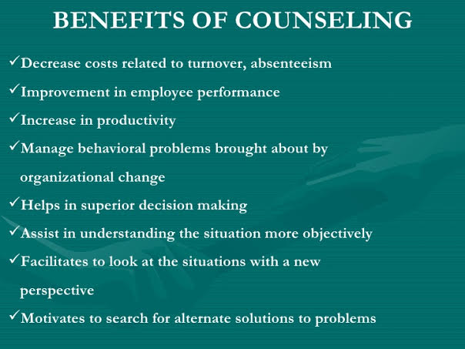

Slide 5


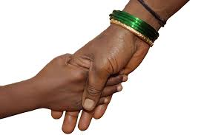

Images That Symbolize My Career

Slide 6
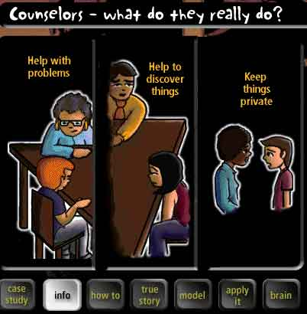
What I Plan To Achieve In:

Slide 7

Obstacles That Might Prevent Me From Pursuing Counseling:
My low salary.
The location of where the jobs are.
The number of available jobs.
My shy, withdrawn personality.
Taking risks.
Selfishness.

