Slide 1
Living Lab
Seminar Project at CITY TECH
Engineering Drawing IND1112 Course objective:
Learn how to use Engineering drafting AutoCAD as a drawing tool.
understand the basics of orthographic projection theory to gain proficiency in creating the orthographic views, and use the concept to describe an object.
be able to describe with accuracy and time limit the object shape using AutoCAD as a tool of communication.
Assignment

Slide 2
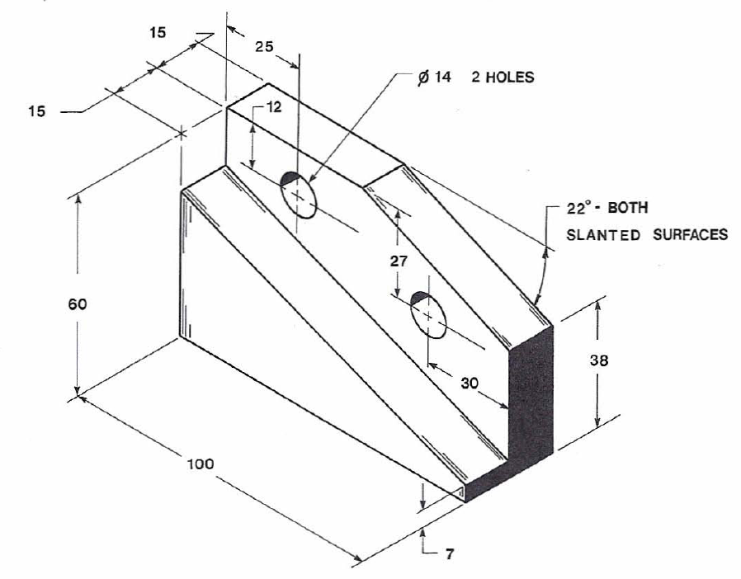
Living Lab
Seminar Project at CITY TECH
Assignment: describe a shape of an object using three orthographic views (Top view, Front view and right side view)
Task: communicate the shape
Tool “Language”: AutoCAD
Skills: observation and scientific reasoning.

Slide 3
Living Lab how HIEPs, Gen Ed, The Open Lab and Assessment will be included in IND1112
General Education Student Learning Outcomes into IND1112: knowledge and skills
Understand the use of communication tool,
Develop observation skills and use scientific reasoning.
Appreciate the relationship of academic discipline to the professional applications: the student can create an object by drawing it, then manufacturing (making) it at the lab (Place-Based learning) High-Impact Educational Practice into IND1112
Use these skills to innovate: be a designer!
OpenLab into IND1112: used for interactions and discussions.
Assessment: use the notion of engineering drafting as a “language” for engineering designers to communicate their idea. This will attract students to the academic discipline.

