Slide 1

C.R.A.A.P 1.0
Freshman Edition
By Elfatih and Steeve

Slide 2
Things To Keep in Mind When Evaluating Sources in the Game
Currency: most recent information.
Relevancy: does it relate to your topic.
Authority: who is responsible for writing it? Are they qualified?
Accuracy: judge the "reliability, truthfulness, and correctness of the informational content."
Purpose: why was this work created? Entertainment or to educate.

Slide 3
More Rules to remember when evaluating the sources.
You Must remember the importance of differentiating between non-fiction and fiction or fact and opinion when evaluating sources.
Websites that End with: edu, gov, us, uk and usually org are often trustworthy but you should still rely on your own judgment.
Notes:
Magazines: Certain mags. Are treated like newspapers sometimes. Although good for timely sources but they are not researched at the professional level
Journals: specialized mags written for and by professionals. A great source because they are often peer-reviewed by other experts in the field giving it major credibility.
Newspapers: Good for current events; sometimes maybe your only source.
Books: what would now be classified as old technology. Provides in-depth studies on 1 subject or sometimes multiple.
eBook: Same as a book but downloaded onto devices.

Slide 4
When evaluating a web Page think of the image below.
Author: Always consider who wrote/published the page and why?
Website: what organization is behind the site? ex: edu or gov
You: only you can judge the relevance of the site or its accuracy.

Slide 5
Start

Slide 6


LEVEL 1
Would this be a Good Source for a research paper on the evidence of evolution?
Yes
No
Rise of the Planet of the apes 2011 – Science Fiction Film.
HINT
Once pressed a timer will begin.

Slide 7
LEVEL 1
Would this be a Good Source for a research paper on evolution?
Yes
No
Rise of the Planet of the apes 2011 – Science Fiction Film.

Slide 8
Oh No!!
You seem to have run out of time.
Click the button below to try again.
Press

Slide 9
Good Job!!!!
All Though it was a good movie, the Rise of the Planet of the Apes would not serve as a good source for a Paper on evolution.

Slide 10
NO.
Remember this was a Science Fiction movie, the fiction part means liberties were taken when it came to the science part.

Slide 11
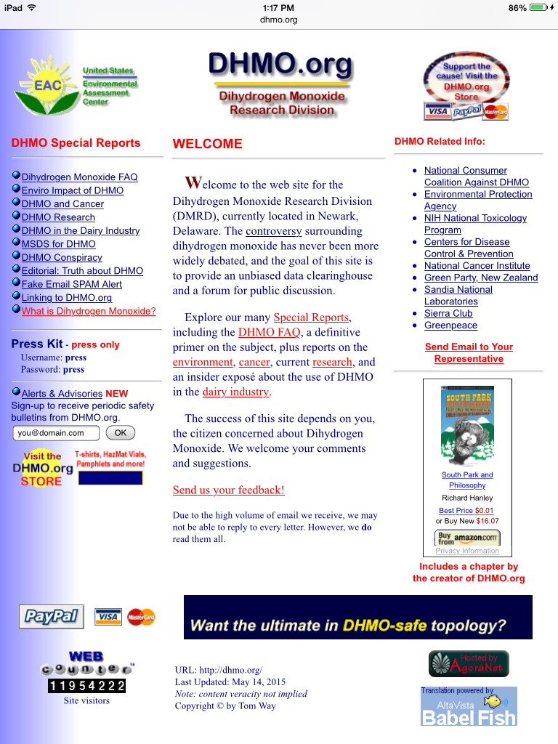
Level 2
Investigate this web source on Dihydrogen Monoxide.
Feel free to go to the webpage for a better look:
DHMO.ORG (remember to apply the CRAAP test as you are investigating.)
If you are stumped hit the fact checker button for some clues
Fact Checker

Slide 12
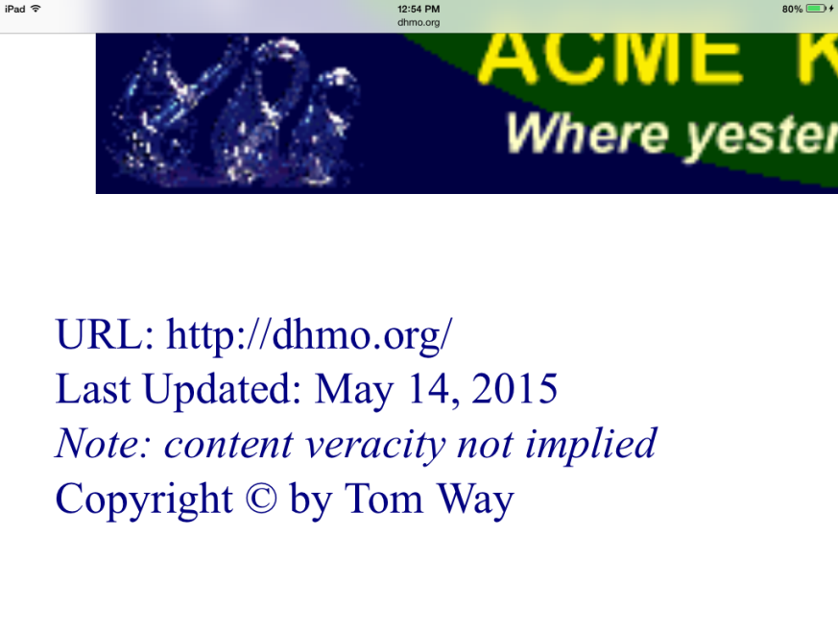

1
Level 2
After your investigation, how trustworthy did you find the webpage to be?
Very trustworthy.
2
Not trustworthy.
Dihydrogen Monoxide is H20 (Water)

Slide 13
Are You Sure?
Take another Look at the webpage and the clues that were provided for you.

Slide 14
Good job with your evaluation!!!
The DHMO web page is a hoax web site that was created by Tom Way To tell people about the “supposed dangers of Dihydrogen Monoxide”.

Slide 15

Thank you for playing this demo, the actual game is still under development.

