Slide 1
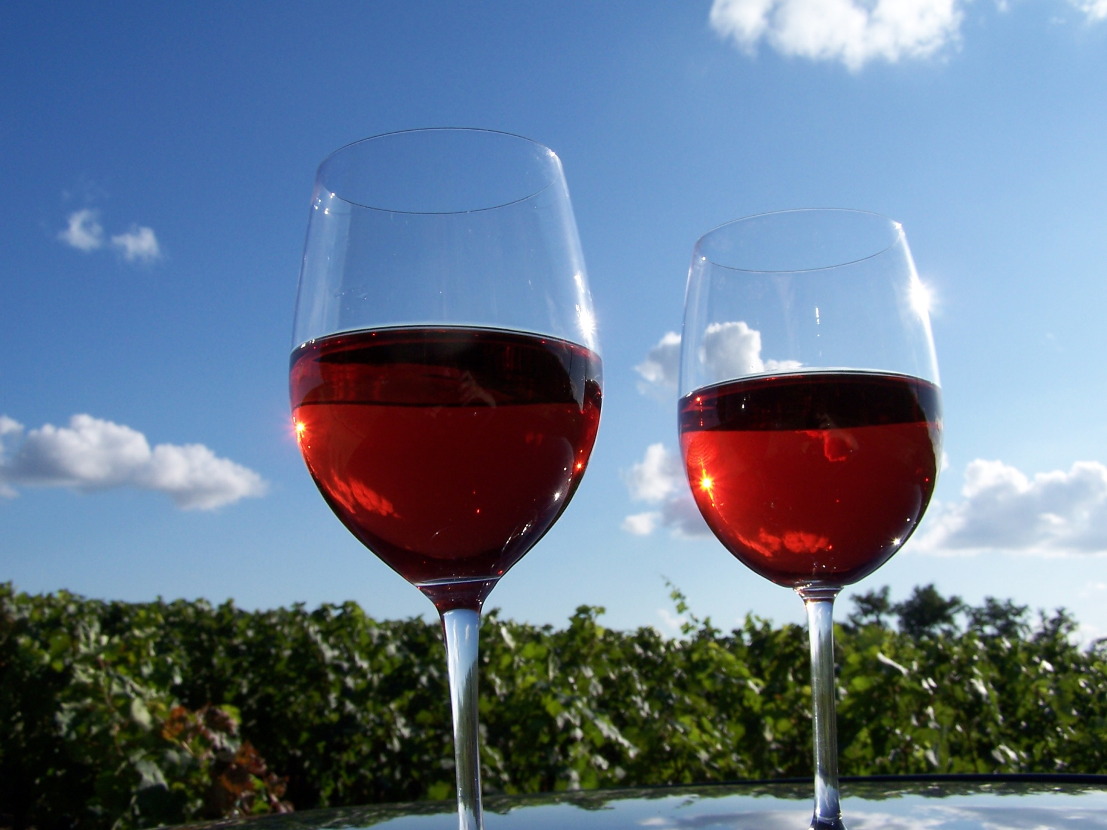
HMGT 2402
Wine & Beverage
Management
Prof. Karen Goodlad
Red Wines of France Fall 2012

Slide 2
European Union Wine Regulations
Protected Designation of Origin (PDO)
  Produced from grapes grown in the specific territory listed on the label
  Names are registered
  Delimited boundaries
  Defined Viticulture practices
    Max. yields, permitted grape varieties…
  Defined Vinification practices
  Defined wine characteristics
  Can be identified by the traditional terms of the country
  Typically do not include grape variety on label
Protected Geographical Indication (PGI)
  85% of grapes come from a registered geographical region
  Viticulture and Vinification are defined but less strict than PDO
  Grapes listed on the label will be listed in descending order.
  May list grape variety on label
Wine/Table Wine
  Least strict

Slide 3
French Wine Regulations
European Union Influence
  Protected Designation of Origin (PDO)
  Regulate the following
    Grape varieties
    Maximum yield
    Row spacing, vine training, trellising…
    Minimum ripeness/date of harvest
    Typicity
  Protected Geographical Indication (PGI)
    Vin de Pays

Slide 4
Appellation Contrôlée
Appellation Protégée
“Controlled Place-Name of Origin”
High Demand + Constant Supply
= Fraud
1935 – Institut National des Appellations d’Origine des Vins et Eauz-de-Vie (INAO)
2010 EU Laws
  “Protected Naming of Origin”
Notes:
Fraud: 1991 Champagne, 1923 Chateauneuf-du-Pape, Negociants,
1935 – Legally defined appellation boundaries
2010 – changes affected by European Union regulations for foods associated with places

Slide 5
Appellation Contrôlée
Appellation Protégée
Appellation d’Origine Contrôlée (AOC)
Protected Designation of Origin (PDO)
Vin de Pays
Protected Geographical Indication (PGI)
Vin de Table Wine
~ 55%
~ 35%
~ 10%
Notes:
AOC (AOP)-- 100% from the appellation (region, district, village, vineyard),
--minimum sugar level, --defined viticulture methods (pruning, training)
-- minimum alc. level --designated maximum yields,
-- bottled with in appellation --taste by INAO --viniculture methods
Vin de Pays (IGP)– 152 regions and zonesmore freedom, changes for international sales…chard, cab, merlot viognier, syrah, defined regions, tasting panels, 85% of varietal on label say (IGP)
Vin de Table (Vin) – distilled into spirits, no regulations beyond health codes

Slide 6
Major Wine Regions of France
White Wines
Red Wines
Bordeaux
Burgundy
Alsace
Loire Valley
Minimal White:
The Rhone Valley
Bordeaux
Burgundy
Beaujolais
The Rhone Valley
The South
Minimal Red:
Alsace
Loire Valley
Notes:
Bordeaux: Cabernet Sauvignong, Merlot, Cab Franc (petit verdot (haute medoc), malbec and carmenere (almost none)
Burgundy: Pinot Noir
Beaujolais: Gamay
Rhone: Syrah, Grenache,

Slide 7
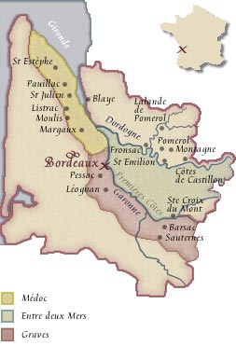
Bordeaux
Medoc & Haut Medoc
  Saint Estephe
  Pauillac
  Saint Julian
  Moulis
  Listrac
  Margaux
Grave
  Pessac-Leognan
Saint-Emilion
Fronsac
Pomerol
Notes:
It is autumn that makes the red wines of Bordeaux so great, the weather otherwise is very maritime with a lot of rain and generally uneven growing conditions.
Gravel contributes as well: Good drainage, good air circulation, concentrates heat
Following are the sub-appellations of the region
Medoc: Mouth of Gironde estuary south to city of Bordeaux
“The best vineyards see the river”
St. Estephe: Most North of appellations Gravel, rocks, sand deep gravel clay
merlot, softer tannins that in past, richer fruit, all are dark, earthy/oaky, cassis
Paulliac: iron rich gravel over clay and limestone…good drainage 3 of five premier cru, mostly cabernet, then merlot, cab franc, petit verdot
St. Julien: gravel soil, layers of clay and limestone, Cab Sauv., Merlot, Cab Franc,
Margaux: Gravelly soil, pebble, sand, limestone
Graves: South east of Bordeaux city, Fine red wines
Pessac-Leognan: All Grave Classification are here
gravely rolling hills, big wines, mineral, floral, smote, red fruit
St. Emillion: very respected region, only reds, bordered by Dordogne and Isle Rivers
all about the limestone
Pomeral: full smooth wines with ripe fruit merlot, then cab franccan be drunk young due to merlot

Slide 8
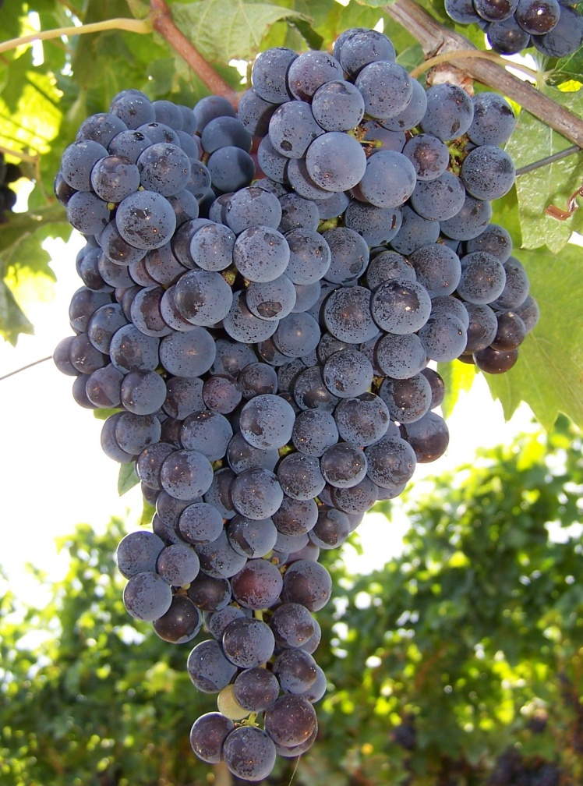
Classification of the Bordeaux Cru
Medoc Classification of 1855 (revised 1973)
  Premiers Crus
  Deuxiemes Crus
  Troisiemes Crus
  Quatriemes Crus
  Cizuimes Crus
Notes:
Paris Exposition Universaelle – All the best that France had to offer.

Slide 9
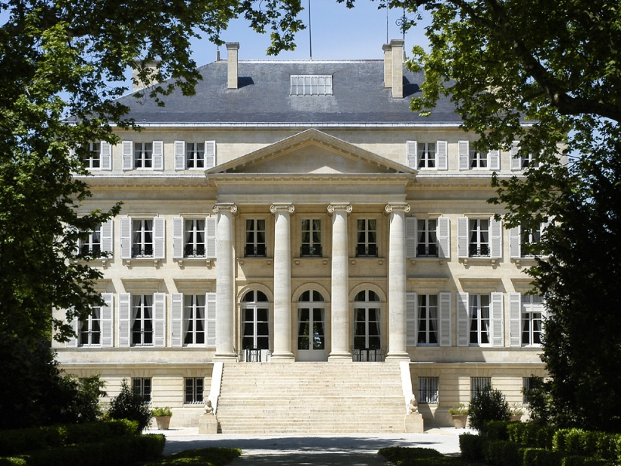
Premiers Crus
Chateau Lafite-Rothschild (Pauillac)
Chateau Latour (Pauillac)
Chateau Margaux (Margaux)
Chateau Mouton Rothschild (Pauillac)
Chateau Haut-Brion (Graves)
Notes:
Mouton Rothschild, 1973
60 total chateaux + 1 graves

Slide 10
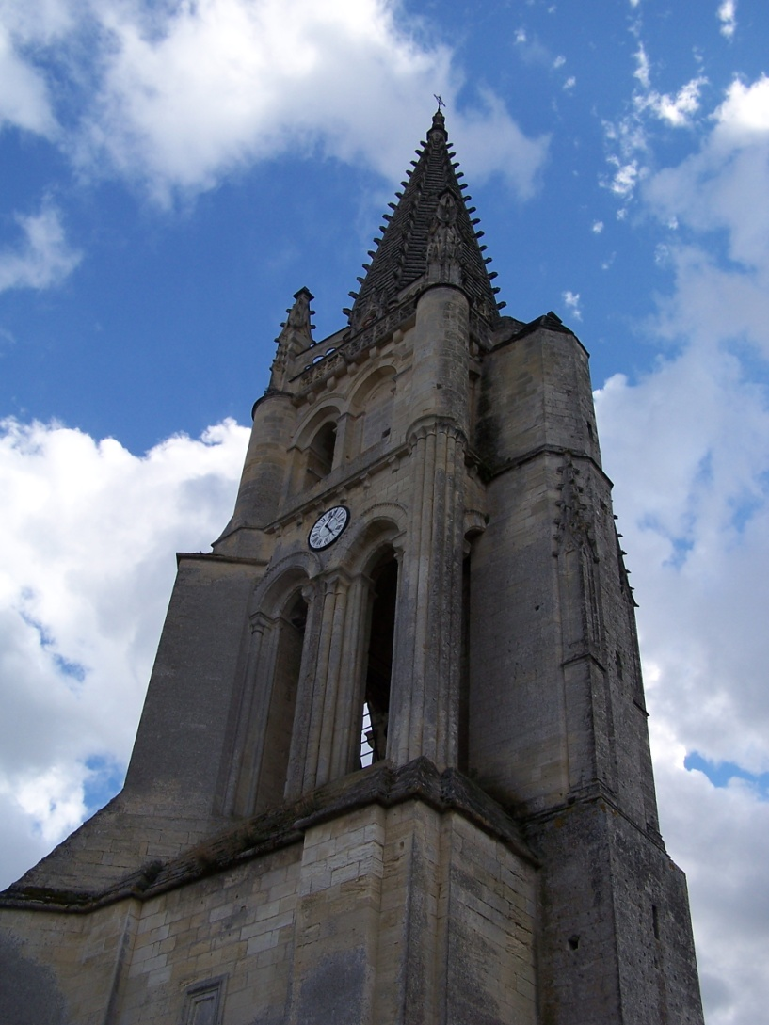
St. Emilion, Cru System 1958
Revised 2006,
currently suspended
Premier Grand Cru Classé, Class A
Premier Grand Cru Classé, Class B
Grand Cru Classé
Grand Cru**

Slide 11
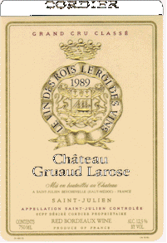
The Bordeaux Wine Label

Slide 12
Burgundy
Côte d’Or, 9.7% of all production
  Côte de Nuits
  Côte de Beaune: Both Red and White
Côte Chalonnaise, 2.8% of all production
Chablis: White Wines, 9.7% of all production
Maconnais: Mostly White, 12.4% of all prod.
Beaujolais: 47% of production
Fro More Information: The NYTimes on Burgundy
Notes:
Burgundy, all Pinot Nior
Many Small Vineyards (at times 1/3 of an acres) (55,000 acres over 10 growers)
Negociant driven
Soil and Climate: many Micro Climates that help with wine definition.
some negotiants use wood, others do not.
AOC Levels: Regional (15 appelations), high elevations
Village name place on label, stricter regulations, lower yields, higher alc
Premier Crus single vineyard in Cote d’Or village name + vineyard name
Grand Crus (31 vineyards) name of vineyard only due to superior quality
Cote de Nuits: (north)
red berry/cherry flavors
Cote Chalonnaise

Slide 13
Burgundy
Côte de Nuits
  Pinot Noir, almost exclusively
  Limestone & Marl
  Aspect Highly Important
Côte de Beaune
  Pinot Noir, both red and white varietals do well
  Limestone
  Aspect Highly Important

Slide 14
Burgundy, Cru System
Grands Crus
Premiers Crus
Communes
Village AOC
30 vineyards, all in Côte d’Or
Near hill tops
All reds come from Nuits
Can age 20-30 years
Mid range of hills
Label includes vineyard name
More complex, more intence
Along low slopes & hill tops
All wine sourced from village
Lower yields, higher alc.
General large areas

Slide 15
Beaujolais
Larger that all areas in Burgundy
Climate is influenced by maritime, continental and Mediterranean conditions

Slide 16
Beaujolais
Beaujolais Crus
  Moulin-A-Vent, St. Amour, Julienas, Chenas, Fleurie, Cheroubles, Morgon, Regnie, Brouilly, Lyonnais
Beaujolais-Village
Beaujolais
Beaujolais Nouveau
  A marketing success story
Fro More Information: The NYTimes on Beaujolais
Notes:
Carbonic Maceration: fermentation of grape is due to pressure of top grapes
Pruning Technique: Goblet = 12 buds per plant aloud
Nouveau, Burgundian vinteners were strapped for $$ and had excess inventory after WWII, November 15 is release date of newly fermented and bottled wine, “Must have” for many, quaffing wine

Slide 17
The Rhône Valley/North
Climate
  Moderate rain, little fear of drought
  Moderate to high heat
Soil
  Granite sand
Notes:
Red Grape: Syrah only
87% of the Rhone Valley AOC wines are red wines
Rosés make up another 9%
whites 4% of total production.
As for the regional Côtes du Rhône appellation, 95% of the wines produced are red, and for Villages the figure goes up to 99%.

Slide 18
The Rhône Valley/North
Chateau Grillet
Cote Rôtie
Condrieu
Hermitage & Crozes-Hermitage
Saint-Joseph
Cornas
Notes:
Red Grape: Syrah only
87% of the Rhone Valley AOC wines are red wines
Rosés make up another 9%
whites 4% of total production.
As for the regional Côtes du Rhône appellation, 95% of the wines produced are red, and for Villages the figure goes up to 99%.

Slide 19
The Rhône Valley/South
Climate
  Dry, April –September
  Some severe storms
  Subject to drought
  Intense wind
Soil
  Clay with sand sandstone pebbles creates local terroir that add to differing tastes
Notes:
Grape: More 23 allowed grape varietals
Dominate varietals
Grenache
Syrah
Mourvedre are

Slide 20
The Rhône Valley/South
Gigondas
Chateauneuf-du-Pape
Lirac and Tavel
Notes:
Grape: More 23 allowed grape varietals
Dominate varietals
Grenache
Syrah
Mourvedre are

Slide 21
Loire Valley
Touraine: Gamay (60%), Cabernet Franc for a Rosé
Upper Loire: Pinot Noir, Gamay
  Only 25% of production is red

Slide 22
The South
Provence
Languedoc & Roussillon

Slide 23
Next Week
Champagne and Sparkling Wine Lecture

