Slide 1
Perspectives in
Hospitality Management
Prof. Karen Goodlad
Fall 2012
Introduction

Slide 2
Introduction
Prof. Bio
Student Introductions
Syllabus Review
Tour of Department
Lecture
OpenLab

Slide 3

So What is Hospitality?

Slide 4
“It's how you make your customers feel while using your products that distinguishes you.” Danny Meyer
At The Ritz-Carlton, hospitality is about providing legendary service to our guests, members and residents while embracing the culture that is The Ritz-Carlton.
"Food is our common ground, a universal experience." James Beard

Slide 5
Specific Areas we will Explore
Tourism
Hotels and Lodging
Food and Beverage
  Restaurants, Food Service, Various Beverage Options
Accounting
Human Resources
Marketing
Event & Conference Planning
Recreation and Theme Parks

Slide 6
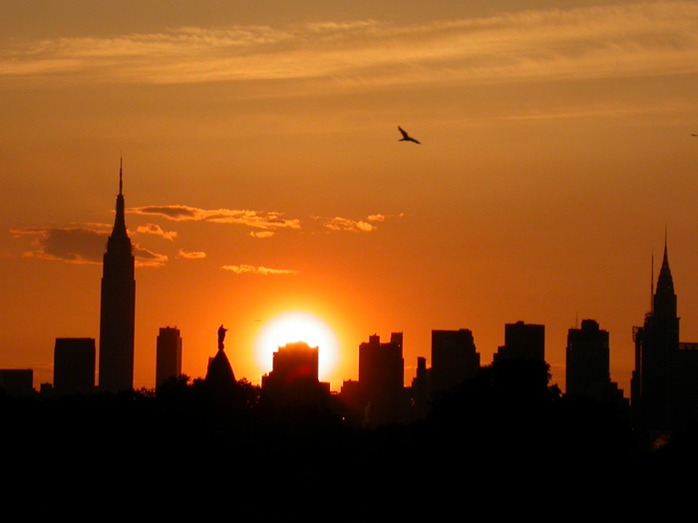
Exploring Your World:
A Moment of Truth

Slide 7
OpenLab
Our electronic classroom
Review and submit assignments
Ask questions
Start blogs
Find club information
Learn about other courses at City Tech
Chat with classmates and others on OpenLab

Slide 8
OpenLab Today
Log on and create Site
Link to HMGT1101, HMGT1102, ENG1101
Begin Electronic Profile assignment
  Due before class on Tuesday, September 6
Explore site
  Blogging, commenting, assignment submissions, editing, connecting with classmates

Slide 9
Before We Meet Again…
Read NYTimes Travel Section
Read Chapters 1 & 2, Introduction to Hospitality and answer “Review Questions # 3, 4, & 6
Register for a City Tech Email Address
Explore OpenLab

