Slide 1
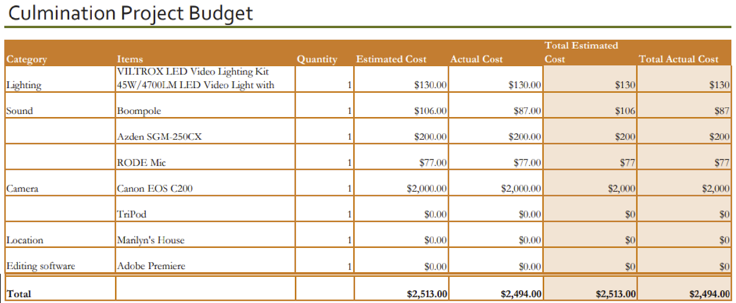
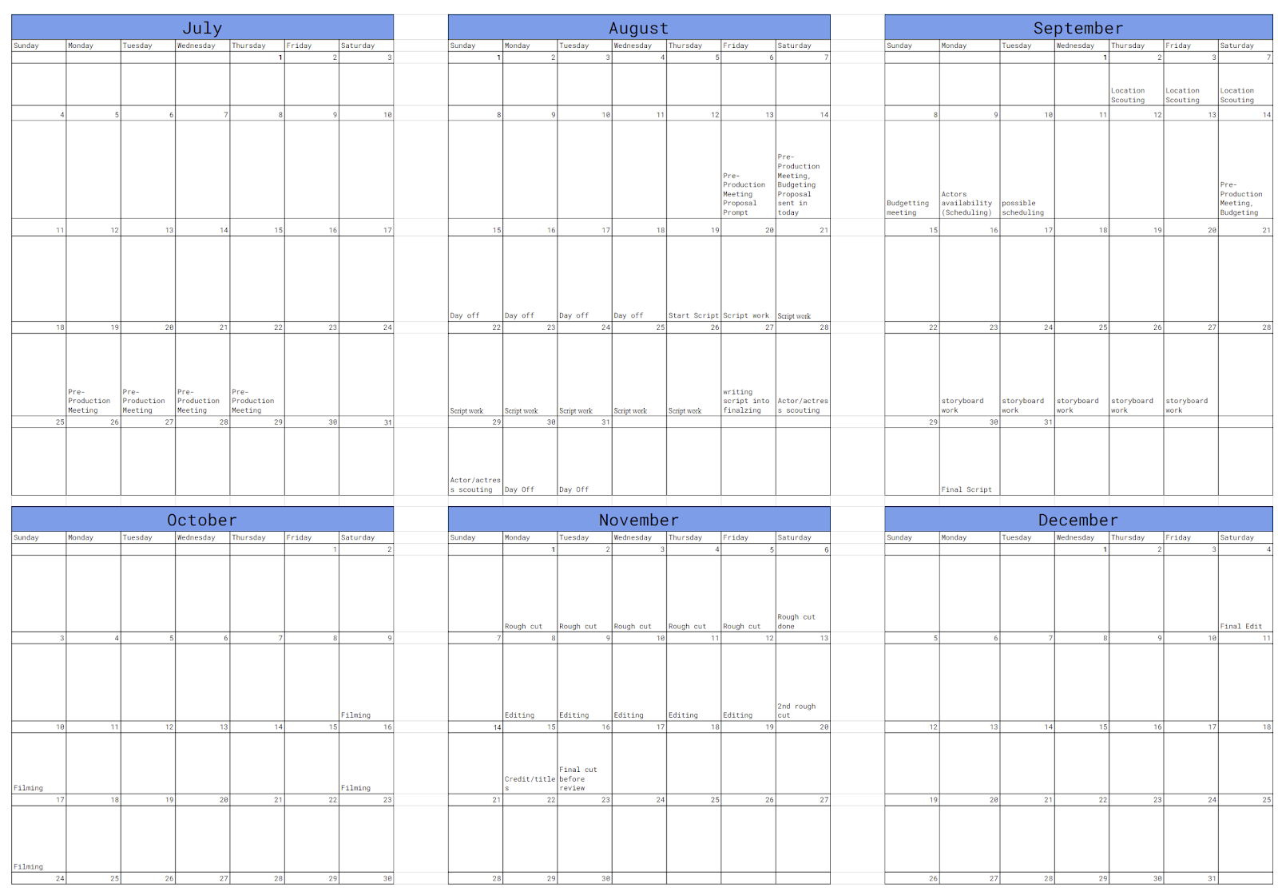
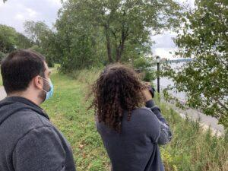
abuela Zakareia Masboob Department of Entertainment Technology
Introduction
In our project we created a short film about a character named Sam. It delves into the battles of loosing someone you love. The film ended up being around 15-16 minutes, and it really pushed our group to make something that was worth while.
The skills include
Camera work
Leadership
Script Writing
Boom Mic Work
The Process
As the director, I had to make sure that the scenes were adequately done. I had to make sure the actors knew what they were doing and know how the scene was going to play out. I also had to tell the Videographer Jorge and lighting designer Yamil Gil what kind of shot I wanted. I also had to work with Aaron Li, who was editing the film. I oversaw the edit and told him to change stuff up and give him my general thought on the edit.
Conclusion
As the finished project roles out, I hope everyone that worked on it is happy with what they have done. Even though there was some shortcomings we still tried and pushed forward with the project. Working on this project has made me a better director, and I hope to continue to push forward with more short films.
Results
1. Showcase project in portfolio.
2. Release the film so People can see
Hypothesis
How are the scenes going to be shot?
What equipment do we use?
Are there going to be props?
What day should we shoot?
Materials:
Canon c200 With 18-35mm lens.
Tripod
Mic
Boom Pole
Acknowledgements:
1.Professor Ryoya
2. Jorge Peralta
3. Yamil Gil
4. Aaron Li

