Slide 1
Early Habits For A Brighter Smile
BY: Yi Yi, Hassan, Yahya, Kenny and Yujing

Slide 4
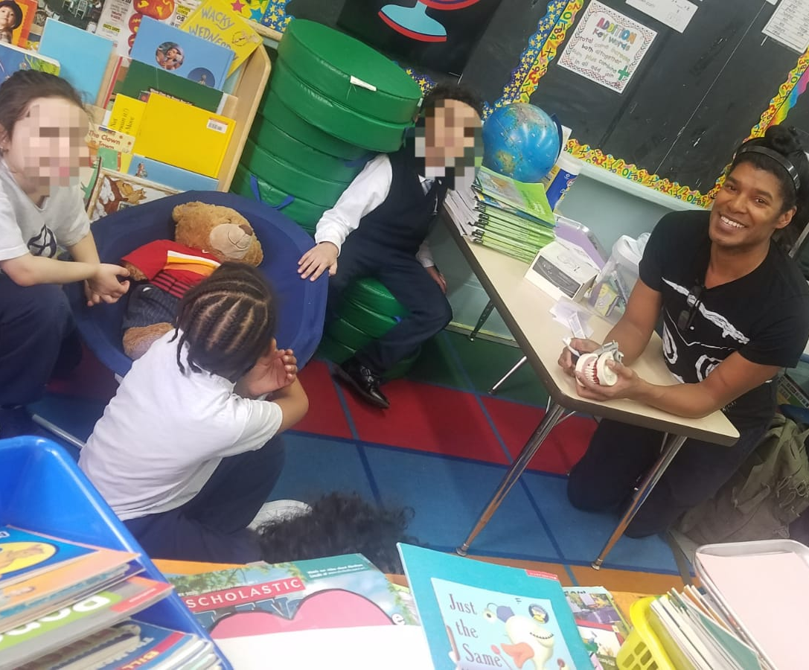

Slide 9
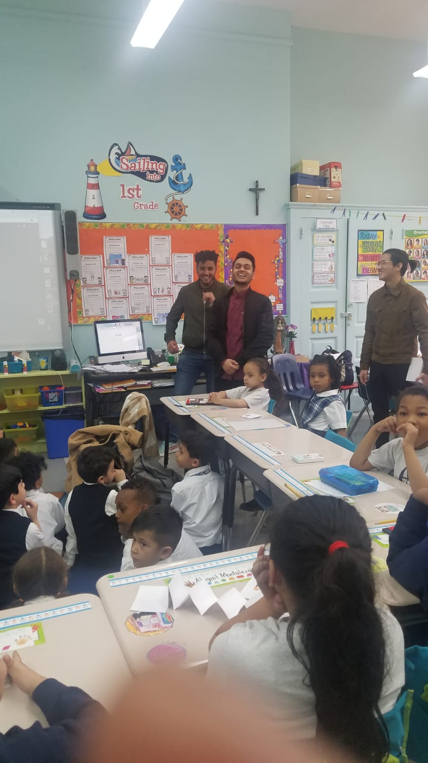

Slide 11
Blessed Them With Knowledge And Gifts

Slide 12
How To Brush Your Teeth Properly- For Kids
https://www.youtube.com/watch?v=hDZXSMU2lAk 0:00-1:52

