Slide 1
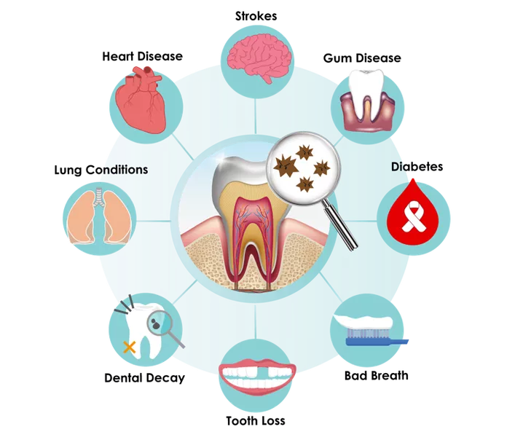
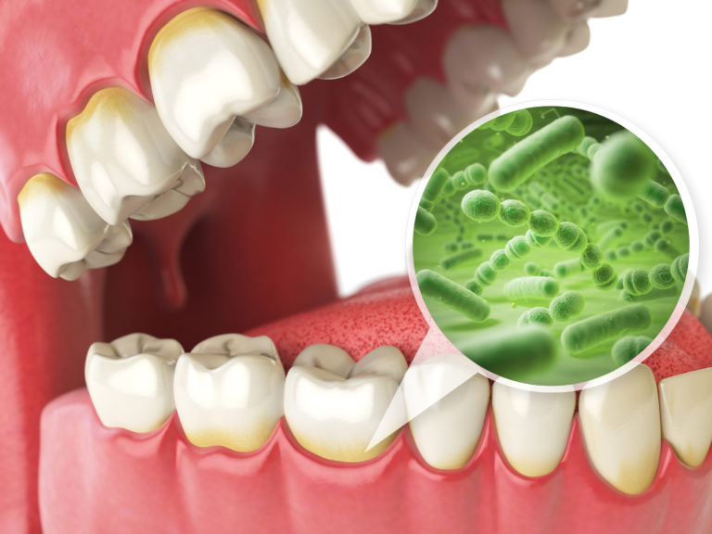
Your mouth, the gateway to your body
Many research studies find that the our oral micro biome is linked to our general health
It is also be linked to various systemic diseases.
They claim that it is important to keep a healthy balance of microbes in our gut and oral cavity for our general health benefit.

Slide 2
What are probiotics ?
Probiotics are living microorganisms, principally bacteria, that are safe for human consumption and, when ingested in sufficient quantities, have beneficial effects on human health, beyond basic nutrition. This definition has been approved by the United Nations Food and Agriculture Organization (FAO) and the World Health Organization (WHO).4
Probiotics primarily work in our gut flora (the symbiotic bacteria occurring naturally in the intestine). Probiotics can be found in the foods we eat or in supplements.
Within the past decade, researchers have studied probiotics as a potential oral health medicine.
Oral probiotics are specific beneficial bacteria used to maintain oral health as a defense against bacteria known to be harmful to teeth and gums.
Probiotics administered orally may benefit oral health by preventing the growth of harmful micro biota.
Probiotic therapy is being considered for application in oral health due to the emergence of antibiotic-resistant bacteria.
Probiotics in oral health is still a new area of research and only a few clinical studies have been conducted. In research studies, Oral probiotics where used in the form of a chewing gum, mouth rinse, or dentifrice.

Slide 3
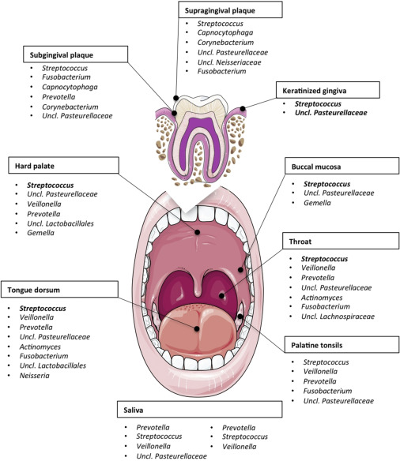
The oral microbiome
What is the oral microbiome?
The oral mircobiome are Microorganisms found in the oral cavity.
Did you know that our mouth contains over 700 species of bacteria?
Microbes are a part of our everyday life. Our body contains both good and bad bacteria.
Dysbiosis – microbial imbalance.
The human oral cavity contains a number of different habitats, including the teeth, gingival sulcus, tongue, cheeks, hard and soft palates, and tonsils, which are colonized by bacteria.

Slide 4
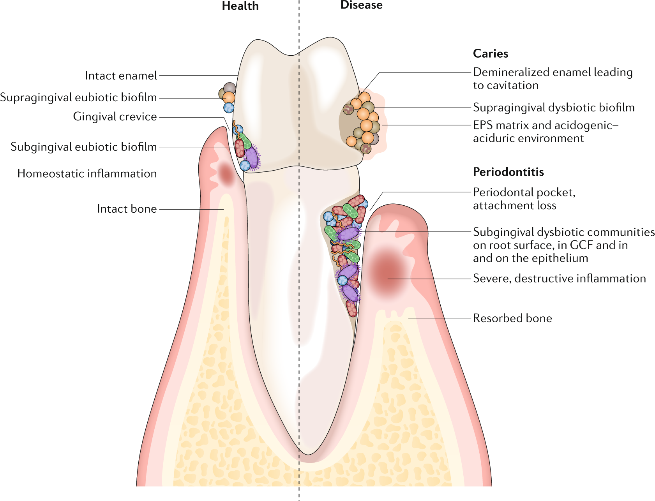
Bacteria and it’s relationship to Gum disease and caries
Biofilm is a surface of film that contains microorganisms and other biological substance.
Plaque is more visible, increased structural amount of biofilm.
Microbial biofilm plays a major role in the initiation and progression of both dental caries and periodontal infection.

Slide 5
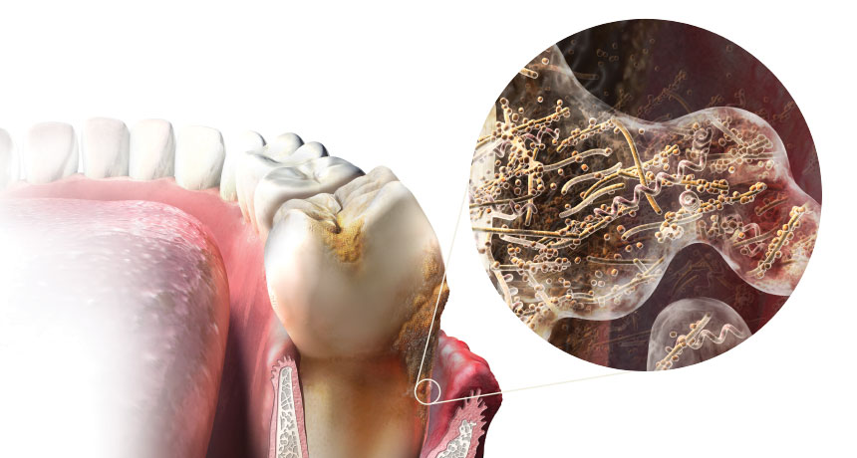

Slide 6
Gum Disease
Early stages of gum disease can indicate an increase/imbalance amount of bacterial population, primarily due to poor oral hygiene. Porphyromonas gingivalis is a Gram-negative oral anaerobe that is involved in the pathogenesis of periodontitis, an inflammatory disease that destroys the tissues supporting the tooth, eventually leading to tooth loss.

Slide 7
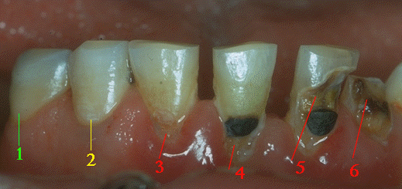
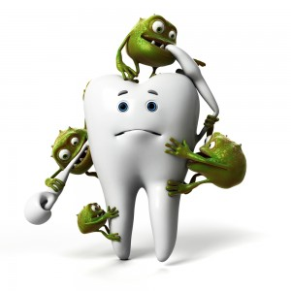
Dental Caries?
Dental Caries is a disease in which minerals of the tooth are dissolved by surrounding bacterial plaque and saliva.
A caries process going on for some time may result in a carious lesion.
If the process is not halted, the enamel surface becomes compromised, resulting in a cavity.
based on many studies, Streptococcus mutants IN SALIVA has been known as a leading CAUSE OF CARIES.³
1- A tooth surface without caries.
2- A small white spot has been formed (initial/incipient caries), indicating the first sign of demineralization. It is not yet a cavity; the surface is still intact and not considered decayed, according to WHO (World Health Organization) criteria. With proper measures, the caries process can be halted here and even reversed.
3- The enamel surface has broken down, resulting in a lesion with a soft floor. It is now considered a cavity.
4- A filling has been made, but demineralization has not been stopped and the lesion is surrounding the filling. Sometimes called secondary caries, but is usually the same disease process.
5- The tooth is both filled and decayed.
6- Demineralization undermines the tooth.
https://www.mah.se/fakulteter-och-omraden/Odontologiska-fakulteten/Avdelning-och-kansli/Cariologi/Cariology/What-is-dental-caries/

Slide 8
Properties of the probiotic
Probiotics have specific properties that can be beneficial when intending to being used for disorders of the mouth.
Although only a few clinical studies have been conducted so far, the results to date suggest that probiotics could be useful in preventing and treating oral infections.
Probiotics have potential in the management of multifactorial diseases such as the periodontal diseases and caries, by more effectively addressing the host-microbial interface to restore homeostasis that may not be achieved with conventional treatments.

Slide 9
Bacteria and its relationship to our Gut health
Oral health and gut health are closely related.
Did you know that The first signs of digestive disease can be seen in the mouth.? For instance
swollen tongue
yeast infection
Ulcers which can be signs of a vitamin deficiency or immune imbalance.
Probiotics help fuel cells of the gut lining, which acts as a protective barrier against harmful bacteria. ⁵

Slide 10
Benefits and research findings of Probiotics
Although there is still much research going on about oral probiotics, some clinical studies have shown that:
Probiotic strains including Bifidobacterium lactis, Lactobacillus acidophilus, and Lactobacillus paracasei have been observed to inhibit cariogenic S. Mutans.^{3,4}
One research claims that Oral probiotic rinse; Sporlac Plus ® Satchets (a probiotic formulation containing Lactobacillus acidophilus, Lactobacillus rhamnosus, Lactobacillus sporogenes, Bifidobacterium longum, and Saccharomyces boulardii) is as efficient as chlorhexadine in the reduction of gum inflammation
Probiotic toothpaste and reducing plaque formation
Probiotic ice cream lowered levels of S.mutants (caries causing bacteria) for over 1 months consumption
There are also specific probiotics know to prevent and heal gum disease.
Research highlights that S. salivarius K12 has shown promising results in treatment of halitosis
Prolonged administration or the repeated application of probiotics may be needed to maintain the desired BENEFIT OF PROBIOTICS IN THE ORAL ENVIRONMENT.⁴
More research study is still needed to evaluate the long-term effect of probiotics and the role of specific strains. The selection of the ‘best’ probiotic for oral health is also a controversial issue.
In the meantime, it is important to maintain a diet with probiotic containing foods to get the benefits of a balanced micro biome. The most effective method of daily plaque removal is by mechanical removal by tooth brushing.
http://www.healthygutbugs.com/bacterial-infections-cause-tooth-decay-and-cavities/

Slide 11
Oral Probiotics in Dentistry

Slide 12
Reduce Plaque Accumulation. Research has proved that toothpaste such as PerioBiotic, which contain Lactobacillus paracasei, help reduce the extent of plaque regrowth upon usage by disrupting the activities of Streptococcus mutans.
Reduce Gum Inflammation From Disease. Research has showing that mouth rinse containing probiotics has similar benefits to Chlorhexidine mouth rinse in which it can decrease the gum inflammatory associated with gum disease without the risks (tooth staining, dry mouth, decrease taste sensation, mouth irritation, unpleasant taste).
Fights Bad Breath. Research has suggest consumption of the mouth rinse containing Streptococcus salivarius K12 significantly reduces halitosis in 85% of people by reducing the bacteria in the oral cavity that causes malodor.
Manage Symptoms of Gingivitis. Research has concluded that probiotics are able to manage symptoms of gingivitis such as tenderness/swelling of gums, bleeding and redness of gum.

Slide 13
Dentifrices: With more and more research and studies supporting the benefits of probiotics in the oral cavity, we start to incorporate them in our toothpaste and mouth rinse allowing it to be more available and easier to use.
Breastfeeding: Research has found probiotics to be available in the breast milk which is essential for the newborn guts.
Diet: Many food contain probiotics with Milk and yogurt being the best source. There’s also Kefir, pickles, Kombucha, some cheese, buttermilk.
Supplements: Online

Slide 14
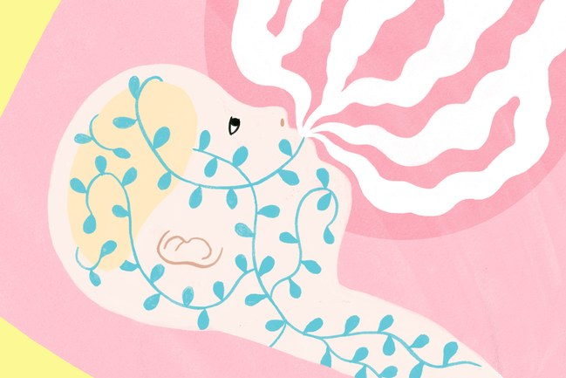
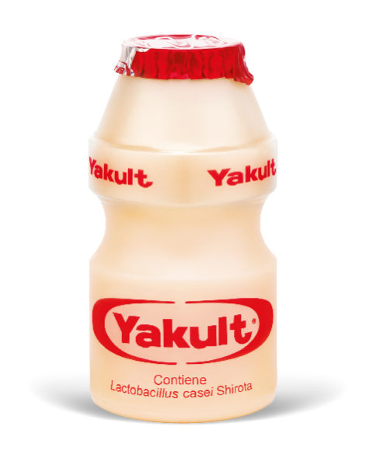
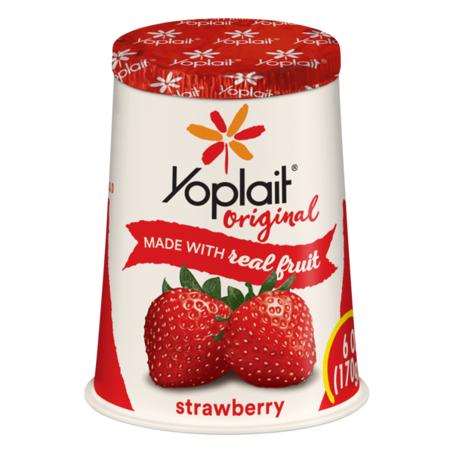
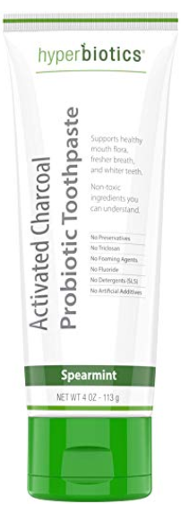
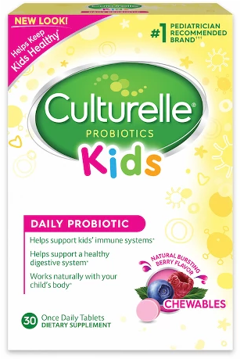
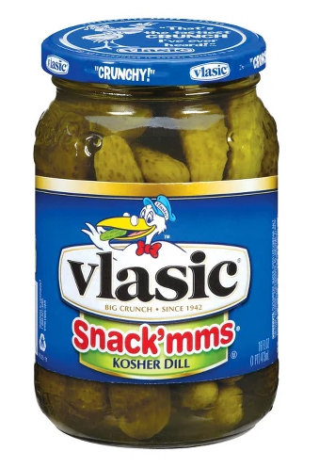
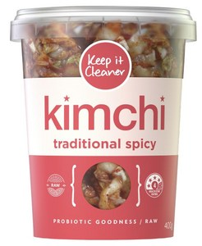
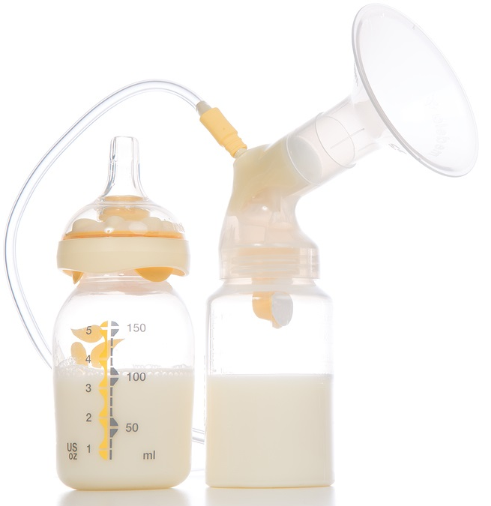
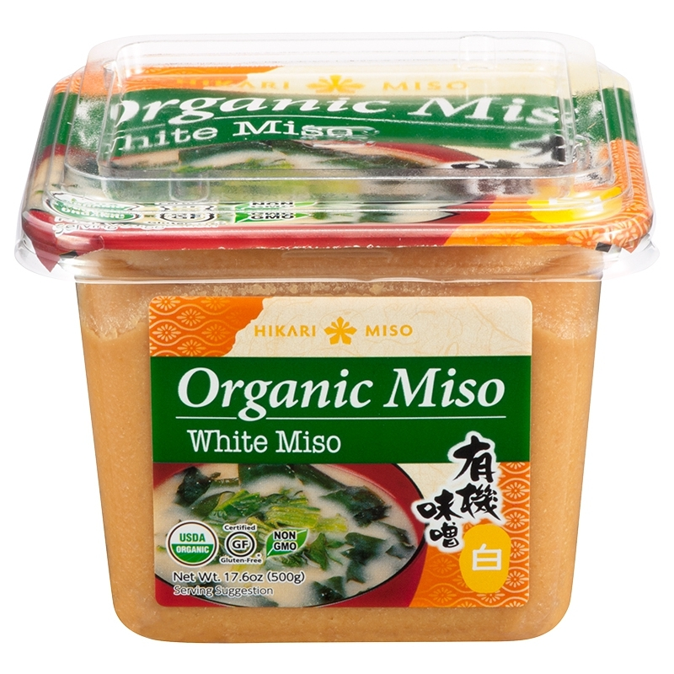
Ways to incorporate probiotics
BREAST MILK
FOODS
DENTRIFICES
SUPPLEMENTATION
https://www.newyorker.com/tech/annals-of-technology/breast-feeding-the-microbiome
https://www.culturelle.com/products/kids/probiotic-chewables
https://www.humnutrition.com/product/6/gut-instinct
https://www.hyperbiotics.com/products/activated-charcoal-probiotic-toothpaste
http://www.medcare.ae/moms/2016/

Slide 15
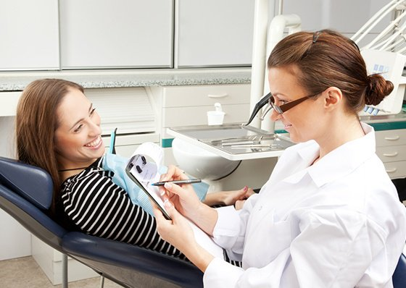
Role of the dental hygienist
Thorough medical and dental history check
Periodontal assessments such as Plaque, Calculus, or Gingival index scores.
Patient education and thorough oral hygiene instructions
Prevention and therapeutic service and maintenance
Dietary assessment
Nutritional counseling and diet log
Public health education
Evidence based practice

Slide 16
References
https://www.healthline.com/nutrition/11-super-healthy-probiotic-foods#section1
https://www.mah.se/fakulteter-och-omraden/Odontologiska-fakulteten/Avdelning-och-kansli/Cariologi/Cariology/What-is-dental-caries/
Mahantesha, T. R. (2015). Comparative Study of Probiotic Ice Cream and Probiotic Drink on Salivary Streptococcus mutans Levels in 6-12 Years Age Group Children. Journal of International Oral Health : JIOH, Vol.7(9), pp.47-50.
Teanpaisan, R., Piwat, S., Tianviwat, S., Sophatha, B., & Kampoo, T. (2015). Effect of Long-Term Consumption of SD1 on Reducing Mutans streptococci and Caries Risk: A Randomized Placebo-Controlled Trial. Dentistry Journal, 3(2), 43-54.
https://www.drstevenlin.com/how-your-gut-microbiome-link-to-a-healthy-mouth/
Mahantesha, T. R. (2015). Comparative Study of Probiotic Ice Cream and Probiotic Drink on Salivary Streptococcus mutans Levels in 6-12 Years Age Group Children. Journal of International Oral Health : JIOH, Vol.7(9), pp.47-50.
Nadkerny, P., Ravishankar, P., Pramod, V., Agarwal, L., & Bhandari, S. (2015). A comparative evaluation of the efficacy of probiotic and chlorhexidine mouthrinses on clinical inflammatory parameters of gingivitis: A randomized controlled clinical study. Journal of Indian Society of Periodontology, 19(6), 633. doi:10.4103/0972-124x.168491
Weinberg, M. A., Theile, C. M., Froum, S. J., Palat, M., & Schoor, R. (2014). Comprehensive periodontics for the dental hygienist. Upper Saddle River: Prentice Hall.
Gao, L., Xu, T., Huang, G., Jiang, S., Gu, Y., & Chen, F. (2018). Oral microbiomes: More and more importance in oral cavity and whole body. Protein & Cell, 9(5), 488-500. doi:10.1007/s13238-018-0548-1
Lin, S., Lin, S., & Lin, S. (n.d.). Probiotics and Your Oral Microbiome by Dr Steven Lin. Retrieved from https://www.drstevenlin.com/probiotics-oral-microbiome/
Granier, D. (2010). Probiotics and Oral Health. JCDA. Retrieved from https://www.cda-adc.ca/jcda/vol-75/issue-8/585.pdf.

