Slide 1
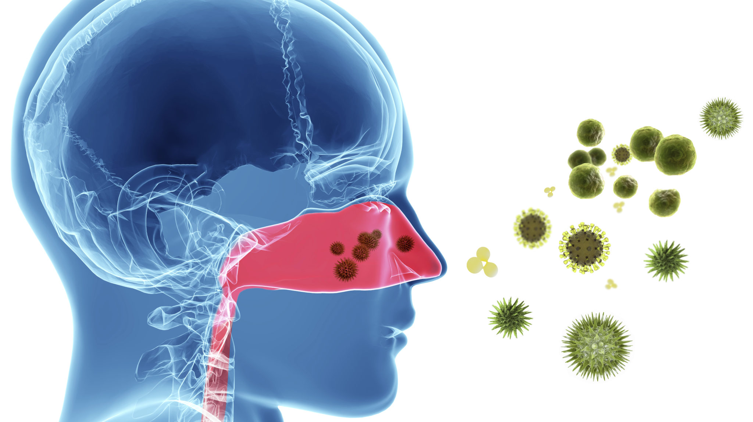
Prescription and OTC anti-allergy medications
Group 3
Saudia Majeed| Yahya Salim| Jashlie Sanchez| Yi Yi Chan
Image credit: Getty Images/iStockphoto

Slide 2
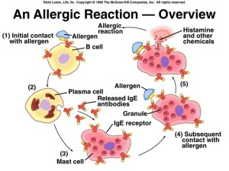
Allergies & The Body’s Defense
Allergies are one of the most chronic conditions affecting health.
Allergies are the result of the immune system’s response to a substance.
With an allergy, the immune system overreacts to an otherwise harmless substance and floods the body with chemicals such as histamine. The main function of these released chemicals is to trigger the body’s defense mechanism and to fight, protect and rid the body of these deemed harmful substances- the body's natural defense.
https://sofislife.com/science/the-science-of-mushroom-beta-glucan/beta-glucan-vs-allergies/

Slide 3
Allergy Symptoms & Management
With there being no injury or infection, essentially a false alarm, histamine and other chemicals released can trigger an array of adverse symptoms, including:
-itching - vomiting
-swelling -rashes
-sneezing -runny nose
-watery eyes -stomach aches
-nausea -vomiting
-swelling -congestion,
- Inflammation -difficulty breathing
-Severe symptoms of anaphylaxis- life threatening.
Allergy medications are used to combat and alleviate these effects because they are able to block (inhibit) the body’s inflammatory defense mechanism.
These medications are usually combination medication, examples include- antihistamines, decongestants, epinephrine and nasal steroids- corticosteroid.

Slide 4
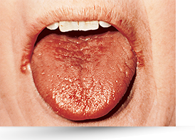
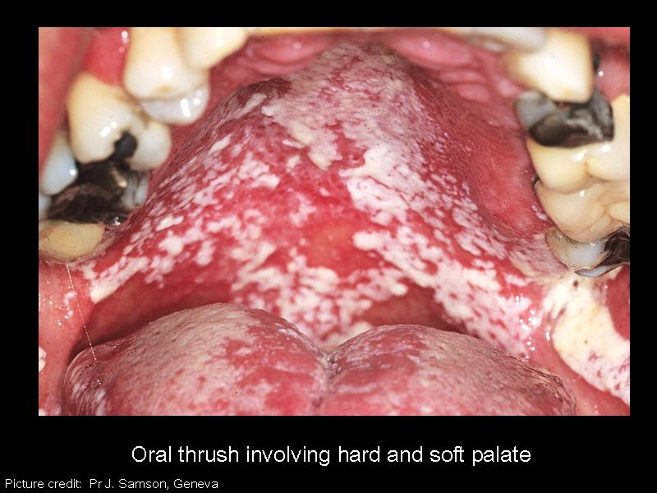
Anti-Allergy Medications Adverse effects
The anti-allergy medications, used to treat the allergy symptoms, aren’t without side effects themselves. Some include:
-Dry mouth, nose or throat
-Oral candidiasis
-Drowsiness
-Altered taste
-Headache
-Restlessness
-Dizziness

Slide 5
Role of Dental Professionals
It is important to know the medication patients take and their side effects, to allow the development of an effective treatment plan, tailored to individual needs, one with no contraindication to anti-allergy medications taken. Knowledge of these medications can help to explain certain side effects and to avoid misdiagnosis of symptoms presented, allowing for adjustment in treatment to ensure efficiency and most importantly- patients’ comfort.

Slide 6
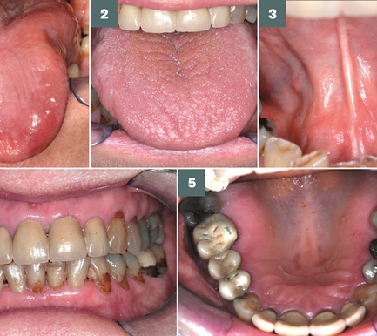
Role of Dental Professionals cont’d
A patient using antihistamines/decongestants can present with xerostomia. Treatment will exclude alcohol-based products. Dental hygiene home care education will include awareness to patients of their increased risk of dental caries and focus on how to avoid such adverse outcomes with proper oral care.
Some asthma patients that uses inhaled corticosteroids can present with oral candidiasis. This can open a conversation to request alternative medication if applicable.
Some anti-allergy medication can also make patients drowsy and are contraindicated in patients with high blood pressure, pregnant women, patients with cardiovascular disease, glaucoma or hyperthyroidism. Patients using anti-seizure and anti-depressants must take extra precautions with anti-allergy medications.
Epinephrine, asthma inhalers and other anti-allergy medications should be kept within easy access and dosages and knowledge of use should be known
Image :https://www.pharmaceutical-journal.com/learning/learning-article/dry-mouth-advice-and-management/20204481.article?firstPass=false |Courtesy, Anwar R Tappuni

Slide 7
Role of Dental Professionals cont’d
Allergies are the 6th leading cause of chronic illness in the U.S. More than 50 million Americans suffer from allergies each year.
As Dental professionals we are guaranteed to have patients suffering from allergies and being treated with anti-allergy medications.
It is important to have knowledge and awareness of allergies, anti-allergy medications and their side effects our patients use, to allow for the development of an effective treatment plan, tailored to individual needs, one without contraindications to anti-allergy medications taken. Knowledge of these medications allows us to be equipped in situations of emergencies, to have conversations with our patients about how these medications affect their oral health, allowing for adjustment in dental treatment to ensure efficiency and most importantly- patients’ comfort. Understanding of certain side effects avoids misdiagnosis of symptoms presented. This allows us to discuss possible alternatives in medicine treatment where applicable.

Slide 8
Antihistamine:
When exposed to an allergen, the immune system cells “mast cells” and “basophiles” are triggered, releasing Histamine and leukotrienes. Specifically H1R and H4R have been discovered to be of an important factors in allergic reactions. H1R is responsible for vasodilation, oedema, and itching and
H4R promotes accumulation of inflammatory cells.
Antihistamine drugs aren’t antagonist but
inverse agonists (producing opposite effect).

Slide 9
First Generation Antihistamine
Histamine producing neurons is an important neuromodulator in the human brain found in the tuberomammillary nucleus.
When released these neurons stimulate H₁-receptors in all of the major parts of the cerebrum, cerebellum, posterior pituitary, and spinal cord where they control major important body function including the increase arousal in the circadian sleep/wake cycle. Due to these drug’s poor receptor selectivity and ability to cross the BBB they interfere with histaminergic transmission causing daytime somnolence, sedation, drowsiness, fatigue, and impaired concentration and memory.

Slide 10
Second Generation Antihistamine
These drugs are major advance in antihistamine because of their minimal sedative or non sedative effect due to their limit on penetrating the BBB and having no anticholinergic effects because they’re highly selective for the histamine H₁-receptor.

Slide 11
Elimination
Not all H1-antihistamine drugs are eliminated similar.
Etirizine and Levocetirizine are not metabolized and are excreted primarily unchanged in the urine.
Desloratadine undergoes extensive metabolism in the liver (Increase drug-drug interactions).
Fexofenadine undergoes minimal (5%) metabolism in liver and is excreted 80% via feces and 10% urine. (potential for interactions with grapefruit juice)

Slide 12
Fire Line Therapy
Corticosteroid activity is mediated by intracellular activation of the glucocorticoid receptor (GR). By physically interacting with p65 the subunits of NF-kB, GR downregulates the production of cytokines and other inflammatory molecules.
Due to its affinity to binding to GR
receptors, Corticosteroid has shown to
be very potent and effective.

Slide 13
Types of Allergy Medication
Antihistamines: These medications are commonly used to treat allergies such as allergic rhinitis or sometimes urticaria (hives).
Immunomodulator Medications: These medications act by directly changing the behavior of the immune system. These are also known as biological medications.
Leukotriene Modifiers: These medications are used for relief of allergic rhinitis symptoms.
Nasal Sprays: various nasal sprays approved to treat allergic rhinitis and/or non-allergic rhinitis.
Eye Drops: medications available to treat allergic conjunctivitis (allergic eye).
Allergic Emergency Medications: These are the medications used to treat anaphylaxis.
Topical Ointments & Creams: topical medications used to treat conditions such as atopic dermatitis and eczema.
Treatment of Hereditary Angioedema: Replacement therapy or immune modulating medicines pertaining to hereditary angioedema (swelling of the skin).
Oral Corticosteroids: These medications are sometimes used to treat severe allergies and can also be used as a rescue medication for asthma.
Sublingual Immunotherapy (SLIT) Allergy Tablets: Allergy tablets are another form of allergy immunotherapy therapy and involves administering the allergens under the tongue generally on a daily basis.
Reference:
[1]Drug Guide: AAAAI. (n.d.). Retrieved from https://www.aaaai.org/conditions-and-treatments/drug-guide

Slide 14
Antihistamines
MOA- competitively block histamines from attaching to histamine receptors
H1- blocks histamines receptors that are located on nerves, smooth muscle, endothelium, glandular cells, and mast cells.
H2- blocks histamines receptors that are found in gastric acid producing parietal cells found in the stomach.
Histamine H1 antagonist (First generation antihistamines; sedating) include:
brompheniramine
chlorpheniramine (Chlor-Trimeton)
diphenhydramine (Benadryl)
doxylamine (found in many OTC sleep aids including Unisom)
carbinoxamine (Karbinal ER)
Histamine H2 antagonist (second generation antihistamines; non-sedating) include:
fexofenadine ( Allegra)
loratadine (Claritin)
loratidine OTC (Alavert, Tavist ND)
desloratadine (Clarinex)
certirizine (Zyrtec)
Major Adverse effects and reactions :
-CV: arrhythmias, hypertension, palpitations, tachycardia
-CNS: dizziness, sedation, nervousness
-GI: nausea, diarrhea , vomiting
-Other: weakness, tremor, dyspnea, polyuria.
Oral/Dental side effects :
-prolonged use may cause decreased salivary flow or xerostomia
OTC antihistamines
Reference:
[2] Ogbru, O. (n.d.). Oral Antihistamines: Side Effects for Allergy Drugs. Retrieved from https://www.medicinenet.com/antihistamines-oral/article.htm
[3](n.d.). Retrieved from https://www.aocd.org/page/Antihistamines
[4] Wynn, R. L., Meiller, T. F., & Crossley, H. L. (2016). Drug information handbook for dentistry: Including oral medicine for medically-compromised patients & specific oral conditions. Hudson, OH: Lexicomp.

Slide 15
Immunomodulators: MOA- inhibits IgE (antibody) binding to the IgE receptor on mast cells ➔ reduced allergic response.
Immunomoducalors Drug :
dipulumab ( Dupixent) – TX for ezcema/dermatitis injection
Omalizumab (Xolair) - TX for urticaria
Major Adverse effects and reactions :
-CV: pulmonary embolism, venouse thrmobosis, myocardial infarction, unstable angina pectoris
-CNS: dizziness, pain, fatigue
-Other: dermatitis, leg pain, arm pain, alopecia,
Oral/Dental side effects :
- Non significant
Leukotrine Modifiers: MOA- leukotriene(inflammatory mediators ) receptor antagonist; selective leukotriene receptor inhibition.
Leukotriene Modifier Drug:
montelukast ( Singulair) – TX for seasonal allergic rhinitis
Major Adverse effects and reactions :
-CV: headache
-CNS: dizziness, fatigue, fever,
-Other: weakness, nasal congestion, upper respiratory tract infection.
Oral/Dental side effects :
-dental pain, tendency to increase bleeding and thrombocytopenia.
Nasal Sprays: MOA- Nasal sprays can have several MOA. Types of nasal sprays consist of either, decongestants, antihistamines, nasal steroids for rhinitis, anticholinergic for rhinorrhea (runny nose), or combinations.
Nasal Sprays:
Antihistamine - Azelastine, Astepro, Olapatadine (Patanase)
Decongestant- Oxymetazoline ( Afrin),
Steroid- budesonide (Rhinocrt), Flunisolide, ciclesonide (Omaris), Zetonna,
Other: Nasal Crom, Fluticasone Propionate (Flonase)
Major Adverse effects and reactions :
-CV: fatigue, headache
-CNS: pain, voice disorder, pharyngitis, hoarseness,
-Other: sinusitis, nasal congestion, upper respiratory tract infection, bhronchitis.
Oral/Dental side effects :
- Localzied infection of candida albicans have occurred in mouth an pharynx with prolong use of sprays.

Slide 16
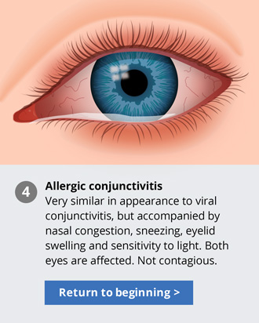
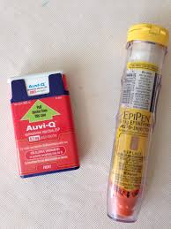
Eye Drops: MOA-similar to nasal sprays, eye drops also come in different forms to help treat allergic conjunctivitis (inflammation or swelling of the conjunctiva). Some are antihistamines, mast cell stabilizers, corticosteroids, and decongestants
Eye Drops:
Antihistamine – Azelastine ( Optivar), Emadastine (Emadine), Epinastine ( Elastat), Naphazoline ( OTC Visine)
Decongestant- naphazoline (Vasocon) ,
Corticosteroid- Loteprednol (Alrex),
Other: nedocromil, olapatadine, Pemirolast
Oral/Dental side effects :
- Non significant
Allergic Emergency Medication: MOA- stimulates alpha-, beta-1, and beta-2 adrenergic receptors resulting in relaxation of smooth muscles, bronchial tree, cardiac stimulation, and dilation of skeletal muscle vasculature.
Emergency Allergic Medication : Epinephrine
Epi Pen or Epi Pen Jr.
Auvi Q
Epinephrine injection 1:1000 (1 mg/ mL)
Adrenaclick 0.15 Adrenaclick 0.30
Major Adverse effects and reactions :
-CV: angina pectoris, cardiac arrhythmias, chest pain, hypertension
-CNS: anxiety, dizziness, drowsiness, nervousness, tingling sensation pain
-Other: nausea, vomiting, hyper or hypo glycemia, lactic acidosis, tremor, weakness, dyspnea.
Oral/Dental side effects :
-xerostomia and dry throat. Resumes upon discontinuation of drug

Slide 17
Topical ointment/ cream steroids: MOA- Topical corticosteroid have anti inflammatory, antipruritic and vasoconstrictive properties. Depress the formation, release, and activity of endogenous chemical mediators of inflammation.
Can be categorized by class based on potency level of steroid:
Mild: Aclometasone 0.05%, Fluocinolone 0.01%, Triamcinolone 0.025%
Intermediate: Desonide 0.05%, Fluocinolone 0.025%, Flurandrenolide 0.025% Fluandrenolide 0.05%, Hydrocortisone 0.1%
Potent: Desoximetasone 0.05%, Amcinonide 0.1%, Triamcinolone 0.5%
Super potent: Betamethasone Dipropionate augmented 0.05%
Anti itch: Doxepin 5% Cream
Immunomodulatory: Pimecrolimus 1%
Others: Crisaborole (Eucrisa)
Oral/Dental side effects :
- Non significant
Tx of hereditary angioedema (HAE) ( severe swelling) : a rare autosomal dominant genetic disease that causes swelling of the skin and tissue just beneath the kin.
C1 Esterase Inhibitor (recombinant) (Ruconest)
C1 Inhibitor (Berinert)
Ecallantide (Kalbitor)
Icatibant (Firazyr)
Lanadelumab (Takhzyro)
[5]- Davis, C. P. (n.d.). Hereditary Angioedema (HAE) Types, Symptoms & Diagnosis. Retrieved from https://www.medicinenet.com/hereditary_angioedema_hae/article.htm#hereditary_angioedema_hae_definition_and_facts

Slide 18
Oral Corticosteroids : treats severe allergies and can also can also be used as rescue medication for asthma.
Oral Corticosteroid Drugs:
Cortisone Acetate – MOA- decreases inflammation by suppression of migration of polymorph nuclear leukocytes and reversal of increased capillary permeability.
Dexamethasone
Hydrocortisone (Cortef)
Methylprednisolone (Medrol)
Prednisolone
Prednisone - MOA- decreases inflammation by suppression of migration of polymorph nuclear leukocytes and reversal of increased capillary permeability.
Major Adverse effects and reactions :
-CV: congestive heart failure, hypertension.
-CNS: headache, intracranial pressure, seizures, mood swings, depression
-Other: Cushing's syndrome, facial erythema, hypothyroidism, glaucoma
Oral/Dental side effects :
- Compromised immune response; consult with physician and get medical clearance
Sublingual Immunotherapy (SLIT)Allergy Tablets: MOA- administering the allergens under the tongue generally on a daily basis. Allergy immunotherapy helps build resistance to the specific allergen.
SLIT Drugs:
Odactra – Dust mile oral extract
Grastek- Timothy grass pollen sublingual extract
Oralair- grass pollen
Ragwitek- short ragweed pollen sublingual extract.
Oral/Dental side effects :
- Local reactions in the mouth such as oral itching, swelling of lips, swollen tongue, xerostomia, oral parenthesis, and oropharyngeal pain. Compromised immune response; consult with physician and get medical clearance

Slide 19
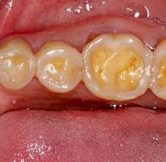
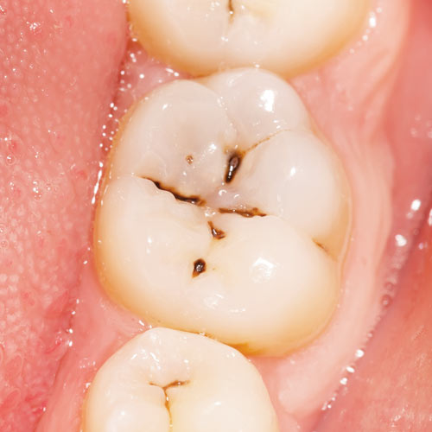
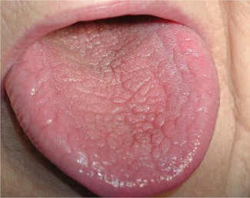
Dental Side Effects and Effects on Treatment for Antihistamines
Thickening of mucus
Block the release of saliva, result in xerostomia
Lead to cavities, discoloration and tooth erosion
Drying irritates the soft tissues in the mouth, which can make the mouth inflamed and heighten the risk for infection
Nervous, excited, or irritable – unstable emotion will make the treatment more difficult
Drowsiness or sleepiness
Dizziness

Slide 20
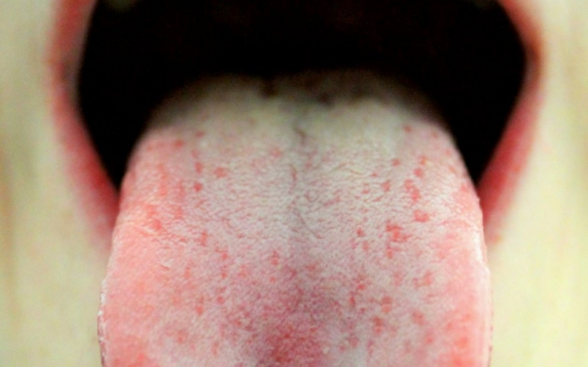
Dental Side Effects and Effects on Treatment for Decongestants
Nervousness – make the dental treatment more difficult
Xerostomia – increase tooth decay and tooth infection
Headaches
Sneezing
Dry or Runny Nose
Dizziness

Slide 21
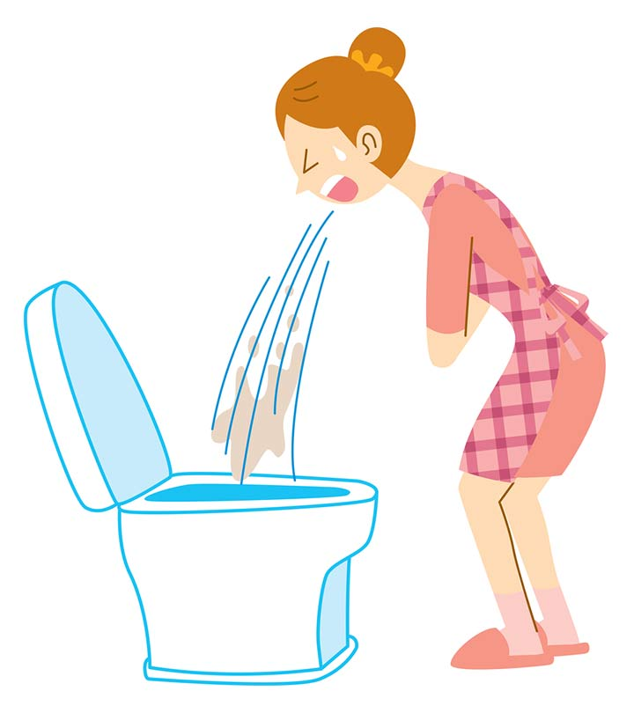
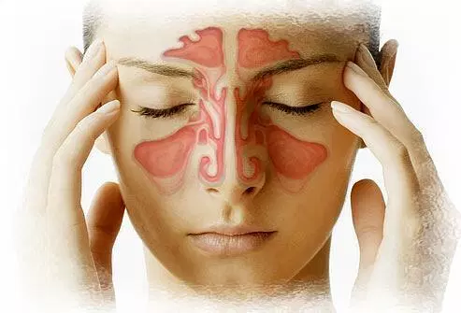
Dental Side Effects and Effects on Treatment for Fluticasone Propionate Nasal Spray
Sore Throat – patient may feel uncomfortable during the treatment
Vomiting - increase tooth erosion
Foul taste in the mouth
Sinus Pain – patient may feel pain when open the mouth and increase tooth pain
Nausea
Cough – cough may be increase during the treatment and make the treatment harder
Sneezing
Sores or White patches inside mouth or around the nose

Slide 22
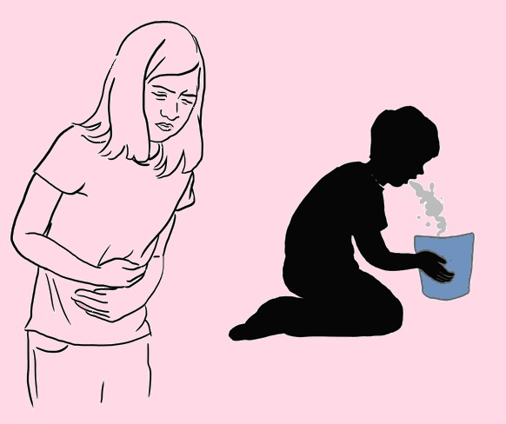
Dental Side Effects and Effects on Treatment for for Epinephrine
Nervousness – make the dental treatment more difficult
Nausea and vomiting – increase tooth erosion
Shortness of Breath – need more time on treating patients
Weakness
Dizziness
Headache
Anxiety - make the dental treatment more difficult

Slide 23
Reference
Allergic Reactions Ttr: Aaaai https://www.aaaai.org/conditions-and-treatments/library/allergy-library/allergic-reactions
Allergy Medications: Know Your Options https://www.mayoclinic.org/diseases-conditions/allergies/in-depth/allergy-medications/art-20047403
Allergy Drugs: Prescription, Otc, Side Effects & Interactions Jim Morelli – https://www.rxlist.com/allergy_medications/drugs-condition.htm#what-are-allergies
Oral Candidiasis Associated with Inhaled Corticosteroid Use Comparison Of Fluticasone and Beclomethasone :Chizu Fukushima-Hiroto Matsuse-Shinya Tomari-Yasushi Obase-Yoshitsugu Miyazaki-Terufumi Shimoda-Shigeru Kohno - https://www.ncbi.nlm.nih.gov/pubmed/12839324
Drug Allergies and Implications For Dental Practice Daniel Becker – https://www.ncbi.nlm.nih.gov/pmc/articles/PMC3891459/

Slide 24
References
Gentile, D. A., Friday, G. A., & Skoner, D. P. (2000). Management of allergic rhinitis: antihistamines and decongestants. Immunology and Allergy Clinics, 20(2), 355-368.
– Drugs to Treat Allergy Symptoms: Prescription & OTC Medications. (n.d.). Retrieved from https://www.webmd.com/allergies/allergy-medications#1
Church, M. (2004). Histamine Receptors, Inverse Agonism, and Allergy. Allergy & Clinical Immunology International - Journal of the World Allergy Organization,16(03), 112-116. doi:10.1027/0838-1925.16.3.112
Ambizas, E. M. (2015, July 20). Allergic Rhinitis and Intranasal Corticosteroid Sprays. Retrieved from https://www.uspharmacist.com/article/allergic-rhinitis-and-intranasal-corticosteroid-sprays
Church1, D. S., & Church1, M. K. (2011, March 15). Pharmacology of Antihistamines. Retrieved from https://waojournal.biomedcentral.com/articles/10.1186/1939-4551-4-S3-S22
Derendorf, H., & Meltzer, E. O. (2008, September 08). Molecular and clinical pharmacology of intranasal corticosteroids: Clinical and therapeutic implications - Derendorf - 2008 - Allergy - Wiley Online Library. Retrieved from https://onlinelibrary.wiley.com/doi/full/10.1111/j.1398-9995.2008.01750.x
Ray, A., Siegel, M. D., Prefontaine, K. E., & Ray, P. (1995). Anti-inflammation: Direct Physical Association and Functional Antagonism Between Transcription Factor NF-KB and the Glucocorticoid Receptor. Chest,107(3). doi:10.1378/chest.107.3_supplement.139s

Slide 25
References:
[1]Drug Guide: AAAAI. (n.d.). Retrieved from https://www.aaaai.org/conditions-and-treatments/drug-guide
[2] Ogbru, O. (n.d.). Oral Antihistamines: Side Effects for Allergy Drugs. Retrieved from https://www.medicinenet.com/antihistamines-oral/article.htm
[3](n.d.). Retrieved from https://www.aocd.org/page/Antihistamines
[4] Wynn, R. L., Meiller, T. F., & Crossley, H. L. (2016). Drug information handbook for dentistry: Including oral medicine for medically-compromised patients & specific oral conditions. Hudson, OH: Lexicomp.
[5]- Davis, C. P. (n.d.). Hereditary Angioedema (HAE) Types, Symptoms & Diagnosis. Retrieved from https://www.medicinenet.com/hereditary_angioedema_hae/article.htm#hereditary_angioedema_hae_definition_and_facts
Church, D. S., & Church, M. K. (2011). Pharmacology of Antihistamines. World Allergy Organization Journal, 4. doi:10.1186/1939-4551-4-s3-s22
– Morelli, J. (n.d.). Allergy Drugs: Prescription, OTC, Side Effects & Interactions. Retrieved from https://www.rxlist.com/allergy_medications/drugs-condition.htm
– PDR Search. (n.d.). Retrieved from https://www.pdr.net/

Slide 26
Reference:
Caroline Leopoid May 30th, 2018, Common Types of Allergy Medicine. https://www.medicalnewstoday.com/articles/311845.php
Lynn Marks. November 25th, 2015. What is an Antihistamine? https://www.everydayhealth.com/antihistamine/guide/
John P. Cunha, Do, FACOEP. January 1st, 2019 Flonase Side Effects Center. https://www.rxlist.com/flonase-side-effects-drug-center.htm#overview
John P. Cunha, Do, FACOEP. Feburary 11st, 2019 Adrenalin Side Effects Center. https://www.rxlist.com/adrenalin-side-effects-drug-center.htm#overview
2019 The Guardian Life Insurance Company of American. 12/20. 5 Medications That May Be Causing Your Tooth Decay. https://www.guardiandirect.com/resources/articles/5-medications-may-be-causing-your-teeth-decay
W. H. Milligan III, PhD, DMD, FICD. July 8^{th,} 2013. Patient “Medical” Conditions That Affect Dental Treatment. http://www.americanmedtech.org/Portals/0/PDF/Meetings%20and%20Events/National%20Meeting/2013/1308%20-%20Patient%20Medical%20Conditions%20That%20Affect%20Dental%20Treatment.pdf

