Slide 1
Tongue Ankyloglossia—Tongue Tie Geographis Tongue Black hairy tongue
Yanling Feng
D218

Slide 2
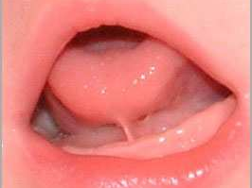
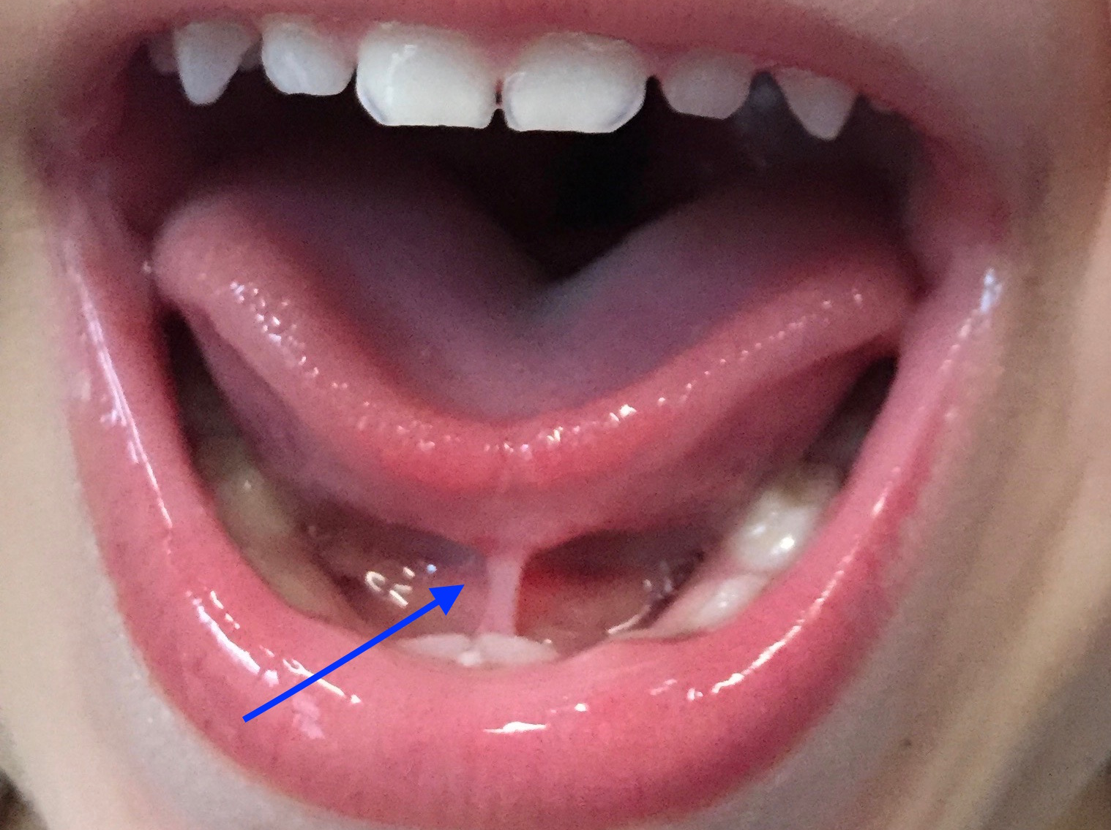
Ankyloglossia—Tongue-Tied
A condition present at birth which an unusually short, thick or tight band of lingual frenulum that tethers the bottom of the tongue's tip to the floor of the mouth

Slide 3
Symptoms
Baby -- having trouble breast-feeding
Difficulty lifting the tongue to the upper teeth
Trouble sticking out the tongue pass the lower front teeth
A tongue that appears notched

Slide 4
Etiology
Typically, the lingual frenulum separates before birth, allowing the tongue free range of motion.
Unknown, some cases have been associated with certain genetic factors

Slide 5
Dental Impact
Poor oral hygiene. For an older child or adult, tongue-tie make it difficulty to sweep food debris from the teeth. This causes tooth decay and gingivitis. Also, it causes the formation of a gap or space between the two bottom front teeth
Challenges with other oral activities. Such as licking the lips, kissing or playing an wind instrument.

Slide 6
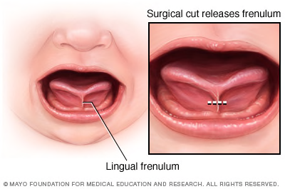
Treatment
Controversial
Frenotomy：a surgical cut to release the frenulum
Frenuloplasty: if the lingual frenulum is too thick for a frenotomy, but more expensive

Slide 7
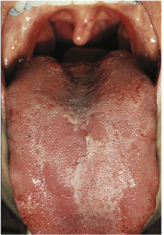
Geographic tongue
A condition appears as red and then paler pink to white patches on the body of the tongue.

Slide 8
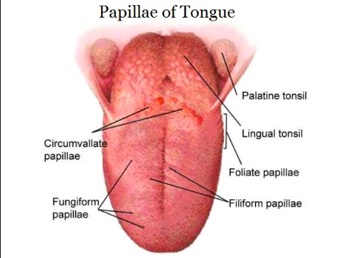
Etiology
Unknown
Geographic is found all age groups and shows sensitivity of the filiform lingual papillae to changes in their environment.

Slide 9
Treatment
It may associated with soreness or slight burning on the surface of the tongue, but It’s a harmless condition.
No treatment is needed for geographic tongue
Dental professionals should reassure the patient and rule out any other more serious tongue lesions.

Slide 10
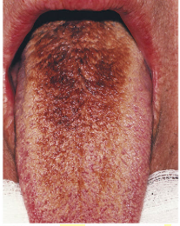
Black Hair Tongue
A dark, furry appearance on the dorsal of the tongue

Slide 11
Etiology
Black hairy tongue is caused by the usual level of shedding of epithelium of the filiform lingual papillae does not occur.
As a result, a thick layer of dead cells and keratin builds up on the tongue surface and staining from bacteria, yeast, food, tobacco or other substances in the mouth.

Slide 12
Treatment
Brushing the tongue is recommended to promote tissue shedding and remove debris

