Slide 1
New York City College of Technology
Department of Dental Hygiene
Case Presentation- Arestin
Yanling Feng
05/04/20

Slide 2
Patient Profile
Ms. CL is 80 years old Caucasion female.
Retired.
Her last dental exam was 3 months ago in our school clinic.
Patient stated that she uses Oral-B toothbrush and water-pik irrigation with Listerine twice a day. Uses Sensodyne toothpaste.

Slide 3
Chief Complaint
Patient stated that “I worried about the few deep probing depths I have and want to have a check.”
Ms. CL would like to have her teeth cleaned and want us to check the probing depth of the teeth she worries.

Slide 4
Health History Overview
Blood Pressure: 118/73, Pluse-95, ASA II.
Medical Conditions
Not present
Current Medications
Multivitamin once a day

Slide 5
COMPREHENSIVE ASSESSMENTS

Slide 6
Summary of Clinical Findings
Extraoral/Intraoral Examination:
Within normal limit
EO: Right side TMJ clicking
IO: Round 5x6 mm amalgam tattoo on right side of buccal mucosa adjacent to #2 – unchanged from previous documentation; bilateral alba.
Occlusion
Bilateral Class I; overjet 5mm; overbite 60%
Deposits
Generalized soft biofilms accumulated on interproximal surfaces
Localized supragingival calculus on interproximal and lingual surface on mandibular anterior teeth

Slide 7
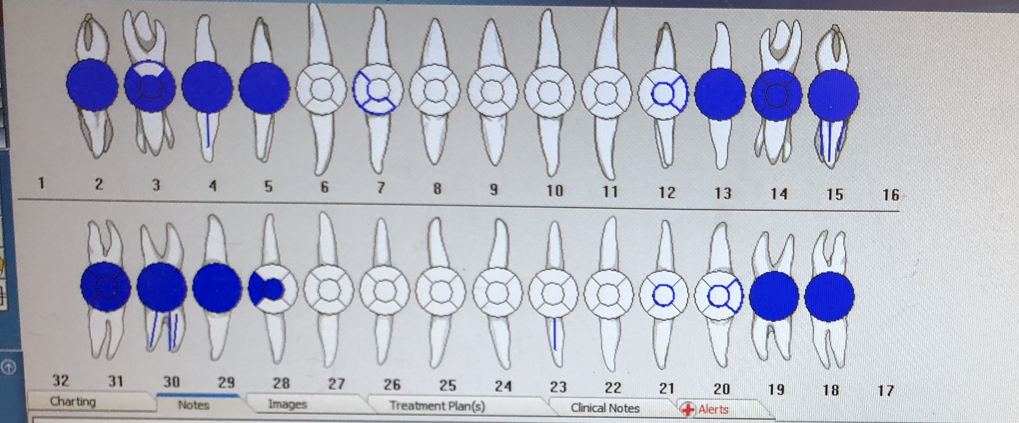
Dental Charting
Missing Teeth: #1, #16, #17, and #32
Amalgam restoration on #3 and #28; composite restoration on #7, #12, #20, and #21
PFM crown on #2, #4, #5, #13, #14, #15, #18, #19, #29, #30 and #31
RCT on #4, #15, #23 and #30

Slide 8
Gingival Description & Periodontal Status
Gingival Description
Generalized coral pink, localized slightly inflamed on lingual surface on lower anterior teeth, embrace space type I; stippled, slightly flaccid on lingual surface of Maxillary posterior #12 to #15.

Slide 9
Periodontal Charting
Generalized 1-4 mm; localized 5-8 mm; localized BOP.
Generalized type II/ localized type III

Slide 10
Dental Hygiene Diagnosis
Low caries risk due to no significant clinical findings of suspicious caries
Active periodontitis based on clinical findings of generalized 1-4 mm; localized 5-8 mm; localized BOP.

Slide 11
Dental Hygiene Care Plan
The patient was planed for 3 times visit for treatment
Visit I: technique of powered toothbrush(OHI); full mouth radiographs; scale whole mouth with Ultrasonic and hand scaling; finish with engine polishing and Varnish application; evaluation of appropriate for Arestin placement.
Visit II: Patient was appropriate for Arestin placement based on probing depth, gingival condition and bone level; planed to place Arestin in 9 sites #2(MB)-5mm, #2(ML)-5mm, #3(DB)-5mm, #3(DL)-5mm, #14(MB)-5mm, #15(DL)-7mm, #15 (ML)-5mm, #15 (DL)-7mm, #19(DB)-5mm; home care instruction after Arestin placement
Visit III: Arestin placement evaluation

Slide 12
IMPLEMENTATION

Slide 13
Implementation- Visit I
Plaque score: 1.3- fair.
OHI: Taught the patient the technique of powered toothbrush. Educated patient what plaque is and how it contribute to oral disease.
Scaled full mouth with slim-line Ultrasonic and hand scaling.
Full mouth radiographs was taking
Engine polishing with fine paste to remove plaque and light stains.
Varnish application for caries prevention.
Treatment completed. Schedule for Arestin placement after 1 week.

Slide 14
Implementation- Visit II
Arestin Placement
Explained the procedures of Arestin and obtained consent
Arestin placement on 9 sites: #2(MB), #2(ML), #3(DB), #3(DL), #14(MB), #15(DL), #15 (ML), #15 (DL), #19(DB).
Oral home care instruction was given to patient after Arestin placement
Arestin evaluation after 4 weeks.

Slide 15
Implementation- Visit III
Arestin evaluation
Arestin Sites | Probing depth: before Arestin placement | Probing depth: after Arestin placement
#2(MB) | 5 mm | 5 mm
#2(ML), | 5 mm | 5 mm
#3(DB) | 5 mm | 4 mm
#3(DL) | 5 mm | 5 mm
#14(MB) | 7 mm | 6 mm
#15(DL) | 5 mm | 5 mm
#15 (ML) | 7 mm | 6 mm
#15 (DL) | 5 mm | 5 mm
#19(DB) | 5 mm | 4 mm
4 of the placement sites improved by decreasing 1 mm in probing depth.

Slide 16
Arestin evaluation
Patient’s Response
Ms. CL was very happy after I told her that there were 4 sites had improved by decreasing 1 mm in probing depth. She told me that she followed every steps of the home instructions after the Arestin placement. She was worried that she removed the powder if she did not comply. She had great concern on those 7mm probing depths. After the evaluation, she though everything she did was worthy. She had a very good experience with Arestin. She stated that she would take good care of her teeth in the future.

