Slide 1
Thaw (White) Murder aka Trial Of the Century

Slide 2
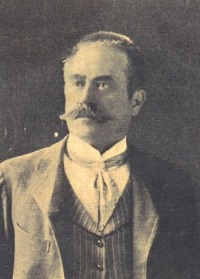
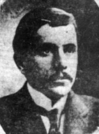
The First 19th Century Love Triangle Murder

Slide 3
Evelyn Nesbit -16 year old from Pittsburg Pennsylvania -Moved to New York with her mother to continue modeling & become an actress -Loved and abused by two wealthy Men

Slide 4
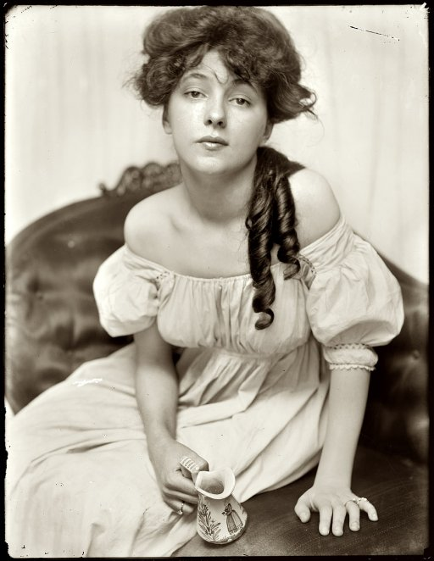

Slide 5
Stanford White -New York City's most famous architect. -Designed Second Madison Square Garden. -Led Evelyn and her female friend to an upstairs room where a red velvet swing hung suspended from the ceiling. -Took Nesbit’s virginity in a form of rape and made her his companion.

Slide 6
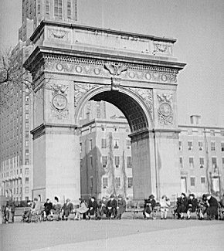

Slide 7
Harry K. Thaw -Wealthy man, but a very troubled individual. -Drug abuser, mentally unbalanced, went from private school to private school as a child. -Obsessed with Evelyn Nesbit -Also abused and raped Nesbit, but from lust, and married her after some time.

Slide 8
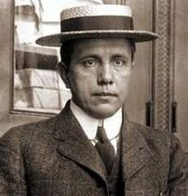

Slide 9
-One day in 1906 Evelyn and Harry accompanied by a friend to a show at the Madison Square Garden. -Harry & Evelyn spot Mr. White and decided to leave. -Evelyn Engages in a conversation with a friend. -Harry slips away and shoots White.

Slide 10
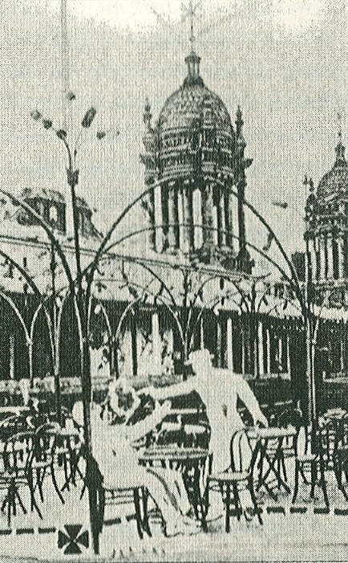

Slide 11
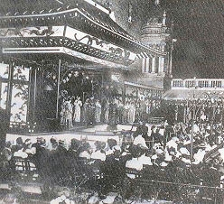

Slide 12
It was all over the papers

Slide 13
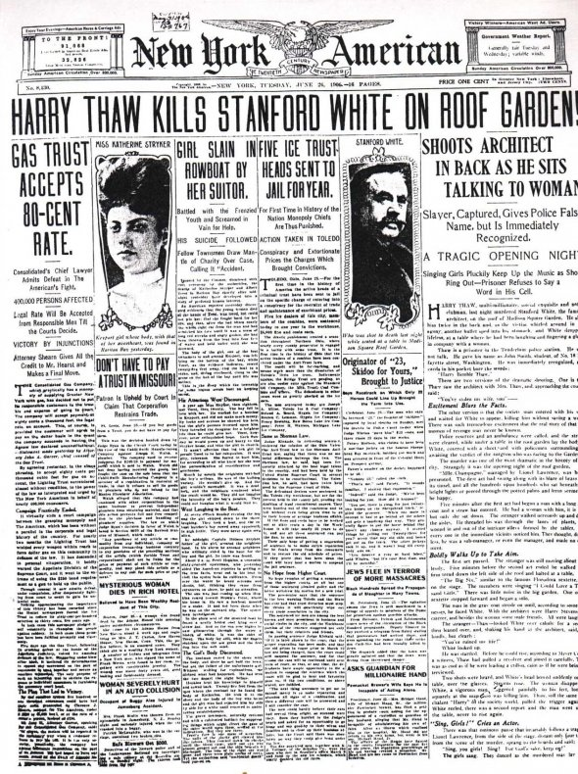

Slide 14
Crowd gathers below the Bridge of Sighs, connecting Tombs prison and the courthouse.

Slide 15
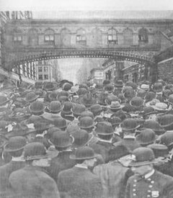

Slide 16
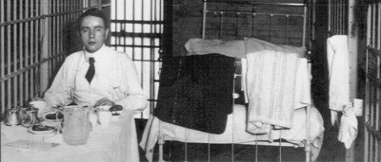

Slide 17
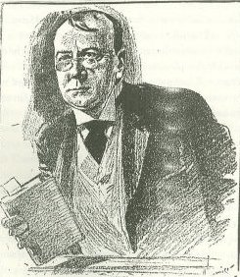
Attorney’s for the Case Left is the DA William T. Jerome Right is the Defense Attorney Delphin Delmas

Slide 18
Two Trials First case dead locked. Second case insanity plea was rendered.

Slide 19
Thaw was incarcerated at the Matteawan State Hospital for the Criminally Insane in Fishkill, New York, enjoying nearly complete freedom. Thaw later was released and died of a heart attack in 1947 at the age of 76.

Slide 20
In 1955 The movie, Girl in a Red Velvet Swing debuted

Slide 21
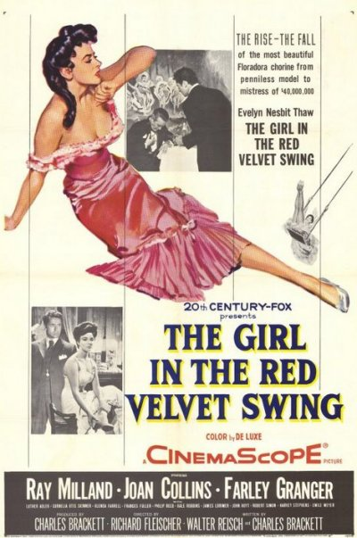

Slide 22
