Slide 1
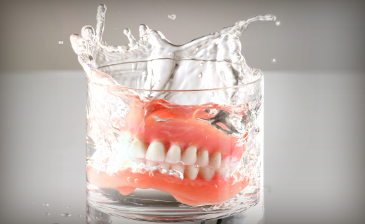
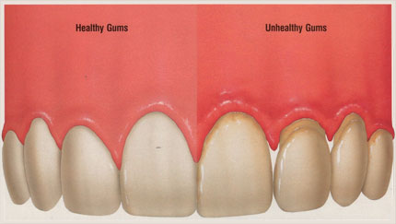
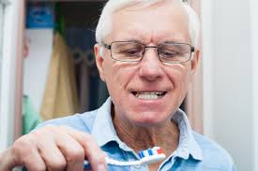
Oral Health Education 老年人口腔保健
For Seniors

Slide 2
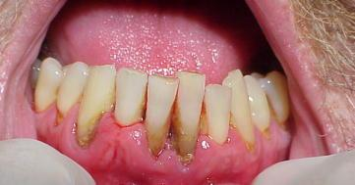
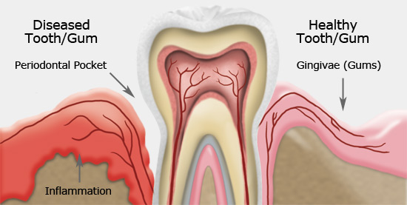
What is Periodontal Disease? 什麼是牙周病?
Healthy Gums 健康的牙肉
Unhealthy Gums 不健康的牙肉

Slide 3
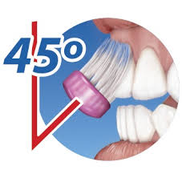
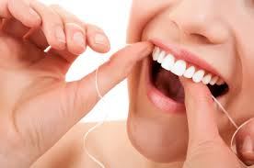
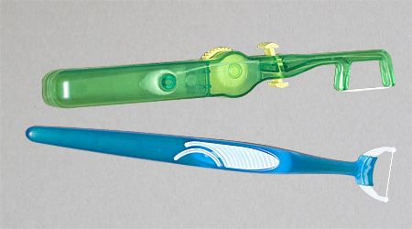
Oral Hygiene Instructions 口腔卫生指导方法
Brushing 刷牙
Brush for 2 minutes twice a day with a soft-bristled toothbrush
使用软毛牙刷每天两次刷牙两分钟
Flossing 牙线
Floss by using about 18 inches of floss, leaving an inch or two to work between teeth 在牙齿间隙处使用大约18英寸的牙线进行清理

Slide 4
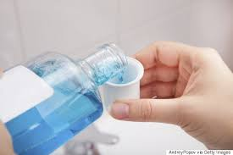
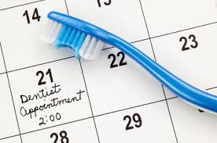
Rinse 漱口
Rinse twice a day with an antibacterial mouthwash that kills germs in hard to reach spots. 每天使用抗菌漱口水漱口两次
Visit your Dentist and Hygienist regularly, at least every 6 months.
至少每六个月定期看牙医和洗牙师。

Slide 5
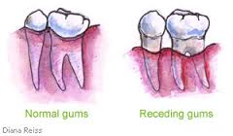
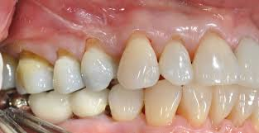
Gingival Recession 牙龈萎缩
What is gum recession?什麽是牙龈萎缩?
It is a common dental problem in which the lower parts/roots of the teeth become exposed. This can lead to tooth sensitivity and the roots of the teeth are also at a higher risk of decay.
这是一个常见的口腔问题，也就是牙根暴露，这可导致牙齿敏感以及会大 大增加蛀牙的风险。

Slide 6
Causes of gum recession 牙龈萎缩的原因
Periodontal (gum) Disease.
牙周病
Brushing too hard or using a hard-bristled toothbrush.
用力刷牙或使用硬毛牙刷
Partial dentures that do not fit right.
不合适的部分假牙
Prominent tooth roots.
突出的牙根部位
Smoking tobacco.
吸烟
Poor oral hygiene.
口腔卫生不良

Slide 7
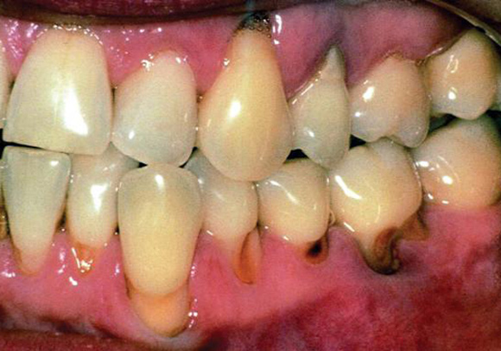
Dry Mouth (Xerostomia) 口腔乾燥症
Effects 影響

Slide 8
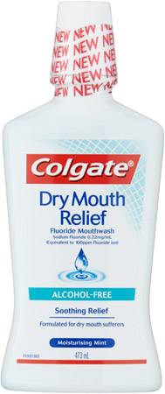
What can help? 如何改善呢?

Slide 9
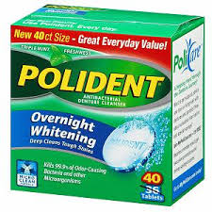
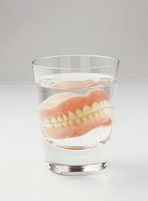
How to clean your denture? 如何保持假牙清潔?
Do NOT wear denture overnight!
不要帶著假牙睡覺!
Use special cleaner to clean your denture
用假牙清潔劑來清潔假牙

Slide 10
If you wear denture 24/7… 如果你一天24小時都帶著假牙的話…
Denture stomatitis
假牙性口炎

Slide 11
Eating Healthy 健康饮食
Eat fruits and vegetables. 多吃水果和蔬菜
Avoid sticky candy and sugary foods. 避免糖果和含糖的食物

Slide 12
Don’t Forget to Smile! 保持微笑！

Slide 13
References
http://www.colgate.com/app/CP/US/EN/OC/Information/Articles/Oral-and-Dental-Health-at-Any-Age/Seniors/Senior-Maintenance-and-Care/article/Oral-Health-for-Seniors.cvsp
http://www.colgate.com/app/CP/US/EN/OC/Information/Articles/Oral-and-Dental-Health-at-Any-Age/Seniors/Senior-Maintenance-and-Care/article/Taking-Care-of-Your-Teeth-and-Mouth.cvsp
http://seniorsoralhealth.org/dry-mouth/tips-and-information/?doing_wp_cron=1428456984.0806128978729248046875

