Slide 1
Ectodermal Dysplasia
Yineeta R Chitlall
D216

Slide 2
What is ectodermal dysplasia?
Involves the abnormal development of one or more structures from ectoderm.
Occurs in the embryonic period
Cause-Hereditary

Slide 3
Effects
Abnormalities of the teeth, skin, hair, nails, eyes, facial structures, glands because these are derived from ectoderm of associated tissue.

Slide 4
Effects on Teeth Partial or Complete Anodontia
Absence of some or all teeth in each dentition, and the teeth that are present for either dentition have frequent disturbances.

Slide 5
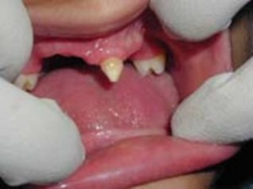
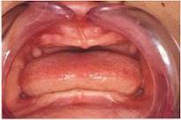
Partial and Complete Anodontia

Slide 6
The Role of the Dental Team
Recommend partial or full dentures for functional and esthetic purposes.
These needs to be reconstructed periodically as the jaws continue to grow.
Implants may be considered after growth halts.

Slide 7
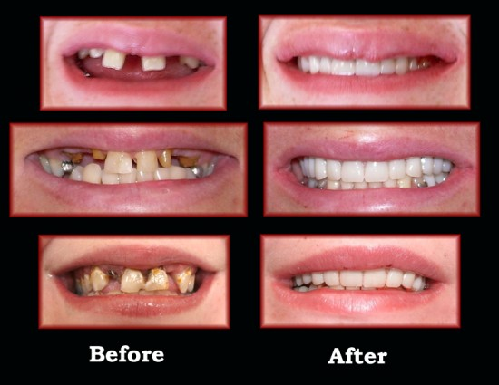
Role of the Dental Team
Replacement with Dentures

Slide 8
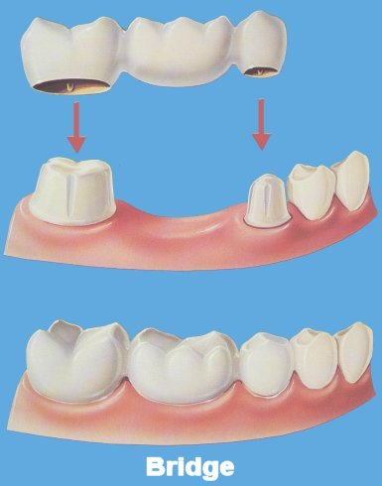
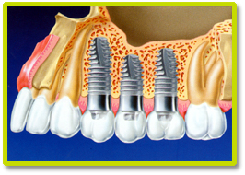
Role of the Dental Team Replacement with Bridge and Implants

