Slide 1
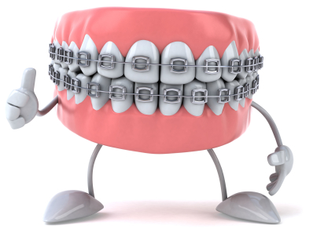
Importance of Good Oral Hygiene during Orthodontic Therapy

Slide 2
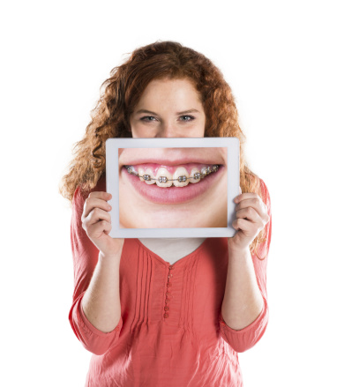
It is important to understand:
Caring for your teeth can be a challenge
Proper oral care IS NOT just about making your teeth look pretty.
Thorough oral Hygiene is more difficult with braces.
FORTUNATELY…
This presentation will prepare you for what is at hand. You will be able to better understand:
The reasons why you need to practice good oral hygiene while undergoing orthodontic therapy.
Effective tooth brushing techniques
Effective flossing techniques
Foods to avoid

Slide 3
What is Orthodontics?
A branch of dentistry that corrects teeth and jaws that are positioned improperly.
Advantages:
Helps with better
mastication
Speech
facial aesthetics
Contributes to general and oral health, thereby improving the quality of life.

Slide 4
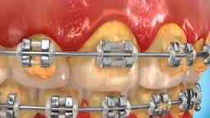
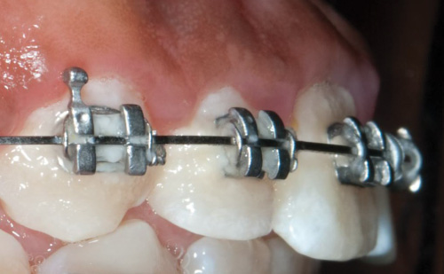
Does this patient practice good oral hygiene?

Slide 5
NO, Poor Oral Hygiene!
Plaque and caluculus (Tartar) Buildup

Slide 6
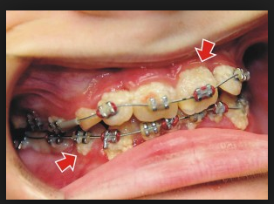
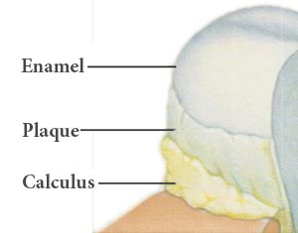
What is Plaque and Tartar?
Plaque is a sticky, colorless deposit of bacteria that is constantly forming on teeth.
How is plaque formed?
Saliva, food, and fluids combine to produce these deposits that collect on teeth and where teeth and gums meet. Plaque buildup is the primary cause of periodontal (gum) disease.
What is Tartar and how is it formed?
Plaque that is not removed by regular brushing and flossing can harden into unsightly tartar (also called calculus). This crusty deposit bonds on the teeth and gums. Tartar formation may also make it more difficult for you to
remove new plaque and bacteria.
Notes:
Fighting plaque is a life-long component of oral care.

Slide 7
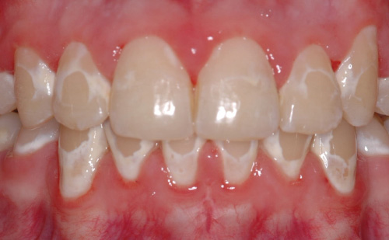
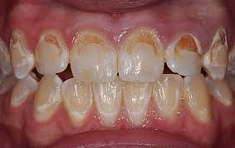
Why is good oral hygiene with braces so important?
Food and plaque can get trapped in the tiny spaces between braces and wires, causing decay and enamel stains.
Food can also react with the bacteria in your mouth and the metal in the braces to produce a bleaching effect, which can cause small, permanent light spots on the teeth called white spot lesions.
Decay
White spot lesion

Slide 8
Decalcification With Braces

Slide 9
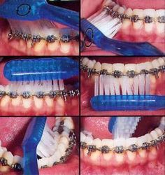
How to prevent Plaque and Tartar
(Calculus) Build up
BRUSH
https://www.youtube.com/watch?v=2Vs80QQuSTs

Slide 10
Let’s do it together!

Slide 11
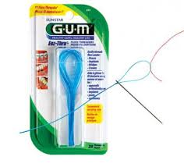
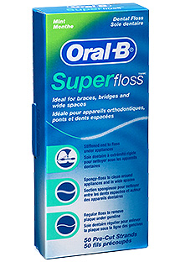
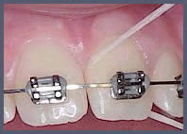
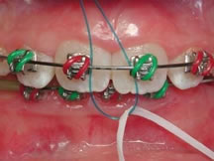
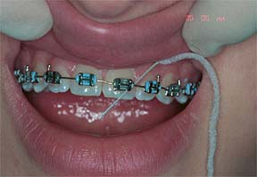
How to prevent Plaque and Tartar
(Calculus) Build up
Floss twice a day
Notes:
Floss threader vs. Superfloss.

Slide 12
Let’s do it together!
https://www.youtube.com/watch?v=XXeEojvMWG
FLOSS

Slide 13
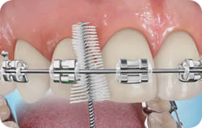
How to prevent Plaque and Tartar
(Calculus) Build up
Use a Proxy Brush two times a day
https://www.youtube.com/watch?v=-V-rFiu3k-Q

Slide 14
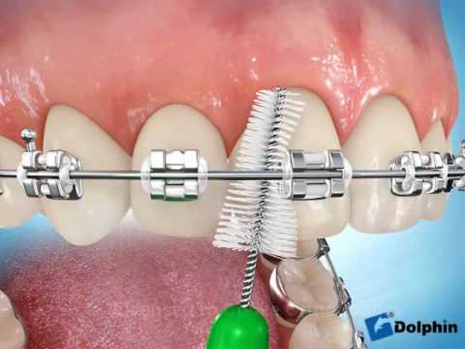
Let’s do it together!
Interproximal Brush

Slide 15
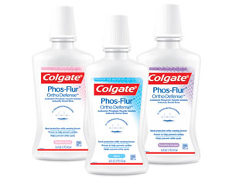
How to prevent Plaque and Tartar
(Calculus) Build up
Rinse once a day
Notes:
An orthodontics rinse. It’s crucial to apply anticavity rinse in order to prevent the formation of white spot lesion.

Slide 16
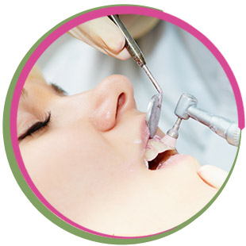
Have regular Professional Dental Cleaning
At Least every
3 months

Slide 17
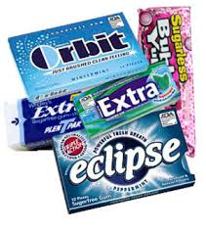
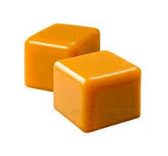
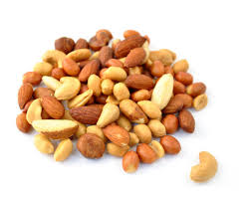
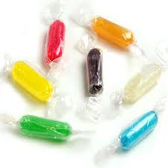
DO NOT EAT:
Notes:
Avoid crunchy/sticky/chewy food!!!!!!!!!

Slide 18
Thank You for listening

