Slide 1
Writing Abstracts for Research Projects
Organized by the Writing Across the Curriculum,
Emerging Scholars, and Honors Scholars Programs
1pm Session: Iris Strangmann & Osha Smith-Gittelman
4pm Session: Natalia Macrynikola & Osha Smith-Gittelman

Slide 2
Overview
What is an abstract?
Where do you see abstracts?
How are abstracts used?
Benefits of writing an abstract
Elements of an abstract
Abstract practice exercises
What you’ll need for this workshop:
A way to take notes:
  Paper + pen OR a Word doc

Slide 3
Getting Started Thinking about Abstracts
Take a few minutes to generate, in writing, your responses to the following questions:
What is an abstract?
Why and when do you write an abstract?
When have you encountered an abstract before?
Notes:
[Julie]
Students spend time free-writing and then get responses

Slide 4
What Is an Abstract?
A summary of the main ideas in a paper, talk, or project. Depending on the context, abstracts tend to be 1-3 paragraphs, or 150 – 300 words. Abstracts should be:
Concise: Include only information that summarizes your project.
Discipline-specific: Use the writing conventions relevant to your discipline and the journal, conference, etc. where you are presenting your work.
Audience-specific: Have a clear idea of who will be reading your abstract (ie. your peers, your professors, scholars inside or outside your field).
Searchable: Use key words that express the big picture of your paper and make it easier to search for in databases or collections
Notes:
Who is their audience again?

Slide 5
Where Do You See Abstracts?

Slide 6
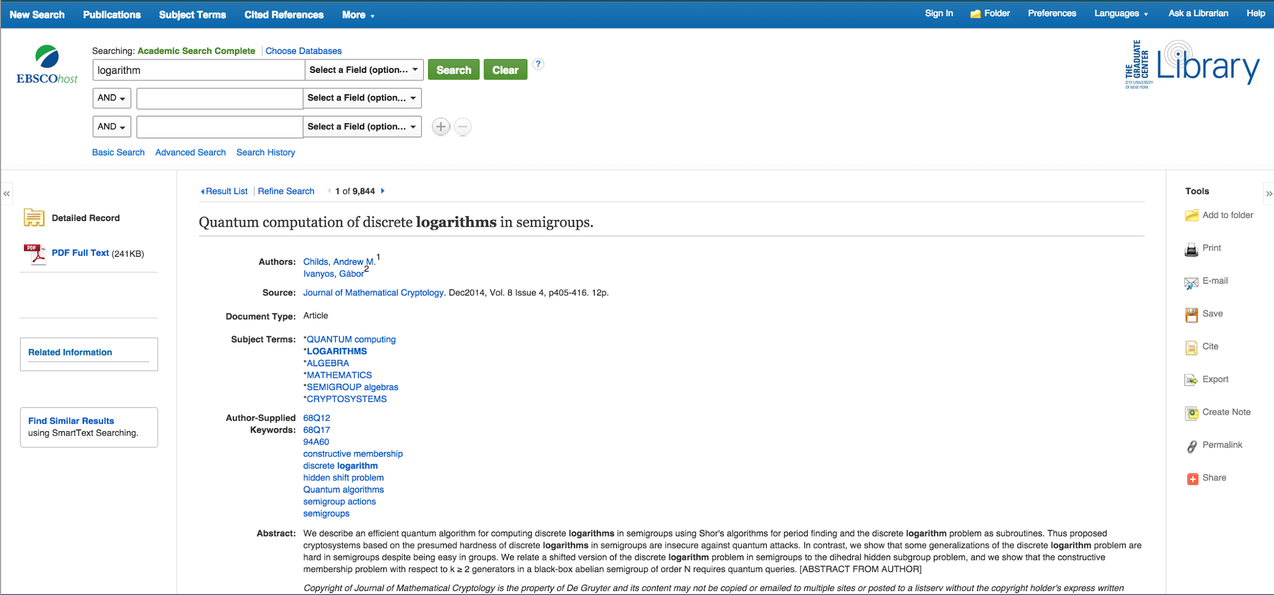
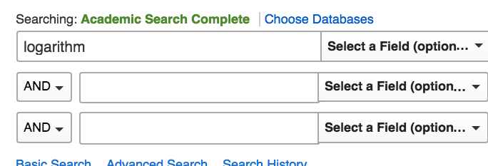
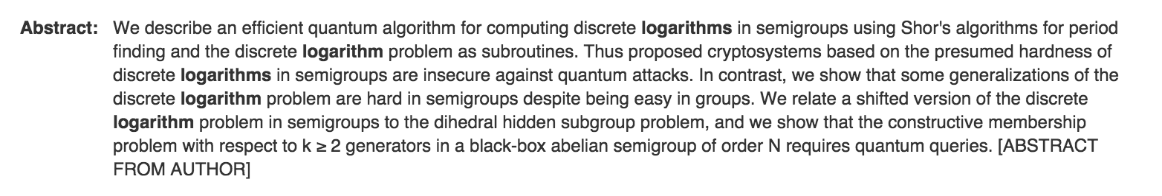
In Search Engine Results

Slide 7
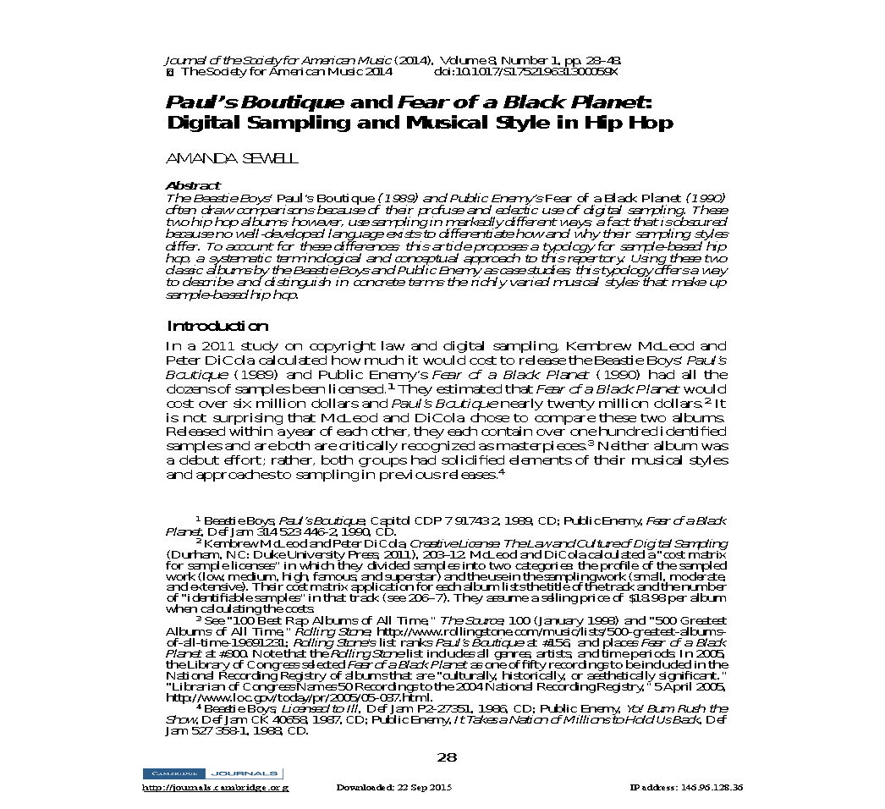
At the Beginning of a Primary Literature Article

Slide 8
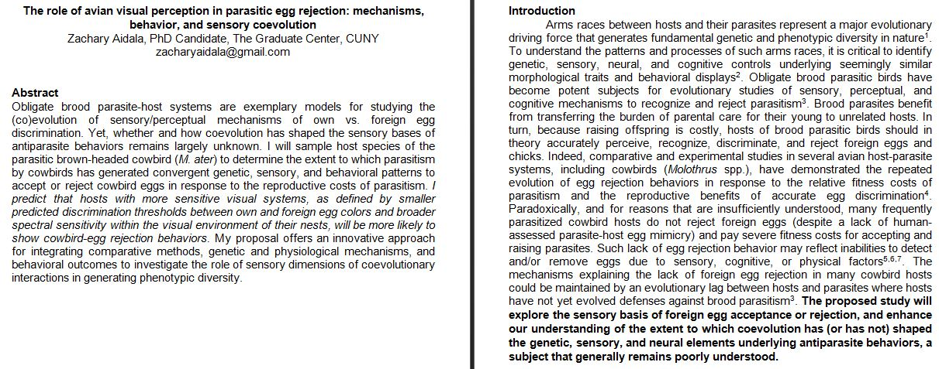
At the Beginning of a Grant Application
Notes:
When you’re applying to graduate school?

Slide 9
How Are Abstracts Used?
LOCATING RESEARCH
Indexing: Allows you to locate relevant research by searching for keywords and terms.
Selection: Helps you decide if an article is relevant to your project.
Notes:
Research:
Finding literature relevant to your project (on a scholarly database).
Choosing talks/posters to attend at conferences.
Deciding to fund a project.

Slide 10
How Are Abstracts Used?
COMMUNICATING RESEARCH
Presentation: Displays the results and significance of your study.
Appeal: Generates interest in your work
Accessibility: Provides convenient access to your ideas and work in concise language
Notes:
Communication:
Giving a poster presentation or talk.
Applying to conferences.
Submitting articles to journals.
Requesting grant money for research.
Conveying your academic work to a future employer.
Your research project!

Slide 11
Benefits of Writing an Abstract
Structure: Provides a blueprint for your project you can refer to throughout.
Self-Reflective Learning: Helps clarify your ideas by imagining how they would be presented or explained to others.
Summary: Allows you to synthesize your completed project in a structured and concise manner.
Notes:
Students will be writing an abstract before doing the project – will be prescriptive/predictive
Goal is to propose research, return to help clarify ideas
Students will be writing their own abstract

Slide 12
Elements of an Abstract
Motivation: Describe the necessity of the investigation in a broader context
  Why does this matter or why should we care?
Question: Describe what is being investigated and what questions are being posed
  What is the objective of the study?
Methodology: Describe how the question at hand is being studied
  What has been done?
Conclusion/Results: Describe any findings or expected findings
  What did you find out?
Implications: Describe the impact this research might have on future studies in your field
  What now?

Slide 13
Motivation/
Significance
Implications
Question / Objective
ABSTRACT
ELEMENTS
Conclusions / Results / Predictions
Methodology
Notes:
Raise the question of background – don’t include too much background information in the abstract
Broader issue or problem and its significance.
What you are investigating about it / what questions are posed
How you are studying it
Predictions – what you expect
What insights you might gain

Slide 14
What is the Structure of an Abstract?
Breakout room assignment:
  Read these two abstracts (Google doc link) paying attention to both the content and structure of the example
  In breakout rooms, identify the motivation/significance, question/objective, methodology, conclusions/results/predictions, and implications
  Total time: 25 minutes
Notes:
Goal: What is this information doing, not what does it mean?
Google doc Abstract link: https://docs.google.com/document/d/1dElQwuQX6ybkUDIt630R10kKHIObixDq_wHsDzQghkw/edit?usp=sharing

Slide 15
Identify the motivation/significance, question/objective, methodology, conclusions/results/predictions, and implications
Title: Assessing Participants’ Feedback to Dental Hygiene Care Provided by City Tech’s Dental Hygiene Students
The purpose of this research is to determine if CUNY students, faculty and staff are aware of the Dental Hygiene Program and services located at New York City College of Technology (NYCCT). Dental Hygiene students at NYCCT provide educational, clinical and therapeutic services to the public in accordance with individual state Dental Hygiene practice acts. Prevention and treatment of oral disease are recognized as important factors in a patient's overall health and well-being. Dental hygienists are important members of the dental health care team providing these services.
The first phase of the project consisted of a free dental screening event that was held during a Wellness Fair at the CUNY Graduate Center on May 2nd, 2018. The study received CUNY IRB approval and the individuals that participated in this event were contacted to schedule an appointment in order to receive a prophylaxis (comprehensive Dental Hygiene examination and treatment/care) with a Dental Hygiene student. The second phase of the project involved an electronic survey completed by the dental screening participants as well as a hard copy (paper) survey that was given to individuals who complete dental treatment at NYCCT’s Dental Hygiene clinic. The findings of this research demonstrated that those individuals who received the dental screening are likely to schedule an appointment to receive a prophylaxis. Additionally, most of the participants who received oral hygiene services at NYCCT greatly benefited from their treatment, oral health education and care. Even though poor oral hygiene is preventable, many individuals from lower-income households and ethnic minorities lack access to dental care services. Although efforts to increase access to services have improved, there is still much to be done at an individual, professional and community level to improve the oral health status of our population. The findings of this study will support raising the level of awareness of the services available in our dental clinic in terms of future dental screenings.

Slide 16
Identify the motivation/significance, question/objective, methodology, conclusions/results/predictions, and implications
Title: Assessing Participants’ Feedback to Dental Hygiene Care Provided by City Tech’s Dental Hygiene Students
Question
The purpose of this research is to determine if CUNY students, faculty and staff are aware of the Dental Hygiene Program and services located at New York City College of Technology (NYCCT). Dental Hygiene students at NYCCT provide educational, clinical and therapeutic services to the public in accordance with individual state Dental Hygiene practice acts. Prevention and treatment of oral disease are recognized as important factors in a patient's overall health and well-being. Dental hygienists are important members of the dental health care team providing these services.
The first phase of the project consisted of a free dental screening event that was held during a Wellness Fair at the CUNY Graduate Center on May 2nd, 2018. The study received CUNY IRB approval and the individuals that participated in this event were contacted to schedule an appointment in order to receive a prophylaxis (comprehensive Dental Hygiene examination and treatment/care) with a Dental Hygiene student. The second phase of the project involved an electronic survey completed by the dental screening participants as well as a hard copy (paper) survey that was given to individuals who complete dental treatment at NYCCT’s Dental Hygiene clinic. The findings of this research demonstrated that those individuals who received the dental screening are likely to schedule an appointment to receive a prophylaxis. Additionally, most of the participants who received oral hygiene services at NYCCT greatly benefited from their treatment, oral health education and care. Even though poor oral hygiene is preventable, many individuals from lower-income households and ethnic minorities lack access to dental care services. Although efforts to increase access to services have improved, there is still much to be done at an individual, professional and community level to improve the oral health status of our population. The findings of this study will support raising the level of awareness of the services available in our dental clinic in terms of future dental screenings.
Motivation
Methodology
Results
Implications

Slide 17
Identify the motivation/significance, question/objective, methodology, conclusions/results/predictions, and implications
Title: Using the Mediation Methodology to Analyze the Northern Ireland communal conflict
Mediation is part of the conflict resolution family and falls in the Alternate Dispute Resolution category. Mediation is basically when two or more parties voluntarily come together with an impartial third party to resolve a conflict. The purpose of this paper is to explain the six steps to the mediation methodology presented in “Peacemakers Toolkit: Managing a Mediation Process” which is authored by Amy L. Smith and David R. Smock. I will be using the Northern Ireland Communal Conflict as a case study.
The six steps to the mediation process include: a) assessing the conflict, b) ensuring mediator readiness, c) ensuring conflict ripeness d) conducting track I mediation e) conducting track II- dialogue and f) constructing a peace agreement. The Northern Ireland Communal conflict deals with the tension between the Protestants who have held the majority of the population whereas the Catholics who have been the minority in Northern Ireland- a case of ethno-nationalism. The Protestants desired to be part of the UK as they identified themselves as British. On the other hand, the Catholics identified themselves as Irish and desired a separate governing structure from the United Kingdom. John W. Burton (1915- 2010) is considered by many to be one the founders of the conflict resolution scholarship.
Throughout this paper I will be mainly referencing to the works of John W. Burton. He derived the concept of “provention”- which involved eliminating the sources of conflict, removing the causes of conflict and promoting an atmosphere where conflict does not exist. "

Slide 18
Identify the motivation/significance, question/objective, methodology, conclusions/results/predictions, and implications
Title: Using the Mediation Methodology to Analyze the Northern Ireland communal conflict
Mediation is part of the conflict resolution family and falls in the Alternate Dispute Resolution category. Mediation is basically when two or more parties voluntarily come together with an impartial third party to resolve a conflict. The purpose of this paper is to explain the six steps to the mediation methodology presented in “Peacemakers Toolkit: Managing a Mediation Process” which is authored by Amy L. Smith and David R. Smock. I will be using the Northern Ireland Communal Conflict as a case study.
The six steps to the mediation process include: a) assessing the conflict, b) ensuring mediator readiness, c) ensuring conflict ripeness d) conducting track I mediation e) conducting track II- dialogue and f) constructing a peace agreement. The Northern Ireland Communal conflict deals with the tension between the Protestants who have held the majority of the population whereas the Catholics who have been the minority in Northern Ireland- a case of ethno-nationalism. The Protestants desired to be part of the UK as they identified themselves as British. On the other hand, the Catholics identified themselves as Irish and desired a separate governing structure from the United Kingdom. John W. Burton (1915- 2010) is considered by many to be one the founders of the conflict resolution scholarship.
Throughout this paper I will be mainly referencing to the works of John W. Burton. He derived the concept of “provention”- which involved eliminating the sources of conflict, removing the causes of conflict and promoting an atmosphere where conflict does not exist. "
Question
Methodology
Motivation
Results
Implications
?

Slide 19
What Makes an Abstract Successful?
Read Abstract 3 on the next slide (or Google doc)
Consider how this abstract is successful and how it can be improved. Ask yourself:
  Are all of the elements present?
  Is it concise?
  Are there redundancies?

Slide 20
Identify the motivation/significance, question/objective, methodology, conclusions/results/predictions, and implications
Title: Cranberry Juice And Grape Juice As Anti-Viral Agents and Cytotoxicity Studies
Defined phytochemicals in potable juices (grape juice and cranberry juice) have been shown to possess antiviral properties both in vitro and in vivo. However, cytotoxicity by chemical treatment of cells may mask any antiviral effects. Accordingly, such testing is critical to validate the effect of the juices in question as antiviral agents.
Antiviral testing in cell culture has addressed the potential issue of cytotoxicity by monolayer pretreatment with cranberry and Concord grape juices. Such [cytotoxicity] testing employed trypan blue exclusion and cell subpassage. However, confirmatory testing to identify subtle effects by juices and other phytochemicals or nutraceuticals needs to be tested by a metabolic assay. This required a non-destructive bioluminescent cytotoxicity assay, which quantitatively measures the release of adenylate kinase (AK) from damaged cells. Release of AK from damaged cells, in complex with ADP, luciferein and luciferase additives from the ToxilightR BioAssay kit, yields an ATP spark – which can be detected by placement of the reaction mix in a luminometer. The luminometer was procured through a GRTI grant, which was used in this collaborative effort.
After the assay was perfected, the data collected from the luminometer showed that 50% Purple, Niagara, and pure cranberry juice reveal no cytotoxicity to monkey kidney cells grown in monolayer culture. This data confirms earlier results in that the antiviral effects were clearly due to the juices, and not artifact associated to host cell cytotoxicity.
Notes:
Have this slide up while they’re working

Slide 21
Identify the motivation/significance, question/objective, methodology, conclusions/results/predictions, and implications
Motivation
Title: Cranberry Juice And Grape Juice As Anti-Viral Agents and Cytotoxicity Studies
Defined phytochemicals in potable juices (grape juice and cranberry juice) have been shown to possess antiviral properties both in vitro and in vivo. However, cytotoxicity by chemical treatment of cells may mask any antiviral effects. Accordingly, testing is critical to validate the effect of the juices in question as antiviral agents.
Antiviral testing in cell culture has addressed the potential issue of cytotoxicity by monolayer pretreatment with cranberry and Concord grape juices. Such [cytotoxicity] testing employed trypan blue exclusion and cell subpassage. However, confirmatory testing to identify subtle effects by juices and other phytochemicals or nutraceuticals needs to be tested by a metabolic assay. This required a non-destructive bioluminescent cytotoxicity assay, which quantitatively measures the release of adenylate kinase (AK) from damaged cells. Release of AK from damaged cells, in complex with ADP, luciferein and luciferase additives from the ToxilightR BioAssay kit, yields an ATP spark – which can be detected by placement of the reaction mix in a luminometer. The luminometer was procured through a GRTI grant, which was used in this collaborative effort.
After the assay was perfected, the data collected from the luminometer showed that 50% Purple, Niagara, and pure cranberry juice reveal no cytotoxicity to monkey kidney cells grown in monolayer culture. This data confirms earlier results in that the antiviral effects were clearly due to the juices, and not artifact associated to host cell cytotoxicity.
Question
Methodology
Results
Implications
Notes:
Highlight differences across disciplines
Finished abstract
Then, handout #2

Slide 22

A Successful Abstract…
… is a clear
summary
… is discipline-specific
… uses keywords as tags
… adds
no new information
… is
tailored to an
audience
Notes:
[ if time]

Slide 23
Thank You!
If you have any further questions, feel free to visit:
https://openlab.citytech.cuny.edu/writingacrossthecurriculum/

