Slide 1
An Introduction to the EAS Exam
Organized by Writing Across the Curriculum
Presented by Samuel Gold and Francois Kiper

Slide 2
What is the EAS?
The Educating All Students (EAS) Test measures the professional and pedagogical knowledge and skills necessary to teach all students in New York State public schools.

Slide 3
Taking the EAS
EAS is a computer-based test lasting 2 hours and 15 minutes
The EAS is self-paced, meaning that you have to manage your own time
You may take the test year-round by scheduling an appointment through the New York State Teacher Certification website
Take a practice exam first! Contact your program director for more information

Slide 4
What to Expect
The EAS exam consists of 40 selected-response (multiple choice) and 3 constructed-response (short answer) questions
The test is divided into five sections, each of which tests a different competency (subject area)
Each section requires you to answer questions based on a set of three exhibits (documents)

Slide 5
What is an exhibit?
Each section begins with a set of three exhibits that you will use to answer the questions
Exhibits are documents about a specific classroom environment or set of student needs
Examples include lesson plans, journal entries, assessment data, or classroom descriptions
Each set includes two written exhibits and one visual exhibit (a table or chart)

Slide 6
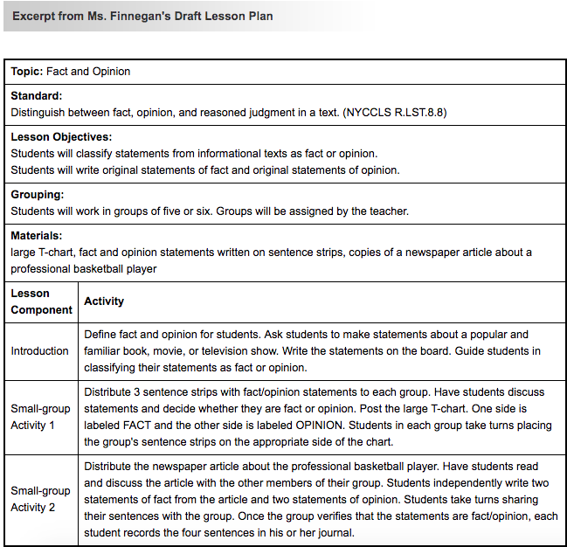
Exhibit example

Slide 7
What does the exam cover?
Each section asks you questions about a specific competency (subject area):
1. Diverse Student Populations
2. English Language Learners
3. Students with Disabilities and Other Special Learning Needs
4. Teacher Responsibilities
5. School-Home Relationships

Slide 8
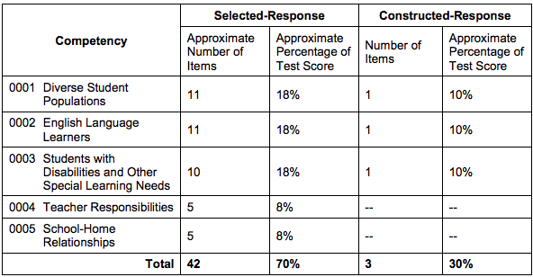
Exam Breakdown
Selected-response (multiple choice) questions make up 70% of the test score
Constructed-response (short answer) questions make up 30% of the test score

Slide 9
How to spend your time
You have a total of 2 hours and 15 minutes to take the exam, and you may set your own pace
The test writers recommend that you spend 10 minutes on each constructed-response (short answer) question and about 2.5 minutes on each selected-response (multiple choice) question
However, remember that it also takes time to read through the exhibits and questions!

Slide 10
Selected-Response Questions
Each selected-response question has four possible answers; read each answer choice and select the one best answer
Answer all questions; if you don't know, guess!
Tip: for each section, read the questions and answer choices before the exhibits! (This way, you will know what key words and phrases to look for as you read.)

Slide 11
Constructed-Response Questions
Each of the three constructed-response questions asks you to write a 150-200 word response based on the exhibits. The structure of each question (and your response) will be the same. You will:
Identify a specific problem/issue
Describe your strategy for addressing that problem
Explain why your strategy will work

Slide 12
Constructed-Response Questions (continued)
You will answer a constructed-response question on each of the following competencies (subject areas):
Diverse Student Populations
English Language Learners
Students with Disabilities and Other Special Learning Needs

Slide 13
Constructed-Response Example

Slide 14
How will my response be assessed?
The exam graders will assess you on your ability to do the following:
Identify a problem, describe a strategy, and explain why your strategy would work
Demonstrate an understanding of the information in the exhibits
Provide evidence for your answers using the exhibits
Write in clear, grammatical English

Slide 15
Strategies for Effective Reading
Read the questions before the exhibits so that you know what kind of evidence to look for
As you read through the questions and exhibits, note key words and important concepts
Take notes as you read! (You will be given notepads if you wish.)

Slide 16
Strategies for Effective Writing
Organize your thoughts before you start writing
Use the prompt to structure your answer: identify in your first paragraph, describe in your second, explain in your final paragraph
Get to your point quickly (no fluffy introductions)
Support your answer with evidence from the exhibits
Give yourself time to re-read what you have written for clarity and accuracy

Slide 17
Homework for the Workshop
Answer question ten on the PDF attached to your email; only give yourself ten minutes to answer it
Type your answer, print a copy, and bring it to the workshop

Slide 18
Further reading
For more information about the EAS, and some free practice questions, visit the NYSTCE website
CUNY's Five Things You Need to Do Before You Take the NYSTCE

