Slide 1
Writing to Succeed on the EDUCATING ALL STUDENTS (eas) eXAM
Organized by the Writing Across the Curriculum Program
Presented by Alicia Andrzejewski and Heather Mir

Slide 2
REVIEW: What is the EAS
The Educating All Students (EAS) Test measures professional and pedagogical knowledge and skills necessary to effectively teach all students in New York State public schools.

Slide 3
REVIEW: Exhibits
3 "exhibits": a set of two short opinion pieces and a visual representation of data related to the same topic (think of an exhibit as a case study)
Each question asks you to refer to one or more exhibits to answer the question
All sets of exhibits have selected-response questions, and 3 sets of exhibits have constructed-response questions
Please review the prompt to know which exhibits to use in each response
Notes:
Who is their audience again?

Slide 4
REVIEW: Constructed Responses
3 Short Responses (150-200 words total)
Themes:
Diverse Student Populations (10%)
English Language Learners (10%)
Students with Disabilities and other Special Learning Needs (10%)
Respond to bulleted questions based on case study material
Original answers

Slide 5
REVIEW: Constructed Response Prompt
All three written assignments have the same instructions:
Use the exhibits to complete the task that follows. After analyzing the information provided, write a response of approximately 150–200 words. The final version of your response should conform to the conventions of edited American English.
Notice that the specific task for each question uses the same language:
Identify (an issue, need, aspect) Describe (a strategy or modification) Explain (why that strategy or modification will work)

Slide 6
CONSTRUCTED RESPONSE TACTICS
Read and analyze the information provided noting key words
Draw from your notes on the case study material
Be sure to respond to all components of the question (use the bullet points if you get stuck)
Give evidence – refer to the facts as described in the case materials
When defending your ideas, try to avoid specific citations (quotes) and paraphrase instead

Slide 7
CONSTRUCTED RESPONSE TACTICS, STEP BY STEP
Step 1. Generate a checklist to see what the response needs to include
Step 2. Outline using topic sentences (answer each part of the question in a separate paragraph)
Step 3. Fill in with evidence and details
Step 4. Edit, refine, and check each sentence for relevance

Slide 8
Review: Homework

Slide 9
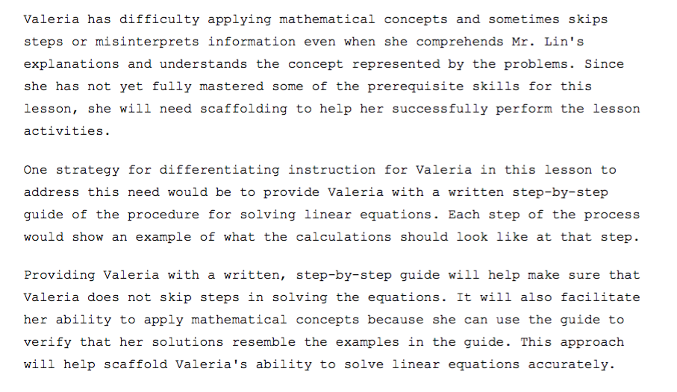
Sample Response: Topic Sentences

Slide 10
PEER REVIEW
Get into groups of two
Generate a checklist of what the response needs to include, based on the task you responded to as homework from last session
Exchange responses and fill out the checklist for your peer
If time remains, discuss your topic sentences: are they clear? do they describe the content of the paragraph well? how do they differ? Make notes for discussion
(If you did not bring a constructed response, write one during this time)

Slide 11
Discussion
What did you discover while writing your constructed response?
What items were on your checklist?
What makes an effective topic sentence?
What did you discover reading your peer's response?

Slide 12
KEY TAKEAWAYS: Effective Writing Strategies
Organize your thoughts before you write
Use the elements of the prompt to shape your outline
Get to your point quickly (no need for fluffy intro... make every word count)
Allow yourself time to review what you've written
Read your response "out loud"
Clearly delineate the boundaries between your ideas and someone else's, knowing it's OK to have an opinion

Slide 13
Any Questions?
Additional practice problems:
http://www.nystce.nesinc.com/Content/STUDYGUIDE/NY_SG_SRI_201.htm
Google: “NY State EAS Practice Exam”

