Slide 1
Reading & Writing to Succeed on the EAS
Organized by Writing Across the Curriculum
Presented by Samuel Gold and Francois Kiper

Slide 2
What is the EAS?
The Educating All Students (EAS) Test measures professional and pedagogical knowledge and skills necessary to effectively teach all students in New York State public schools.

Slide 3
What to Expect
Format
40 selected-response (multiple choice) items
3 constructed-response (short answer) -- "Exhibits" to use to answer the questions
Computer-based
Time
2 hours 15 minutes (135 minutes)
Test Dates
By appointment year-round, Monday through Saturday
Passing Score
520 (on a 400-600 scale)
Notes:
[Julie]
Students spend time free-writing and then get responses

Slide 4
Question Types
3 "exhibits": a set of two short opinion pieces and a visual representation of data related to the same topic (think of an exhibit as a case study)
Each question asks you to refer to one or more exhibits to answer the question.
All sets of exhibits have selected-response questions, and 3 sets of exhibits have constructed-response questions.
Notes:
Who is their audience again?

Slide 5
EAS Competencies
Five competencies (subject areas) will be assessed:
Diverse Student Populations
English Language Learners
Students with Disabilities and Other Special Learning Needs
Teacher Responsibilities
School-Home Relationships

Slide 6
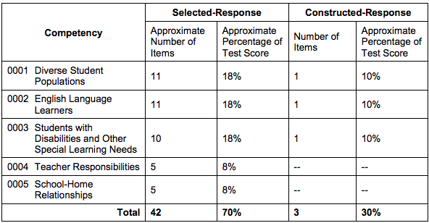
How You Will Be Evaluated
The selected-response items count for 70% of the total test score and the constructed-response items count for 30% of the total test score.
Notes:
[Luca/Carrie]

Slide 7
Strategy
You can determine how much time you spend on each question.
The test suggests that you spend 10 minutes on each constructed-response item and up to 105 minutes on all of the selected-response items.

Slide 8
Selected Responses (Multiple Choice)
Each selected-response question in this test is presented with four answer choices.
Read each question and answer choice carefully and select the ONE best answer.
You should answer all questions.
Even if you are unsure of an answer, it is better to guess than not to answer a question at all.

Slide 9
Multiple Choice Strategies
Read the question and choices before reading the exhibit material
Note key words and phrases before reading remaining materials

Slide 10
Constructed Responses (Short Answers)
3 Short responses (150-200 words total each)
Competencies assessed:
Diverse Student Populations (10%)
English Language Learners (10%)
Students with Disabilities and other Special Learning Needs (10%)
Respond to bulleted questions based on case study material
Original answers

Slide 11
Scoring Guide for Constructed Responses
Your response will be read for the following criteria:
Relevant engagement with the prompt (identify, describe, explain)
Understanding of the exhibits
Use of evidence to support your argument

Slide 12
Constructed Responses Strategies
Read and analyze the exhibits provided, noting key words
Draw from your notes on the case study material
Respond to each part of the prompt: identify, describe, and explain
Give evidence from the case materials

Slide 13
Effective Reading Strategies
Identify key points and clues for answering the questions
Think about evidence relevant to the prompt
Make notes about your thoughts as you're reading
Notes:
I think we can delete this slide or consolidate it with slide 5, some of the points seem redundant (see slide 8). - Lisa

Slide 14
Reading Activity
Read questions six through ten on your handout. Then read each exhibit, underlining information or data relevant to the questions.

Slide 15
Effective Writing Strategies
Organize your thoughts before you write
Use the elements of the prompt to shape your outline (identity, describe, explain)
Get to your point quickly (no fluffy introductions)
Allow yourself time to review and re-read what you've written

Slide 16
Homework for Workshop 2

Slide 17
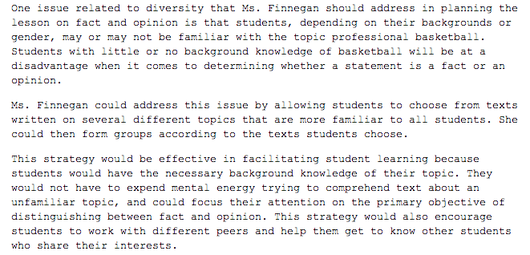
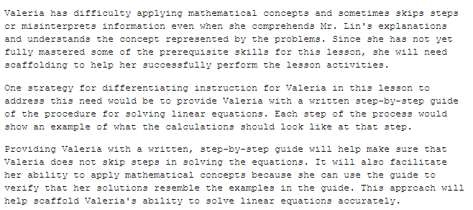
Sample Response

Slide 18
Workshop 2
November 15, 2018: 1-2PM
Our Website: openlab.citytech.cuny.edu/writingacrossthecurriculum/

