Slide 1
Writing Abstracts for Research Projects
Organized by the Writing Across the Curriculum,
Emerging Scholars, and Honors Scholars Programs
Presented by Yosefa Ehrlich & Anna Soo-Hoo at 1pm
Presented by Hilarie Ashton & Samuel Gold at 4pm

Slide 2
Getting Started Thinking about Abstracts
Take a few minutes to generate, in writing, your responses to the following questions:
What is an abstract?
Why and when do you write an abstract?
When have you encountered an abstract before?
Notes:
[Julie]
Students spend time free-writing and then get responses

Slide 3
What is an Abstract?
A summary of the main ideas in a paper, talk, or project. Depending on the context, abstracts tend to be 1-3 paragraphs, or 150 – 300 words. Abstracts should be:
Concise: Include only information that summarizes your project.
Discipline-specific: Use the writing conventions relevant to your discipline and the journal, conference, etc. where you are presenting your work.
Audience-specific: Have a clear idea of who will be reading your abstract (i.e., your peers, your professors, scholars inside or outside your field).
Searchable: Use key words that express the big picture of your paper and make it easier to search for in databases or collections.
Notes:
Who is their audience again?

Slide 4
Where do you see abstracts?
Notes:
[Luca/Carrie]

Slide 5
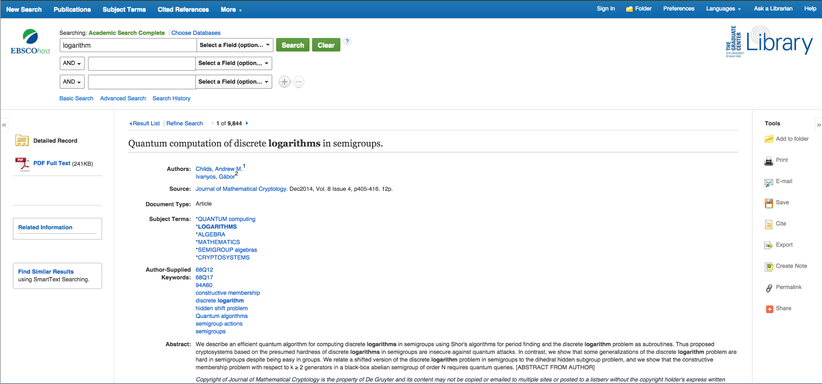
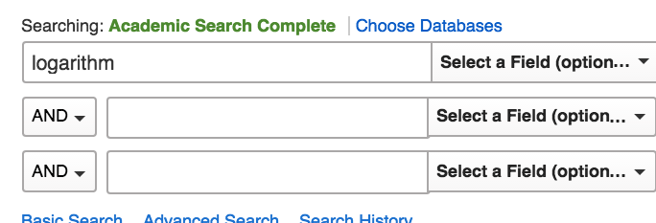
In Search Engine Results

Slide 6
At the Beginning of a Primary Literature Article

Slide 7
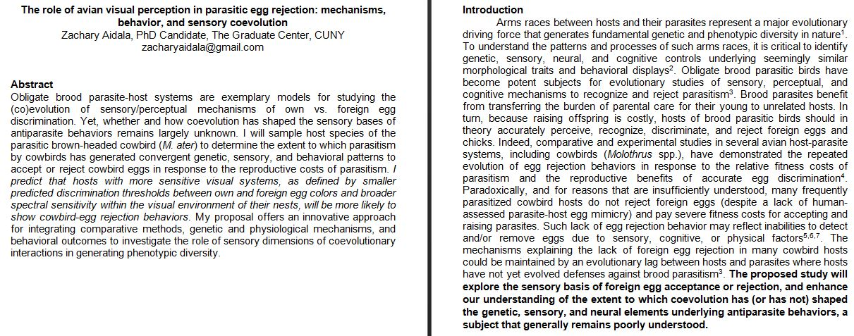
At the Beginning of a Grant Application
Notes:
When you’re applying to graduate school?

Slide 8
How are Abstracts Used?
LOCATING RESEARCH
Indexing: Allows you to locate relevant research by searching for keywords.
Selection: Helps you decide if an article is relevant to your project.
Notes:
Research:
Finding literature relevant to your project (on a scholarly database).
Choosing talks/posters to attend at conferences.
Deciding to fund a project.

Slide 9
How are Abstracts Used?
COMMUNICATING RESEARCH
Presentation: Displays the results and significance of your study.
Appeal: Generates interest in your work.
Accessibility: Provides convenient access to your ideas and work in concise language.
Notes:
Communication:
Giving a poster presentation or talk.
Applying to conferences.
Submitting articles to journals.
Requesting grant money for research.
Conveying your academic work to a future employer.
Your research project!

Slide 10
Benefits of Writing a Research Abstract
Structure: Provides a blueprint for your project you can refer to throughout.
Self-Reflective Learning: Helps clarify your ideas by imagining how they would be presented or explained to others.
Summary: Allows you to synthesize your completed project in a structured and concise manner.
Notes:
Students will be writing an abstract before doing the project – will be prescriptive/predictive
Goal is to propose research, return to help clarify ideas
Students will be writing their own

Slide 11
Motivation/
Significance
Problem/ Objective
Implications
ABSTRACT
Conclusions
(or Predictions)
Methodology
Notes:
Raise the question of background – don’t include too much background information in the abstract
Broader issue or problem and its significance.
What you are investigating about it / what questions are posed
How you are studying it
Predictions – what you expect
What insights you might gain

Slide 12
What is the Structure of an Abstract?
Read Abstract 1 on your handout, paying attention to both the content and structure of the example.
Next, work in pairs to describe the function of each paragraph:
Which paragraph describes the researcher’s method?
Their motivation?
Their results?
Notes:
Goal: What is this information doing, not what does it mean?

Slide 13
Sample Abstract 1
Title: Cranberry Juice And Grape Juice As Anti-Viral Agents and Cytotoxicity Studies
Defined phytochemicals in potable juices (grape juice and cranberry juice) have been shown to possess antiviral properties both in vitro and in vivo. However, cytotoxicity by chemical treatment of cells may mask any antiviral effects. Accordingly, such testing is critical to validate the effect of the juices in question as antiviral agents.
Antiviral testing in cell culture has addressed the potential issue of cytotoxicity by monolayer pretreatment with cranberry and Concord grape juices. Such [cytotoxicity] testing employed trypan blue exclusion and cell subpassage. However, confirmatory testing to identify subtle effects by juices and other phytochemicals or nutraceuticals needs to be tested by a metabolic assay. This required a non-destructive bioluminescent cytotoxicity assay, which quantitatively measures the release of adenylate kinase (AK) from damaged cells. Release of AK from damaged cells, in complex with ADP, luciferein and luciferase additives from the ToxilightR BioAssay kit, yields an ATP spark – which can be detected by placement of the reaction mix in a luminometer. The luminometer was procured through a GRTI grant, which was used in this collaborative effort.
After the assay was perfected, the data collected from the luminometer showed that 50% Purple, Niagara, and pure cranberry juice reveal no cytotoxicity to monkey kidney cells grown in monolayer culture. This data confirms earlier results in that the antiviral effects were clearly due to the juices, and not artifact associated to host cell cytotoxicity.
Notes:
Have this slide up while they’re working

Slide 14
Sample Abstract 1
Problem
Title: Cranberry Juice And Grape Juice As Anti-Viral Agents and Cytotoxicity Studies
Defined phytochemicals in potable juices (grape juice and cranberry juice) have been shown to possess antiviral properties both in vitro and in vivo. However, cytotoxicity by chemical treatment of cells may mask any antiviral effects. Accordingly, testing is critical to validate the effect of the juices in question as antiviral agents.
Antiviral testing in cell culture has addressed the potential issue of cytotoxicity by monolayer pretreatment with cranberry and Concord grape juices. Such [cytotoxicity] testing employed trypan blue exclusion and cell subpassage. However, confirmatory testing to identify subtle effects by juices and other phytochemicals or nutraceuticals needs to be tested by a metabolic assay. This required a non-destructive bioluminescent cytotoxicity assay, which quantitatively measures the release of adenylate kinase (AK) from damaged cells. Release of AK from damaged cells, in complex with ADP, luciferein and luciferase additives from the ToxilightR BioAssay kit, yields an ATP spark – which can be detected by placement of the reaction mix in a luminometer. The luminometer was procured through a GRTI grant, which was used in this collaborative effort.
After the assay was perfected, the data collected from the luminometer showed that 50% Purple, Niagara, and pure cranberry juice reveal no cytotoxicity to monkey kidney cells grown in monolayer culture. This data confirms earlier results in that the antiviral effects were clearly due to the juices, and not artifact associated to host cell cytotoxicity.
Motivation
Methodology
Results
Implications
Notes:
Highlight differences across disciplines
Finished abstract
Then, handout #2

Slide 15
What Makes an Abstract Successful?
Read Abstracts 2 and 3 on the handout.
Working in small groups, consider how these abstracts are successful and how they can be improved. Ask yourself:
Are all of the types of information present?
Is it concise?
Are there redundancies?

Slide 16
Sample Abstract 2
Title: Using the Mediation Methodology to Analyze the Northern Ireland communal conflict
Mediation is part of the conflict resolution family and falls in the Alternate Dispute Resolution category. Mediation is basically when two or more parties voluntarily come together with an impartial third party to resolve a conflict. The purpose of this paper is to explain the six steps to the mediation methodology presented in “Peacemakers Toolkit: Managing a Mediation Process” which is authored by Amy L. Smith and David R. Smock. I will be using the Northern Ireland Communal Conflict as a case study.
The six steps to the mediation process include: a) assessing the conflict, b) ensuring mediator readiness, c) ensuring conflict ripeness d) conducting track I mediation e) conducting track II- dialogue and f) constructing a peace agreement. The Northern Ireland Communal conflict deals with the tension between the Protestants who have held the majority of the population whereas the Catholics who have been the minority in Northern Ireland- a case of ethno-nationalism. The Protestants desired to be part of the UK as they identified themselves as British. On the other hand, the Catholics identified themselves as Irish and desired a separate governing structure from the United Kingdom. John W. Burton (1915- 2010) is considered by many to be one the founders of the conflict resolution scholarship.
Throughout this paper I will be mainly referencing to the works of John W. Burton. He derived the concept of “provention”- which involved eliminating the sources of conflict, removing the causes of conflict and promoting an atmosphere where conflict does not exist. "

Slide 17
Sample Abstract 2
Title: Using the Mediation Methodology to Analyze the Northern Ireland communal conflict
Mediation is part of the conflict resolution family and falls in the Alternate Dispute Resolution category. Mediation is basically when two or more parties voluntarily come together with an impartial third party to resolve a conflict. The purpose of this paper is to explain the six steps to the mediation methodology presented in “Peacemakers Toolkit: Managing a Mediation Process” which is authored by Amy L. Smith and David R. Smock. I will be using the Northern Ireland Communal Conflict as a case study.
The six steps to the mediation process include: a) assessing the conflict, b) ensuring mediator readiness, c) ensuring conflict ripeness d) conducting track I mediation e) conducting track II- dialogue and f) constructing a peace agreement. The Northern Ireland Communal conflict deals with the tension between the Protestants who have held the majority of the population whereas the Catholics who have been the minority in Northern Ireland- a case of ethno-nationalism. The Protestants desired to be part of the UK as they identified themselves as British. On the other hand, the Catholics identified themselves as Irish and desired a separate governing structure from the United Kingdom. John W. Burton (1915- 2010) is considered by many to be one the founders of the conflict resolution scholarship.
Throughout this paper I will be mainly referencing to the works of John W. Burton. He derived the concept of “provention”- which involved eliminating the sources of conflict, removing the causes of conflict and promoting an atmosphere where conflict does not exist. "
Motivation
Methodology
Problem
Results
Implications
?

Slide 18
Sample Abstract 3
Title: Recent Advances in Alzheimer’s Disease Research
This project is a continuation from last year’s poster presentation of, “What are your risks of developing Alzheimer disease?” The research is focused on Alzheimer Disease research and how it has changed in just one year. Many new statistics show that Alzheimer Disease has not declined and most importantly that we need to be aware and take care of the way we treat our minds and bodies as early as we can. My project last year focused on the relationship between Alzheimer Disease and type-2 diabetes. Type-2 diabetes leads to neuronal cell loss that results in short term memory deficit. This means that diabetes is one of the many risk factors, this potential association between Alzheimer’s disease is known as hypercholesterolemia (high level of cholesterol in the blood). Cholesterol can be obtained from dairy products and an unbalanced diet that can lead to an accumulation of this molecule in the body. Hypercholesterolemia causes metabolic syndrome and loss of glucose regulation, which commonly leads to diabetes. It is important for people with diabetes or hypercholesterolemia to consider an appropriate diet in which the nutrients they intake will help them regulate and maintain a healthy diet. We are going to review and update the recent studies in Alzheimer Disease during the past one year and report the findings.
Notes:
[if time]

Slide 19
A Successful Abstract…
… is a clear
summary
… is discipline-specific
… uses keywords as tags
… adds
no new information
… is
tailored to an
audience
Notes:
[ if time]

Slide 20
Thank You!
If you have any further questions, feel free to contact:
Yosefa Ehrlich (yehrlich@gradcenter.cuny.edu)
Anna Soo-Hoo (asoohoo@gradcenter.cuny.edu)
Hilarie Ashton (hashton@gradcenter.cuny.edu)
Samuel Gold (sgold@gradcenter.cuny.edu)
Website: www.openlab.citytech.cuny.edu/writingacrossthecurriculum/

