Slide 1
Writing to Succeed on the EDUCATING ALL STUDENTS (eas) eXAM
Organized by the Writing Across the Curriculum,
Emerging Scholars, and Honors Scholars Programs
Presented by AMAnDA HUMINSKI

Slide 2
What is the EAS
The Educating All Students (EAS) Test measures professional and pedagogical knowledge and skills necessary to effectively teach all students in New York State public schools.

Slide 3
Exhibits
3 "exhibits": a set of two short opinion pieces and a visual representation of data related to the same topic (think of an exhibit as a case study)
Each question asks you to refer to one or more exhibits to answer the question
All sets of exhibits have selected-response questions, and 3 sets of exhibits have constructed-response questions.
Please review the prompt to know which exhibits to use in each response.
Notes:
Who is their audience again?

Slide 4
Constructed Responses
3 Short Responses (150-200 words total)
Themes:
Diverse Student Populations (10%)
English Language Learners (10%)
Students with Disabilities and other Special Learning Needs (10%)
Respond to bulleted questions based on case study material
Original answers

Slide 5
Constructed Response Prompt
All three written assignments have the same instructions:
Use the exhibits to complete the task that follows. After analyzing the information provided, write a response of approximately 150–200 words. The final version of your response should conform to the conventions of edited American English.
Notice that specific task for each question uses the same language:
Identify (an issue, need, aspect) Describe (a strategy or modification) Explain (why that strategy or modification will work)

Slide 6
CONSTRUCTED RESPONSE TACTICS
Read and analyze the information provided noting key words
Draw from your notes on the case study material
Be sure to respond to all components of the question (use the bullet points if you get stuck)
Give evidence – refer to the facts as described in the case materials
When defending your ideas, try to avoid specific citations (quotes) and paraphrase instead.

Slide 7
CONSTRUCTED RESPONSE TACTICS, STEP BY STEP
Step 1. Generate a checklist to see what the response needs to include
Step 2. Outline using topic sentences (answer each part of the question in a separate paragraph)
Step 3. Fill in with evidence and details
Step 4. Edit, refine, and check each sentence for relevance

Slide 8
Let’s Practice!

Slide 9
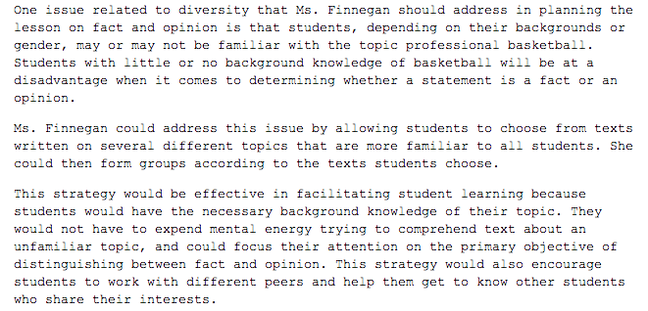
Sample Response

Slide 10
Any Questions?
Additional practice problems:
http://www.nystce.nesinc.com/Content/STUDYGUIDE/NY_SG_SRI_201.htm
Google: “NY State EAS Practice Exam”

Slide 11
KEY TAKEAWAYS: Effective Writing Strategies
Organize your thoughts before you write
Use the elements of the prompt to shape your outline
Get to your point quickly (no need for fluffy intro... make every word count)
Allow yourself time to review what you've written
Read your response out loud (in your head)
Clearly delineate the boundaries between your ideas and someone else's. It's definitely OK for you to have your own opinion here.

Slide 12
Thank You!
If you have any further questions, feel free to contact us
Amanda Huminski (ahuminski@gradcenter.cuny.edu)
Our Website: openlab.citytech.cuny.edu/writingacrossthecurriculum/

