Slide 1
Better Note Taking, Better Grades: A Student Workshop
Lisa Jahn
Robert Ostrom
Writing Across the Curriculum and READ
February 13, 2018
Notes:
Begin with introductions, give a brief overview of the workshop

Slide 2
Intro Activity
Do you take notes during lectures?
To what extent does your success in a class depend on note taking?
For the following lecture, take notes as you normally would
Christina Warinner “Tracking Ancient Disease Using Dental Plaque” (2012).
Notes:
To start off, we’d like you to get a sense of where you’re at with note taking, what your normal habits are.
Raise your hand if you take notes during lecture. Why?
Raise your hand if you don’t. Why?
Let’s hear from a few people, to what extent does your success in a class depend on note taking?
Thank you for sharing
Next, we’re going to watch a a portion of a lecture
Will you please take notes as you normally would in a class at CityTech.

Slide 3
Follow-up Discussion
Together with your neighbor, discuss how you took notes. Describe your method/style.
Identify the most important parts of the lecture.
How do you identify on your notes that these are important?
Notes:
1-2 minutes, maybe 2-3 answers from audience
Point out that there are styles and methods for note taking - Note taking as a process
Follow-up to the helpful question: would these notes be useful when you go to study?

Slide 4
Thoughts on Note Taking
Note taking is a cognitive skill
Not dictation
“Encoding” vs. “external storage”
Note taking is a form of writing
Requires practice
Initial effort = improved results
Notes:
Not dictation – not stenography
(Dictation: the action of saying words aloud to be typed)
(Stenography: taking shorthand dictation)
notetaking as e a generative activity because it encourages learners to build connections between lecture information and prior knowledge and experience.
The external storage function suggests that notes are valuable as a product because they are a repository of information for later review and additional cognitive processing. The learner can review notes to prevent forgetting, to relearn forgotten information, or as the basis for further generative activities” (Armbruster, Bonnie B. 2009. “Notetaking From Lectures,” in Rona F. Flippo & David C. Caverly, eds. Handbook of College Reading and Study Strategy Research, 2nd ed. New York and London: Routledge.)
Good example of external coding is the student who takes a picture of the ppt
Involves a number of cognitive steps, each helps reinforce learning and supports original thought/creativity
When you write things from the board or look at the PP slides, you are memorizing but not learning.
You still need to take notes on the things provided for you by the instructor.
Notes are a record of your synthesis of the material. Notes are meant to help you understand course material, not simply remember or memorize.
Other ways of thinking about note taking: process, interpret, understand, put it in your own words
It should go without saying, that your additional effort up front (i.e. notetaking) will make studying for tests more effective, writing papers easier, less time/stress before major assignments, better performance (A+)!
Like all writing, it takes practice to get good at it

Slide 5
Science demonstrates the power of note taking
Neuroscience suggests handwriting – in comparison to typing - stimulates brain activity, enhances learning (James & Englehardt 2012)
Notes by hand vs. laptop note taking: handwritten notes improved conceptual understanding over long-term (Mueller & Oppenheimer 2014)
Comparison of ‘guided notes’ vs. Cornell method of note taking: Cornell method leads to higher-level understanding (Jacobs 2008)
Notes:
Neurosci:
Note-taking by hand engages more brain areas that play an important role in learning.
Summarizing & reviewing your lecture notes before you sleep helps your brain store information/memories better. (reinforce this later)
Mueller & Oppenheimer:
Taking notes by hand leads to summarizing material on the spot, which helps you learn.
This is not the case with laptop note-taking
If recording, or take photo of board, still take notes!
Because typing is faster it leads to writing down everything vs. summarizing and encoding.

Slide 6
Note taking “best practices”
Write it down!
Question/Contextualize
Reflect/Summarize

Slide 7
1. Write it down
Differentiate between important and supporting materials
Paraphrase/Use your own words
Don’t write down everything! Simplify!
Use symbols, abbreviations, arrows, lines
e.g., i.e., b/c, w/, w/o, texting language (b4, WTF, IMO)
How do these strategies apply or look different in your humanities classes versus your science / math classes?
Notes:
Ask question: how do you determine what’s important in a lecture?
How to differentiate importance:
-repetition
-modes of speaking, hand gestures
-learn your professor’s cues and style
-if you ONLY write down what’s on the board, or things that the professor says “are important,” then you are likely missing out on many of the overarching themes/important points
-this is why ONLY looking at a power point might not yield results….
FOMO – fear of missing out! Don’t worry if you don’t catch everything!
Paraphrase: Encourage students to develop their own voice when paraphrasing the source material
Paraphrasing: combining elements and placing the source material into a perspective
Don’t be afraid to make it simpler for yourself
Use layout to your advantage to indicate importance, corollary thoughts, hierarchy
“You’re not graded on your notes, you’re graded on your knowledge”
Introduce some symbols – “therefore,” e.g., i.e., numbered lists

Slide 8
2. Question/Contextualize
Write down questions that you have
Write your own thoughts about the material separate from lecture
Indicate feelings/thoughts/events that occur during lecture to act as guideposts during review
Notes:
Remember: - comment on terms provided/things written on board in order to facilitate understanding/avoid rote memorization.
- Write down things like: that was a great thought, this relates to an earlier thought, etc.
Feelings:
e.g. You start to feel hungry; someone got up to use restroom – these items will reinforce the content that was delivered simultaneously, and also prevent you from getting distracted/mind wandering
- Feelings about both material and ambient/extracurricular things.

Slide 9
3. Reflect/Summarize
How does this fit in to what I already know?
What is the main theme of this particular page of notes?
What questions do I need clarified?
What are the guiding questions for this material?
This should be done AFTER the lecture, but before you go to sleep that night.
Notes:
The third, and oftentimes neglected, step of successful note taking is summarization and reflection
Give your brain time to process/rest, but also make sure you retain the information before restarting a new day
Neuroscientific studies show that this helps your brain store information/memories better.
It’s ideal to do it that night
Don’t wait until the day before the exam to review your notes, make it part of your nightly routine.
It’s like working out, you have to do it frequently to see results. You can’t just run a marathon the day before you want to lose 10 lbs.
Big questions that you have – if you do, you can ask about it at the beginning of the next class and score some participation points. Your prof. will remember you. “I was reviewing my notes from last class…”

Slide 10
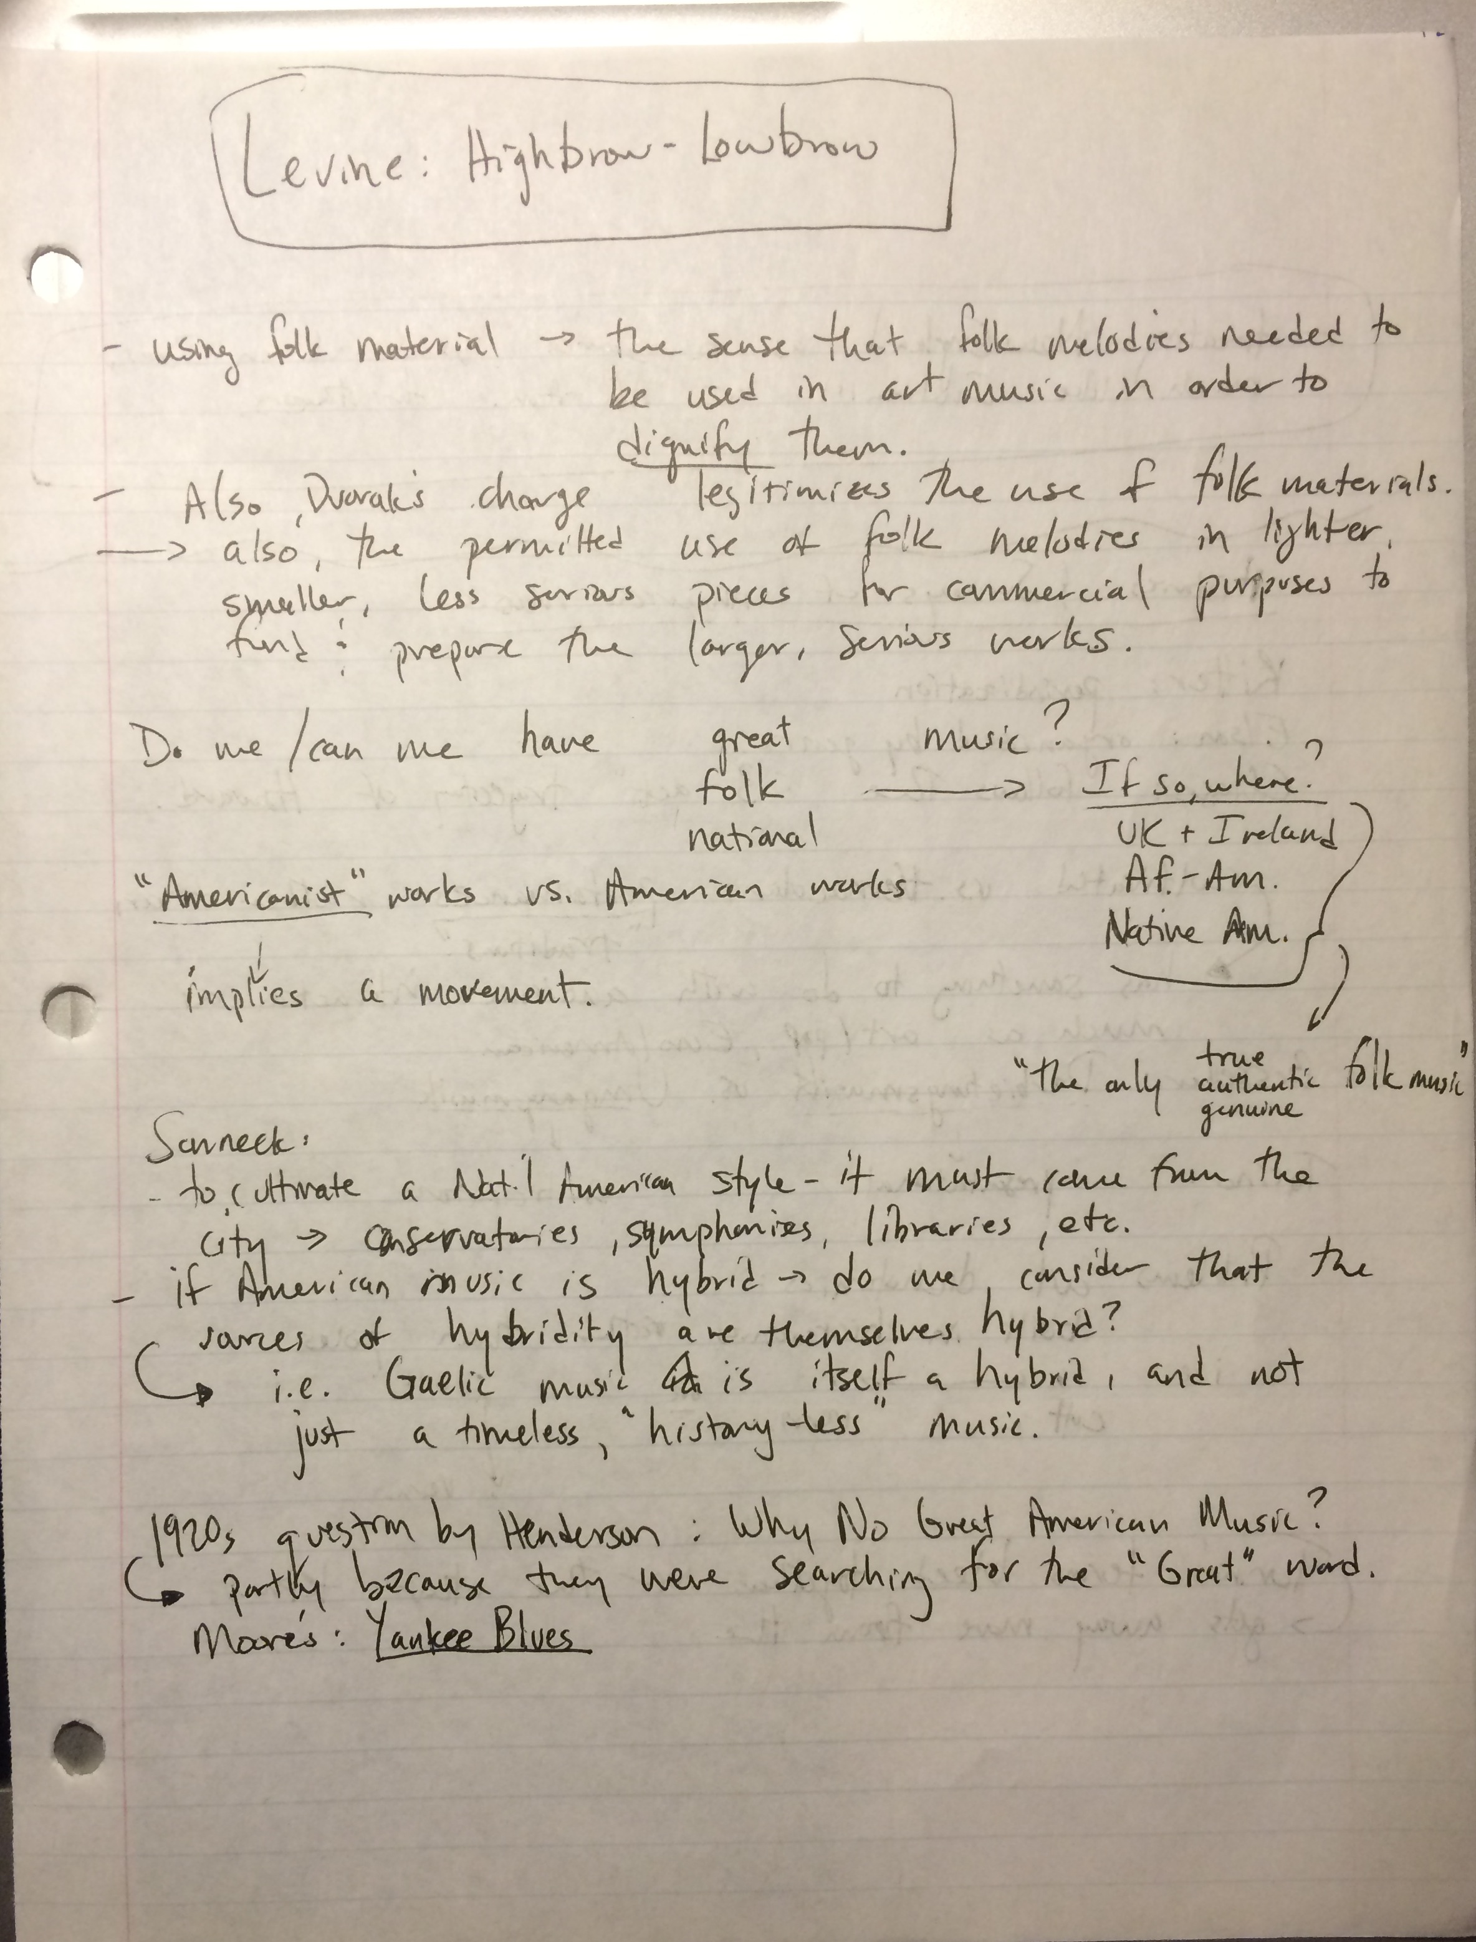
Notes:
When played it will demonstrate the different approaches to note taking
1.Parapharsing – using your own words
2.Important concepts/themes
3. Raising a question

Slide 11
How is this done?
“Cornell Method”
Notes:
Great note taking takes time to develop. Eventually, you’ll figure out your own unique process.
But, a good place to start is with the Cornell system of note taking.
It’s a template, a way to organize your sheet of paper
Walk through handout with them on the next slide
(See PDF handout. Retrieved from http://lsc.cornell.edu/study-skills/cornell-note-taking-system/)

Slide 12
QUESTIONS/
REFLECTIONS: After Class
NOTES: During Class
SUMMARY: After Class
Notes:
Divide your sheet (We will actually give these out)
Notes during class: Main points and details
Quest/Reflect: After class, main ideas, prompts and questions
Summary: After class, sunray of the lesson, highlighting the main points

Slide 14
Try it out!
Watch another lecture
Thelma Goldman, “How Art Gives Shape to Cultural Change.” Ted Talk (2013)
Notes:
1:45 -5 min.
Don't do the bottom "summary" part right now, because remember you do that after the lecture but before going to bed that night.

Slide 15
Recap
Was this harder than the original note taking?
Practice!!
Don’t worry about missing out!
If using your computer, write notes in your own words.
Notes:
Do you think these notes will be easier for exam/paper writing review?
Make sure to reinforce that this is the normal growing pain of learning this specific skill but it will likely pay dividends in the end for them if they commit to trying this technique out for a full semester in their own courses.
some students in that limited time may feel they struggled with attempting to "do" the strategies or that it feels uncomfortable to them.

Slide 16
Some Interesting Links
Cornell Method of note taking
http://lsc.cornell.edu/wp-content/uploads/2015/10/Cornell-Note_Taking-System.pdf
https://shp.utmb.edu/asa/Forms/cornell%20note%20taking%20system.pdf
Relevant studies
(James & Engelhardt 2012) http://www.sciencedirect.com/science/article/pii/S2211949312000038#
(Mueller & Oppenheimer 2014) http://pss.sagepub.com/content/25/6/1159.full
Other:
https://openlab.citytech.cuny.edu/writingacrossthecurriculum/2014/09/02/notetaking-by-hand-writing-to-learn/

Slide 17
Taking Notes on Reading by Dr. Robert Ostrom

Slide 18
Thank you!
Please visit the Writing Across the Curriculum website for student resources. https://openlab.citytech.cuny.edu/writingacrossthecurriculum/student-resources/
Lisa Jahn ljahn@gradecenter.cuny.edu
Avoiding Plagiarism April 19 @ 1pm.

