Slide 1
APA Style, Citations & Plagiarism Dining Operations Lecture Class Yosefa Ehrlich, WAC Fellow September 7, 2017

Slide 3
What is it?
APA Format
Style / format for writing academic papers- convention
Most common in social sciences (v. MLA – liberal arts / humanities)
(American Psychological Association)
How to organize your paper (sections)
How to reference the work of others

Slide 4
Why do we care?
APA Format
1. Provides a common language
Notes:
Computer’s way of saying it doesn’t understand the format. Doesn’t know how to read what you’re asking it to read

Slide 5
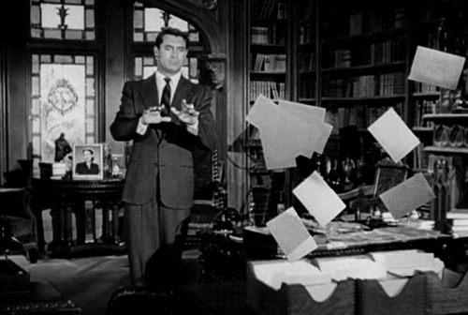
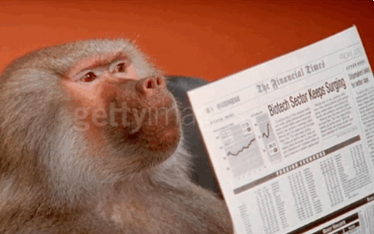
Why do we care?
APA Format
2. Helps writer stay organized
3. Helps reader navigate paper
Notes:
Allows the writer to present thoughts in an organized way
Familiar format so the reader can quickly scan the paper for the important material

Slide 6
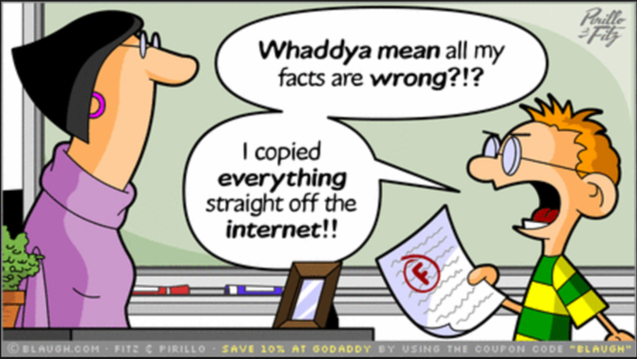
Why do we care?
APA Format
4. Protects against plagiarism by allowing proper citation
Notes:
This allows us to protect ideas
Proves that you did your own work

Slide 7
Basic Format:
APA Format
Title Page
Abstract
Body: Intro, Methods, Results, Discussion
References

Slide 8
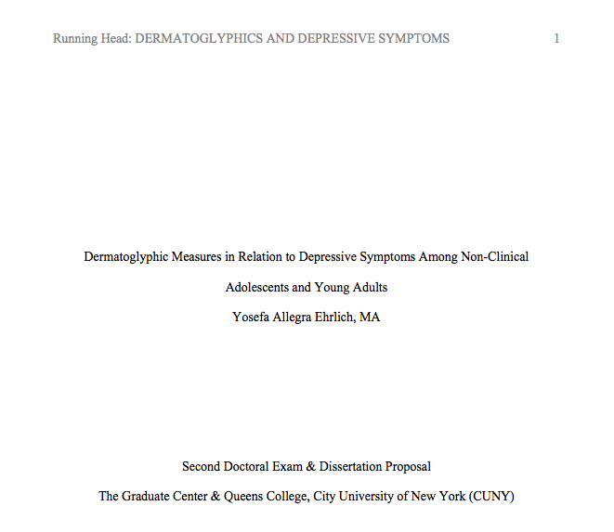
APA Format
Running Head
Page #
Title Page
Paper Title
Author Name
Course
Professor Name
Submission Date
Notes:
Running head – shortened version of paper’s full title. Only include words Running Head on 1st page
Title – summarize main points of the paper
See guidelines for specifics on what to include in bottom

Slide 9
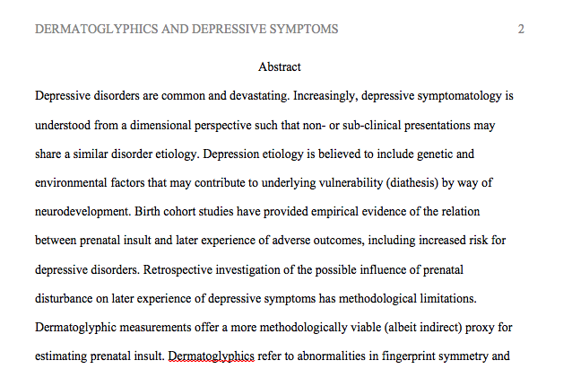
APA Format
Abstract
Single paragraph that summarizes the whole paper
Presents main ideas, methodology and findings
Notes:
Note: No longer says’ Running Head’

Slide 10
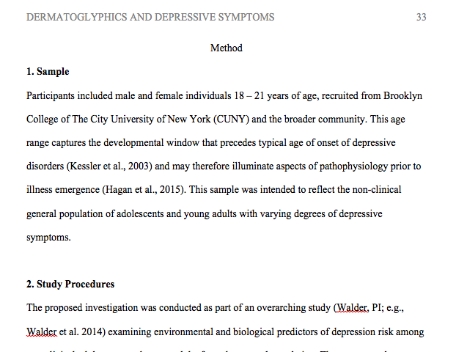
APA Format
Body
Introduction
Methods (can be divided into subsections)
Results
Discussion
Notes:
Note: No longer says’ Running Head’

Slide 11
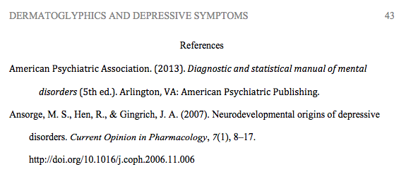
APA Format
References
Journal Article:
Author, A. A., Author B. B., & Author C. C. (Year). Title of article. Title of Periodical, volume number(issue number), pages. URL of website.
Author A. A. (Year of publication). Title of book: Capital letter for subtitle. Location: Publisher.
Book:

Slide 12
Citations: Plagiarizing Paraphrasing Quoting
What are they?
APA Format
In-text references that indicate the source where you obtained the information (Ehrlich, 2017).
Format: (Last Name, Year)
Alt format: “According to Ehrlich (2017)…”
Multiple authors :
(Ehrlich & Tyson, 2017)
If 6 + authors (Ehrlich et al., 2017)
Notes:
Think hyperlinks in Wikipedia – you’re providing knowledge and referring to the sources where you obtained that knowledge so the reader can find it themselves
There are various ways to format them- these are just some examples

Slide 13
Citations: Plagiarizing Paraphrasing Quoting
Why do we care?
APA Format
Penalties
Respect others’ ideas
Ensure proper credit for your original ideas
No one expects you to know everything
“If I have seen further, it is by standing on the shoulders of giants” – Sir Isaac Newton
Authenticity / integrity
Notes:
We build on knowledge and transfer it from one generation to the next
This is how we share information forward

Slide 14
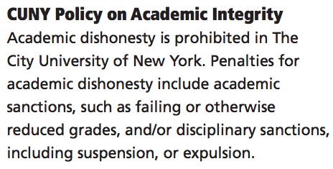
http://www.citytech.cuny.edu/catalog/docs/catalog.pdf

Slide 15
Restate someone else’s words in a new way:
Change entire structure, not just a few words
Retain original meaning
Cite (Last Name, Year)
APA Format
Citations: Plagiarizing Paraphrasing Quoting
Original:
Any trip to Italy should include a visit to Tuscany to sample their exquisite wine.
- Mike Tyson, 2008
Paraphrase:
Be sure to include a Tuscan wine-tasting experience when visiting Italy (Tyson, 2008).

Slide 16
Reproduce another author’s words verbatim.
Only include if author said it best
< 40 words, include in text
> 40 words, present as block
Cite with page # (Last Name, Year, p. XX)
APA Format
Citations: Plagiarizing Paraphrasing Quoting
Put simply, “any trip to Italy should include a visit to Tuscany to sample their exquisite wine” (Tyson, 2008, p. 45).
According to heavy weight champion Tyson (2008), “any trip to Italy should include a visit to Tuscany to sample their exquisite wine” (p. 45).

Slide 17
Resources
Tutorial on APA style: http://flash1r.apa.org/apastyle/basics/index.htm?_ga=2.105626307.1976846484.1504282506-1454284476.1504282506
Comprehensive APA style guide: https://owl.english.purdue.edu/owl/resource/560/01/
Sample paper: https://owl.english.purdue.edu/owl/resource/560/18/
Citation maker: http://www.citationmachine.net/#

