Slide 1
Avoiding Plagiarism and Using Library Resources
Writing Across the Curriculum Fellows
Pamela Thielman and Wilson Sherwin
October 22nd 2015

Slide 2
Workshop Agenda
  Understanding plagiarism
  Strategies for preventing plagiarism
  Responding to plagiarism
Notes:
Emphasize that you are obligated to respond to plagiarism as an incentive to avoid in the first place.
Brainstorming activity! QUIZ Questions 3, 11, 15

Slide 3
Quiz: What Counts as Plagiarism?
Troubling Questions?
3. I got my friend to read my paper and write down other quotes that would help support my argument.
11. My tutor rewrote my thesis statement to change it from a summary to something that opens up an argument.
15. My class discussed the reading and I used some of the points my teacher wrote on the board in my essay.
Notes:
Emphasize that you are obligated to respond to plagiarism as an incentive to avoid in the first place.
Brainstorming activity! QUIZ Questions 3, 11, 15

Slide 4
I. Understanding Plagiarism
“Students and all others who work with information, ideas, texts, images, music, inventions, and other intellectual property owe their audience and sources accuracy and honesty in using, crediting, and citing sources. As a community of intellectual and professional workers, the College recognizes its responsibility for providing instruction in information literacy and academic integrity, offering models of good practice, and responding vigilantly and appropriately to infractions of academic integrity.” – NYCCT statement on academic integrity
“Students and all others who work with information, ideas, texts, images, music, inventions, and other intellectual property owe their audience and sources accuracy and honesty in using, crediting, and citing sources. As a community of intellectual and professional workers, the College recognizes its responsibility for providing instruction in information literacy and academic integrity, offering models of good practice, and responding vigilantly and appropriately to infractions of academic integrity.” – NYCCT statement on academic integrity
“Students and all others who work with information, ideas, texts, images, music, inventions, and other intellectual property owe their audience and sources accuracy and honesty in using, crediting, and citing sources. As a community of intellectual and professional workers, the College recognizes its responsibility for providing instruction in information literacy and academic integrity, offering models of good practice, and responding vigilantly and appropriately to infractions of academic integrity.” – NYCCT statement on academic integrity
Notes:
An important starting point in preventing plagiarism among your students is to be sure that you are all on the same page about what exactly it means. Students must know what it is in order to avoid it. Here is the statement of academic integrity from the city tech policy manual.
Required to go on syllabi, let’s unpack it a little.

Slide 5
Common Justifications and/or
Actual Reasons for Plagiarism:
“I didn’t know this was plagiarism.”
“But, my professor asked for two quotations and that’s what I did!”
“My writing isn’t good enough.”
“My English isn’t strong enough.”
“I’m not an expert in this topic, what could I possibly have to say that’s important?”
“I can’t write this entire paper tonight!”
Notes:
Students aren’t always trying to cheat when they plagiarize!
“Good faith” citation errors
Bad Paraphrasing
Themes:
1-2: lack of knowledge/understanding of what plagiarism is
3-4: lack of self-confidence/ Cultural differences
5. getting overwhelmed
6: bad time management

Slide 6
II. Strategies for Preventing Plagiarism

Slide 7
1. Education and Awareness
  In Class Discussions
    Pedagogical purpose of research (“Coach” not “Police”)
  Assignments / Quiz to help students
  Further Resources
  Student workshop in the spring
  Baruch library tutorial
Notes:
[Jake]
Share what you know – have an open and honest discussion about what plagiarism is. Don’t just say “don’t plagiarize,” define it for them so there is no mystery, and you are all on the same page.
Remember – they might have been taught to “do research” incorrectly in high school.
-Some HS teachers, unfortunately, accept plagiarism as legitimate research.
Think about the way you approach students - students turn off when you start to sound like a police officer or parent telling them how to behave.
You might have more luck talking to them as you are – really – a scholar speaking to a group of future fellow scholars - who all are in the same boat and must play by the same rules with respect to writing and plagiarism
Point 2:
It’s not about getting it “right” -self-efficacy – identify the pedagogical goal of a research project. Otherwise students might see it as busy work.
presenting an original idea that contributes to the community
(BD) Most students have not been exposed to secondary sources and/or research papers before they are asked to do assignments. Make sure they have seen relevant examples prior to assignment.
Let students know what you are asking for in an assignment.
Make sure to offer constructive input when students veer into grey area.
---We have for you a sample handout – that is filled with all kinds of information in different forms – which can be given directly to students, or taken apart as you please. AT the end is the entirety of the quiz we worked on earlier and another exercise that helsp students identify plagiarism

Slide 8
2. Teaching Paraphrasing
Paraphrasing is difficult
  Tough cognitive ability (native and ELL students)
Developing paraphrasing skills
  Beyond summary → synthesis
Model good paraphrasing
  Remember: this isn’t just extra work for you! Also helps students understand course content
Notes:
Earlier we discussed different types of plagiarism...
Errors in quoting or citing correctly can be easier to correct
We tell students to paraphrase, which involves combining elements and placing source materials into a perspective, but we don't explain what it is, or show them how to do it.
This task involves a high level of cognitive ability, both for native english speakers and ESL students
Encourage students to develop their own voice when paraphrasing the source material
Paraphrasing: combining elements and placing the source material into a perspective
Help student understand the material they're reading: If they don’t understand it they’re more likely to just borrow key words and rearrange.
Model paraphrasing -- start with easy examples and work up to expert writing
Understand course content – if we ask students to do paraphrase exercises with assigned readings, it helps them understand the readings better.

Slide 9
Paraphrasing
The original passage: Students frequently overuse direct quotation in taking notes, and as a result they overuse quotations in the final [research] paper. Probably only about 10% of your final manuscript should appear as directly quoted matter. Therefore, you should strive to limit the amount of exact transcribing of source materials while taking notes.
Lester, J. D. (1976). Writing Research Papers. 2nd ed. 46-47.
Version 1: Students often use too many direct quotations when they take notes, resulting in too many of them in the final research paper. In fact, probably only about 10% of the final copy should consist of directly quoted material. So it is important to limit the amount of source material copied while taking notes (Lester, 1976).
Version 2: In research papers students often quote excessively, failing to keep quoted material down to a desirable level. Since the problem usually originates during note taking, it is essential to minimize the material recorded verbatim (Lester, 1976).
Notes:
Earlier we discussed different types of plagiarism...
Errors in quoting or citing correctly can be easier to correct
We tell students to paraphrase, which involves combining elements and placing source materials into a perspective, but we don't explain what it is, or show them how to do it.
This task involves a high level of cognitive ability, both for native english speakers and ESL students
Encourage students to develop their own voice when paraphrasing the source material
Paraphrasing: combining elements and placing the source material into a perspective
Help student understand the material they're reading: If they don’t understand it they’re more likely to just borrow key words and rearrange.
Model paraphrasing -- start with easy examples and work up to expert writing
Understand course content – if we ask students to do paraphrase exercises with assigned readings, it helps them understand the readings better.

Slide 10
3. Plagiarism-Resistant Assignments
Use Unique Details
Scaffolding
Notes:
helpful info: what databases should students start with? Which are appropriate for your discipline/this particular project
Have students turn in a short assignment that builds towards a larger one
DON’T PANIC: WE WILL GO OVER ALL THESE POINTS IN DETAIL

Slide 11
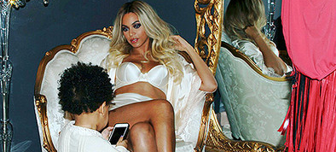
Use Details in Assignments
Current events
Specific, novel/unique applications of concepts
Notes:
Another strategy for designing plagiarism resistant assignments is … make the assignment so specific, that it cannot be found elsewhere. Beyonce example
Current events – not as much written about it.
Encourage students to express their own opinion.
Consider alternative paper styles – rather than a report, call it an email to a friend.

Slide 12
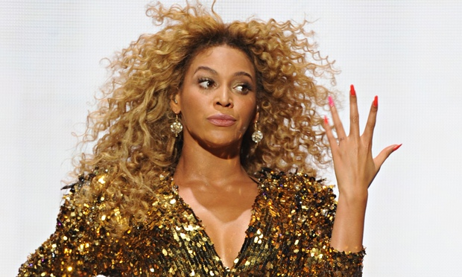
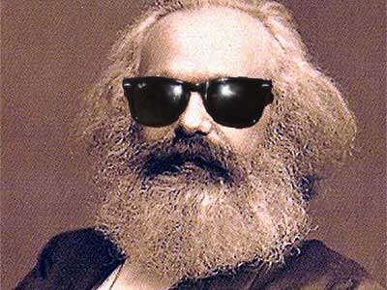
Group Activity
What key concept could your students understand via a contemporary or unique approach?
Notes:
Break into groups, identify three key concepts you focus on in one of your classes. Share them with the group then decide on *one* and design an assignment in which students apply the concept to either a contemporary event or in a non traditional way. (How long do we give them for this?)

Slide 13
Scaffolding
  Discrete steps that build towards a larger assignment
  Or smaller steps that build skills
  Helps with time management and confidence building: two potential contributing factors of plagiarism
  “One of the main goals of scaffolding is to reduce the negative emotions and self-perceptions that students may experience when they get frustrated, intimidated, or discouraged when attempting a difficult task without the assistance, direction, or understanding they need to complete it.” Source: the GLOSSARY OF EDUCATION REFORM
Notes:
[Jake]
Cumulative actually compel them to think about and complete the assignment in stages, OR – simply assign smaller assignments that build the skills required for them to complete the final assignment.
---tough to plagiarize because such quirky, tiny pieces
---tackling smaller assignments gives students confidence–in skills, or because they have done parts of the assignment well before it’s due
---helps avert plagiarism bc students who have committed to a topic, or a point of view in a set of assignments already will not be able to find an already done assignment that will match their earlier work
-fights the reasons for plagiarism that we introduced originally – getting overwhelmed, bad time management, lack of self-confidence.
Informal = can be graded OR ungraded
Breaks skills into discrete steps. E.g. if you are requiring a thesis statement or a methodology section or an analysis, you can assign these as small informal tasks to be completed before final project.
Helps students process course content and experiment with ideas without pressure to be “right” – bring it back to the fact that many of our students are looking for the “right” answer.
Quotation
not just how to quote, but how to integrate quotes into student writing.
---all kinds of in-class assignments that can help lead to a paper – here are a few that aid in content digestion
---comments, questions, quotations – for students to respond to – and these can be graded – and viewed by peers
---reading journal can take many forms, answering questions, responding to prompts, tracking a them or idea, generating questions, free-writes, etc.
e.g. during the last five minutes of class, ask students to write a response to a prompt, such as, “Explain to me what . . . (key concept from class) means”; or, “Tell me why . . . (key concept from class) is important to (larger topic).”
Teach quotation:
Not just proper citation, but integration into text

Slide 14
Sample Scaffolded Assignment Schedule
Assignment: Find an idea in one of the assigned critical readings of Jane Eyre with which you disagree. Figure out why you think it is wrong, and write a 5-7 page persuasive essay arguing for your own, “better” reading…
In-class summary of novel: 10% of grade – 10/25
Summary of idea with which you disagree: 10% of grade – due 11/1
Annotated bibliography of at least 2 sources that support your reading: 10% of grade – due 11/8
First Draft: 10% of grade – due 11/21
Peer Review Participation: 10% of grade – 11/21
Second Draft: 50% of grade – due 11/26
Notes:
This is a sample assignment that is cumulative – in the sense that the student completes the larger assignment in stages—ideally to avoid that night before it’s due panic, and to enhance the quality of the work product – through longer-term thinking and revising.
This is a schedule though – each of these steps should receive its own prompt/handout/written explanation.
Make sure you include grade values so students know up front that they’re going to need to complete all these to get the A.

Slide 15
4. Library Support
Collaborate with library faculty to
  develop students’ research skills
  help you develop subject and research guides
Urge students to visit the reference desk or schedule research consultations with librarians
Take students to the library!
Notes:
[Bronwen]
Demo of library website – here or in conjunction with another slide…
Suggestions for shaping assignments: limiting assignments to a few particularly fruitful databases
Suggest that faculty take students to the library – for a mini tour?
Subject guides, tutorials,

Slide 16
Library Resources
Library subject specialists: http://cityte.ch/dir
Library catalog: http://cityte.ch/cat
Library databases: http://cityte.ch/db
Tutorials and Subject Guides
Notes:
[Bronwen]
Demo of library website – here or in conjunction with another slide…
Suggestions for shaping assignments: limiting assignments to a few particularly fruitful databases
Suggest that faculty take students to the library – for a mini tour?
Subject guides, tutorials,

Slide 17
III. Responding to Plagiarism
Notes:
[Bronwen]

Slide 18
What To Do if You Suspect Plagiarism
  Use a plagiarism detection site like SafeAssign
  Schedule a meeting with your student
  Keep copies of student work
  Keep records of your interactions with the student
  Make sure the student understands the impact on the course grade
Report to your Department Chair

Slide 19
Academic Integrity Committee
Refer to the Academic Integrity Policy Manual for info about how to report cases of plagiarism.
https://www.citytech.cuny.edu/students/academic_integrity/ai_flow_charts.pdf
While the consequences for plagiarizing are very serious, it is still possible to respond constructively and make sure that your students understand what is expected of them moving forward.

Slide 20
Contact
Pamela Thielman: pthielman@citytech.cuny.edu
Wilson Sherwin: ssherwin@citytech.cuny.edu
NEXT WORKSHOP: Effective Grading and Minimal Marking, Thursday 11/19, LOCATION: Namm 1005
Read chapter 15 and 16 in Engaging Ideas (Bean)
http://openlab.citytech.cuny.edu/writingacrossthecurriculum

