Slide 1
Better Note Taking, Better Grades: A Student Workshop
Alicia Andrzejewski
Albert de la Tierra
Writing Across the Curriculum Fellows
February 21, 2017

Slide 2
Intro Activity
Do you take notes during lectures?
To what extent does your success in a class depend on note taking?
For the following lecture, take notes as you normally would
Bonnie Bassler, "How Bacteria Talk.” Ted Talk (2013)

Slide 3
Follow-up Discussion
Together with your neighbor, discuss how you took notes. Describe your method/style.
Identify the most important parts of the lecture.
How do you signify on your notes that these are important?

Slide 4
Thoughts on Note Taking
Note taking is a cognitive skill
Not dictation
“Encoding” vs. “external storage”
Note taking is a form of writing
Requires practice
Initial effort = improved results
WAC Fellows: brief personal experiences

Slide 5
Science demonstrates the power of note taking
Neuroscience suggests handwriting – in comparison to typing - stimulates brain activity, enhances learning (James & Englehardt 2012)
Notes by hand vs. laptop note taking: handwritten notes improved conceptual understanding over long-term (Mueller & Oppenheimer 2014)
Comparison of ‘guided notes’ vs. Cornell method of note taking: Cornell method leads to higher-level understanding (Jacobs 2008)

Slide 6
Note taking “best practices”
Write it down!
Question/Contextualize
Reflect/Summarize

Slide 7
1. Write it down
Differentiate between important and supporting materials
Paraphrase/Use your own words
Don’t write down everything!
Simplify!
Use symbols, abbreviations, arrows, lines
Spatially organize
Use layout to indicate importance, corollary thoughts, hierarchy
e.g., i.e., ∴, b/c, w/, w/o, texting language (b4, WTF, IMO)
How do these strategies apply or look different in your humanities classes versus your science / math classes?

Slide 8
2. Question/Contextualize
Write down questions that you have
Write your own thoughts about the material separate from lecture
Indicate feelings/thoughts/events that occur during lecture to act as guideposts during review

Slide 9
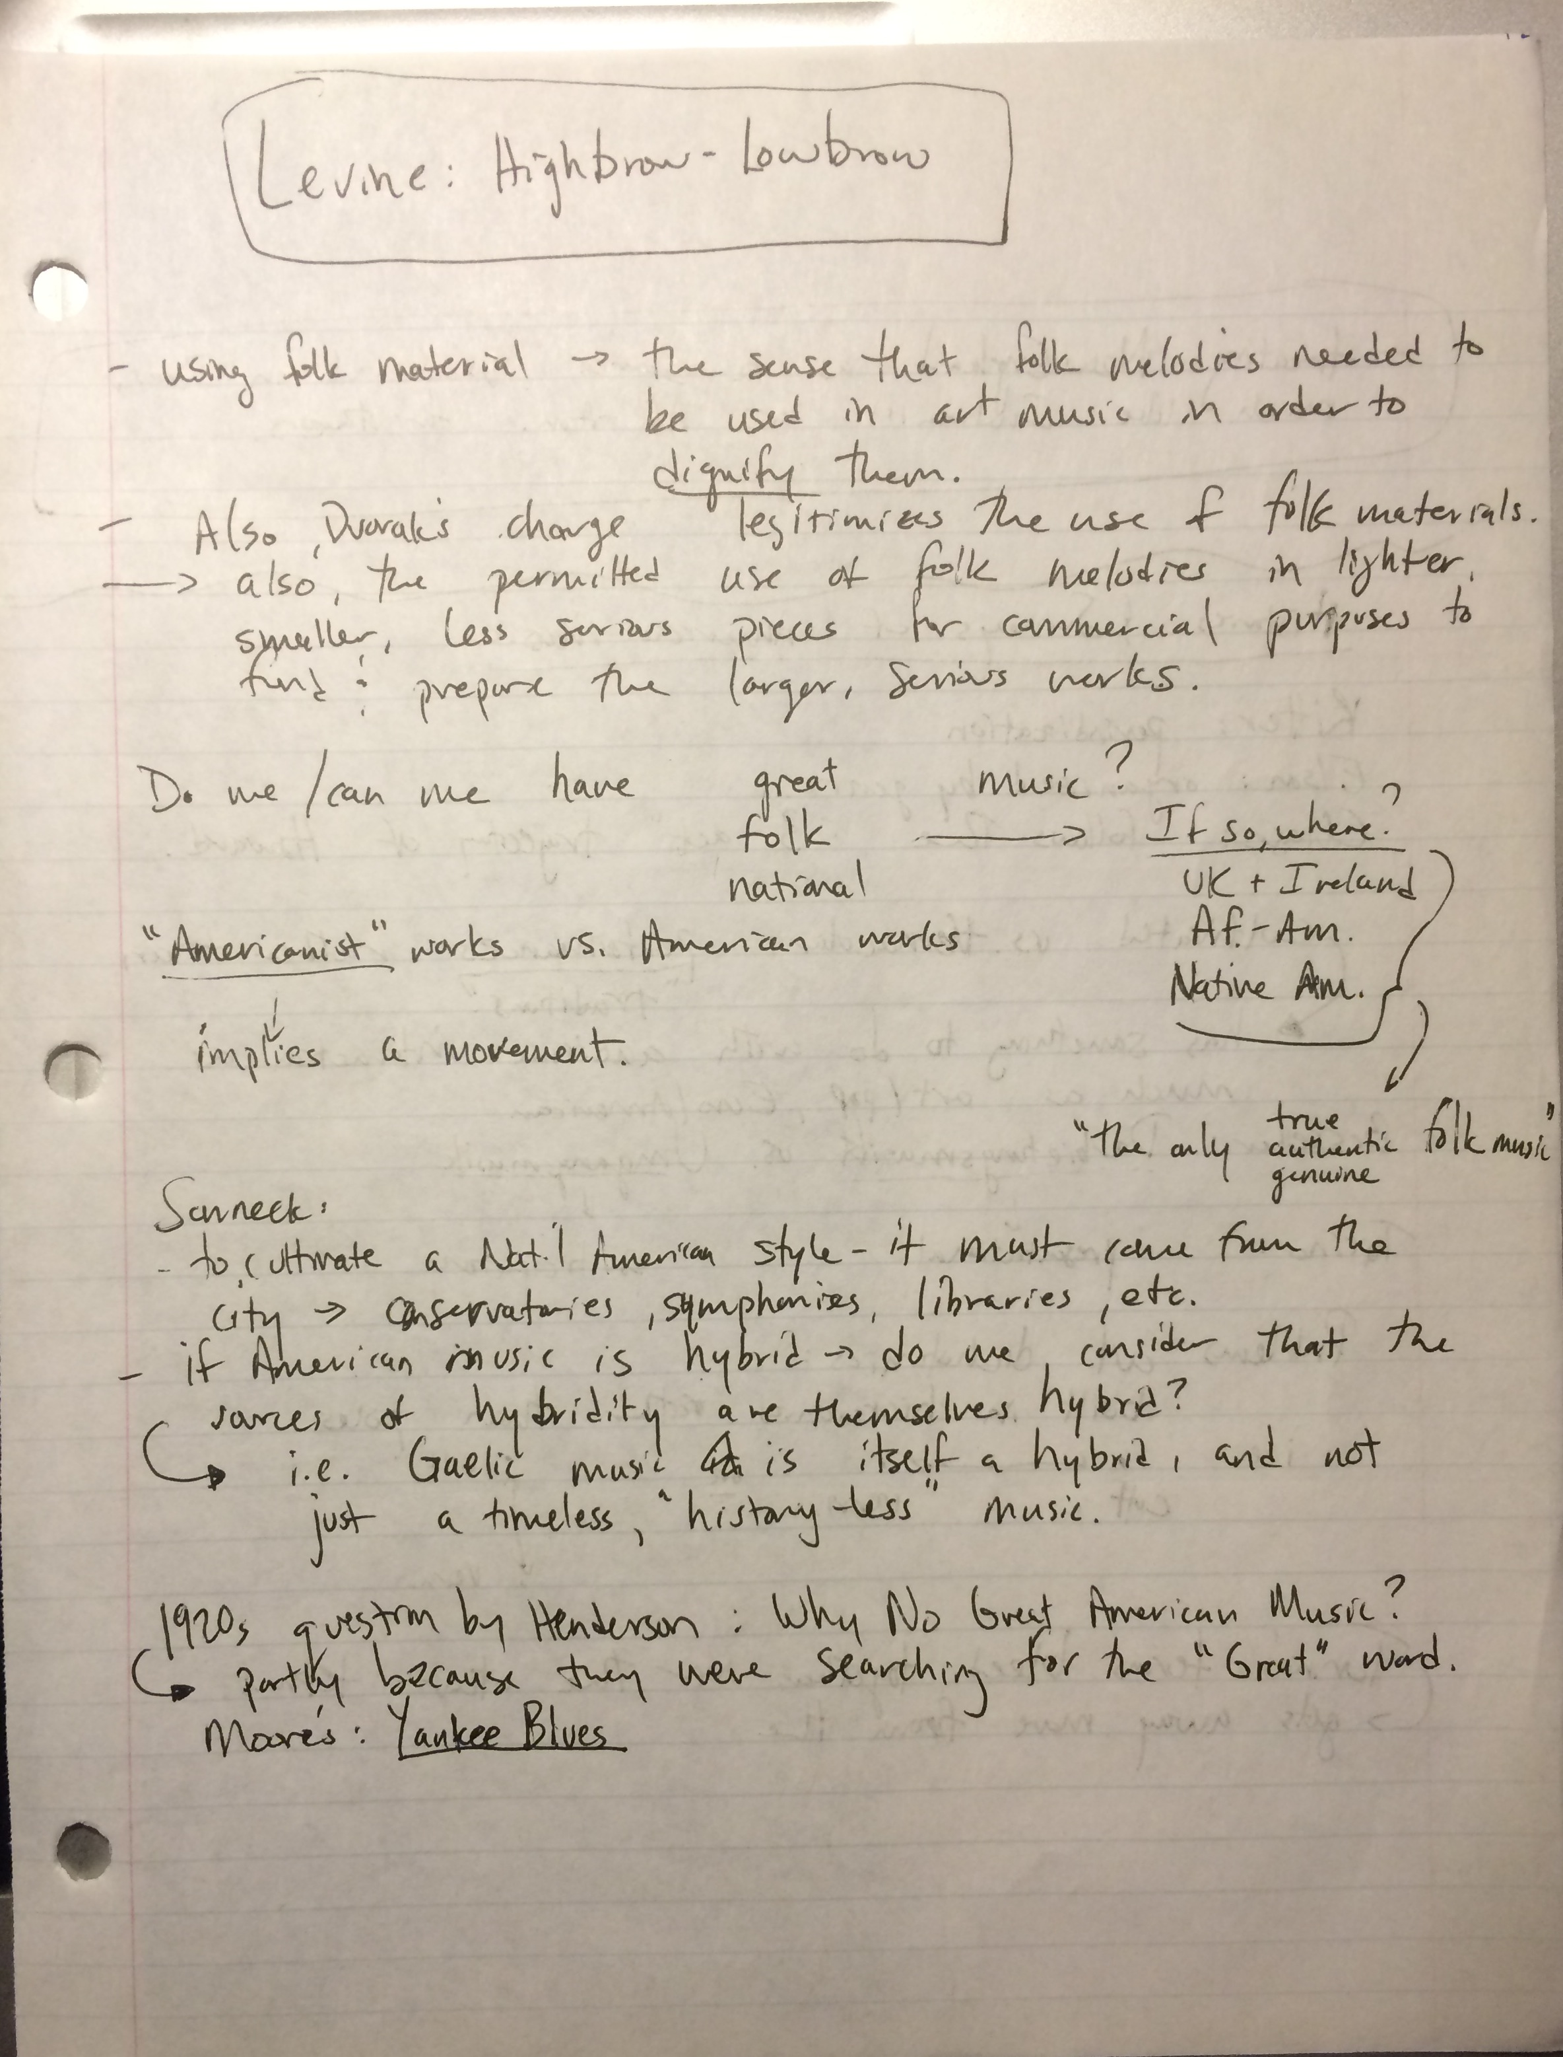

Slide 10
3. Reflect/Summarize
How does this fit in to what I already know/prior knowledge?
What is the main theme of this particular page of notes?
What questions do I need clarified?
What are the guiding questions for this material?
This should be done AFTER the lecture, but before you go to sleep that night.

Slide 11
How is this done?
“Cornell Method”

Slide 12
QUESTIONS/
REFLECTIONS
NOTES
SUMMARY

Slide 15
Try it out!
Watch another lecture
Thelma Goldman, “How Art Gives Shape to Cultural Change.” Ted Talk (2013)

Slide 16
Recap
Was this harder than the original note taking?
Practice!!
Don’t worry about missing out!
If using your computer, write notes in your own words.

Slide 17
Taking notes on reading
If it’s a book, you can do the same thing, however….
Beware of reliance on highlighting/underlining
Add comments to highlighting – helps you remember why you highlighted it
Your notes in the margin are the same as the left-hand column in Cornell method
Take notes on PowerPoint slides from your professors

Slide 18
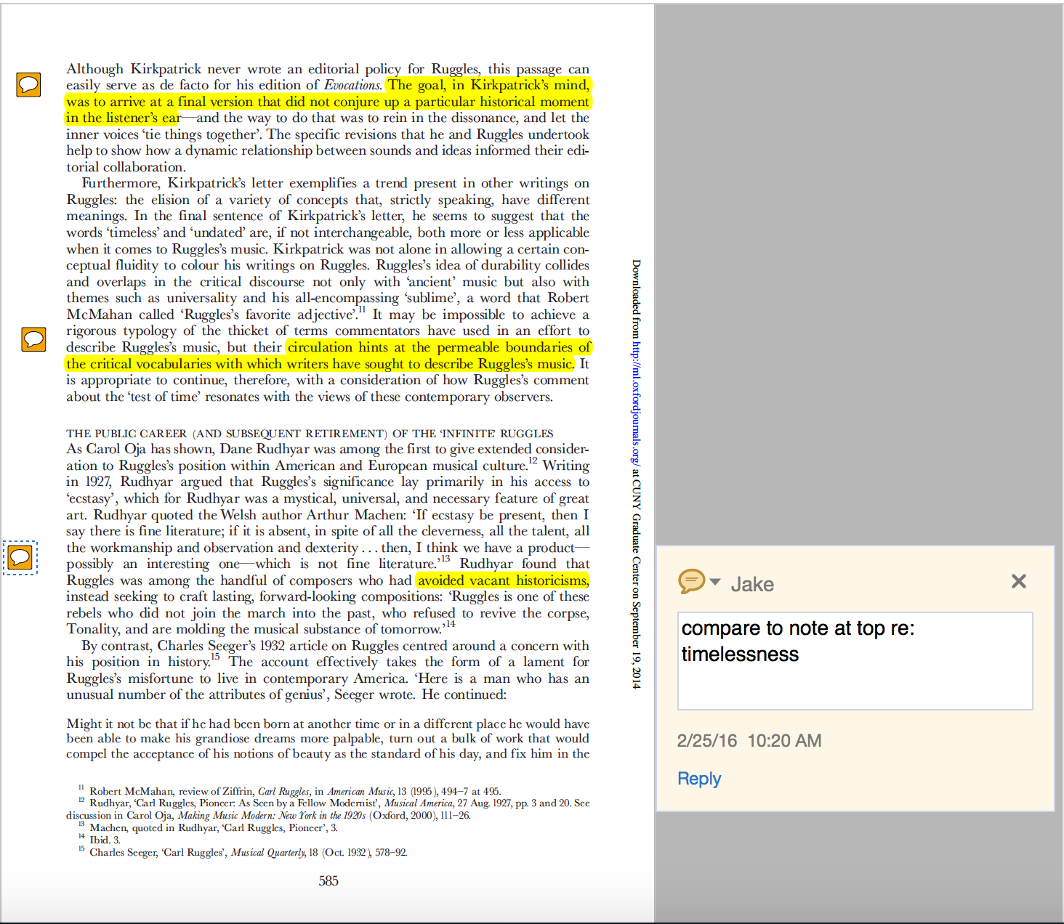
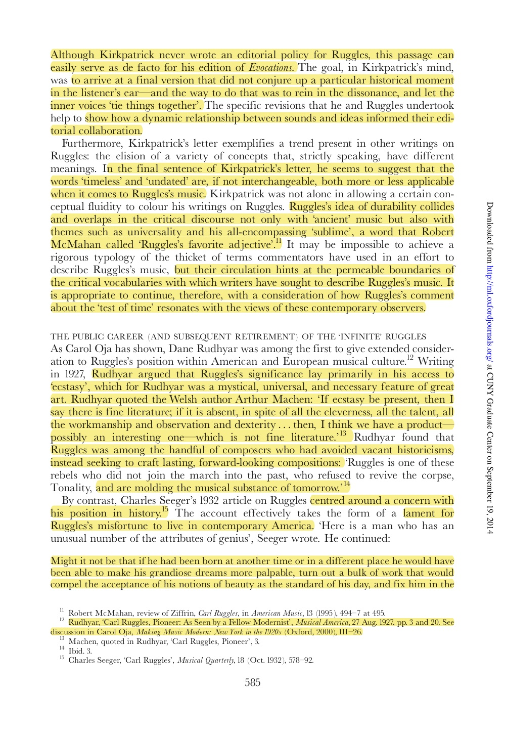

Slide 19
Questions/Comments
If you want to review this presentation, visit our web page: http://tinyurl.com/CityTechWAC
(…but make sure you take notes on it!!)

Slide 20
Some Interesting Links
Cornell Method of note taking
http://lsc.cornell.edu/wp-content/uploads/2015/10/Cornell-Note_Taking-System.pdf
http://www.wyzant.com/resources/lessons/study-skills/cornell-notes
https://shp.utmb.edu/asa/Forms/cornell%20note%20taking%20system.pdf
Relevant studies
(James & Engelhardt 2012) http://www.sciencedirect.com/science/article/pii/S2211949312000038#
(Mueller & Oppenheimer 2014) http://pss.sagepub.com/content/25/6/1159.full
(Jacobs 2008) http://absentprof.missouristate.edu/assets/WritingCenter/Wichita_and_Cornell.pdf
Other:
https://openlab.citytech.cuny.edu/writingacrossthecurriculum/2014/09/02/notetaking-by-hand-writing-to-learn/

