Slide 1
Effective Grading Strategies
A workshop presented by New York City College of Technology Writing Fellows
Louis Lipani
Bisola Neil

Slide 2
Goals
I. Improve Student Writing
II. Efficient Grading Strategies

Slide 3
Brainstorm Activity
Working together in a group, take two minutes to
brainstorm the elements that you evaluate when grading a
student paper (e.g. thesis, spelling, etc.)
Notes:
At he end of the two minutes, ask participants what do they look for when grading?
Sort answers by lower and higher order concerns
Whiteboard or chart paper needed
What room???

Slide 4
Higher-Order Concerns
Lower-Order Concerns
Spelling
Grammar (agreement)
Formatting (font, spacing)
Citation
Punctuation
Sentence structure
Vocabulary/word choice
Style
Thesis statement
Quality of argument/ideas
Evidence used correctly
Logic of conclusions
Use of topic sentences
Organization of paper
Follows assignment?
Demonstrates understanding of course material
Notes:
Faculty often think of writing as a lower-order concern. YOU as a faculty are the expert in higher-order concerns, even if you feel less comfy w lower-order. Higher-order concerns also discipline specific.

Slide 5
Upfront Work Will Pay Dividends
Design High Quality Assignments
Students will start earlier
Students will have fewer questions
Clarify Grading Criteria
Rubrics
Examples of Past Student Work
Organize Class Discussion
Paired Interviews about Paper Ideas
Notes:
Norming Session example where is it?

Slide 6
Recognize and Engage Partners
Peer Reviews
Face-to-Face
Discussion Boards
Group Conferences
Instructor Involvement
Atrium Learning Center
http://www.citytech.cuny.edu/students/learningcenter/
ESL Writing Tutors in English Department

Slide 7
Myth
“Students’ writing will improve in direct
proportion to the amount of time their
teachers spend on their papers.”
(Hairston 2002)

Slide 8
Instructor Feedback: General Themes
First Rule: “At least do no harm”
Recognize that students receive most feedback from instructors as criticism
Be careful not to turn students into our adversaries
Less accepting of the important feedback we do have
Frame comments in a forward-looking way

Slide 9
How do students perceive feedback?
Coach vs. judge
Positive vs. negative
Impact on student’s self-efficacy
Students at Bunker Hill Community College, Boston, MA
Notes:
Our best-intended comments can antagonize students without our knowledge
Decide on sections to watch

Slide 10
The Purpose of Grading
Your Ethos is Evident…
What are you communicating to students when you grade?
Notes:
Grading is the “process by which a teacher assesses student learning through classroom tests and assignments, the context in which good teachers establish that process, and the dialogue that surrounds grades and defines their meaning to various audiences” (1).
providing feedback to their students is the most time-consuming and challenging part of the job and we want to be mindful that our teaching philosophy is reflected in our practice/

Slide 11
Four Roles of Grading
Evaluation
2) Communication
3) Motivation
4) Organization
Notes:
Discuss: Grading serves four roles: 1) it Evaluates the quality of a student’s work; 2) Communicates with the student,; 3) it Motivates how the students study, what they focus on, and their involvement in the course; and 4) it Organizes to mark transitions, bring closure, and focus effort for both students and teachers

Slide 12
Strategies & Options
Options for Minimal Marking
Strategies for Supportive Responding
Notes:
Primary Focus: An Minimal Marking separates commenting from grading
“Grades need not be given to every piece of student work – only if your students need that type of assessment. Comments need not necessarily accompany grades – only if learning results” (120).
Key Question to ask yourself: “Did the assignment succeed in promoting student learning in the way we intended?” & “Do our responses to student writing help them learn to write better?”

Slide 13
Strategic Marking
13
Supports students in improving their writing
Gives students concrete ways to fix what has been marked
Encourages student accountability for the quality of their writing
Saves time!
Notes:
Minimal marking has many advantages.
Gives students autonomy over their education and ideas, ownership over their work, encourages/supports thigher order thinking and critical thinking and models the editing process

Slide 14
Options for Marking
Low Stakes Assignments
High Stakes Assignments
Put the pen down!
Have a conversation
Question
Line Edits
End Comments
Develop a Key
Notes:
Discuss:
Minimal Marking Strategies can vary but no matter what variation is used pay attention to higher order concerns and patterns in lower order errors
Higher Order Concerns = Organization
Lower Order Concerns = Grammatical Structure
Explain last bullet as: Identify sentences with errors, but leave corrections to students
Discipline Specific
Match Strategy with Assignment

Slide 15
An Option: Develop a Key
Incorrect word
Incorrect sentence
Insertion
Reversal
Delete
Redundancy
Yes!
Well Said
Upper case/lower case
Join
Provide more support
Awkward phrasing
Combine ideas for concision
New Paragraph
Notes:
Discuss Slide

Slide 16
Strategies for Supportive Responding
Ask questions
Use any color ink or pencil…except red
Write in legible and complete sentences
Vary and prioritize feedback
Notes:
Bullet 1: Sandwich negative comments between positive ones
Bullet 3: Use neutral descriptions – this is what you did (I am aware of what you’re doing)
Bullet 4: Can save time on drafts because you can re-read your old comments

Slide 17
Types of Feedback
Positive Feedback
“A nice start to your essay! You’ve done a great job at finding facts and quotes to support your argument”
Revision-Oriented Feedback
“Your supporting arguments need some development, but your thesis statement is clear and strong.”
Informational Feedback
“Most states do allow a waiting period before an adoption is final—Do you feel that all such laws are wrong?”
Descriptive Feedback
“Your use of verb tenses is often confused. Please review paragraphs 1 and 2 on page 4 where those errors were corrected for you.”
Notes:
Bullet 1: Sandwich negative comments between positive ones
Bullet 3: Use neutral descriptions – this is what you did (I am aware of what you’re doing)
Bullet 4: Can save time on drafts because you can re-read your old comments

Slide 18
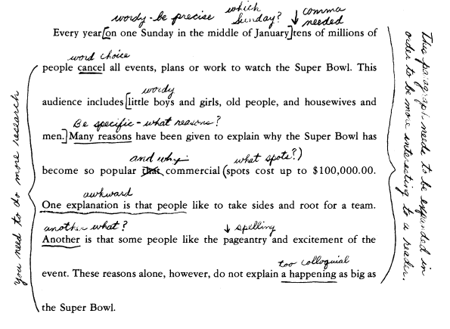
Avoid comments on material that will be removed (Sommers)
Notes:
Low Stakes

Slide 19
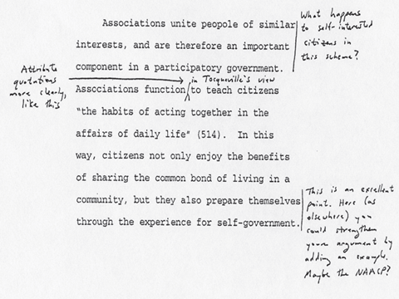
Supportive Responding (Walk)

Slide 20
Group Grading Exercise

Slide 21
Conclusion
Establish priorities
Peers as a resource
Communicate early and often
Notes:
Establish priorities: what sort of assignment am I grading? How much feedback do my students need? Will I be supplementing this feedback with a one-on-one conversation?
Befriend the clock: estimate how much time you’ll need to spend on each student’s assignment. Then reduce it by one fifth.
Schedule: grading is not what happens when you’re sick of doing everything else, or what you’ll “get to some time this weekend.” Schedule grading time, and stick to it.
Set boundaries: your students owe you assignments. You owe them feedback. You don’t owe them around-the-clock coverage of their progress in your course.
Rely on regularly-scheduled office hours.
Communicate early and often with colleagues if a professor’s grading expectations seem impossibly

Slide 22
References
Bean, John C. Engaging Ideas. 2nd edition. San Francisco: Jossey-Bass, 2011.
Elbow, Peter. “High Stakes and Low Stakes in Assigning and Responding to Writing.” In Writing to Learn: Strategies for Assigning and Responding to Writing in the Disciplines, ed. Mary Deane Sorcinelli and Peter Elbow. San Francisco: Jossey-Bass, 1997.
Harris, Muriel. “The Overgraded Paper: Another Case of More is Less.” In How to Handle the Paper Load, ed. Gene Stanford, 91-94. Urbana, IL: National Council of Teachers of English, 1979.
Sommers, Nancy. “Responding to Student Writing.” College Composition and Communication 33, no. 2 (May 1982): 148-156.
Walk, Kerry. “Teaching with Writing: A Guide for Faculty and Graduate Students.” Princeton Writing Program: 30-40.

