Slide 1
The Creative Classroom: Group Work, Visual Texts, Technology
Jake Cohen
Melanie Lorek
Heather Zuber
Writing Across the Curriculum (WAC)
May 6, 2014

Slide 2
Workshop Goals/Outline
Discuss advantages of active learning using WAC principles
Offer and model strategies for creative classroom activities
Provide time for questions

Slide 3
Warm-Up: “Snowball”
Identify one question you have about student engagement in the classroom. Write it on the question section of your paper.

Slide 4
Why try alternatives to “passive learning”?
New modes of content delivery and learning (Emerson and Taylor 2004, Metros 2008)
Interactive (Knight and Wood 2005)
Fun! (Garner 2006, Robinson and Kakela 2006)
Technology – use it, don’t fight it
Teaching portfolio
Publication

Slide 5
Creative Classroom activities reinforce WAC practices:
Low-stakes writing
“Low-stakes learning”
Clarity
Scaffolding
Group work
Assignment Design
Writing-to-learn
Active Learning

Slide 6
Strategies for effective group work
Be very detailed in your assignment / give written assignment
Be transparent about the function of the activity
Assign a role to each student (Moderator, Documentation, Speaker…)
Make sure the group’s size corresponds with the learning activity
Assign groups rather than self-selection
Give a clear time frame and check in with group regularly
Provide clear spaces in which to work

Slide 7
Different types of group activities
No-Tech and Low-Tech Group Work Assignments
Games
Multimedia Group Work Assignments (Low- and High-Tech)

Slide 8
I. No Tech Group Work Assignments
Brainstorming
Concept maps
Debates

Slide 9
II. Games
Some options:
Jeopardy-style game
Snowball question game
Bingo

Slide 10
Low Tech Strategy #1: Multimedia Group Work Assignments
Incorporate A/V texts into class
Controversial video
Audio Recording
Lecture
Don’t worry about technical language! (music, film, etc.)
Have students generate a multimedia project (see handout)
“Being in Brooklyn” – Project from SPE 1330 and ENG 1101 Learning Community, Fall 2013. Profs. Jody R. Rosen and Justin Davis.

Slide 11
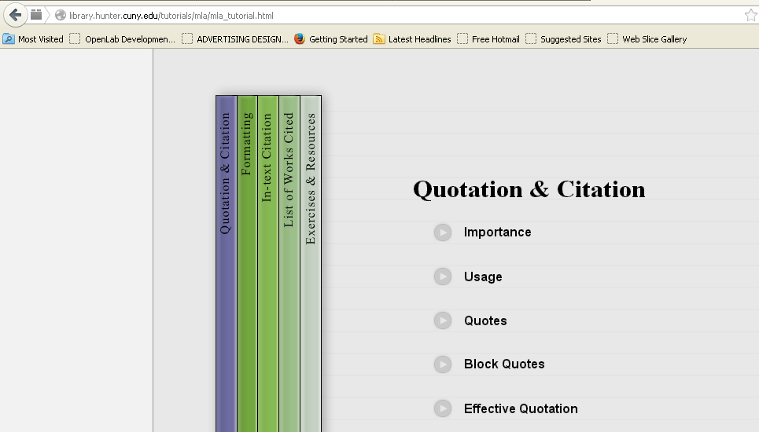
Low Tech Strategy #2: Online Activities and Tutorials
Investigate if your textbook publisher has activities you can use
Example:
Online MLA Citation tutorial, created by faculty of Hunter College

Slide 12
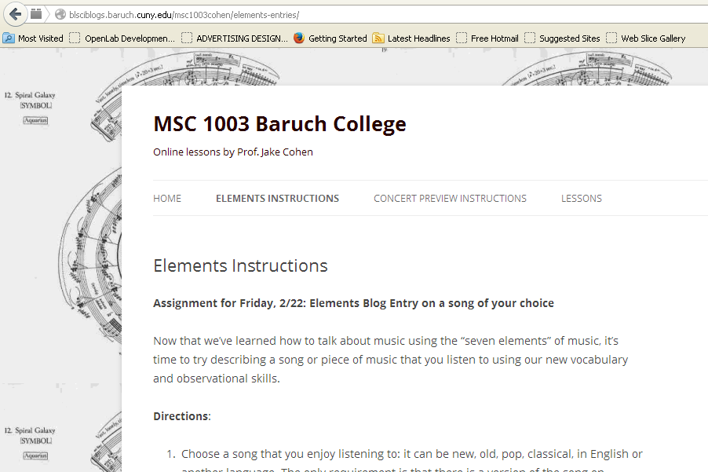
High Tech Strategy: Blogs
Click on the image to link to an example blog

Slide 13
Group Activity: Snowball Reprise

Slide 14
Questions?
Melanie Lorek: mlorek@citytech.cuny.edu
Heather Zuber: hzuber@citytech.cuny.edu
Jake Cohen: jcohen@citytech.cuny.edu
Notes:
Make sure to put tons of references on handout

Slide 15
Works Cited
Emerson, Tisha L. N., and Beck A. Taylor. 2004. “Comparing Student Achievement Across Experimental and Lecture-Oriented Sections of a Principles of Microeconomics Course.” Southern Economic Journal 70: 672–93.
Garner, R. L. 2006. “Humor in Pedagogy: How Ha-ha Can Lead to Aha!” College Teaching 54(1): 177-80.
Knight, Jennifer K., and William B. Wood. 2005. “Teaching More by Lecturing Less.” Cell Biology Education 4: 298–310.
Prince, Michael. 2004. “Does Active Learning Work? A Review of the Research.” Journal of Engineering Education 93: 223–31.
Robinson, Carole F., and Peter J. Kakela. 2006. “Creating a Space to Learn: A Classroom of Fun, Interaction, and Trust.” College Teaching 54: 202–06.

