Slide 1
Avoiding Plagiarism
Writing Across the Curriculum Fellows
Alicia Andrzejewski and Carrie DiMatteo
October 18th 2016

Slide 2
Workshop Agenda
Understanding plagiarism
Strategies for preventing plagiarism
Responding to plagiarism

Slide 3
Free Writing
Write about the worst case of plagiarism that you have encountered in your own classroom, or heard about from another instructor in your discipline.
Make sure to think about the assignment the students were responding to.

Slide 4
Quiz: What Counts as Plagiarism?
Troubling / Disputed Questions?

Slide 5
I. Understanding Plagiarism
“Students and all others who work with information, ideas, texts, images, music, inventions, and other intellectual property owe their audience and sources accuracy and honesty in using, crediting, and citing sources. As a community of intellectual and professional workers, the College recognizes its responsibility for providing instruction in information literacy and academic integrity, offering models of good practice, and responding vigilantly and appropriately to infractions of academic integrity.” – NYCCT statement on academic integrity
“Students and all others who work with information, ideas, texts, images, music, inventions, and other intellectual property owe their audience and sources accuracy and honesty in using, crediting, and citing sources. As a community of intellectual and professional workers, the College recognizes its responsibility for providing instruction in information literacy and academic integrity, offering models of good practice, and responding vigilantly and appropriately to infractions of academic integrity.” – NYCCT statement on academic integrity
“Students and all others who work with information, ideas, texts, images, music, inventions, and other intellectual property owe their audience and sources accuracy and honesty in using, crediting, and citing sources. As a community of intellectual and professional workers, the College recognizes its responsibility for providing instruction in information literacy and academic integrity, offering models of good practice, and responding vigilantly and appropriately to infractions of academic integrity.” – NYCCT statement on academic integrity

Slide 6
Common Justifications and/or Actual Reasons for Plagiarism:
“I didn’t know this was plagiarism.”
“But, my professor asked for two quotations and that’s what I did!”
“My writing isn’t good enough.”
“My English isn’t strong enough.”
“I’m not an expert in this topic, what could I possibly have to say that’s important?”
“I can’t write this entire paper tonight!”

Slide 7
II. Strategies for Preventing Plagiarism

Slide 8
1. Education and Awareness
Expanding Syllabus Policy
In Class Discussions
Assignments / Quiz to help students
Teaching format and your WAC fellow
Pedagogical purpose of research (“Coach” or, preferably, "Colleague" not “Police”)
Further Resources
Future WAC workshops for students (possibly in the Spring)
Library Resources

Slide 9
2. Teaching Paraphrasing
Paraphrasing is difficult
Tough cognitive ability (native and ELL students)
Developing paraphrasing skills
Beyond summary → synthesis
Model good paraphrasing
Remember: this isn’t just extra work for you! Also helps students understand course content

Slide 10
3. Plagiarism-Resistant Assignments
Incorporate personal experience or activities into early low stakes writing and formal papers, if appropriate
In this paper you will select one of your own dreams (ideally one you’ve described in a blog post and gotten feedback on) and develop an interpretive argument using the techniques provided in class to answer the question: what is the dream’s psychic meaning? You must interpret it using Freudian techniques and concepts, meaning your argument must be an attempt to reveal the latent content in the dream, and strive to “read” the dream closely, instead of coming to the most obvious conclusion.

Slide 11
Plagiarism-Resistant Assignments, continued
Use unique, specific details or current events in assignments.
Write and turn in at least 2 pgs, double spaced in which you use The Oxford English Dictionary to close read one line from Sula in which a female character’s human rights are violated, based on CEDAW.
Write and turn in, at least 1 page of writing, double spaced, in which you make an argument for the didactic nature of Lemonade as a whole OR one song off of the album, identifying the inciting incident, climax, and resolution of the text.

Slide 12
Plagiarism-Resistant Assignments, continued
Identify the pedagogical goal of writing assignments.
This paper will develop an argument to analyze the tension between two sources. You will select two different thinkers introduced in class thus far (Freud, Jung, Hartmann, or Hobson) and explicate the differences between their respective theories on dream interpretation, ultimately arguing for why you believe one theoretical approach is more effective or compelling. You will quote, paraphrase, and summarize the authors’ arguments while also evidencing a persuasive argument of your own using the rhetorical skills discussed in class.

Slide 13
Scaffolding
Discrete steps that build towards a larger assignment
Or smaller steps that build skills
Helps with time management and confidence building: two potential contributing factors of plagiarism
“One of the main goals of scaffolding is to reduce the negative emotions and self-perceptions that students may experience when they get frustrated, intimidated, or discouraged when attempting a difficult task without the assistance, direction, or understanding they need to complete it.” Source: the GLOSSARY OF EDUCATION REFORM

Slide 14
Sample Scaffolded Assignment Schedule
Assignment: Find an idea in one of the assigned critical readings of Jane Eyre with which you disagree. Figure out why you think it is wrong, and write a 5-7 page persuasive essay arguing for your own, “better” reading…
In-class summary of novel: 10% of grade – 10/25
Summary of idea with which you disagree: 10% of grade – due 11/1
Annotated bibliography of at least 2 sources that support your reading: 10% of grade – due 11/8
First Draft: 10% of grade – due 11/21
Peer Review Participation: 10% of grade – 11/21
Second Draft: 50% of grade – due 11/26

Slide 15
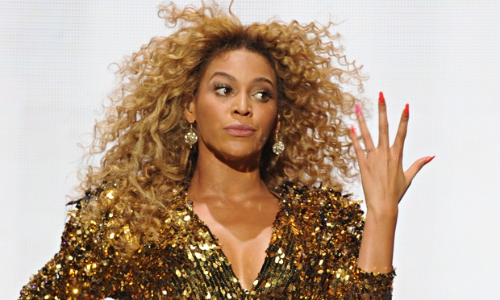
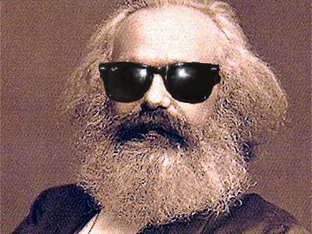
Group Activity
Revise the assignment you discussed in your freewrite using the aforementioned strategies:
Incorporate personal experience or activities into early low stakes writing and formal papers, if appropriate
Use unique, specific details or current events in assignments.
Identify the pedagogical goal of writing assignments.
Scaffold your assignment

Slide 16
4. Library Support
Collaborate with library faculty to
develop students’ research skills
help you develop subject and research guides
Urge students to visit the reference desk or schedule research consultations with librarians
Take students to the library!

Slide 17
Library Resources
Library subject specialists: http://cityte.ch/dir
Library catalog: http://cityte.ch/cat
Library databases: http://cityte.ch/db
Tutorials and Subject Guides

Slide 18
III. Responding to Plagiarism

Slide 19
What To Do if You Suspect Plagiarism
Use a plagiarism detection site like SafeAssign
Schedule a meeting with your student
Keep copies of student work
Keep records of your interactions with the student
Make sure the student understands the impact on the course grade
Report to your Department Chair

Slide 20
Academic Integrity Committee
Refer to the Academic Integrity Policy Manual for info about how to report cases of plagiarism. http://www.citytech.cuny.edu/academics/docs/academic_integrity_policy.pdf
While the consequences for plagiarizing are very serious, it is still possible to respond constructively and make sure that your students understand what is expected of them moving forward.

Slide 21
Contact
Alicia Andrzejewski: aandrzejewski@gradcenter.cuny.edu
Carrie DiMatteo: cpappas@gradcenter.cuny.edu
NEXT WORKSHOP: Effective Grading and Minimal Marking, Thursday 11/15, LOCATION: TBA
Read chapter 15 and 16 in Engaging Ideas (Bean)
http://openlab.citytech.cuny.edu/writingacrossthecurriculum

