Slide 1
Word Hunt
Finally, it is fun to write research papers.

Slide 2
THE PROPOSAL
Writing research paper is a time consuming job.
Word Hunt will help you to choose, narrow down and research about the topic.
Word Hunt will not be limited to academic use only. Writers, journalists, experts of specific subjects, anyone will be able to use.
Word Hunt will provide trusted links to several other websites like governmental, news source, academic source, research databases, non-profitable organizations.

Slide 3
THE PROPOSAL CONT’D.
Third party websites will be checked for biased information on specific topics.
Word Hunt will have inbuilt thesaurus to eliminate time consumption by searching for all the synonyms at one time and providing links to each of them.
The website will look like word cloud.
The results will be sorted in categories; news related results will go under news heading and so on.
Inbuilt citation generating machine will help in generating different citation styles.

Slide 4
DOCUMENTATION
Word Hunt’s algorithmic functions are similar to a thesaurus to give you similar words to help you decide and narrow the topic you want to focus on.
Each result yields words which is a mask to links to other websites, databases, and library catalogs that are specific to the topic in order of relevance.
This minimizes time taken to choose topic and to do actual research.
For example: Racism will give subtopics such as “Segregation,” “Jim Crowism,” “Sexism,” or “Authoritarianism.”
Links to each subtopic will provide information precisely related to the subtopic, which will cut down the time consumption.

Slide 5
It is tough to write research papers.

Slide 6
DOCUMENTATION CONT’D.
Finding scholarly sources proved to be difficult on Google, Yahoo or Bing search engines because they produce so many results and it’s hard to fish through all the information to find the relevant sources.
Google, Yahoo!, and Bing fail at distinguishing one type of information from another because they do flat searches.
We tried to think about how our search tool was going to function in order to cluster the information like Quintura does. So, we added thesaurus to the research tool.
Our tool is able to yield a tag cloud with words that are under the same hierarchy as the word you first searched.
With every word or topic you search our tool also yields links to relevant sources around the internet.
Our tool will only produce results from reliable and relevant sources that have expertise in that topic like scholarly sources and not from websites where they might have a blog post about the topic.

Slide 7
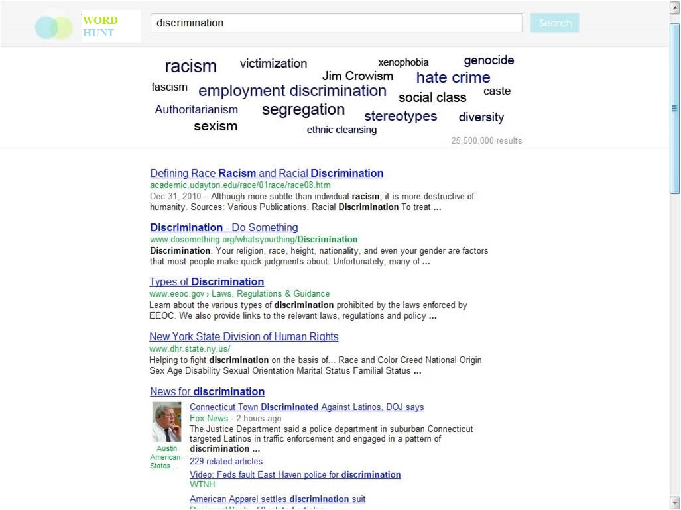

Slide 8
CITATIONS
Anant, N. S. (2012, January 30). Agony. In Flickr. Retrieved from http://www.flickr.com/photos/anantns/6790625269
Guo, Y., Wang, S., Johnson, V., & Diaz, M. (2011). College Students? Stress Under Current Economic Downturn. College Student Journal, 45(No. 3).
Jordan, F. (2011, March 23). Quintura: Visual Search Keyword Tool. Ford Jordancom RSS. Retrieved December 9, 2013, from
http://www.fordjordan.com/seo-web-consulting/quintura- visual-search-keyword-tool
Thesaurus. (2013, June 12). Wikipedia. Retrieved from http://en.wikipedia.org/wiki/Thesaurus
Thesaurus Find Synonyms and Antonyms of Words. (n.d.). Thesaurus.com. Retrieved from http://thesaurus.com

