Slide 1
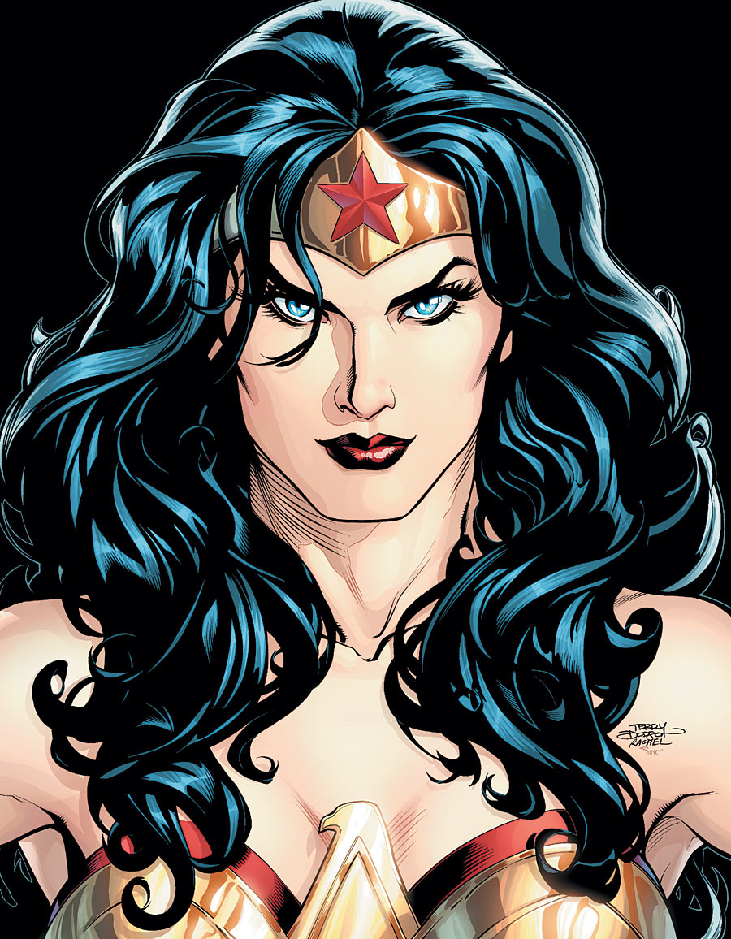
Sure, this character portrait of Wonder Woman is lovely! But it does not have the information a sequential artist would need to begin a project.
Notes:
Whether you are drawing a comic book, a kid's book, or creating characters for animation, chances are your character will be seen from more than one viewpoint.

Slide 2
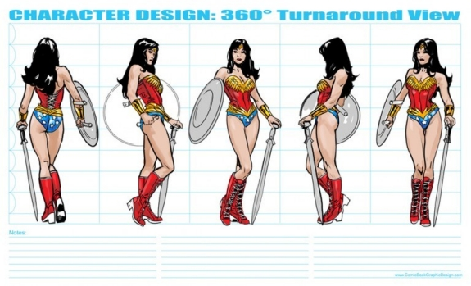
THE MODEL SHEET
Notes:
A model sheet, is a template of a character shown from every side.
Model sheets ensure that the structure, proportion, and design for a character and their costume details make sense and remain consistent. When working on a sequential project it is very easy for small variations to happen in the character's design from page to page. By referencing the model sheet, we know what our character is supposed to look like from a given point of view, and we can be sure that they have the same number of stripes on their sneakers, for example, on page 1 as they do on page 32.

Slide 3
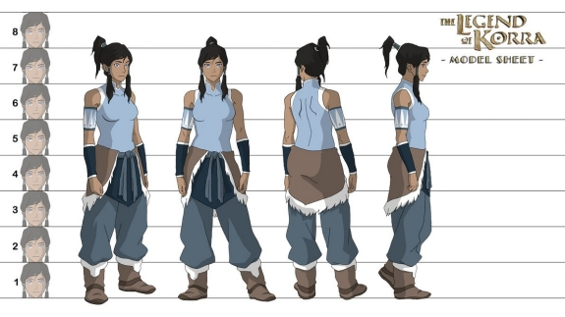
Notes:
A model sheet, is a template of a character shown from every side.
Model sheets ensure that the structure, proportion, and design for a character and their costume details make sense and remain consistent. When working on a sequential project it is very easy for small variations to happen in the character's design from page to page. By referencing the model sheet, we know what our character is supposed to look like from a given point of view, and we can be sure that they have the same number of stripes on their sneakers, for example, on page 1 as they do on page 32.

Slide 4
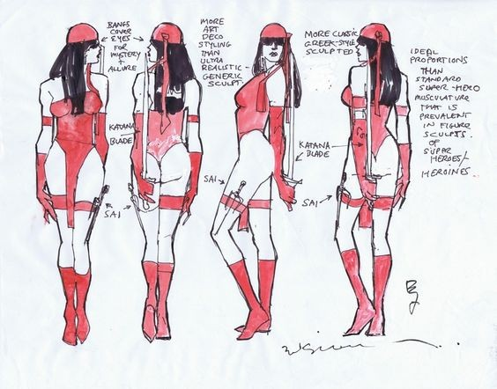
Notes:
A model sheet, is a template of a character shown from every side.
Model sheets ensure that the structure, proportion, and design for a character and their costume details make sense and remain consistent. When working on a sequential project it is very easy for small variations to happen in the character's design from page to page. By referencing the model sheet, we know what our character is supposed to look like from a given point of view, and we can be sure that they have the same number of stripes on their sneakers, for example, on page 1 as they do on page 32.

Slide 5
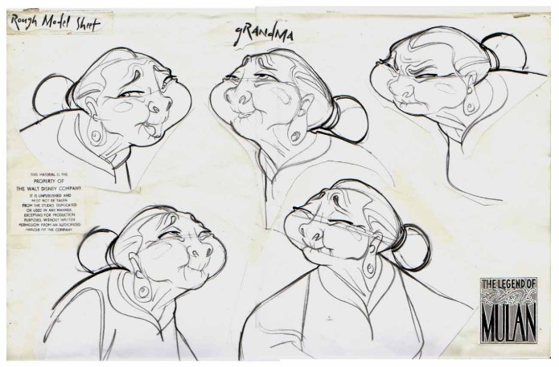
Notes:
Here we are focused of facial expressions

Slide 6
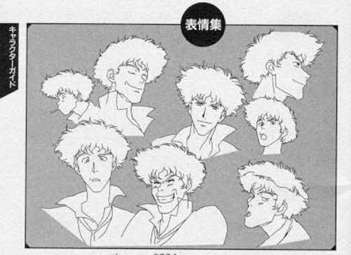

Slide 7
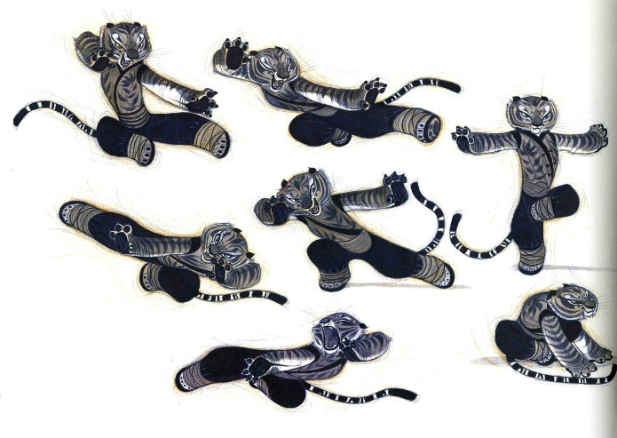
Notes:
And here on gesture

Slide 8
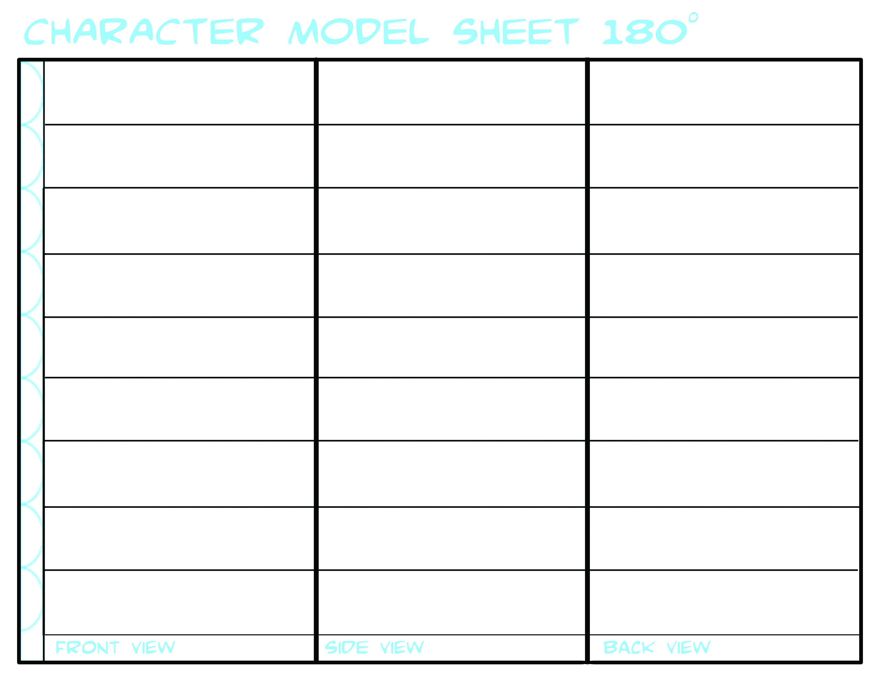
Your final designs for your characters are due next week, including a model sheet and a sheet of facial expressions and gestures.
This template is available on OPENLAB.
You may choose to use it or not, depending on how well it suits your needs.
For INSPIRATION go to LIVING LINES LIBRARY and click on Production Art!
Notes:
http://livlily.blogspot.com/2010/11/model-sheets-production-drawings.html

