Slide 1
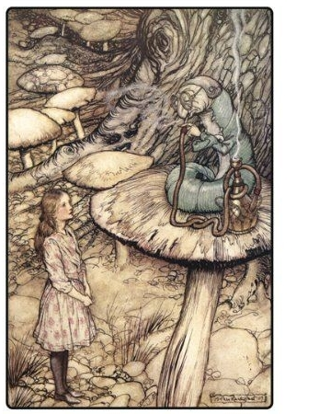
"Whoooo are you?" asked the caterpillar
Getting to know a character is like getting to know a new friend.
In order to do it you need to ask questions, questions such as:
Where are they from?
What are their likes and dislikes?
What is their personality like?
What motivates them?
Who are they?
Notes:
When creating a fictional character, you must take the time to fully flesh them out. Do the necessary work to bring them to life! If you do not understand your character, he or she will not be credible

Slide 2
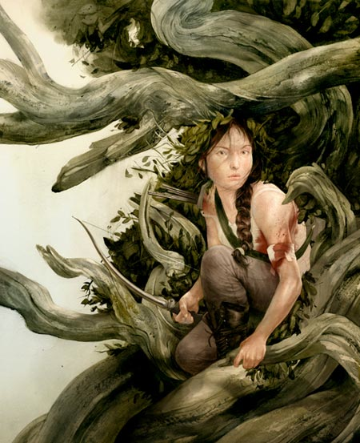
Be sure to ask specific questions that can help you focus on what this character should look like.
For example:
physical appearance: species, age, gender, size, and ethnicity
personality: thoughtful, angry, selfish, silly, introverted, extroverted etc.
personal or professional history: education, occupation, relationships, beliefs
character motivations: goals, money, sex, power, revenge, friendships, love, etc.
important events: life-changing moments or experiences that affect who the character is
Sam Weber

Slide 3
Character Design: Form and Personality
First impressions are everything!
Overall shape can say a lot about who a character is to your viewer.
We have instinctive reactions towards shape based on our sense of touch and real life experiences. Rounded shapes tend to be soft or safe, while angular shapes make us feel cautious.
Therefore overall shape tends to imply character traits.
Notes:
Once you have an understanding of who you are drawing, it's time to begin fleshing out your character.
Your character profile will have given you some key features to begin with, or at least some.
Though as we learned visual language can vary between cultures, shape has a way of communicating universally.

Slide 4
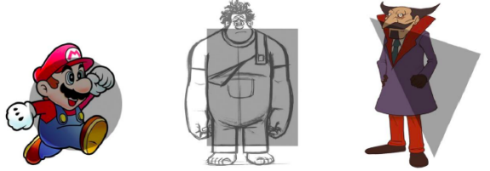
THE BASIC SHAPES
CIRCLES
Circular shapes or soft shapes read as the friendliest. Circular shapes in nature have a tendency to be harmless, so they make us predisposed to like the round character.
SQUARES
Square-like shapes communicate strength, stability, and confidence. They often depict steadfast characters who are dependable, like Wreck-it-Ralph.
TRIANGLES
Triangles are composed of diagonal angular lines. They are the most dynamic of the three shapes. This shape is often the basis for bad guys or villains, as the shape form is easily made to appear sinister and communicate aggression.
Notes:
Remember that clarity in illustration is key, and exploring a character's overall shape or silhouette at the beginning of the design process will help a character's readability and can communicate a character's personality.
This approach has its roots in animation.
Animators strive to create clearly define characters whose gestures are easily recognizable.

Slide 5
Character Design of Pixar’s UP
CARL is a grouchy, stubborn old man who wants to stay put, and his solid and static manner is revealed in his square-like shape.
Charles Muntz, Carl's adversary, has a much more angular design. We can see this in his head, shoes and cane. When silhouetted we can easily recognize that his major shape is triangular.
Alpha, Muntz' dog, has a hostile appearance.
Dug has obviously friendly appearance.
The two dogs appearance differences are a triangle shape versus a circular one.
Notes:
Examine these characters from Pixar Animation Studios' Up and their silhouetted shapes.

Slide 6
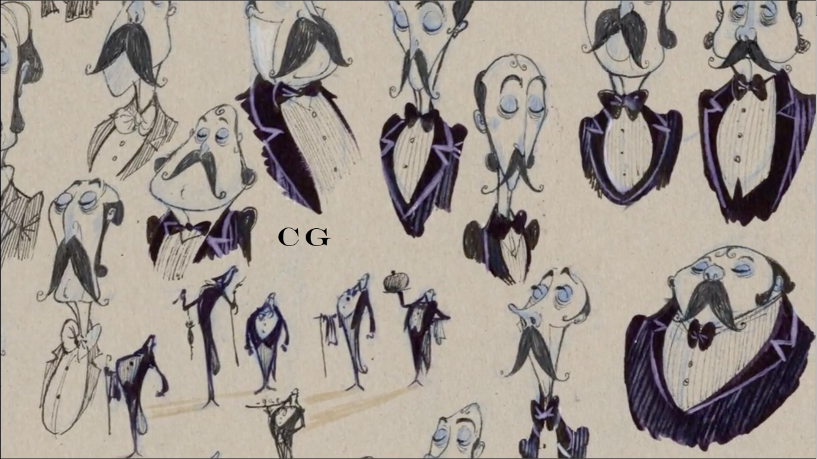
TRIAL AND ERROR
As we have seen in so many aspects of illustration, our designs are strengthened by multiple attempts.
Notes:
we can see Carlos Grangel trying many different variations on the same overall character, testing to see how swapping on detail for another effects the overall read.When you are designing your own characters, don't settle! Take the time to test out many different variations on the theme. What would your character look like with an upturned nose? Or a more rounded one?

Slide 7
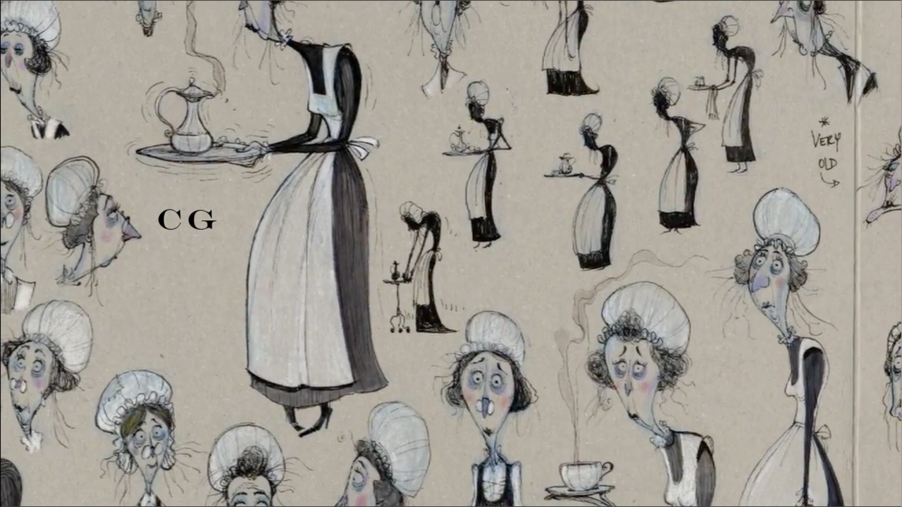
Once you have a basic form, try out different smaller shapes, for example swapping out different facial features, to achieve a memorable character communicating the right personality to the viewer.
Notes:
Here we can see Carlos Grangel trying many different variations on the same overall character, testing to see how swapping on detail for another effects the overall read.

Slide 9
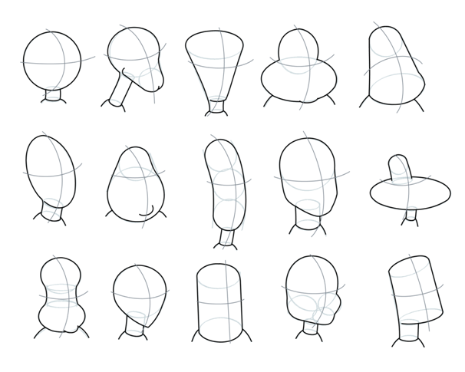
When you are designing your own characters, don't settle! Take the time to test out many different variations on the theme.
Notes:
When you are designing your own characters, don't settle! Take the time to test out many different variations on the theme.

Slide 10
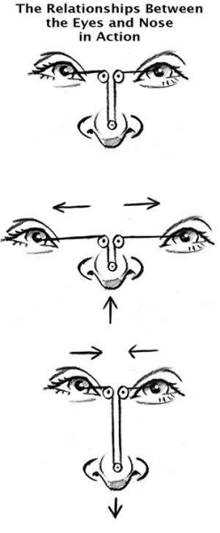
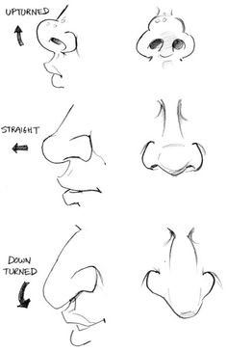
What would your character look like with an upturned nose? Or a more rounded one?
What if you changed the “T shape”,
or distance of the features?
Notes:
Or what if you swapped out the big round eyes for smaller, beady ones? How do these changes effect our overall impression of him or her? Take some risks!
DOWNLOAD PDF on OPEN LAB

