Slide 1
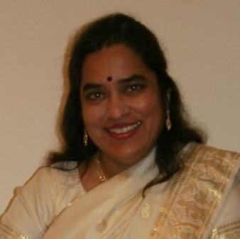
Global feminism project interviewee- Ruth vanita
Mario Hall

Slide 2
Work cited
http://umich.edu/~glblfem/en/transcripts/cross/Vanita_CS_E_102806.pdf
https://youngfeminists.wordpress.com/2008/08/18/same-sex-love-in-conversation-with-dr-ruth-vanita/

Slide 3
Introduction
Ruth was born in Rangoon, Burma n 1955
Moved to New Delhi, India when she was 2
After 8th grade she was homeschooled by her mother through high school. Her mother came from a long line of educators.
Went to college at Miranda House in Delhi university(All girls college)
Received her B.A, M.A and P.H.D in English.

Slide 4
Introduction continued
While in college Ruth and another student worked together to create Manushi. Which was India's first feminist journal.
Worked with women's groups to tackle issues such as dowry practices, wife battering and murder.
Ruth chose to left Manushi to return to work on her P.H.D. She stated that she did not like the direction the magazine was going in. There was not much talk of sexuality in the magazine since they were afraid of being labeled as lesbians.

Slide 5
Ruth's homosexuality
She came out to her mother in 1985, though she was never too upset she did have amnesia on the subject for a while but has accepted her.
While working on Manushi around 1989 Ruth hung with a group of gay girls and lived a double life outside of her work with Manushi.
She formed a group named D.A.R.E after leaving Manushi but did not stay with it long due to having to leave the country

Slide 6
Ruths Homosexuality Continued
Ruth says that she dislikes the word queer. She finds that it is too general. It could refer to pedophilia, and many other types of fetishes.
She also stated that she dislikes the word because it has a negative tone to it and is sometimes used as an insult. Especially in India. She refers to her work as lesbian/gay studies.
Ruth said she was never confused about her sexuality she just needed time to discover it. So writing about same sex relationships was her obvious next move.

Slide 7
Ruth's current work
Ruth is currently teaching liberal studies at the University of Montana.
She has put out many books such as Gender, Sex and the City: Urdu Rekhti Poetry in India Ruth Vanita
Queering India: same sex love
Sappho and the virgin Mary
And more
Ruth is happily married with her partner and the couple has a son

Slide 8
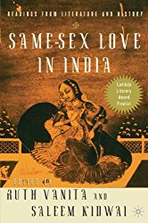
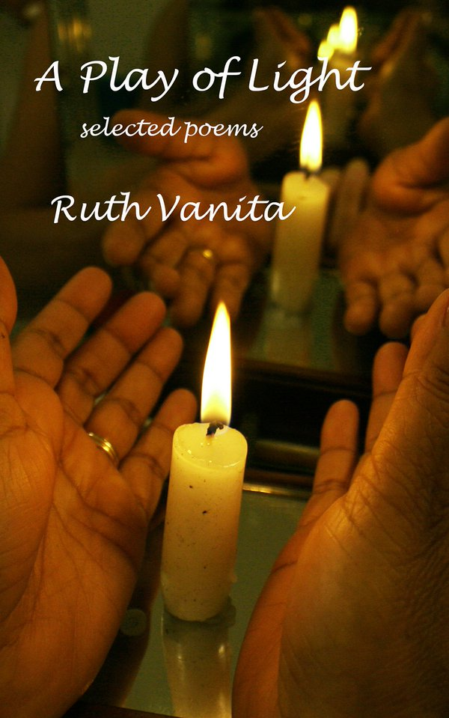
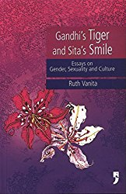
Ruths Books

