Slide 1
Global Feminisms Project Country:India
Ese Abamwa

Slide 2
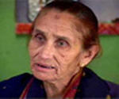
Shahjehan Aapa

Slide 3
Beginnings...
She was born in Mathura which is a district of the Indian state of Uttar Pradesh in 1946.
Comes from a working class background like working in a factory and never thought about working for issues concerning women.
When she was a kid she doesn't remember whether she been to school or not. However the people who looked after her gave her an education in a Madarsa.(Muslim religious school)
She had seven sons and two daughters but one of her daughter met a tragic end. That daughter got married and what should of been a happy ending turned out to be a nightmare in the making.

Slide 4
She was married at the young age of fourteen and a girl of fourteen years was considered to be in her youth. She told her father that she didn’t want to get married to this person. He removed his cap and kept it at my feet and said, “My honour is in your hands.” So I swallowed my feelings and kept quiet.
He was an extremely foul-mouthed person, he would argue, hurl abuses and I used to talk to everyone with a smile. I loved to be playful and talk and laugh with everyone. When I was married I felt very sad and felt trapped inside a cage.

Slide 5
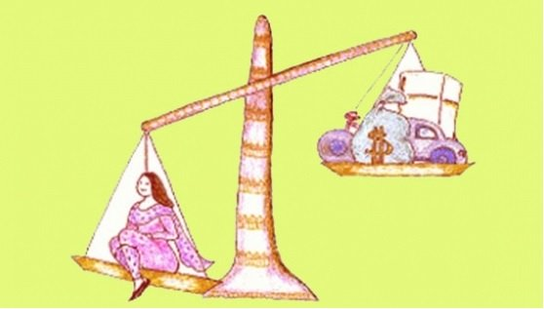
Dowry + Killing =
Dowry are property or money brought by a bride to her husband on their marriage. It is an ancient custom. It continues to be expected and demanded as a condition to accept a marriage proposal. With this they can get cash or property depending on the source of income from the bride’s family
Women are murdered or driven to suicide due to the pressure placed on them by husbands and in-laws in an effort to extort an increased dowry.

Slide 6
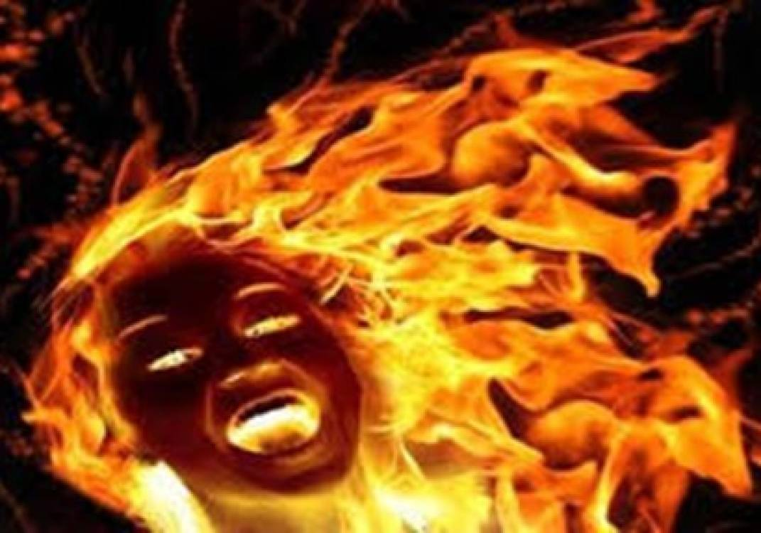
From Pain comes...
Her daughter marraige took a toll on herself and her in-laws started harassing her to bring more money in. She had nothing but a strong sense of pride by not telling her mother the things that were going on at her home. Unfortunately her young daughter Noorjehan life was cut short due to her being burnt alive. What’s even more heartbreaking is the fact that the crime was done not by a stranger but by her in-laws. She is nothing more than a powerful woman with nothing but determination and will keeping her going.
With her daughter death she found the strength and guidance to...

Slide 7
Strength and guidance
When a mother loses her child it’s heartbreaking and they feel like giving up but in the wake of her daughter's death it gave her the purpose to go out seeking justice not only for her daughter but for many like her.
Her efforts paid off and she became the President of Shakti Shalini. It’s a women's organization in Delhi that deals with counseling and redress of grievances.
She waged a long legal battle to punish her daughter's perpetrators but she was successful.

Slide 8
Hope
She had worked within the house but choose to step out to work after her daughter’s death. The reason why was because at the time she knew that other women were being tortured at home by men and they could end up like her daughter, She thought why should she just give in, after she had tolerated it for many years.
After my daughter died I threw away my burqa and stepped out in a way that my own people refused to recognise me. But if my own deserted me, strangers accepted me. The best thing was that the stains in my life were wiped out and I started working with the people in such a way that I forgot my grief.

Slide 9
Fight On
After the incident occurred with with her daughter she was alone. There was no organisation and at the time she was not aware of anything like organisation and didn’t know that people were coming together like this and working. When her daughter died she had protest in front of Nangloi police station and when people saw that a woman who had never stepped out and is today sitting in front of the police station thousands of people started collecting. After that she no longer felt lonely; I felt as if the world was with me.
She raised her daughter’s case for 3 years and unfortunately their was no justice for her. However in every loss there is victory and a number of cases came to her. She felt that she has to do whatever she can for them for her own peace. The first thing she did was to form a Mahila Samiti against dowry along with 25 women. There were no computers or typewriters when they started.
Her group had some serious confrontations with the police but she wasn’t scared. She felt that if she had the spirit and was conscious about the work then they would never be unsuccessful, we would always be successful.

Slide 10
WorkShop
They had three different types of workshops . One workshop is where they have lawyers giving legal advocacy, wherein they tell you how we can fight using (IPC) Section 12532 or how (IPC) Section 49833 can be used to fight against dowry related cases or what you can get with (IPC) Section 49634 and how you can fight for your various rights — all this legal advice is given.
The other workshop is for building unity among ourselves. We discuss when and where to meet. If a woman is friendly with five women they will come with her.
The last workshop is one where they discuss about what work is being done in our locality and what is not.

Slide 11
Ending
She died here. I never felt like leaving this place although I am not staying in
my own house — it is a rented place — it belongs to someone else. Not that I want to grab it, but
I stay here for some reasons. Even my children ask me why I don’t like any other place. Even I
don’t know what attachment I have to this place. I started my work from here and my daughter
died here; I started my life from here and this is the reason why I do not feel like leaving
Nangloi. My children always say that we should go to some other place, we will get better
opportunities for employment. I feel that if I lost things here, I also gained here. I don’t feel like
leaving Nangloi because I started my life here, doing so many things.
5:09
https://deepblue.lib.umich.edu/handle/2027.42/55727
This right here shows that she felt that if she left this place where so many things affecting her well being it would be a disgrace to all of the pain that she has felt through her years. She was raised here, she lost a daughter here, and it’s where she found a new beginning in her life.

Slide 12
Citations
Project, Global Feminisms. "Interview with Shahjehan Aapa." Global Feminisms Project. Urvashi Butalia, 02 May 2004. Web. 03 Nov. 2016.
"Global Feminisms Project - University of Michigan." Global Feminisms Project - University of Michigan. N.p., n.d. Web. 03 Nov. 2016.

