Slide 1
SABRINA MANUEL ENG 2160 Section D540 NOVEMBER 8^{th,} 2016
Global Feminisms Project
Country: INDIA
Interviewee: Nivedita Menon

Slide 3
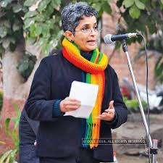
NIVEDITA MENON
Professor of Political Science (Jawaharlal Nehru University, Delhi)
Noted Feminist/Activist
Hailed as one of the pioneers in feminist theory
She has also been involved in many social and political movements
Author of ‘Seeing Like a Feminist’ which is known as the Holy Grail amongst works in feminist theories
Her opinion on feminism goes as follows: “feminism is not about that moment of final triumph over patriarchy but about the gradual transformation of the social field so decisively that old markers shift forever” (Nivedita Menon)
Best Peer Reviewed Publications
1. “The Conundrum of Agency” Seminar January 2014

Slide 4
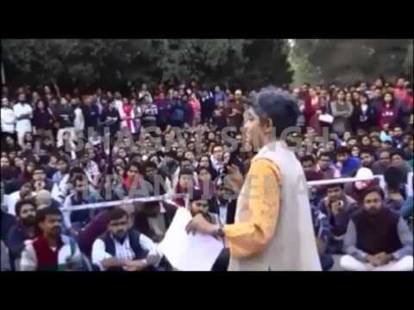
Speech on Kashmir Conflict

Slide 5
Political and Social Movements Nivedita Menon has been involved in
The Kashmir Conflict
Is a territorial conflict primarily between India and Pakistan which started after the partition of India in 1947. Her involvement in the 2016 JNU protests led to her being criticized by members of the Bharatiya Janata Party and in the media, and led to her being seen as a symbol of resistance against the Hindutva movement.
One of the questions that have been asked since independence is whether India and Pakistan can have everlasting peace. Kashmir, claimed by both countries as a jugular vein, integral part and “inseparable limb” is at the heart of the confrontation and almost 70 years have passed with the situation only worsening in the absence of a constructive way forward.
Nuclear Power
She is known for taking positions on several political issues, including nuclear power.
On February 9th, 2016 students of Jawaharlal Nehru University held a protest on campus against capital punishment.
Armed Forces Special Powers Act
Acts of the Parliament of India that grant special powers to the Indian Armed Forces in what each act terms “disturbed areas”.
The Acts have received criticism from several sections for alleged concerns about human rights violations in the regions of its enforcement alleged to have happened.^{[5][6]}

Slide 6
The Conflicts Women of India Face
Gender Justice
Polygamy
Domestic Violence
Laws that have been passed to protect women from these injustices are:
The Protection of Woman from the Domestic Violence Act, 2001
The Muslim Woman (Protection of Rights on Divorce Act), 1986
Shamim Ara vs State of Up, 2002, (Citation)

Slide 7
Citations
Wikipedia, Nivedita Menon
Economic and Political Weekly
Faculty Profile
You tube video

