Slide 1
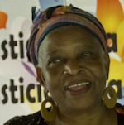
Global Feminisms Project Nicaragua Interviewee: Matilde Lindo
Berline Gassant

Slide 2
Matilde LINDO
Born in 1954.
Born in Puerto Cabezas but grew up in Rosita Mines.
First language is Creole English.
From the Moravian religion.
Her only two career options growing up was nursing school and teaching school.
She studied to be a teacher and taught elementary as well as High school.
Has three children, all girls.
She was interested in learning different languages.

Slide 3
Background con’t
Had her first child at the age of 16
She had a very supporting family, who supported her throughout her pregnancy.
Grew up in a household where women had as much of a voice in the house as men did.
She believed both men and women had rights in the household.

Slide 4
Line of work
After a Revolution had started Matilde started working with INSS or the Nicaraguan Social Security Institute for a year.
Then she moved on to work for MIDINRA (Ministry of Agriculture Development and Agrarian Reform) which deals with Agrarian rights.
She loved anything that had to do with teaching but later moved towards the study of social investigations or research.
In 1976 she traveled to Cuba for the sociology course because she wanted to become more educated.
She was then hired to be an analyst to go see about the social issues, such as education, healthcare, social security and so on in the Northern Atlantic Autonomous Region.

Slide 5
BEGINNING OF MOVEMENT
In 1989 she started getting involved in the women's movement, human rights and everything that had to do with women.
Her friend Raquel Dixon, who was the first black person to be elected to Nicaragua’s National Assembly chose Matilde to be one of the strong voices for women.
After being politically attacked Matilde joined the legal rights women movement and left her teaching job and other jobs to dedicate her full time to this movement.

Slide 6
BEGINNNING OF MOVEMENT CON’T
After learning about the violence against women, her and the other women she worked with started a radio program.
In 1990 they got a lot of support from Oxfam in England, an international confederation working to fix the issues of poverty and injustice in the world.
Around that time, a big revolution among women who were breaking from an Association of Nicaragua Women was occurring and it was the perfect time for Matilde and her group to form alliances to better the issue.
Developed strategies like being brave to reach the goal of letting your voice be heard and forming alliances with women all over the country.

Slide 7
Activism
Matilde wasn’t against working with men because she believed that men and women need to learn to grow together to put a stop to discrimination between men and women.
She started the Network Against Violence to raise awareness to the political issues of the law stating that women were violent.
This organization pushed for policy and cultural changes to reduce domestic violence in Nicaragua.
In 1995 she and other women held The Fourth World Conference on Women in Beijing to promote women’s empowerment worldwide.

Slide 8
ACTIVISM CON’T
She became involved in many organizions that had to do with all Latin America and Caribbean and formed an Afro-Latin and Afro-Caribbean Women’s Network
Working in Nicaragua through the Network of Violence Against Women, there were about 90 organizations but Matilde wasn’t apart of it she and the other women she worked with were on their own.
They created national assemblies and each year they would dedicate it something like the law and work on passing new laws to put an end to the violence.

Slide 9
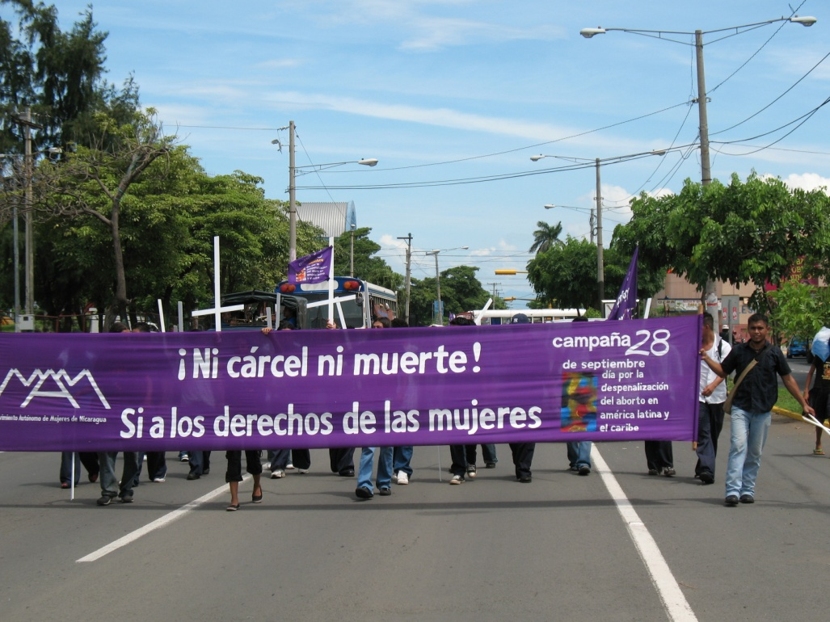
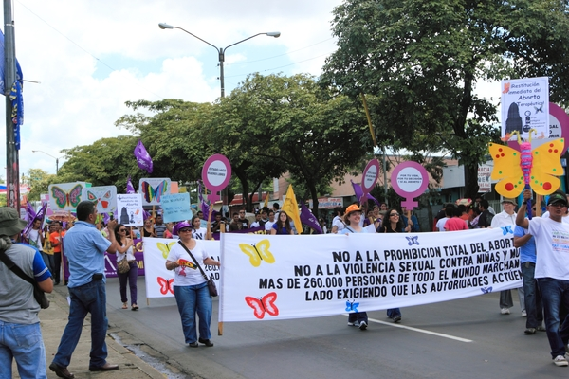
Pictures & short clip
https://deepblue.lib.umich.edu/handle/2027.42/108134

Slide 10
Accomplishments
One of her accomplishments in the Women’s Movement was being able to recognize that the women’s issues shows a lot of different demonstration on how important it is to understand what goes on in women’s daily lives all over the world and being able to change that and with all her networks and organizations she joined and formed she's felt made a big difference in women’s lives today.

Slide 11
Definition of feminism
Matilde Lindo’s definition of feminism is a way of thinking, giving you different kind of criteria to face the world.
She compares it to Christianism and says that she doesn’t see it as a set of principles but as a way of living.

Slide 12
Works cited
http://umich.edu/~glblfem/en/transcripts/nicaragua/LindoTranscriptionAnnotatedwithThemesFINAL.pdf
https://deepblue.lib.umich.edu/handle/2027.42/108134.

