Slide 1
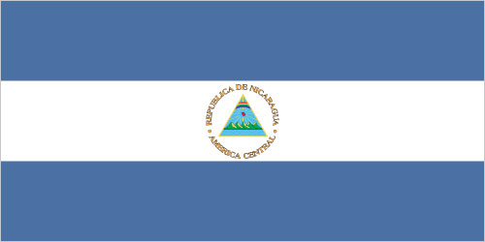
Nicaragua
Monica Baltodano
By: Clara M

Slide 2
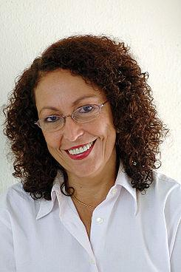
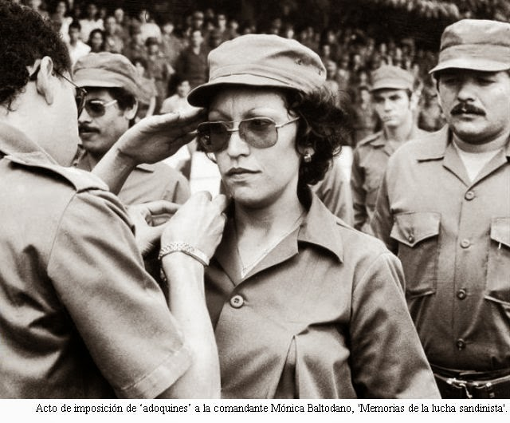
Background: Family
Monica Baltodano was born in Leon, Nicaragua in August 14, 1954.
Raised in a Middle Class Household, 3 sisters and two parents. Her mother owned a shop, and her father had education in law but owned a cotton plantation.
Aside from her comfortable living she felt the difference as women and a middle class citizen.

Slide 3
Motivation/ 1st movement
-Monica’s financial benefit allowed her a private religious school education, where she saw first hand the difference in treatment from those who were poor and those who were rich.
-She had a nun who taught sociology that pushed her to question herself and about injustice.
*Monica’s first protest “ my first big action was a march to demand Doris Tijerino freedom, a guerilla woman who had been captured, she had been raped, humiliated, and she appeared with bruises from her capturers, with marks from the aggression that she suffered. So we mobilized with the school to protest and demand her freedom.”

Slide 4
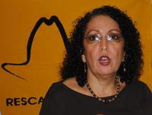
Family part 2 (after revolution)
I re-established ties with my mother. All of my sisters had actively participated, I lost a sister who was 16 years old. And another of my sisters who was just fifteen had a bomb explode near her and she lost both her hands and my mother, and a sister of mine was imprisoned, and others underground, so the whole family was spread out, so the reconstruction implied a reunion of the whole family. We were all very involved and this helped. We didn’t have a big split that some family members belonged to the other side
I had four children. I mean after the two children with my first husband, I got remarried and I had two more children. And then with those two children, I could dedicate myself to being a mother. The first two were more affected and still today they show it in their temperament and insecurity

Slide 5
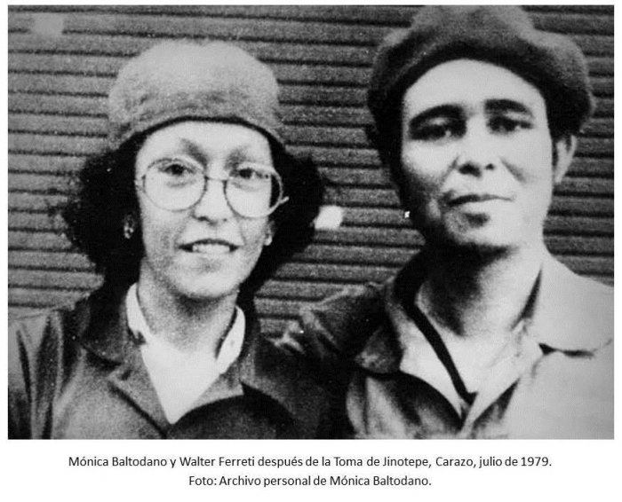
Movements
In the year 1969 there was a big strike and I was fifteen years old at the time and we became involved in the strike to back up the teachers and later in what were called school takeovers, I organized it at my school to demand, for example, better salaries for our teachers.
Revolutionary Student Front, this coincided with a movement of reflection throughout the world about the role of Christians, about the injustices of the world. Sending letters that obligated the priests and religious leaders to reflect about the injustice in the world, the Second Vatican Council, the Latin American Episcopal Conference in Medellin that had an impact in what was later called the popular church or liberation theology. (this lead her to join Sandinista Front for National Liberation)

Slide 6
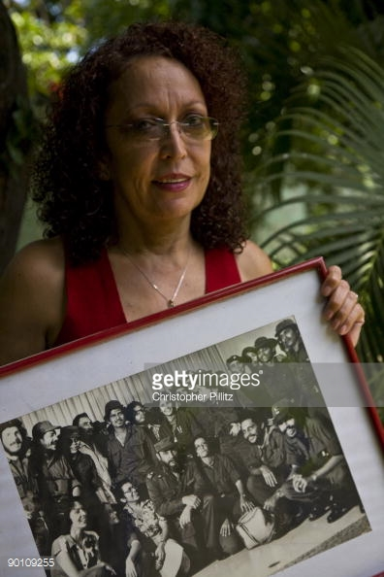
Movements part 2
In 1974, was the start of the underground work, it consisted of political and military responsibilities. When the Revolution triumphed, she was imprisoned for one year, and had participated in distinct political and military actions and became part of the general security staff of Managua, the capital.
Post Revolution: They were given recognition but their was only 3 women (Dora María Téllez and Leticia Herrera) in the whole Sandinista Front of Guerilla Combatants, in 1982 she named Minister of Regional Affairs until 1990. We she started Municipality and Territory work. This allowed her to work with people.

Slide 7
Programs and Feminism
“The Revolution despite all the difficulties to come undone, it was able to develop social programs that diminished inequality, that gave peasants, and women peasants, access (even though not sufficiently)to land, access to education, access to health, social wellness, centers of infant development, and we could develop our feminism because when we were fighting we didn’t have enough consciousness that in addition to the general rights of people, we were fighting for our rights as women.”
“being feminist for me is to fight to change the situation of discrimination and inequality that women continue living and that have very concrete agendas in economics, politics, in relationships of power in the struggle for secular states, in the rights of women to control her own body, reproduction, her reproductive role.”

Slide 8
Happy Ending :)
Monica was one of the founders of the MRS, which was a program the pushed democratic ideals into the government to allow citizens a say in the government. She gets voted out of the program after Daniel Ortega felt she no longer had ‘the best interest at heart’.
After so much commitment to the north, she decides to leave the FSLN in 2005 due to corruption and authoritarian leadership from inside the party and decides to better the south
There was also this movement called the “Autonomous Movement” but they/her also refer to as the women who got organized in fights against violence, the collectives, the group promoted decriminalization of therapeutic abortion. Allowing women to have a say in what happened to their bodies and their ability in what their options can be.
Monica currently resides in Parliament, her main goal has been linked to the struggle for women’s rights and have the ability to convince women of other ideologies to become involved in the fight. The proposition of the ‘Family Code’,which is the decriminalization of therapeutic abortion and the Law for Sexual and Reproductive Rights. Which has a lot to do with the education of women and their bodies. Also to be on the topic of breast cancer, it should be a women’s right to understand the illnesses that affects them in specifically.

Slide 9
Works Cited
https://deepblue.lib.umich.edu/handle/2027.42/108130
http://umich.edu/~glblfem/en/transcripts/nicaragua/BaltodanoTranslationAnnotatedFINAL.pdf

