Slide 1
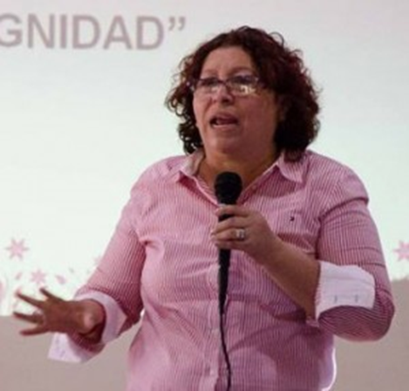
Global feminism Project Nicaragua Interviewee: Sandra Ramos
Dinesh Surujdeo

Slide 2
Sandra Ramos Bio
Sandra Ramos was born in the city of Managua, Nicaragua in 1959.
She is a leader in the Women’s Rights Movement whose activism and organizing focuses on women workers
Her family was poor so she had to work with her mother who worked at largest marketplace in Managua and attend school at the same time
Her mother and her grandmother were her inspiration in activism because they were poor, worked hard, and were willing to share what they had

Slide 3
Bio
Sandra Ramos was the only one of eight sisters to finish college although all attended at least primary school.
As a child, she describes herself as rebellious because she was the middle child. She fought to go to college.
She married and had two sons while still studying in college

Slide 4
The Start of her Activism
As a young child in school, Ramos witnessed student protests
When she went to National Autonomous University of Nicaragua where she became involved with the Sandista Front
Then when the Revolution began, she went to work for the Nicaraguan Film Institute where she learned about worker unions and became a union activist

Slide 5
Nicaraguan History
From 1937 to 1979 Nicaragua was ruled by a political dynasty dictatorship, beginning with Anastasio Somoza García and followed by his two sons, Luis Somoza Debayle and Anastasio Somoza Debayle. the Revolution refers to the period when opposition to the Somoza dictatorship grew and eventually led to the resignation of Somoza in 1979.
The Sandinista Front for National Liberation. In 1979, became the only guerrilla movement to overthrow a Latin American government since the Cuban Revolution

Slide 6
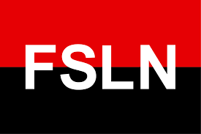
Nicaraguan History

Slide 7
Ramos’s Reputation
Ramos was a founder of the Sandinista Workers’ Center, Nicaragua’s dominant national trade union center
The Workers Center focused on having men and women form the working class
But Ramos wanted right to a life free of violence, free of sexual harassment in the workplace, awareness on the issue of maternity, right, the issue of sexual and reproductive health

Slide 8
Ramos’s Reputation PT2
After facing accusations of crime and then having an arrest warrant against her, Ramos left the Workers Center and assembled the María Elena Cuadra on May 7, 1994
Composed of 800 working women, the María Elena Cuadra focused on making visible the contribution women make to the nation’s economy as subjects with rights, working with domestic working women (Farmers) and providing workshops on gender, self-esteem, human rights, labor rights, and education women on leadership

Slide 9
Ramos’s Impact in Present Day
Because of Sandra Ramos and the María Elena Cuadra Movement
There is a special law, to demand better health conditions for workers known as the Law on Labor Health
There are laws being pushed to protect sexual and reproductive health rights, rights of pregnant women in the workplace
There is a leadership academy in the Central American University, educating and preparing young female leaders
There are factories in Honduras, Guatemala, Canada, Philippines, Korea, and America to develop Nicaragua's economy

Slide 10
End

