Slide 1
Nancy Morales ENG 2160 Section D540 September 8^{th,} 2016
Global Feminisms Project
Country: China
Interviewee: Chen Mingxia

Slide 2
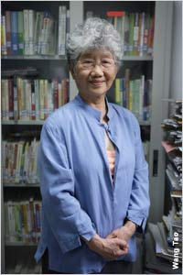
Chen Mingxia
Born in 1948 (Yuhui 1)
From Beijing, China (Yuhui 1)
Researcher at the Institute for Legal Research of the China Academy of Social Sciences. There she promotes women’s legal rights (Mingxia 00:05:44)
One of many who initiated an Anti-domestic violence project. Later it developed into the first large women’s NGO (Non-Profit Organization) in China. (Mingxia 00:05:55)
Was a victim of Domestic Violence. (Liwen 1)
Her personal understanding of Feminism (nuquan zhuyi and nuxing zhuyi):
Nuquan Zhuyi has 2 meanings of feminism. Either women’s right-ism or women’s power-ism (Mingxia 00:00:35)
Nuxing Zhuyi means feminine-ism or female-ism, which many people translated as freedom of females. (Mingxia 35)
Chen Mingxia prefers Nuquan Zhuyi because she believes it’s goal is right’s for women. She believes that this term tries to say that women should use power to get the rights that they deserve and not take away men’s rights. (Mingxia 35)

Slide 3
Video : https://deepblue.lib.umich.edu/handle/2027.42/55713

Slide 4
Women’s Situation in china . . .
It was considered that women's purpose was to serve for her husband and care for her children. (Burnett 292)
Women were expected to have their feet binded, polygamy was allowed for men and many more discriminations were made against women. (Burnett 292)
Women weren't able to join the work force because many bosses believed that "an update incapable man is better than a woman" (Burnett 293)
Chen Mingxia had mentioned that in her past generations females weren't allowed to have an education, she also mentioned that she grew up in a very feudal Family (women's rights weren't respected or ignored). Women were also not allowed to be present whenever they had guests. They weren't given a name until their husbands named them, if the husband wanted to name her. (Mingxia 00:02:45)

Slide 5
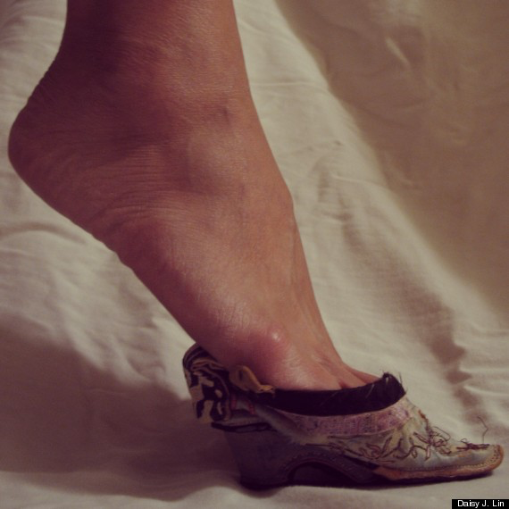
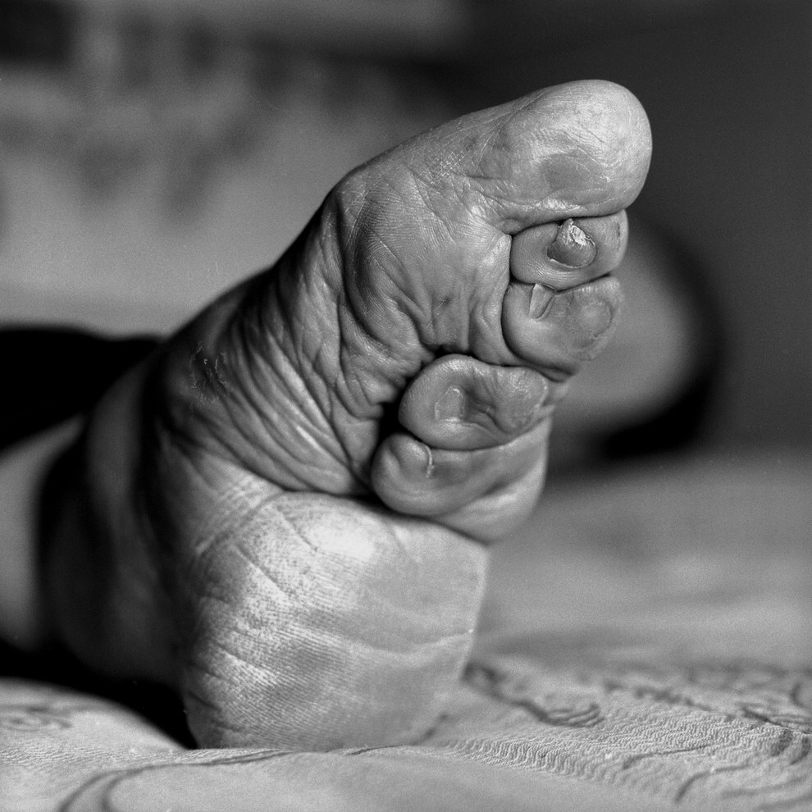
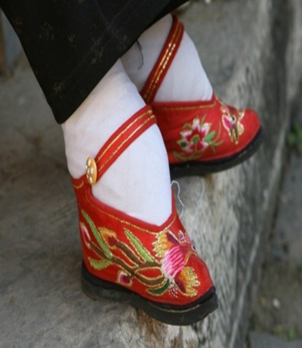
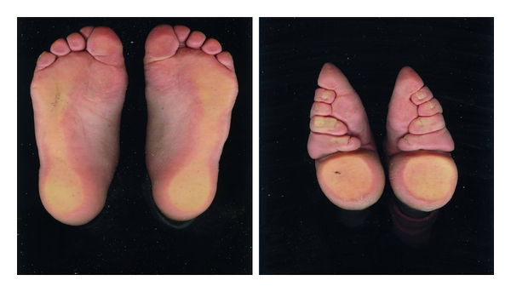

Slide 6
Anti-domestic violence Project
Developed in June of 2000 (Liwen 1)
The goal is to provide an equal environment (Liwen 1)
Requires a gender perspective training course to join this project. ((Minxia 00:14:25)
Found out about the "Gender blind spots". There were laws made by men, for men. (00:14:12)
Has 15 smaller projects within this project. (Mingxia 00:29:00)
Oral history(Mingxia 00:29:00)
Legislation (Mingxia 00:29:00)
Has interviews with women who went through domestic violence (Mingxia 00:54:48)
Helped them understand that it wasn’t their fault (Mingxia 00:54:48)
Learned how to stand up (Mingxia 54:48)
Men were given lessons for domestic violence. As abusers they were taught that they were victims of living in a male-dominated society, this caused problems like inequality between men and women. (Mingxia 00:55:16)

Slide 7
Challenges within the project
Getting everybody together (Mingxia 00:41:32)
They worked extra hard when they were together and tried to arrange a time in their schedule to be spent in the organization (Mingxia 00:41:32)
When they have an experimental site run by men. ( Mingxia 00:47:27)
When the experimental site assigns a male director, the NGO will point out the problem. They will at least require the assistant director to be a woman. (Mingxia 00:47:52)
Deciding the times of training/approaching work. (Mingxia 00:43:18)
They have a good discussion and come to a solution. (Mingxia 00:43:22)
“From the very beginning, we chose to associate with the China Law Society, an NGO within the [political] system. First, because we thought legislation is fundamental for the anti–domestic violence movement. Second, the China Law Association has ready access to the essential, relevant government branches, like legislative, juridical and public security offices, and is trusted by them.” this is what Chen Mingxia said in a different article (Liwen 1)

Slide 8
Anti-domestic project's success
They worked with the women's federation (Largest women's organization in China) (Mingxia 01:03:20)
Aired a program against domestic violence on a very popular channel for a month. (Mingxia 01:06:01)
Made anti-domestic street signs that help society change their ideas by realizing that domestic violence is harmful. (Liwen 1)
Many other NGO's have joined this project. (Liwen 1)
Promotes development of feminism (Liwen 1)
First to introduce gender to law in china (Liwen 1)
United many NGO's in order to complete their goal. (Liwen 1)
According to my research, in 2001 divorce was permitted if there was domestic violence (Liwen 1)
There was a legislation passed in 2013 which prohibited verbal, physical and emotional abuse. (Burnett 1)

Slide 9
Citations
Burnett, Jaime. "Women's Employment Rights in China: Creating Harmony for in the Workforce". Jaime Burnett, 2010. Web. 06 Sept. 2016
Jinling, Wang, and Zhang Jian. "Interview with Chen Mingxia." Global Feminisms Project. Trans. Kim Dorazio. N.p., 06 Sept. 2005. Web. 04 Sept. 2016
Liwen, Qin. "Gender Equality and Combating Domestic Violence." IIP Digital. N.p., 10 Sept. 2012. Web. 07 Sept. 2016.

