Slide 1
White Standards of Beauty
Normalized cultural assumptions about beauty
Beautiful women have:
Blond hair
Blue eyes
Large breasts
Skinny body
Women of color are not in the picture

Slide 2
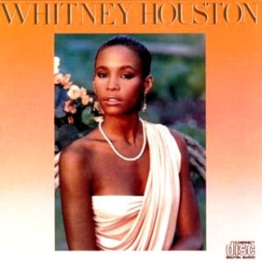
The “whiter” the look the better?

Slide 3
Women of color often internalize racist standards of beauty
Lighter skin as more beautiful
Thinner as better
Attempt to“correct”racial features
The Afro hair
The Jewish nose
The Asian eyes

Slide 4
Asian Blepharoplasty (Double Eyelid Surgery)

Slide 5
Women of Color and Body Image
Women of color may have the impossible task of achieving beauty standards for both her cultural group and the dominant culture
If they internalize white standards of beauty and adhere to them, they perpetuate the racial hierarchy
Yet, if they do not adhere to the norm, they may have to pay a price

Slide 6
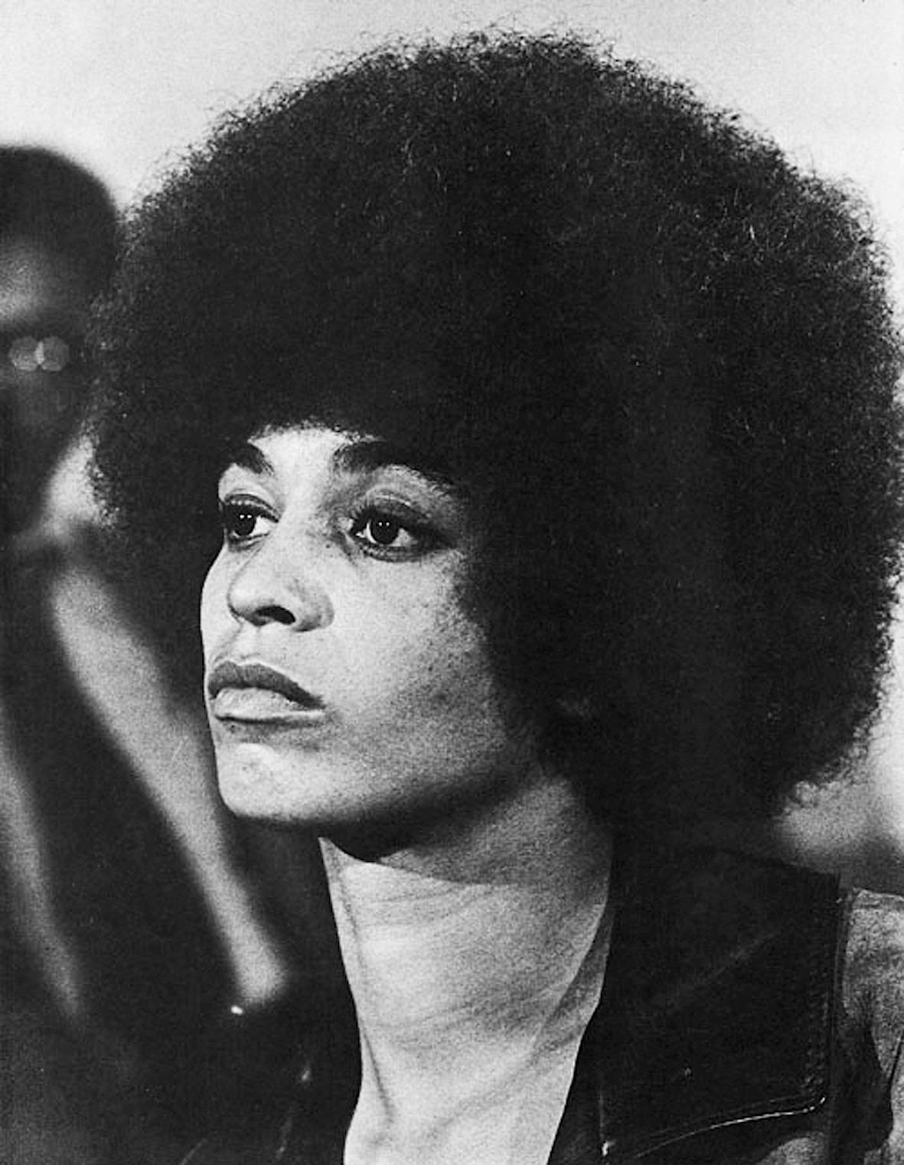
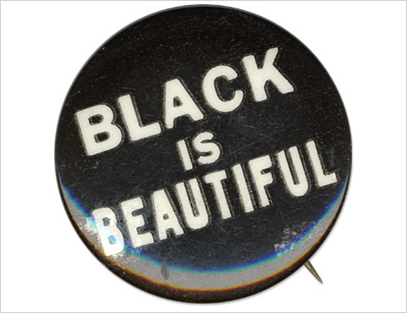
Black is Beautiful
A movement in the 1960s that celebrated the beauty of non-European physical features
Came out of the Black Power Movement
Angela Davis
Notes:
http://www.pbs.org/wnet/african-americans-many-rivers-to-cross/video/black-is-beautiful/ (3:00)

Slide 7
Toni Morrison on the reclamation of racial beauty in the 1960s
“The assertion of racial beauty was not a reaction to the self-mocking, humorous critique of cultural/racial foibles common in all groups, but against the damaging internalization of assumptions of immutable inferiority originating in an outside gaze” (Morrison xi)

Slide 8
Colorism
A term developed by Alice Walker in In Search of Our Mothers’ Gardens (1983)
“prejudicial or preferential treatment of same-race people based solely on their color”
Dark Girls Documentary: Addresses the “deep-seated biases and attitudes about skin color—particularly dark skinned women, outside of and within the Black American culture.”
Notes:
http://officialdarkgirlsmovie.com/preview/ (9:20)

Slide 9
Beauty in Americanah
Find two examples in which a character exhibits internalized white beauty standards in Americanah.
Are they invested in those beauty standards in relation to themselves or are they imposing those expectations on others?
Find two examples of a resistance to white beauty standards and/or the reclamation of non-white beauty standards in Americanah.
How do the characters resist/reclaim beauty? What is the result?

