Slide 1
The Three Waves
Second Wave Feminism

Slide 2
Women’s Liberation/The Women’s Movement
In the U.S., second wave feminism began in the 1960s
Grew out of the civil rights and anti-Vietnam war campaigns
Issues:
Advancement in the workplace (pay equity, the glass ceiling, sexual harassment)
Recognition of women’s labor in the home
Contraceptive equity and legality and access to reproductive health care
Constitutional equality
Women’s safety (especially from rape and domestic violence)
Political participation among women
Seely, Megan. Fight Like a Girl: How to be a Fearless Feminist. New York: New York University Press, 2007.

Slide 3
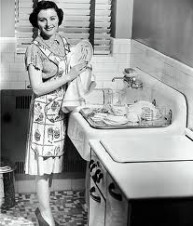
“The Problem that Has NO Name”
The Feminine Mystique by Betty Friedan (1963)
“Over and over women heard in voices of tradition and of Freudian sophistication that they could desire no greater destiny than to glory in their own femininity. . . . how to dress, look, and act more feminine and make marriage more exciting; how to keep their husbands from dying young and their sons from growing into delinquents. They were taught to pity the neurotic, unfeminine, unhappy women who wanted to be poets or physicists or presidents. They learned that truly feminine women do not want careers, higher education, political rights—the independence and the opportunities that the old-fashioned feminists fought for” (16).

Slide 7
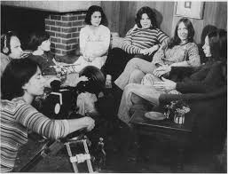
“The Personal is Political”
Consciousness-Raising Groups
Women got together to examine and understand their experiences and to “connect personal experience to the structures that define our lives” (Hartsock qtd. in Donovan 98).
Consciousness-raising leads to “an awareness of membership in a politically oppressed group” (Donovan 98).
http://www.makers.com/moments/consciousness-raising-contagion
Donovan, Josephine. Feminist Theory: The Intellectual Traditions, 3rd ed. New York: Continuum, 2000.

Slide 8
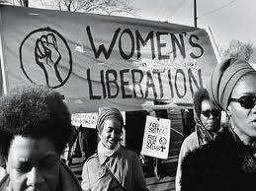
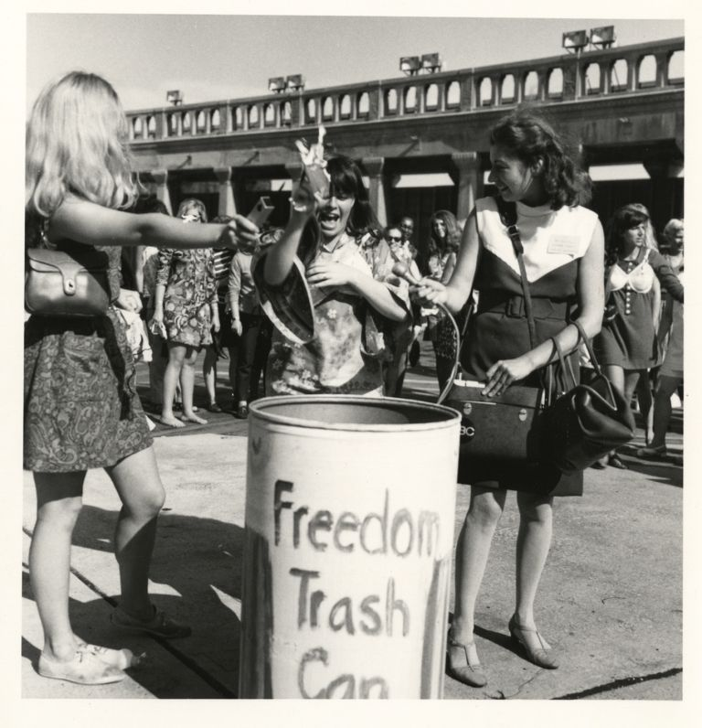
Protests
Miss America Pageant, Atlantic City (1968)
Objectifies women, unrealistic beauty standards, racist, encouraged young women to aspire to beauty instead of political power or career success
Items of oppression thrown into a “freedom trash can”
Girdles, high-heeled shoes, bras, copies of Playboy magazine, hair curlers, etc.
National Women’s Strike for Equality (1970)
Work stoppage (workplace and domestic)
Main goals: repeal of antiabortion laws, establishment of child-care centers, and equal opportunity in jobs and education.

Slide 9
Reproductive Health
Birth control no longer classified as “obscene” (1936) allowing dissemination of birth control information through the mail
Griswold v. Connecticut (1965)
Allows the use of birth control devices by married couples
Roe v. Wade (1973)
Allows abortion in the first trimester
Pregnancy Discrimination Act (1978)
Makes job discrimination against pregnant women illegal

Slide 10
Equal Rights amendment (ERA)
Constitutional Equality
Written in 1923 by first-wave feminist, Alice Paul
Picked up by the second wave in the 1970s
Never achieved approval by ¾ of the states in order to be adopted as an amendment to the Constitution.
Section 1. Equality of rights under the law shall not be denied or abridged by the United States or by any state on account of sex.
Section 2. The Congress shall have the power to enforce, by appropriate legislation, the provisions of this article.
Section 3. This amendment shall take effect two years after the date of ratification.

Slide 11
The Bell Jar
Do any of these second wave issues appear in the beginning chapters of The Bell Jar?
What is she doing when we are first introduced to her?
What are the social expectations for Esther?
How is she challenging those expectations? How is she conforming to them?
Does this take a toll on her mental health?

