Slide 1
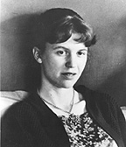
Sylvia Plath
1932-1963

Slide 2
Early years
Born in Boston to a German father and an Austrian mother
As a child, she was both brilliant and erratic
At 8, her father died (complications from diabetes).
He was strict father and authoritarian, and his death influenced both her relationships and her poems
At 17, she published her first short story and her first poem (In the Christian Science Monitor)

Slide 3
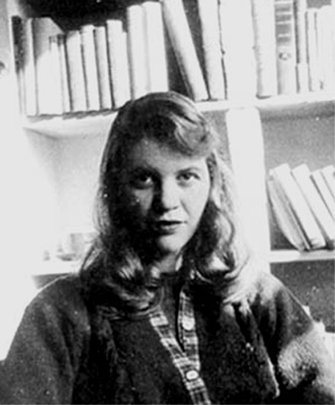
The beginning of her struggles
Entered Smith college on a scholarship
Became increasingly obsessed with horror, death, isolation, and entrapment
Attempted suicide in 1953
Was hospitalized and underwent psychiatric therapy
These experiences informed The Bell Jar

Slide 4
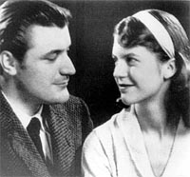
Graduated from Smith with highest honors
Received a fellowship to Cambridge University and got her M.A.
There she met and married British poet Ted Hughes

Slide 5
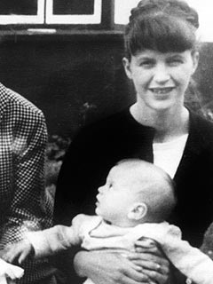
They had two children and lived in England
They separated when
Plath discovered that
Hughes was having an
affair
Plath moved into a flat
with the children

Slide 6
Her death
On February 11, 1963, during one of the worst English winters on record, Plath committed suicide.
She left the doctor’s phone number displayed, gave her sleeping children some food and milk, placed towels under the kitchen doors to protect the children from gas, and killed herself using her gas oven.

Slide 7
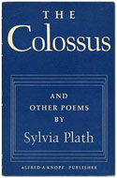
Poetry and The Bell Jar
Her first book of poetry, The Colossus, was published in 1960
Acclaimed by critics
Then she wrote another book of poems, entitled Ariel
This was not published until 1965 (after her death)
Published The Bell Jar in 1963 under the pseudonym Victoria Lucas

Slide 8
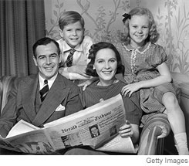
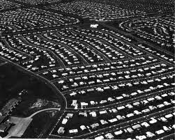
Midcentury America
After WWII, men came home and women were forced to give up their jobs and return to their domestic roles
The GI Bill allowed for men to access education and housing in new, suburban developments
Marriage rates were at an all time high

Slide 9
The Baby Boom: 1946-1964

Slide 10
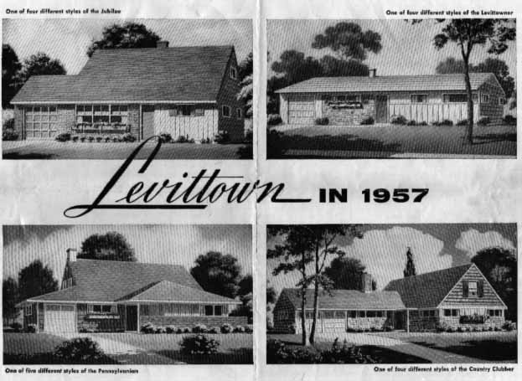
Levittown and Suburbia
Suburbia: The suburban home served as the tangible symbol of “the American Way of Life”
This “normal” American life is what the veterans were fighting for
GI Bill (white veterans can get a loan and a home)
Levittown: William Levitt created a housing development that was a model for suburban life. House after house was constructed in uniform, tight grid format in this new concept of homogeneous American suburbia. Houses came with televisions already installed, and furniture arrangement suggestions. Levittown was immediately billed as the suburban democratic ideal for everybody.
Racial segregation (because they only gave loans to certain people and wouldn’t allow them within certain housing developments)
This idea of “normal” closeted homosexuals and kept women contained in the home
Leave it to Beaver as the epitome of ideal American life.
Notes:
https://www.youtube.com/watch?v=5Sb1W0uu8w0
https://www.youtube.com/watch?v=OApZePeJSdU

Slide 11
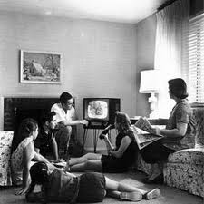
Consumer Culture
Television in every home. At first, it was a way to distribute culture to the masses (plays, concerts, etc.), but by the end of the 1950s it was all sitcoms, game shows, and advertising
Conspicuous consumption became the means by which one demonstrated success (buying larger, newer, bigger, and more technologically advanced products as status symbols)

Slide 12
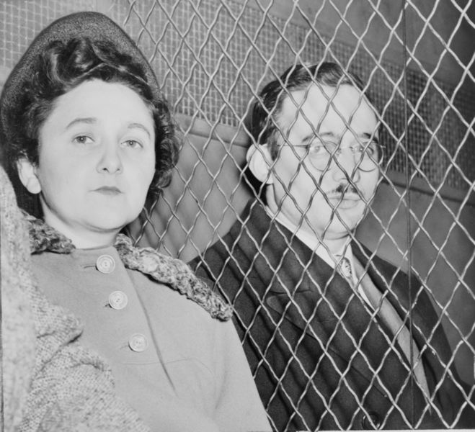
The Rosenbergs
Julius and Ethel Rosenberg were accused of espionage, tried, and finally executed in 1953.
The courts claimed that the Rosenbergs supplied the Soviet Union with classified information about United States atomic bomb research.
Came to symbolize the mass hysteria of the anti-communist era in the US, and many doubted their actual participation in espionage activities and criticized the courts for executing them.
People were especially horrified by the execution of Ethel since many believed that her only crime was simply being married to Julius.

Slide 13
The Bell Jar
Roughly autobiographical Roman á Clef
Autobiography
A narrative account typically written by an individual that claims to depict his/her life and character
Roman á Clef
A novel that represents real people in the guise of novelistic characters bearing fictional names.
Usually, the author makes the identities of the characters readily apparent

Slide 14
Plath considered The Bell Jar “potboiler” novel and originally published it under a pseudonym (Victoria Lucas)
About the limitations imposed on a young, intelligent woman in the 1950s
Esther does not like the choices she is offered by society.
What are her choices?
Who are her female role models?

Slide 15
Female Bildungsroman
Many consider The Bell Jar to be the female version of Catcher in the Rye by J.D. Salinger
Both are the coming of age story of a young adult
Bildungsroman: a novel that recounts the development of an individual from childhood to maturity, to the point at which the protagonist recognizes her/his place in the world

Slide 16
Answer the questions, include quotes to support your answers
Find an example of a second wave feminist issue appearing in The Bell Jar? Explain the issue and how it is represented in the text.
What is Esther’s situation when we are first introduced to her? Where is she? Why? What is her mental state during this time?
How does Esther’s scholarship job give mixed messages about proper behavior for young women?
Review the scene in which Esther watches a child being born. What is her reaction to this? Why do you think she reacted this way?

