Slide 1
Gender, sex & Sexuality
An Introduction

Slide 2
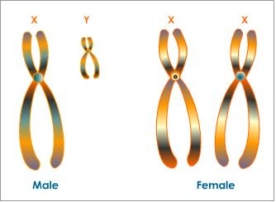
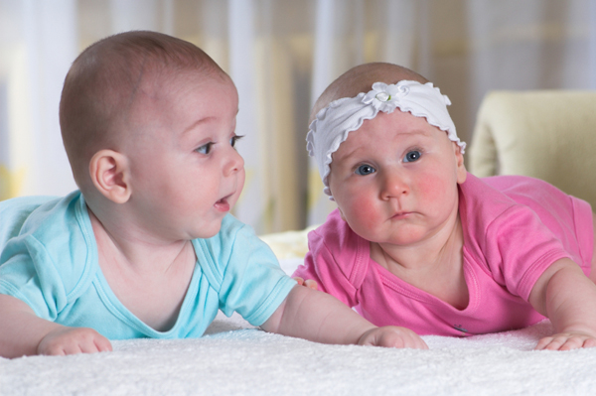
Sex Gender
≠
Sex
Gender
Physical Traits
Primary and secondary sexual characteristics
Male (or male-bodied)/Female (or female-bodied), Intersex
Social expectations of what it means to be male or female-bodied
Masculine/Feminine, Transgender

Slide 3
What about sexuality?
Sexuality or sexual identity: Sexual desire, attraction, and practice, based on sexual object choice
We are attracted to certain biological traits
But MOSTLY we are attracted to someone’s gender
We THINK that biological sex and gender always go together but they don’t
There are many combinations of biological sex and gender expression

Slide 4
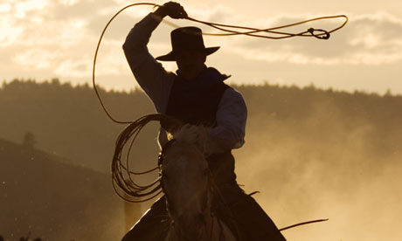
Cowboy

Slide 5
Sexuality Continuum
We assume that there are only two (maybe three) options for sexual preference
What are those options?
But people fall into a wide range of sexualities AND these can change over time

Slide 6
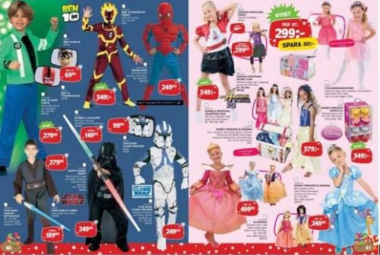
Social Construction of Gender
Gender is created through social interaction and culture. It is made meaningful through a shared interpretation.
We are taught how to be masculine or feminine

Slide 7
In other words…
Expectations about what men and women should be like and do are products of our culture
Masculinity and femininity do not originate in our biology, but are created by humans and reinforced by participants in our society, who “do gender” day in and day out.
Male and female are placed on binary oppositions, in order to have them fulfill certain social roles that make up our social order
Cultural expectations about binary gender are imposed on bodies that do not neatly fit into the male/female categories (such as the case of intersex)

Slide 8
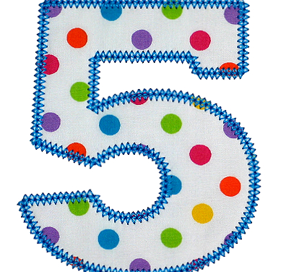
Components of Gender
From My New Gender Workbook by Kate Bornstein

Slide 9
Components of Gender
Gender Assignment: The gender assigned to your that matches your perceived biological sex
Gender Role: The sum total of qualities, mannerisms, duties, and cultural expectations accorded a specific gender
Gender Identity: The way we feel our gender to be at any given moment
Gender Expression: How we show our gender identity to the world
Gender Attribution: The attribution of a gender to others based on certain cultural cues, including physical appearance, mannerisms, context, and use of power.

Slide 10
Identity
Membership in a group: assumed by a person AND assigned TO a person
There are many different aspects of our identity that intersect to make us who we are
Why does Bornstein compare identity to armor?
How do you feel about that comparison?

Slide 11
2nd wave Contribution
2nd Wave Feminists worked to differentiate sex and gender. Why?
If social differences between men and women are not of biological origin
And what it means to be a man or a woman is socially ascribed
Then male/female differences are not fixed
Therefore, gender roles are challengeable and changeable

